Slide 1
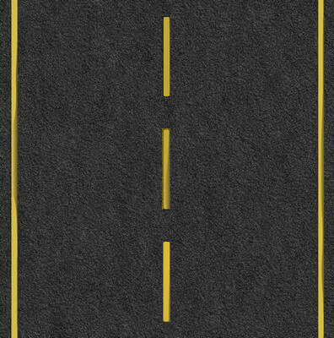
Car Travel Race Game Pitch Proposal
New Brunswick Community College
PROG1189 - Comprehensive Development Project
Bruno Bortoli de Oliveira

Slide 2
1.0 Executive Summary
Car Travel Race is a racing game on a normal road with moving cars and trucks. The player must drive the car carefully and avoid colliding with other vehicles travelling on the road. The player must dodge and overtake cars and trucks to avoid colliding with other vehicles.
In addition to all the skill and attention the driver needs on the road, he still needs to collect the tool pickups to fix the car in case of a collision. In addition to the repair tool, if the vehicle has collided and is damaged, the player will also have to fuel his car by collecting the pickup of gallons of fuel. Only the player with all the skills a driver needs to dodge other vehicles and collect pickups can cross the finish line.

Slide 3

2.0 Game Description
2.1 Overview
2.2 The quest
2.3 Main character
2.4 Sketch of the main character

Slide 4
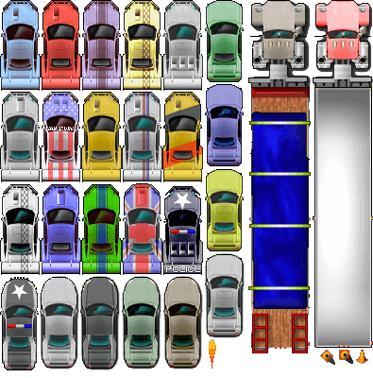
2.0 Game Description
2.5 Opponents
2.6 Sketch of the opponents

Slide 5
2.0 Game Description
2.7 Environment
2.8 Sketch of the world

Slide 6
2.0 Game Description
2.9 Menu
1. Play 2. Instructions 3. Exit
2.10 Controls Menu Screen: Up | Down | Enter Game screen: Up | Right | Left | P | Esc 2.11 Sounds Music on the menu Vehicle acceleration Vehicle collision Sound when the player collects pickups

Slide 7
3.0 Summary
This is a racing game that people of all ages and genders can play. Despite being a simple and lightweight game, having fun with players who enjoy speed and racing takes little. Games like this are more than enough to guarantee fun during all your leisure time
4.0 References
All websites below provide free images.
https://www.pngfind.com/
https://www.freepik.com/
https://www.shutterstock.com/

Slide 8
Thank you

