Slide 1

The Carrefour
Master’s degree program in
Computer Engineering – Computer systems and networks
University of Pisa
PECSN - Project 11
Bruno Augusto Casu P. De Sousa
Arsalen Bidani

Slide 2
Summary
System Modeling
Simulator Development
Tests and Results
Conclusions

Slide 3
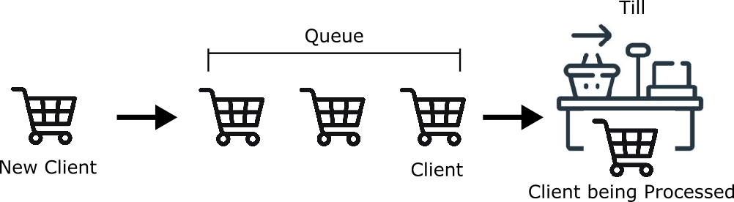
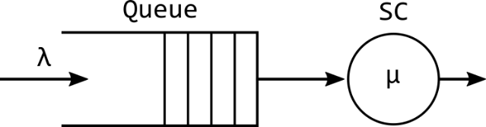
System Modeling
Objective: The Carrefour project aims to simulate a supermarket checkout system, where clients join a queue waiting to be processed in a till
Queueing System: The checkout system will be modeled as a queuing system
KPIs: The tests will provide valuable results and insights on the system response under a varying workload, considering the main parameter for the system quality evaluation: the Average Queue Time, and the Maximum Queue Time

Slide 4
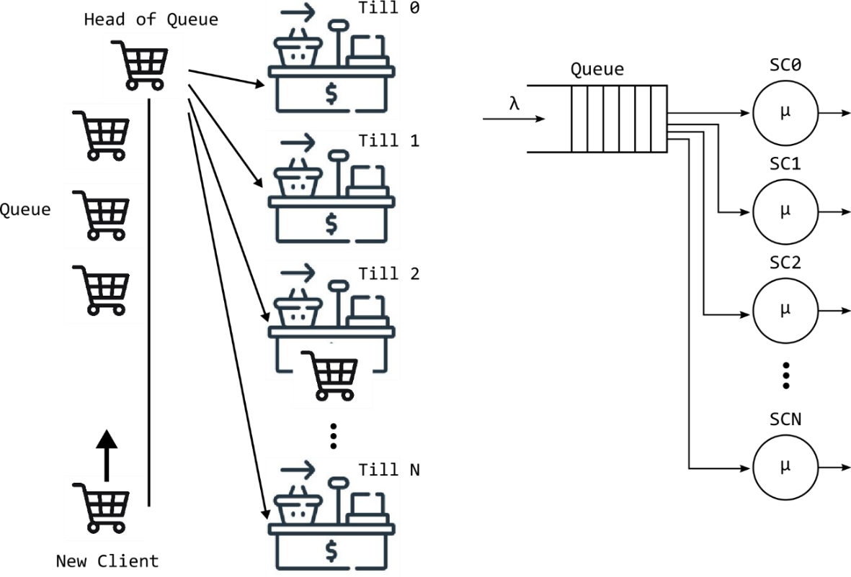

System Modeling
Policy A: The first scenario to be modeled and tested makes the clients join a single queue (FIFO type) and assign them to any free till available.
Clients also must spend some amount of time to reach the till (proportional to the distance).
The assignment then prioritizes the closest till to the head of the queue.
The model behaves as an M/M/N queuing system
Utilization:
$$ρ=λ/(N×µ)$$

Slide 5
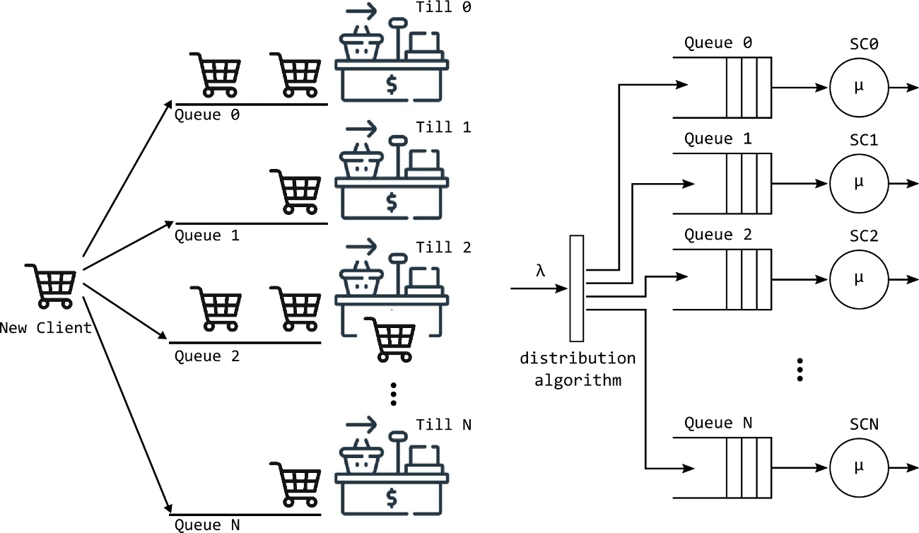
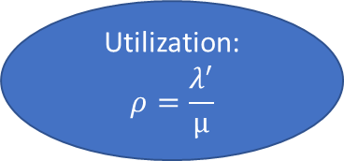

System Modeling
Policy B: The second scenario to be modeled and tests makes the clients join one queue that is serving on till.
Clients are assigned to the queue/till subsystem with the smallest queue
The individual tills are an M/M/1 queuing system
On each till:
$λ^{′}$ = $λ /N$
Utilization:
$$ρ=\frac{λ^{′}}{µ}$$

Slide 6
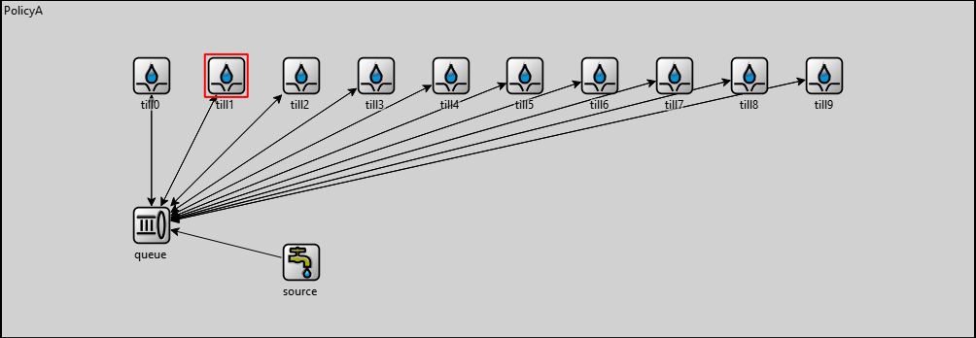
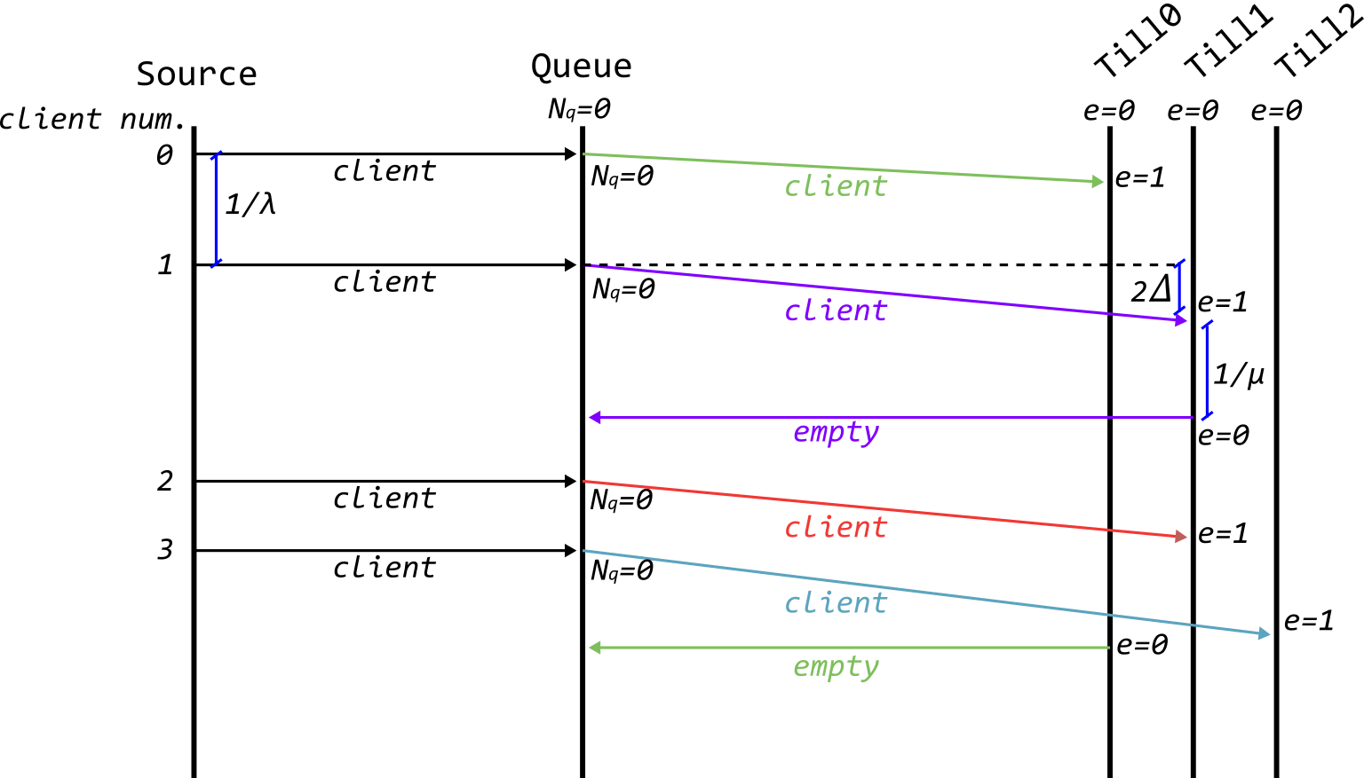
Simulator Development
Policy A: For the simulation, three modules were developed:
Source: Sends the “client” messages to the queue with an interarrival (IA) time defined by a IID RV.
Queue: As the “client” messages arrives, a sort algorithm find the closest free till, and dispatch the client with another message. If no free till is found, the client is added to the queue.
Till: Receives the “client” messages from the Queue module. It will generate a processing time (PT), based on a IID RV, and return an “empty” message to the Queue once the client is processed.
System is stable if:
IA < PT/N
Nq=1
Client
Nq=0

Slide 7
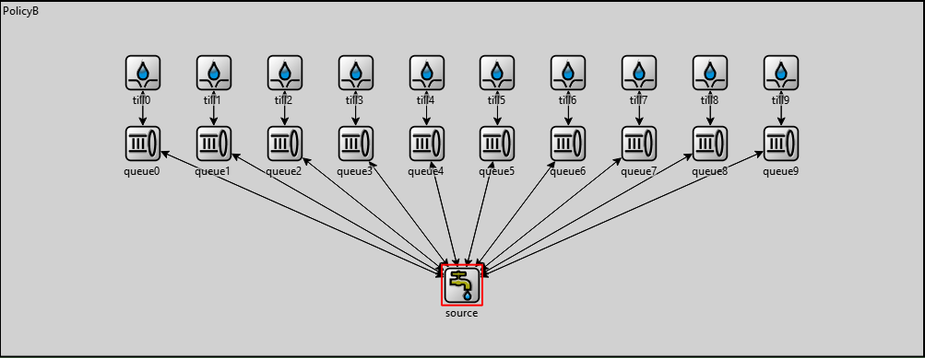
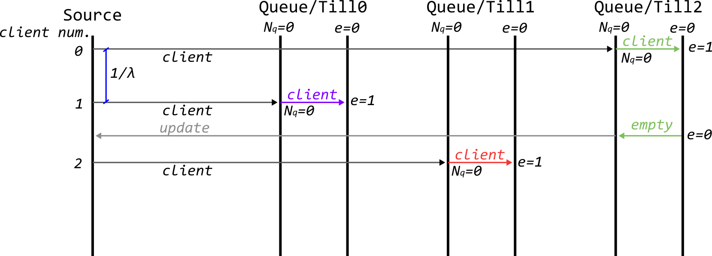

Simulator Development
Policy B: Implements multiple queues
Source: Functions similar to scenario A, but on this system, the Source module has the distribution algorithm. It will generate the client messages with an IA time and try to find the queue with the lowest number of clients.
Queue: Receives “client” messages, and dispatch clients or add them to the queue if the till is being used. It also sends an “update” message back to the source, to notify the queue size.
Till: Simplified sink module, generates a PT value, and informs the queue when clients finish its processing.
$$\frac{1}{µ}$$
Nq=1
e=1
System is stable if:
IA*N < PT
Client
empty
Nq=0
Client

Slide 8
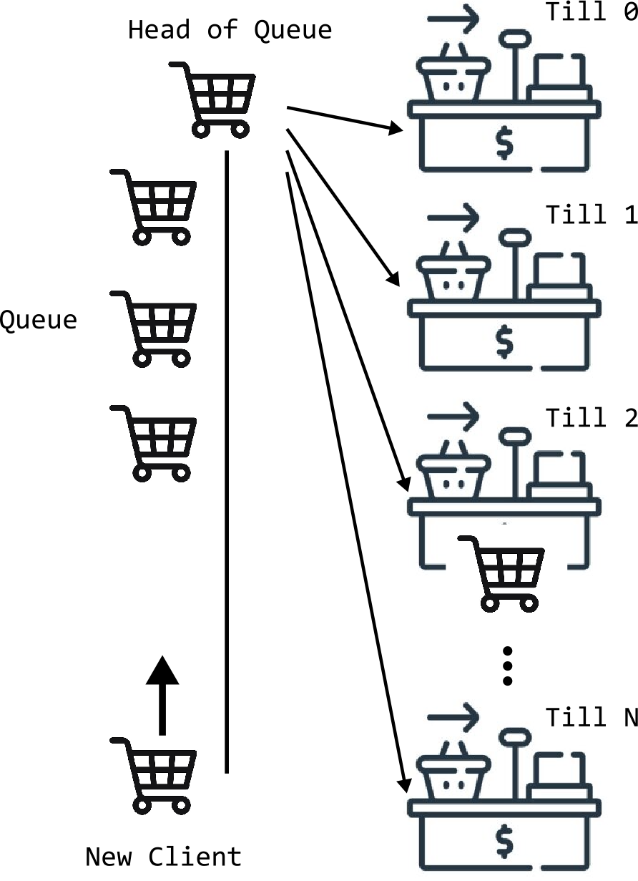
Tests and Results
Reference time values for the 2^{k}r analysis:
Scenario A testing: Before the main tests, a 2^{k}r factorial analysis was done:
SYSTEM WORKLOAD | SERVICE DEMAND | CAPACITY
NORMAL CLIENT ARRIVAL (60s) | LOW DEMAND (120s) | LOW (6 Tills)
HIGH CLIENT ARRIVAL (30s) | NORMAL DEMAND (240s) | FULL (10 Tills)
Impact of the parameters on the Average queue time
System Configuration for the next tests:
Time to process: 30s fixed + 11s to reach (avg.) + generated RV with 240s mean
Impact of the parameters on the Maximum queue time
Number of active Tills: 10
Clients IA time: generated RV with mean 60s, 45s, 30s, 34s, 27s

Slide 9
Tests and Results
Queue size progression
IA = 45s Utilization: 0,62
Scenario A testing: System Response when changing the Clients IA time
CI was computed by testing all configurations with 3 different random seeds
IA = 30s Utilization: 0,94
IA = 20s Utilization: 1,40
System PT: 281s
using 10 tills

Slide 10
Tests and Results
Scenario A testing: Till usage under different utilization values
Under high utilization, all tills receive and process on average the same amount of clients
Under low utilization, the last tills have less Throughput values compared with the closest tills
Closest Tills: have lowest time to reach
Furthest Tills: have the highest time to reach

Slide 11
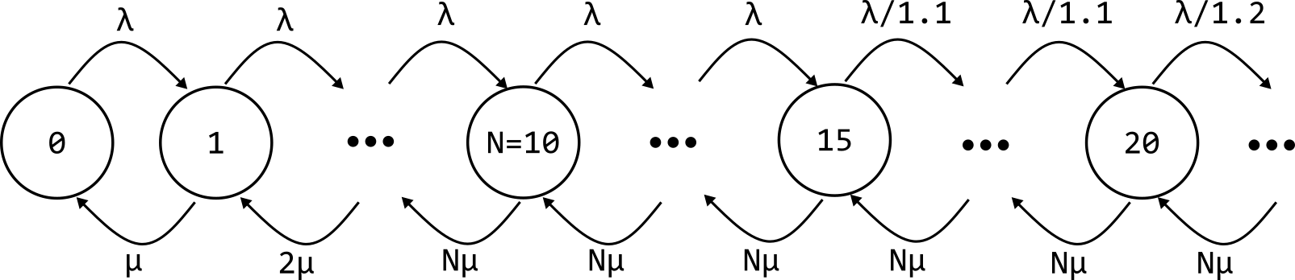
Tests and Results
The system never reaches saturation, as less clients join the queue once it starts growing
Scenario A testing: Using Discouraged arrival Mode
Client IA = 20s
The queue informs the source the current size
CTMC of the developed system. The maximum division is 1,5 at 25 clients in the queue

Slide 12
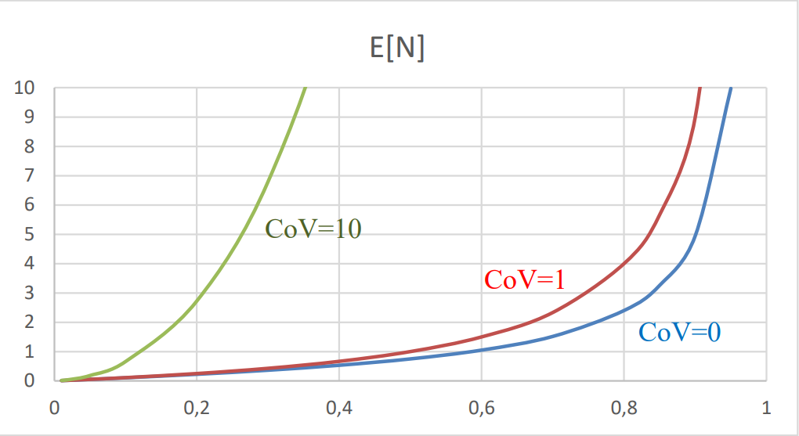
Tests and Results
Using a Lognormal distribution with a lower spread made the distribution with a lower Variance when compared with the Exponential tests
Scenario A testing: Processing time (Client Demand) as a Lognormal RV
System PT: 281s
using 10 tills

Slide 13
Tests and Results
Results obtained with the simulations of scenario A were like a real experience in a supermarket
Scenario A testing: KPIs results

Slide 14
Tests and Results
Scenario B testing: System Response when changing the Clients IA time
Till 0 results
The System response was similar to Policy A. However, the individual queue size was lower than the single queue in Policy A
System PT: 270s
using 10 tills

Slide 15
Tests and Results
Under low or high utilization, the Throughput of all tills remained, on average, the same
Scenario B testing: Till usage
The distribution algorithm always chooses the queue with less clients in to dispatch a client

Slide 16
Tests and Results
KPIs evaluation
Scenario B testing: Processing time (Client Demand) as a Lognormal RV
Result for max. queue time in Policy B with Expo. RV showed very high values
The Lognormal distribution of clients PT maintained the observed gap (due to its lower variance compared with the Expo. distribution)

Slide 17
Tests and Results
Scenarios Comparison
Considering the average queue time observed in the tests for the implemented Policies, no significant difference was noted
Both systems response to the varying workload of clients IA was very similar

Slide 18
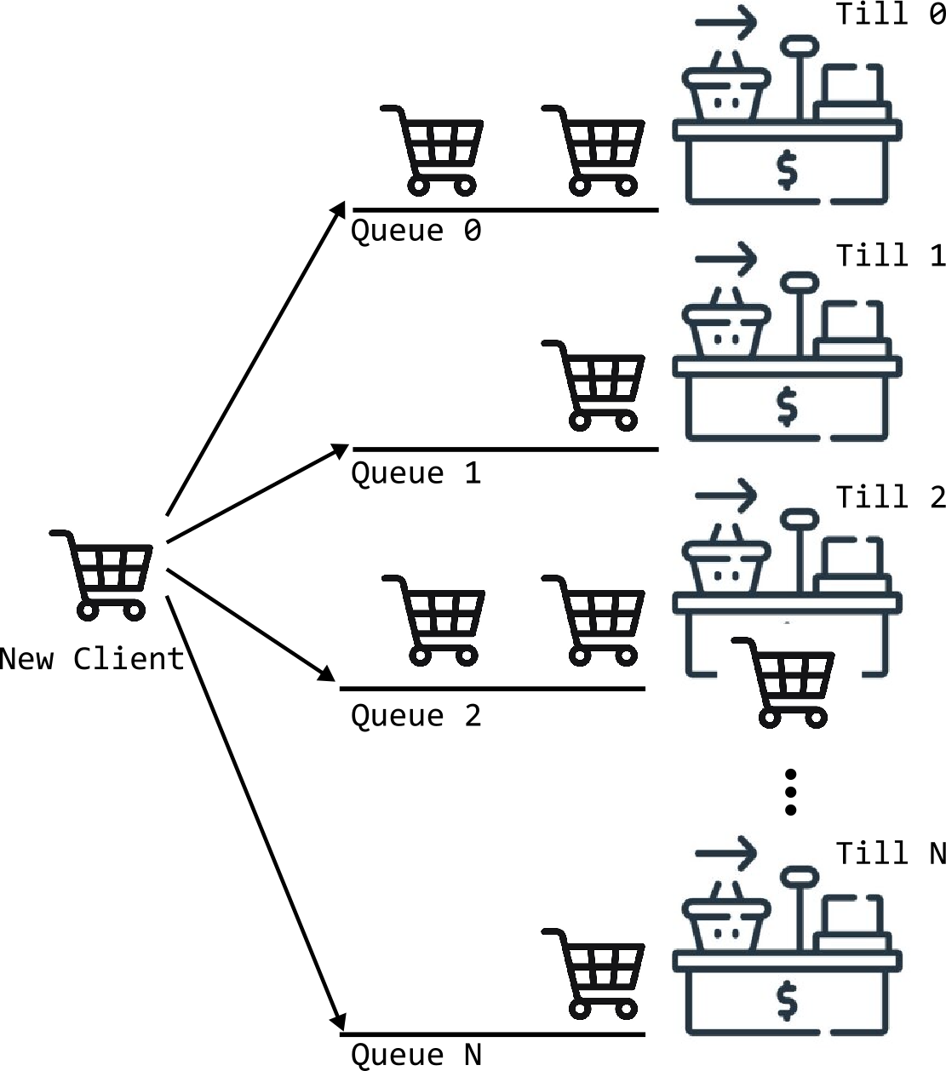

Tests and Results
Probable cause for this effect: On Policy B Some clients are joining queues with others that may have a very high demand. They must wait on that queue regardless…
Scenarios Comparison: Max. Queue time evaluation
In Policy A is very unlikely that ALL tills are stalled by High demand clients, meaning that one ore more till will often be available to clients at the head of the main queue
Policy B produced very High Max. Queue time values when compared with Policy A
C1: High Demand Client
C2: Will have a high Waiting time
On AVERAGE both system behave the same, however, in Policy A the delay added by ONE client stalling is “distributed” to all clients waiting on the main queue, while in Policy B, this delay is ONLY distributed to the few clients waiting on that specific till
C2: Will likely take another till
C1: High Demand Client

Slide 19
Tests and Results
Max. Queue time evaluation: Improving Policy B system
Implement Fast Tills, replacing part of the available in the system (they can only receive low demand clients)
Normal System
total PT: 270s
IA: 34s
using 10 tills
Fast queue mode total PT: 200s
IA: 24s
using 10 tills
Policy B KPI comparison
Normal Tills (Mean PT 240s)
Fast Tills (Mean PT 120s, if generated PT is higher than 300s, its divided by 10)
The results obtained seemed to have shown an improvement in performance. However, it is necessary to extend the testing scenarios, as the reduced overall system PT may have caused this behavior and NOT the actual usage of Fast Tills

Slide 20
Conclusions
The model developed to simulate the supermarket checkout policy produced results close enough to as expected for a real system, considering its response and the main performance indicators.
The data collected and the analysis demonstrated that the model behaved as a queueing network. With this, meaningful results were presented when analyzing the system under different workloads, as well as when using a lognormal distribution for the client's demand.
From the Policies comparison, on average, they seemed to have the same waiting time, meaning neither system is faster than the other. However, it was noticed a much higher max. queue time on Policy B, which could affect the clients experience in a negative way.

Slide 21
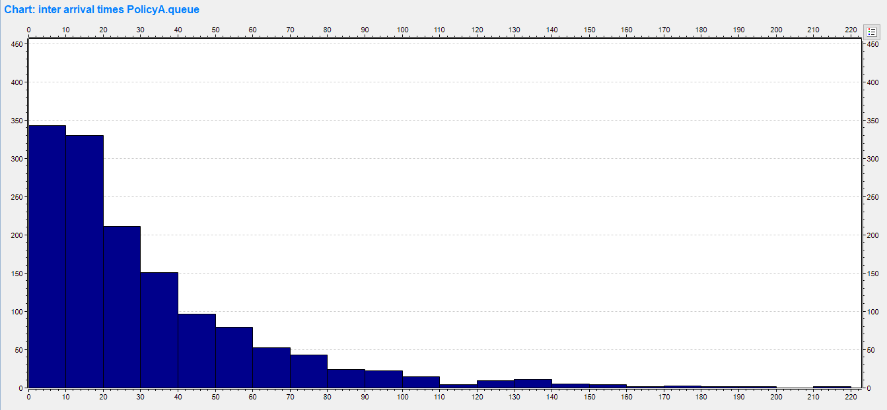
Backup
RV histograms

Slide 22
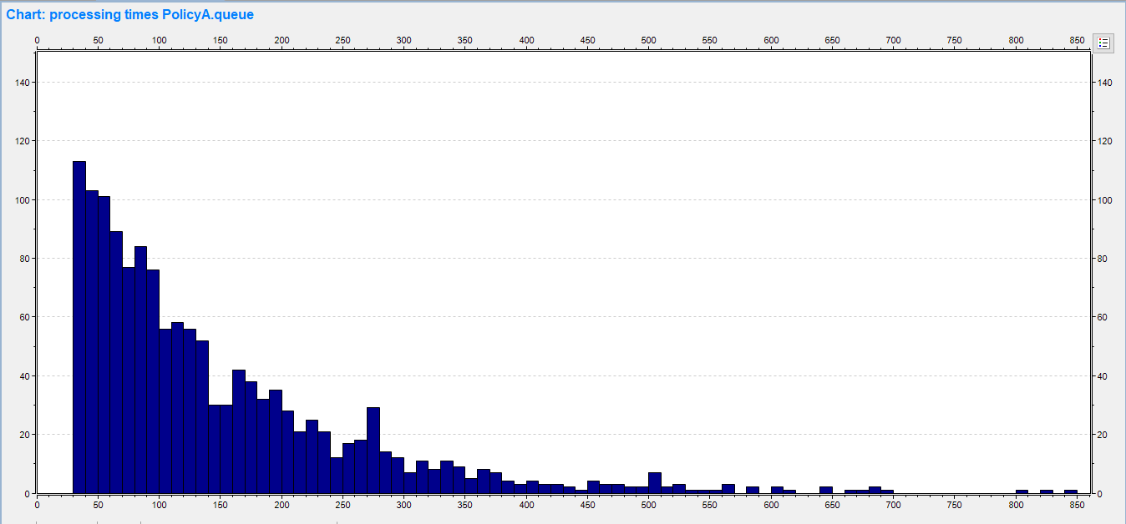
Backup
RV histograms (Expo. PT)

Slide 23
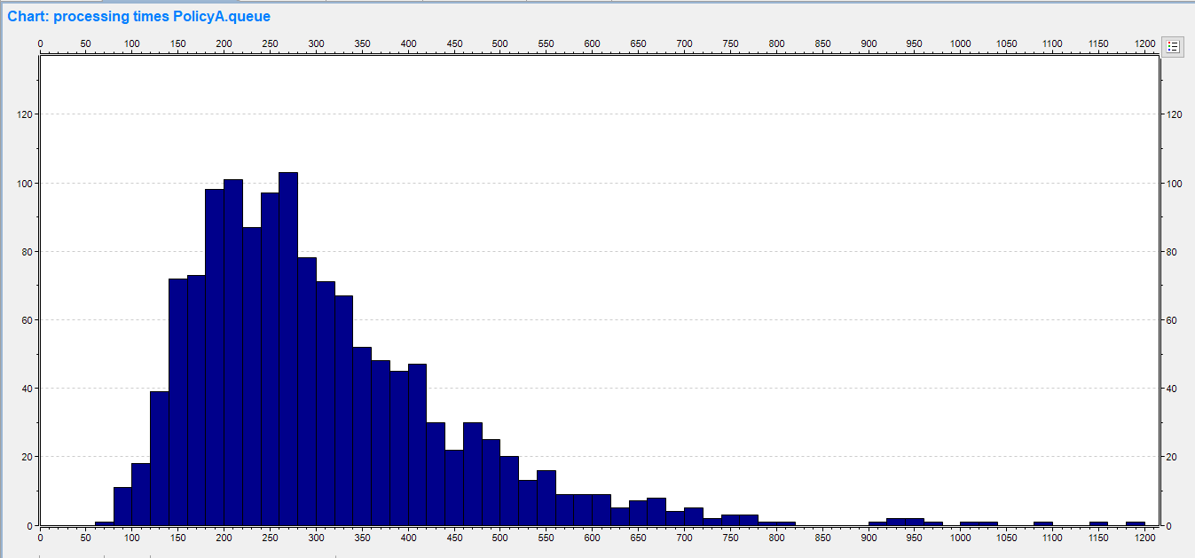
Backup
RV histograms (Lognormal PT, w/ spread 0,5)

Slide 24
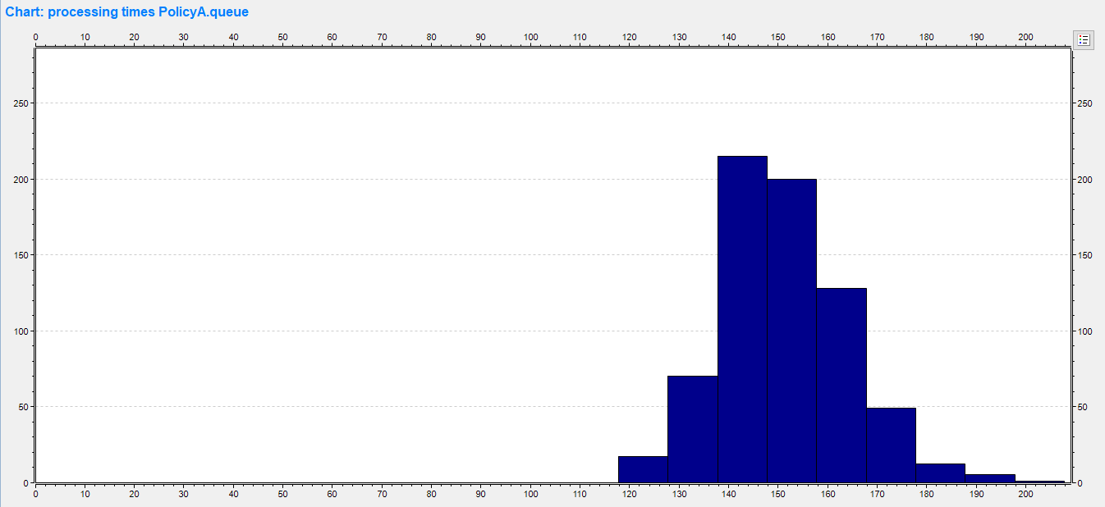
Backup
RV histograms (Lognormal PT, w/ spread 0,1)

Slide 25
Backup
Main configuration comparison (Policy A)

