Slide 1
Event Streaming Bank Demo
Simple demonstration of using Kafka Streaming for building a transactions stream for a fictional bank

Slide 2

Demo - Overview
ESBank – Analisys of data streams
Simple demonstration of streams application using Kafka streamming platform tools
1
Simulate Customers of a bank sending transactions
2
Process customer transactions
Event
Store
TXN
Generator
TXN
Manager
3
Inspect/Act over customer transactions
Results

Slide 3

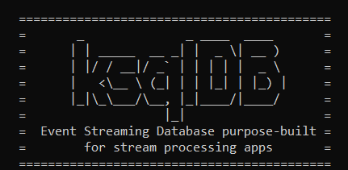


Demo – Detailed Components View
ESBank – Analisys of data streams
Simple demonstration of streams application using Kafka streamming platform tools
Transactions
Kafka client
ESBank Topics
Kafka Streams API
TXN
Generator
TXN
Manager
2
Filter transaction events
and split it into deposit and withdrawals events
Deposits
Withdrawals
1
Generate random transactions of
100 different users
ksql cli
3
SQL Query streams
ksqlDB
Anomalies
Balance
Results
4
Produce a table view of current balance per user
App
Kafka Topic
5
Processes the balance views and generate fraud events
Database
Table
Kafka Sink Connector
6
Display events for monitoring
Kafka Broker

