Slide 1
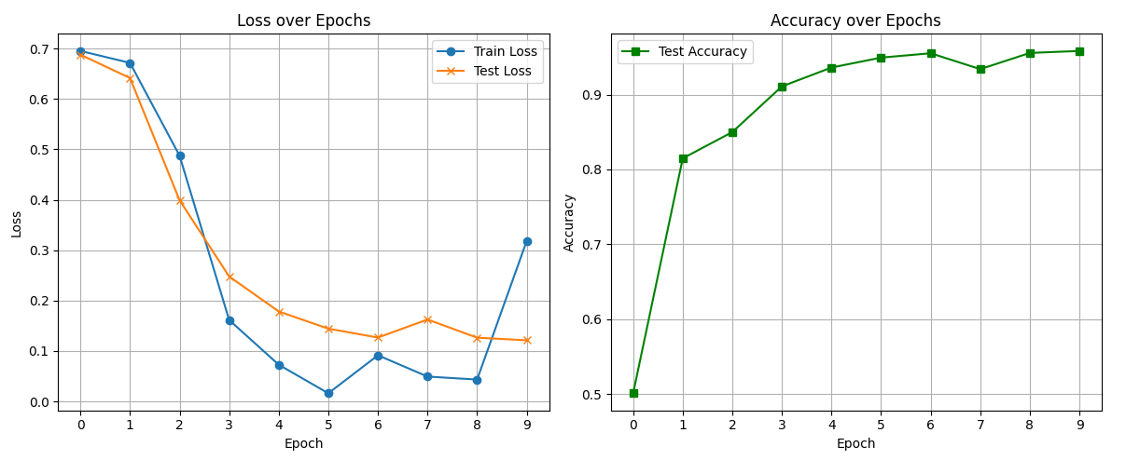
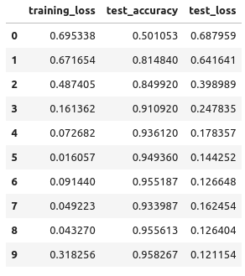
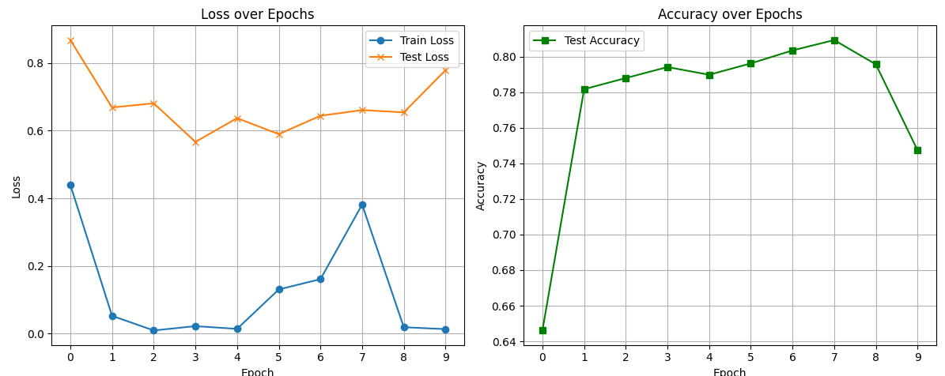
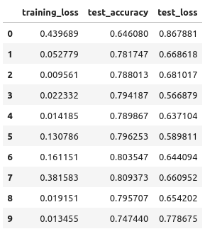
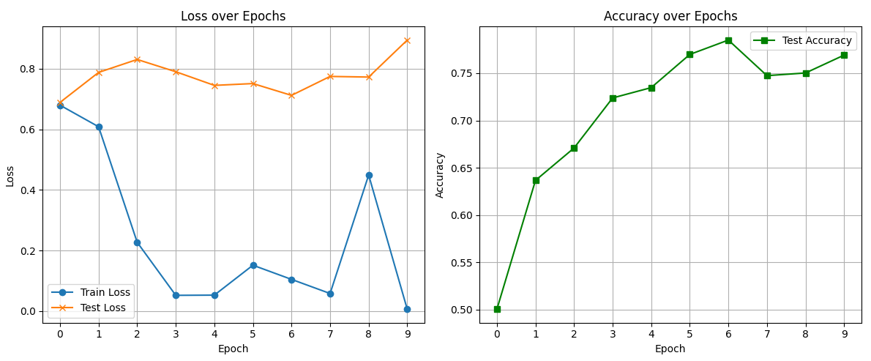
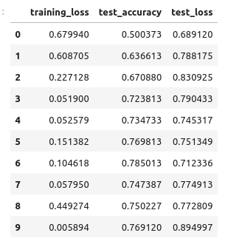
MD2 backbone. chunk_75ns(Train: first_75ns/Test: last_75ns). 150 ns x 10 trj
1
A)
B)
C)

Slide 2
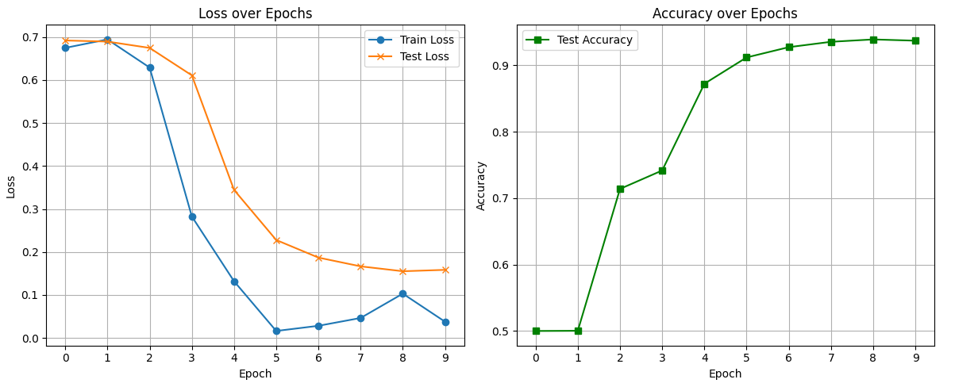
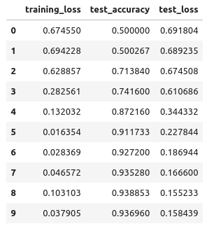
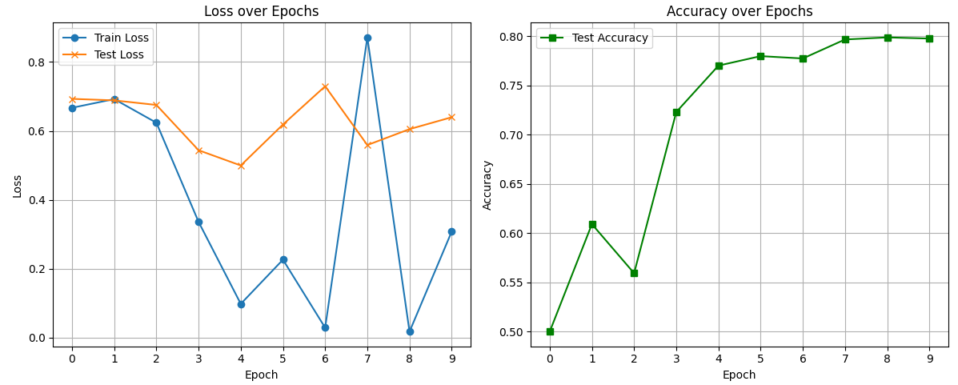
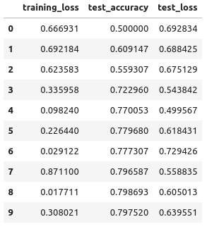
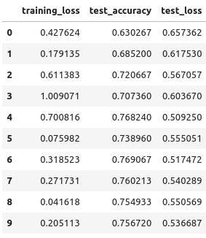
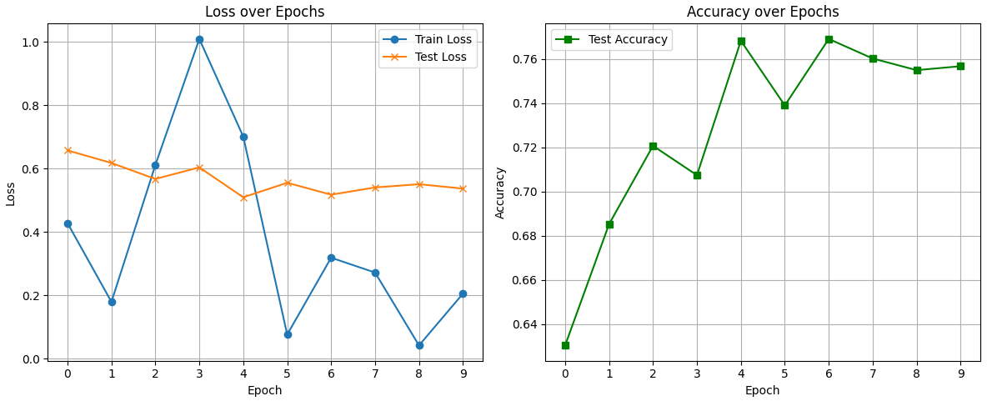
MD2 backbone. Chunk_37.5ns(Train: first_37.5ns/Test: last_37.5ns). 76-150ns x 10 trj
2
A)
B)
C)

Slide 3
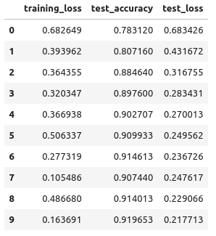
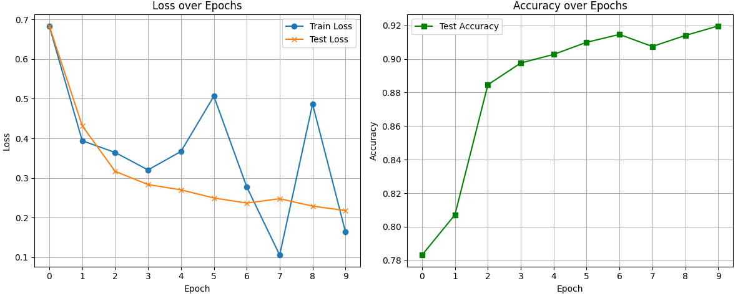
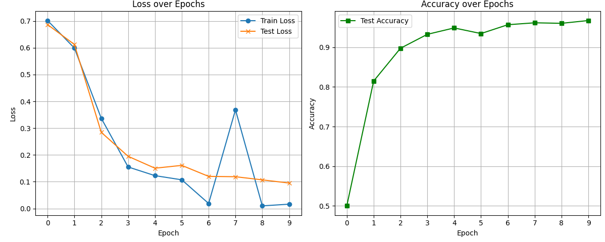
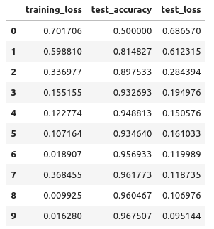
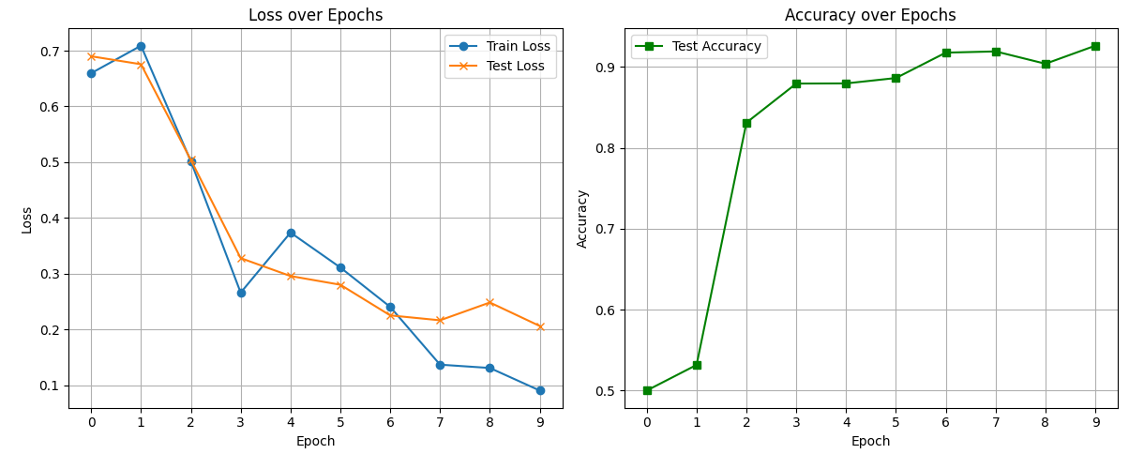
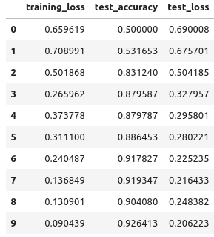
MD2 backbone. Train: chunk_1 ns. 150 ns x 10 trj
3
A)
B)
C)

Slide 4
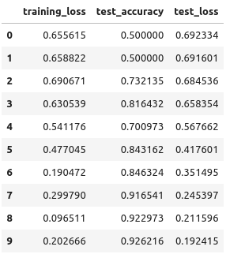
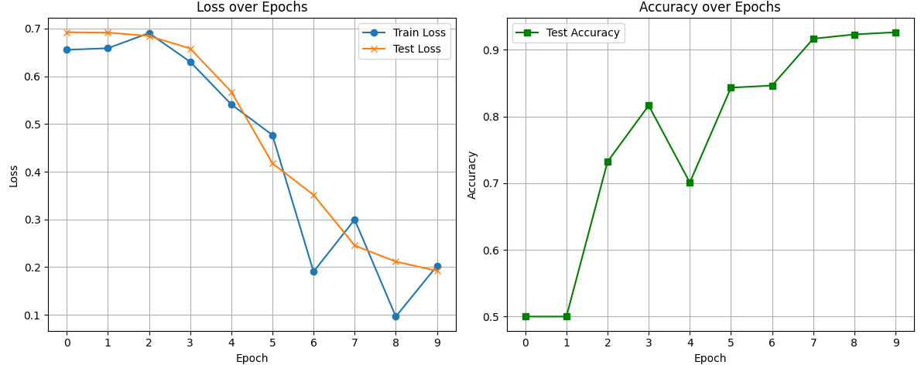
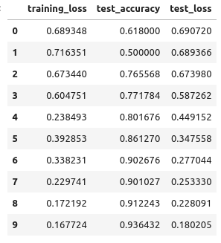
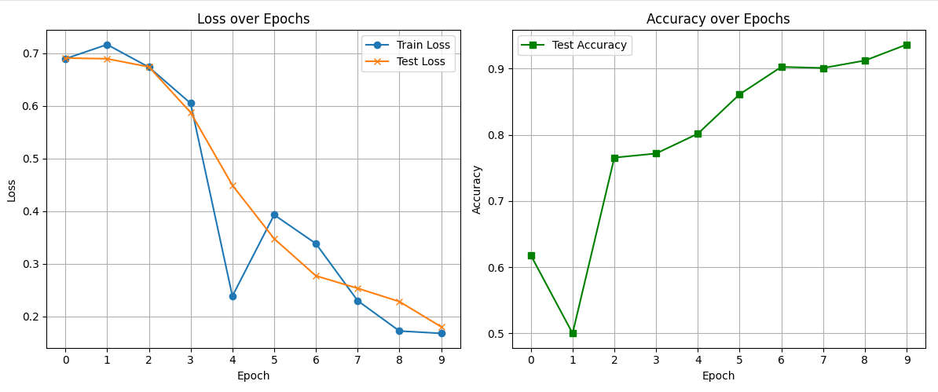
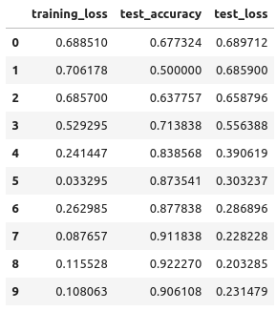
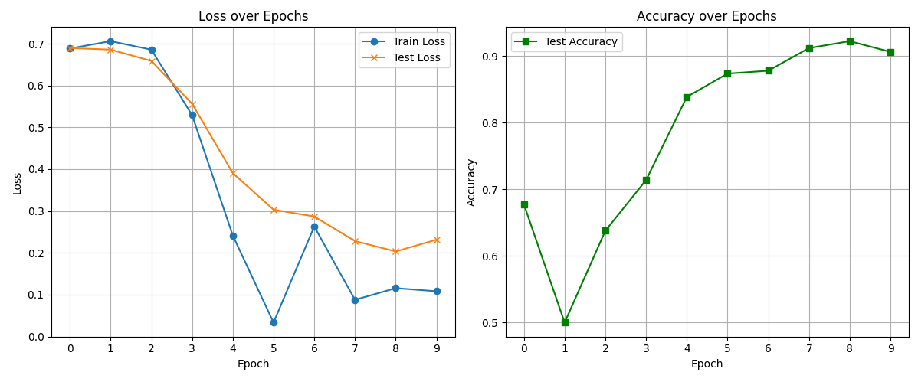
MD2 backbone. Train: chunk_1 ns. 76-150 ns x 10 trj
4
A)
B)
C)

Slide 5
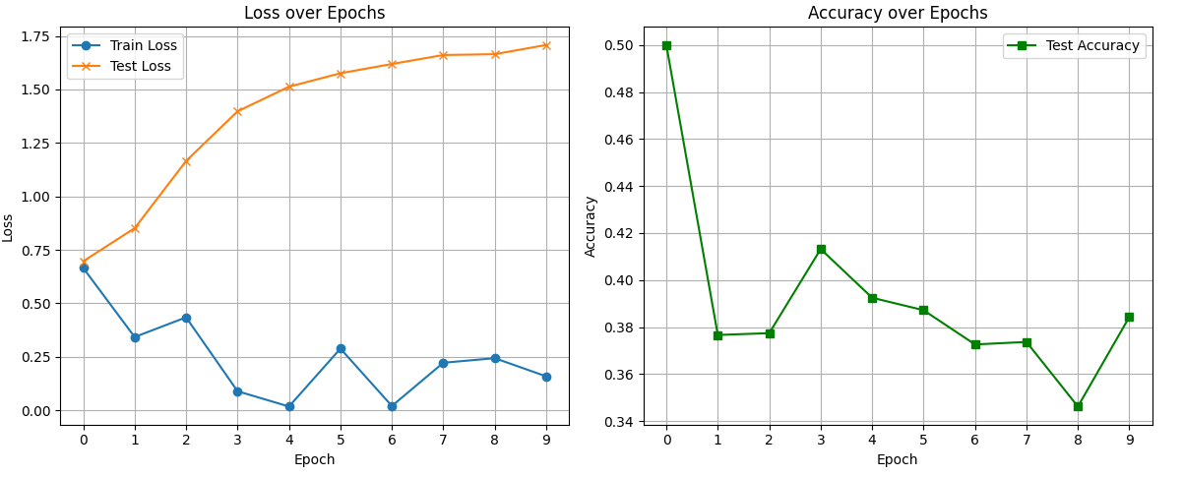
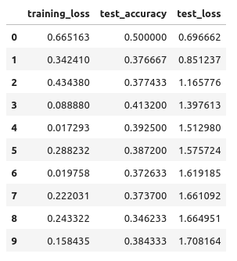
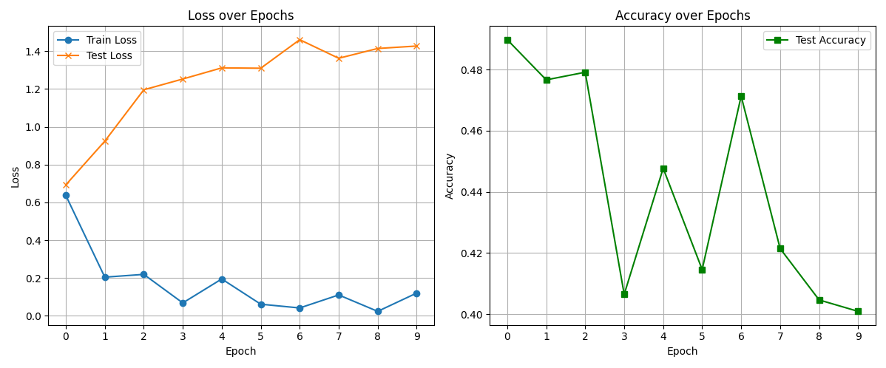
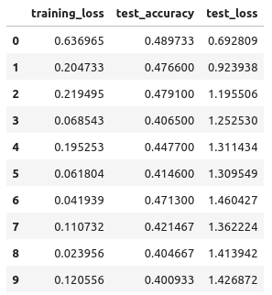
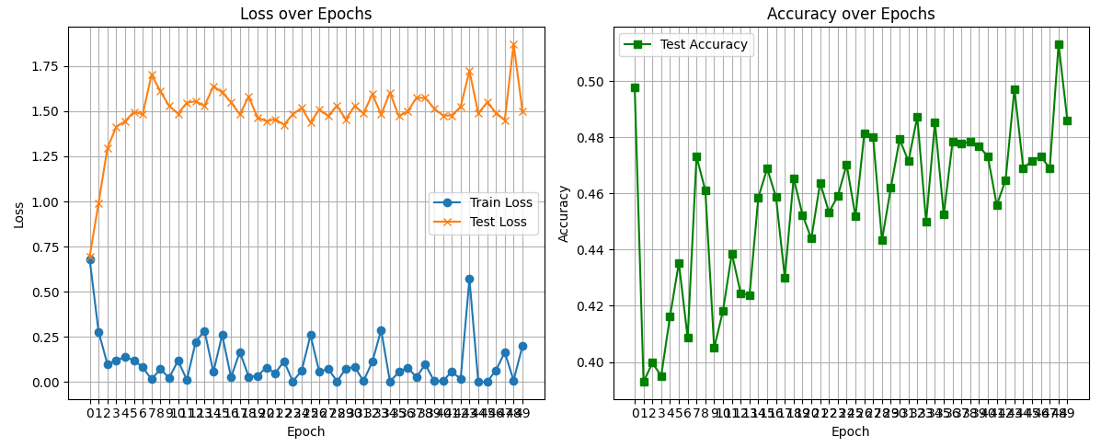
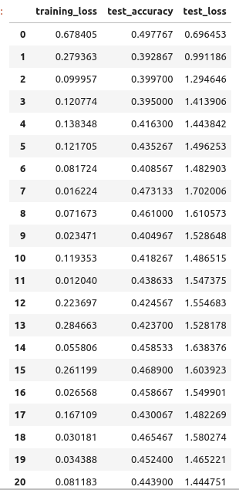
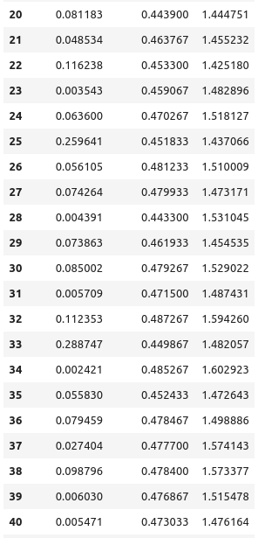
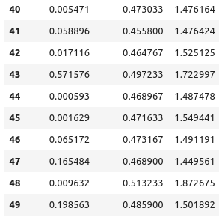
MD2 backbone (r=5.0). Train 8 trj (first); test 2 trj. 10X trj (last), 150ns each
5
A)
B)
C)

Slide 6
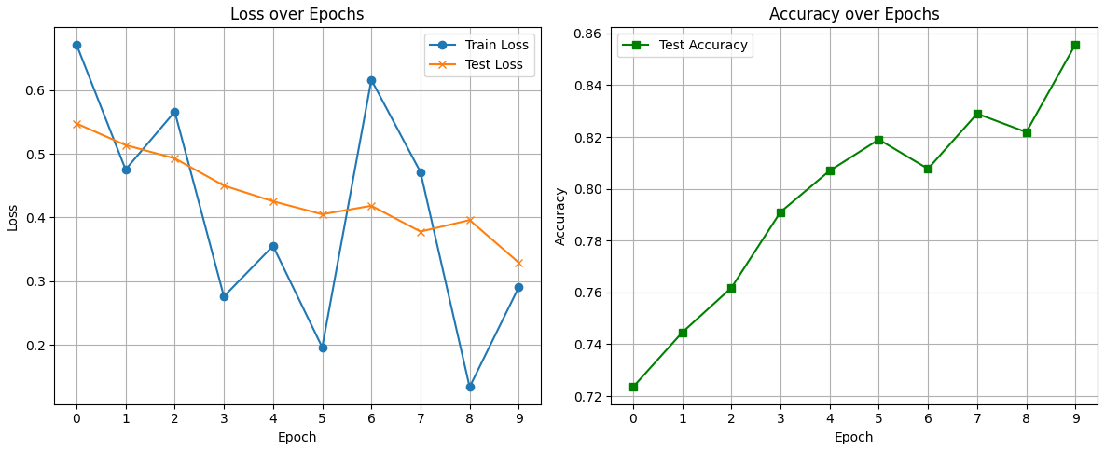
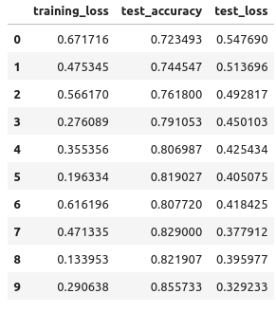
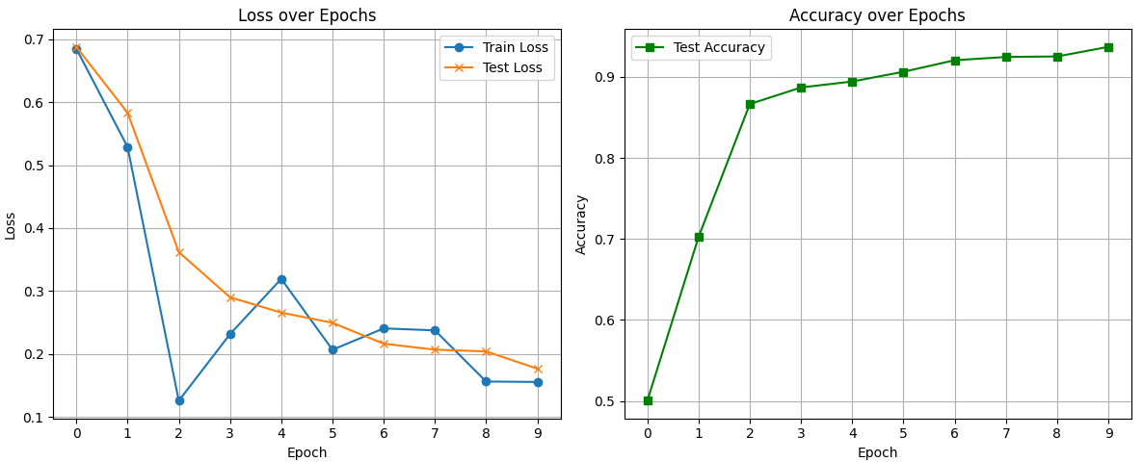
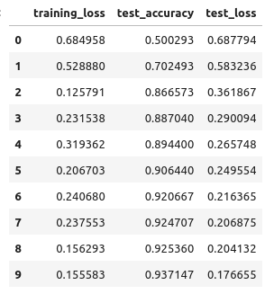
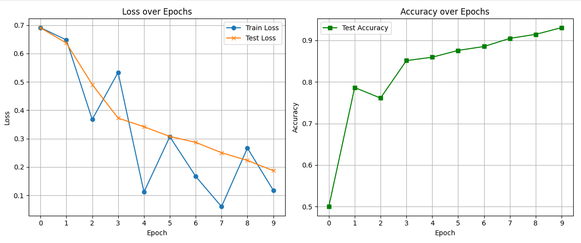
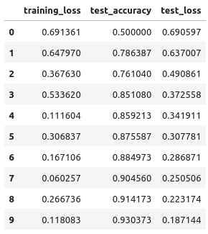
MD2 Full-atom (r=4.0). Chunk_1ns, 10X trj, 150ns each
6
A)
B)
C)

Slide 7
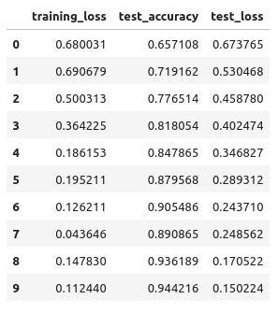
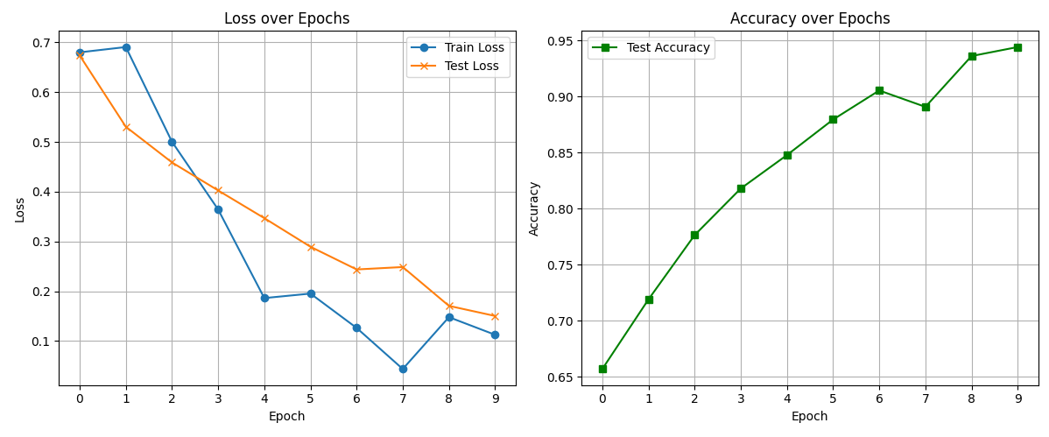
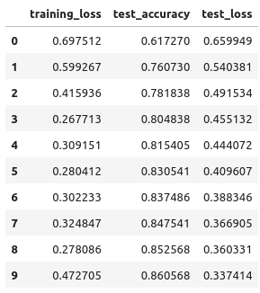
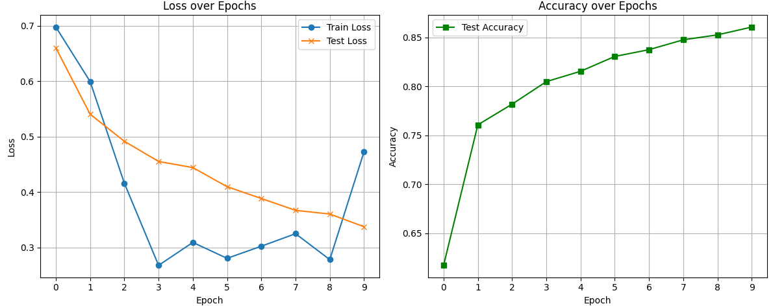
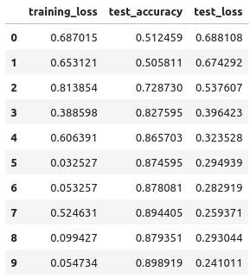
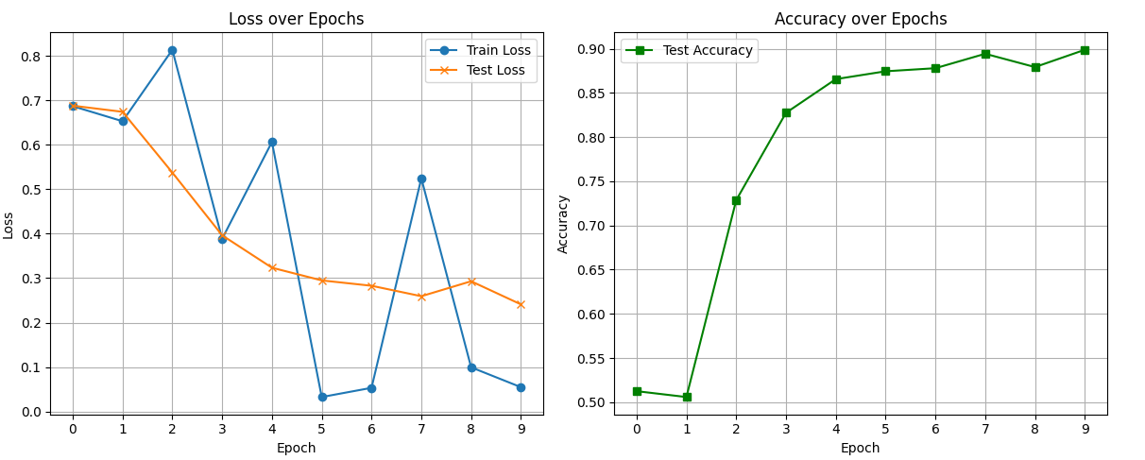
MD2 Full-atom (r=4.0). Chunk_1ns, 10X trj, 76-150ns each
7
A)
B)
C)

Slide 8
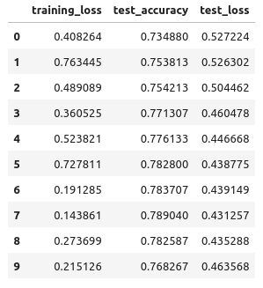
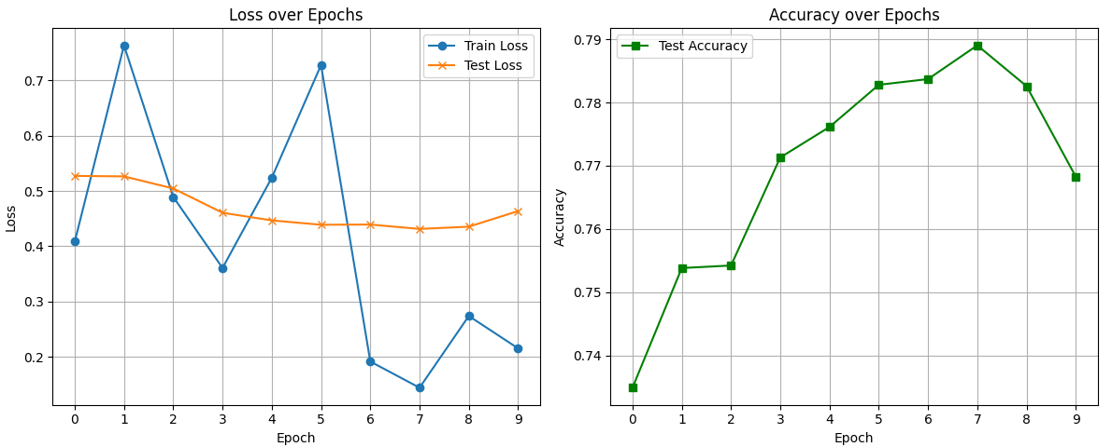
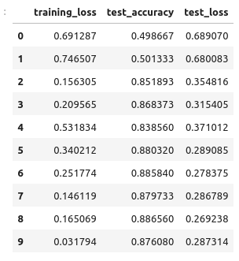
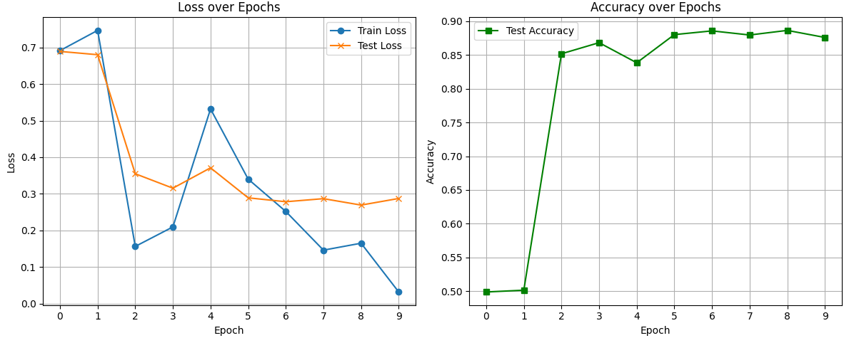
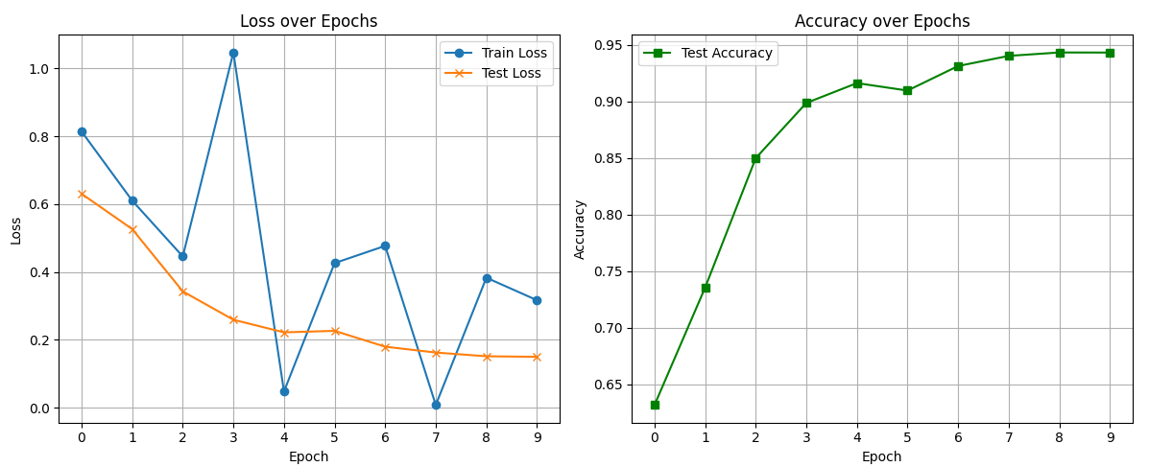
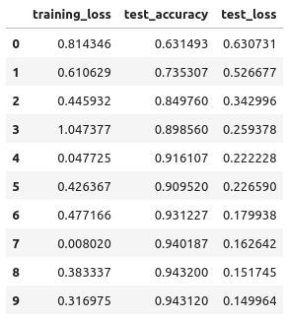
MD2 Full-atom (r=4.0). Chunk_1ns, 10X trj, 0-75ns each
8
A)
B)
C)

Slide 9




MD2 full-atom (r=4.0). Train 8 trj (first); test 2 trj. 10X trj (last), 150ns each
9
A)
B)
C)

Slide 10








MD2 active region (r=4.0). Train 8 trj (first); test 2 trj. 10X trj (last), 150ns each
10
"resid 247 618 626 627 628 638 640 642 646 655 657 659 661 665 670 672 674 675 684 686 688 696 698 707 709 711 712 713 714 715716 717 718 725 726 727 729 740 741 743 745 746 747"
A)
B)
C)

Slide 11






MD2 active region (r=4.0). Train 8 trj (first); test 2 trj. 10X trj (last), 150ns each
11
"resid 247 618 626 627 628 638 640 642 646 655 657 659 661 665 670 672 674 675 684 686 688 696 698 707 709 711 712 713 714 715716 717 718 725 726 727 729 740 741 743 745 746 747"
Epochs= 200
A)
B)
C)

Slide 12








MD2 active region (r=4.0). Train 8 trj (first); test 2 trj. 10X trj (last), 76-150ns each
12
"resid 247 618 626 627 628 638 640 642 646 655 657 659 661 665 670 672 674 675 684 686 688 696 698 707 709 711 712 713 714 715716 717 718 725 726 727 729 740 741 743 745 746 747"
A)
B)
C)

Slide 13






MD2 polar rim (r=4.0). Train 8 trj (first); test 2 trj. 10X trj (last), 150ns each
13
"resid 671 to 686 709 to 723" #Full-atom of polar rim of MD2
A)
BEST!
B)
C)

Slide 14






MD2 polar rim (r=4.0). Train 8 trj (first); test 2 trj. 10X trj (last), 76-150ns each
14
"resid 671 to 686 709 to 723" #Full-atom of polar rim of MD2
A)
B)
C)

Slide 15










MD2 polar rim (r=4.0). Train 10 trj (FP11+12); test 1 trj (FP18). 11X trj (last), 150ns each
15
"resid 671 to 686 709 to 723" #Full-atom of polar rim of MD2. Production_5 of FP18
A)
A)
A)
D)
B)
B)
B)
E)
C)
C)
C)
F)

Slide 16






MD2 polar rim (r=4.0). Train 10 trj (FP11+12); test 1 trj (FP18). 11X trj (last), 76-150ns each
"resid 671 to 686 709 to 723" #Full-atom of polar rim of MD2. Production_5 of FP18
16
A)
B)
C)

Slide 17








MD2 polar rim (r=4.0). Train 10 trj (FP11+12); test 3 trj (FP18). 13X trj (last), 150ns each
"resid 671 to 686 709 to 723" #Full-atom of polar rim of MD2. Production_3,4,5 of FP18
17
A)
B)
C)

Slide 18




MD2 polar rim (r=4.0). Train 10 trj (FP11+12); test 3 trj (FP18). 13X trj (last), 76-150ns each
"resid 671 to 686 709 to 723" #Full-atom of polar rim of MD2. Production_3,4,5 of FP18
18
A)
B)
C)
D)

Slide 19


MD2 polar rim (r=4.0). Train 10 trj (FP11+12); test 3 trj (FP18). 13X trj (last), 76-150ns each
"resid 671 to 686 709 to 723" #Full-atom of polar rim of MD2. Production_3,4,5 of FP18; +500 epochs
19
A)
B)
C)

Slide 20







MD2 active region (r=4.0). Train 10 trj (FP11+12); test 3 trj (FP18). 13X trj (last), 76-150ns each
"resid 247 618 626 627 628 638 640 642 646 655 657 659 661 665 670 672 674 675 684 686 688 696 698 707 709 711 712 713 714 715716 717 718 725 726 727 729 740 741 743 745 746 747" #Full-atom of active region of MD2. Production_3,4,5 of FP18
20
A)
B)
C)

Slide 21




MD2 polar rim (r=4.0). Train 10 trj (FP11+12); test 6 trj (FP18+FP7). 16X trj (last), 76-150ns each
"resid 671 to 686 709 to 723" #Full-atom of polar rim of MD2. Production_3,4,5 of FP18 and FP7
21
A)
B)
C)
D)

Slide 22




MD2 active region (r=4.0). Train 10 trj (FP11+12); test 6 trj (FP18+FP7). 16X trj (last), 76-150ns
“resid 247 618 626 627 628 638 640 642 646 655 657 659 661 665 670 672 674 675 684 686 688 696 698 707 709 711 712 713 714 715716 717 718 725 726 727 729 740 741 743 745 746 747" #Full-atom of active region of MD2. Production_3,4,5 of FP18 and FP7
22
A)
B)
C)
D)

Slide 23




MD2 polar rim (r=4.0). Train 10 trj (FP11+12); test 6 trj (FP18+FP7). 16X trj (last), 76-150ns each
"resid 671 to 686 709 to 723" #Full-atom of polar rim of MD2. Production_3,4,5 of FP18 and FP7
23
A)
B)
C)
D)

Slide 24







MD2 active region (r=4.0). Train 12 trj (4x(FP11+12)+2x(FP7+FP18)); test 4 trj (FP11+FP12+FP18+FP7). 16X trj (last), 76-150ns
24
“resid 247 618 626 627 628 638 640 642 646 655 657 659 661 665 670 672 674 675 684 686 688 696 698 707 709 711 712 713 714 715716 717 718 725 726 727 729 740 741 743 745 746 747" #Full-atom of active region of MD2. Production_3,4,5 of FP18 and FP7
A)
B)
C)
D)

Slide 25






MD2 active region (r=4.0). Train 12 trj (4x(FP11+12)+2x(FP7+FP18)); test 4 trj (FP11+FP12+FP18+FP7). 16X trj (last), 76-150ns
25
"resid 671 to 686 709 to 723" #Full-atom of polar rim of MD2. Production_3,4,5 of FP18 and FP7
A)
B)
C)
D)

Slide 26






MD2 active region (r=4.0). Train 16 trj (4x(FP11+FP12+FP7+FP18)); test 4 trj (FP11+FP12+FP18+FP7). 20X trj (last), 76-150ns
26
"resid 671 to 686 709 to 723" #Full-atom of polar rim of MD2.
A)
B)
C)
D)

Slide 27






MD2 active region (r=4.0). Chunk_1ns, 20X trj, 76-150ns each
27
"resid 671 to 686 709 to 723" #Full-atom of polar rim of MD2.
A)
B)
C)
D)

Slide 28






MD2 active region (r=4.0). Chunk_1ns, 20X trj, 76-150ns each
“resid 247 618 626 627 628 638 640 642 646 655 657 659 661 665 670 672 674 675 684 686 688 696 698 707 709 711 712 713 714 715716 717 718 725 726 727 729 740 741 743 745 746 747" #Full-atom of active region of MD2.
28
A)
B)
C)
D)

Slide 29






MD2 backbone (r=4.0). Chunk_1ns, 20X trj, 76-150ns each
29
selection_string = "resid 613:754 and name CA N C O" #Backbone MD2
A)
B)
C)
D)

Slide 30




MD2 backbone (r=5.0). Chunk_1ns, 20X trj, 76-150ns each
30
selection_string = "resid 613:754 and name CA N C O" #Backbone MD2
A)
B)
C)
D)

Slide 31






TLR4 and MD2 backbone (r=5.0). Chunk_1ns, 20X trj, 76-150ns each
31
selection_string = "resid 6:754 and name CA N C O" #Backbone TLR-4 and MD2
A)
B)
C)

Slide 32







MD2 backbone (r=5.0). Train/test (p3-p6)x4/(p7)x4, 20X trj, 76-150ns each
32
selection_string = "resid 613:754 and name CA N C O" #Backbone MD2
A)
B)
C)
D)

Slide 33







TLR4 and MD2 backbone (r=5.0). Train/test (p3-p6)x4/(p7)x4, 20X trj, 76-150ns each
33
selection_string = "resid 6:754 and name CA N C O" #Backbone TLR-4 and MD2
A)
B)
C)

Slide 34







MD2 active region (r=4.0). Train/test (p3-p6)x4/(p7)x4, 20X trj, 76-150ns each
“resid 247 618 626 627 628 638 640 642 646 655 657 659 661 665 670 672 674 675 684 686 688 696 698 707 709 711 712 713 714 715716 717 718 725 726 727 729 740 741 743 745 746 747" #Full-atom of active region of MD2.
34
A)
B)
C)
D)

Slide 35








MD2 active region (r=4.0). Train/test FP11+FP12/FP18/FP7, 20X trj, 76-150ns each
“resid 247 618 626 627 628 638 640 642 646 655 657 659 661 665 670 672 674 675 684 686 688 696 698 707 709 711 712 713 714 715716 717 718 725 726 727 729 740 741 743 745 746 747" #Full-atom of active region of MD2.
35
A)
B)
C)
D)

