Slide 1
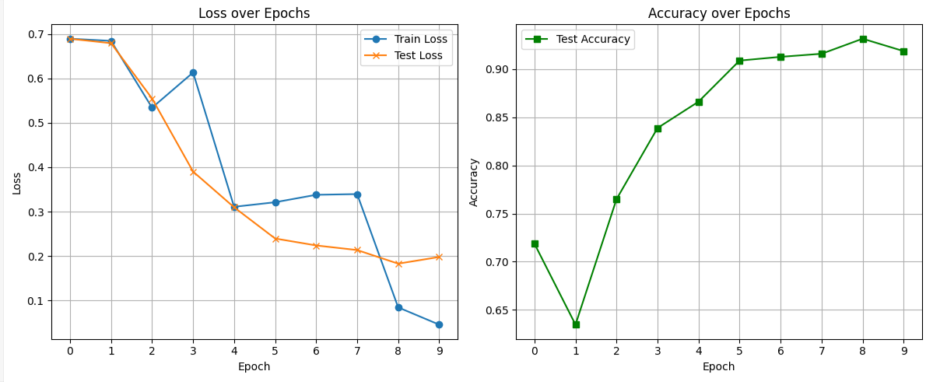
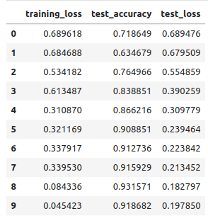
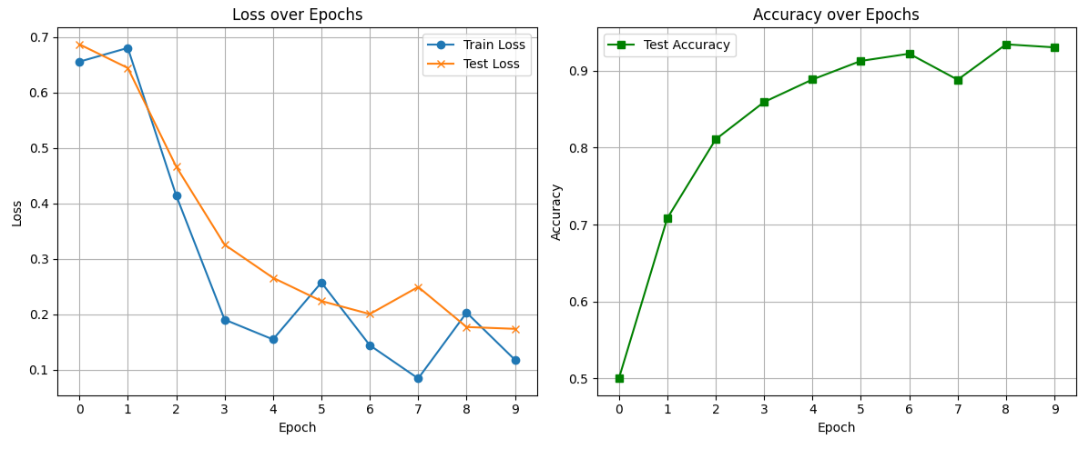
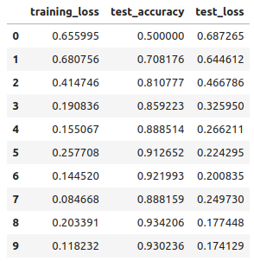
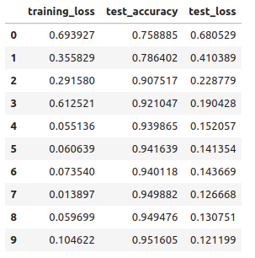
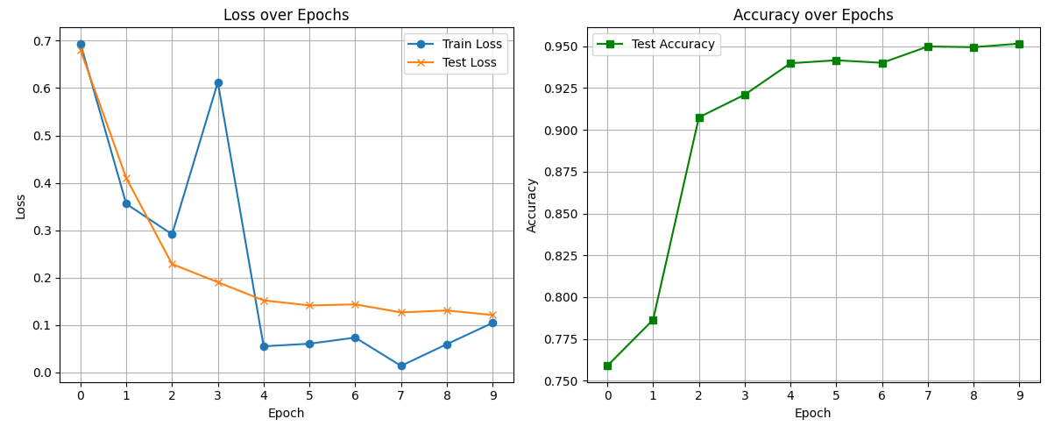
MD2 backbone. Chunk_1 ns. 75-150ns x 16 trj. FP7+11+12+18
1
A)
B)
C)

Slide 2
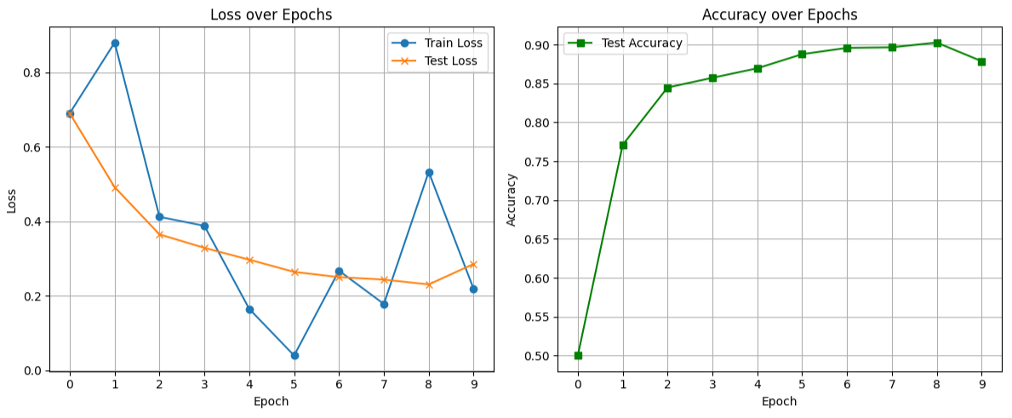
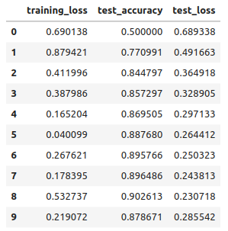
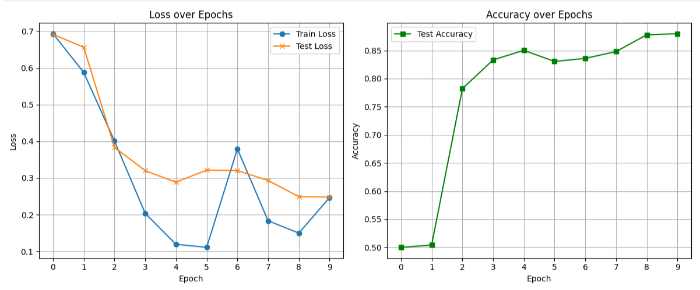
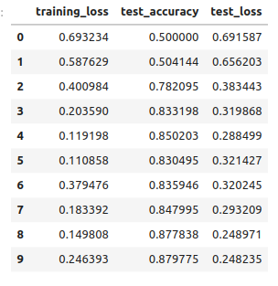
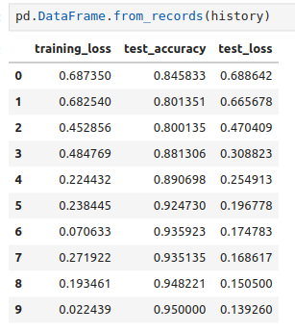
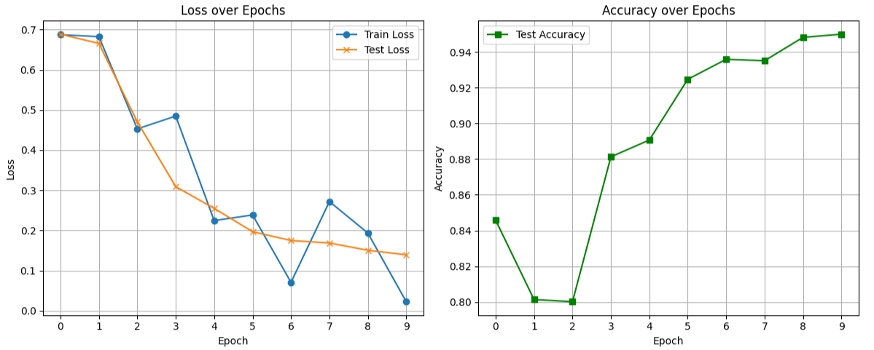
MD2 backbone. Chunk_1 ns. 75-150ns x 12 trj. FP7(noP2)+11(noP1)+12(noP0)+18(noP2)
2
A)
B)
C)

Slide 3
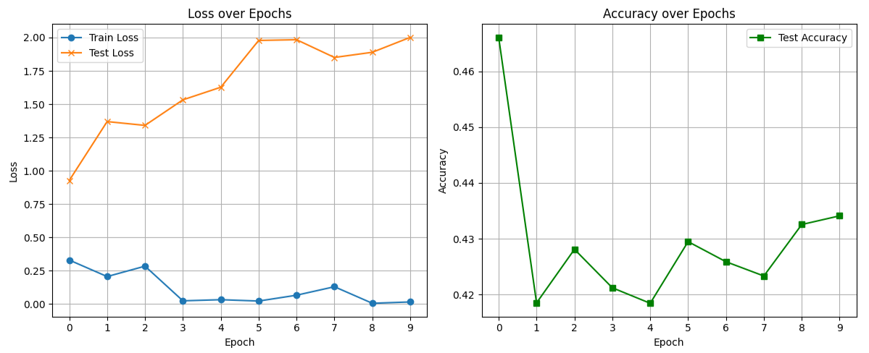
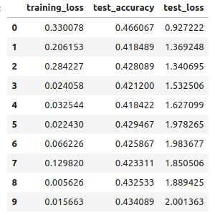
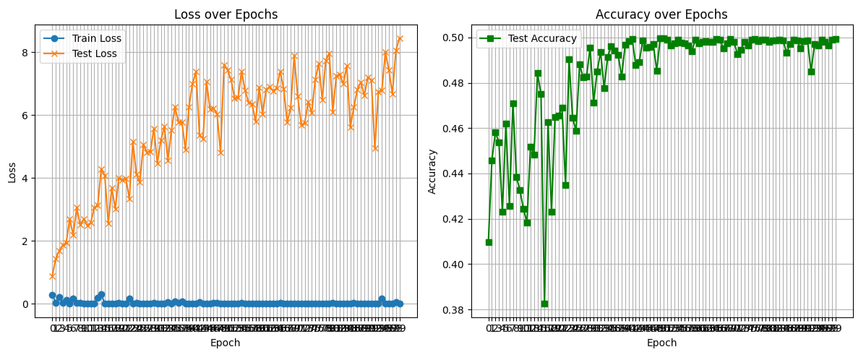
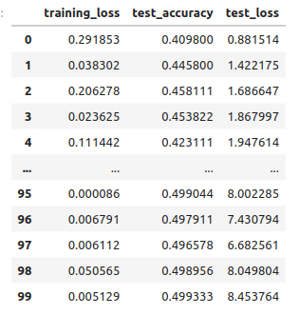
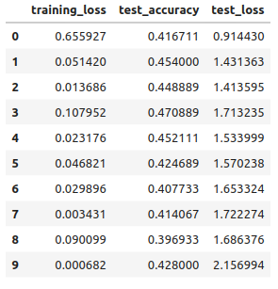
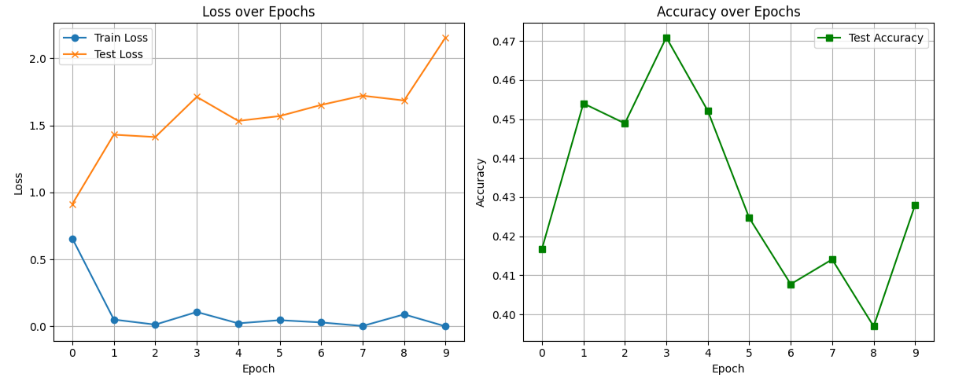
MD2 backbone. Train:11(noP1)+12(noP0). Test: FP7(noP2)+18(noP2). 75-150ns x 12 trj.
3
A)
B)
C)

Slide 4
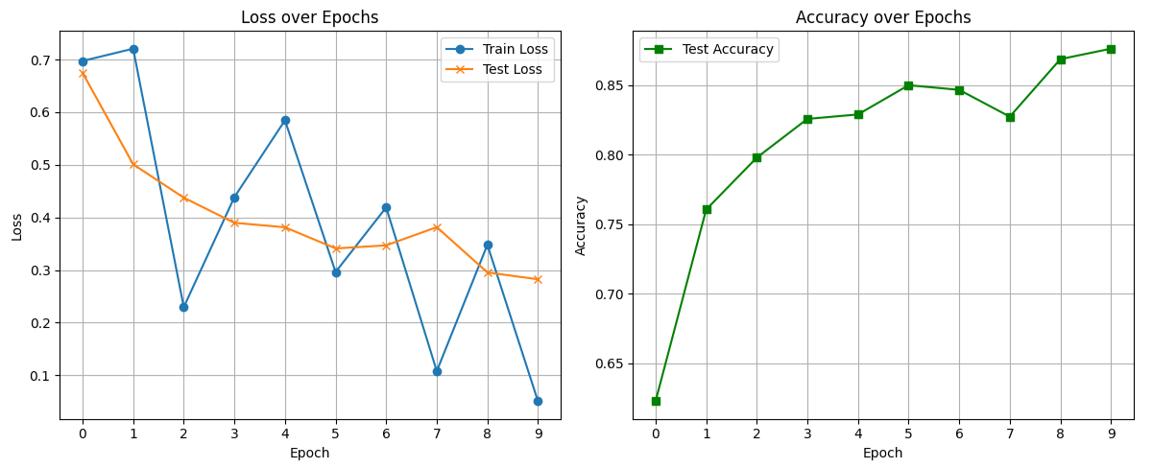
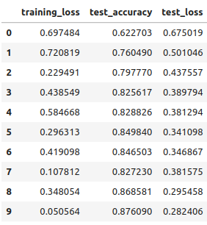
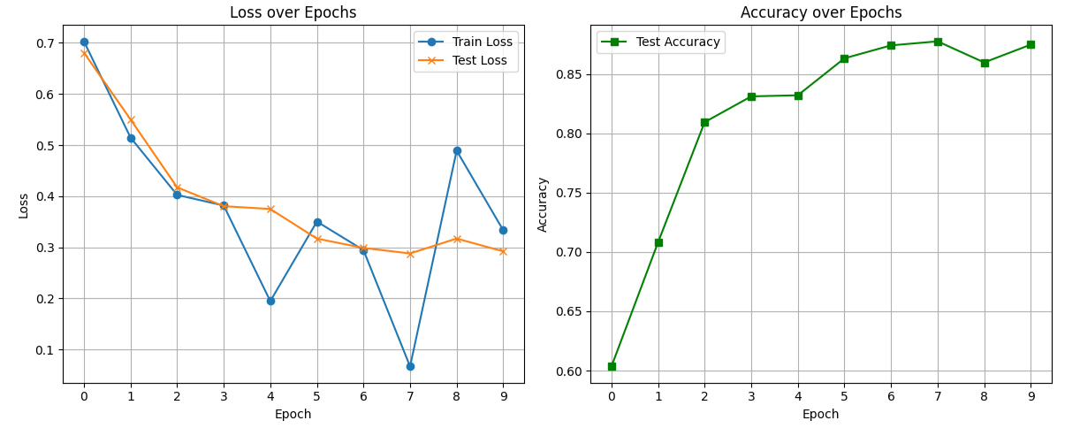
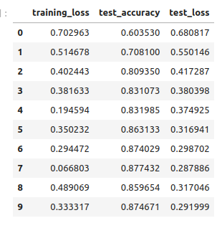
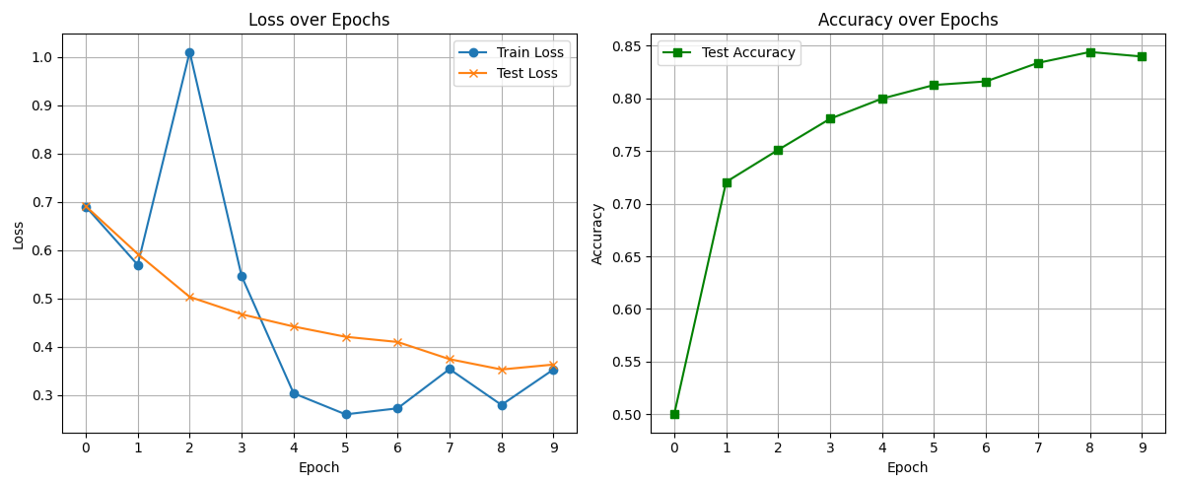
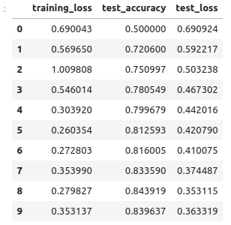
MD2 backbone. Chunk_1 ns. 75-150ns x 32 trj. FP7+11+12+18
4
A)
B)
C)

Slide 5
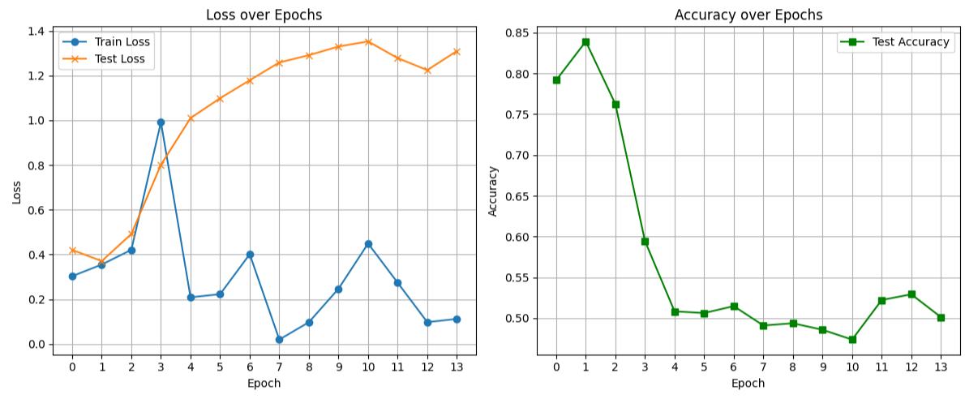
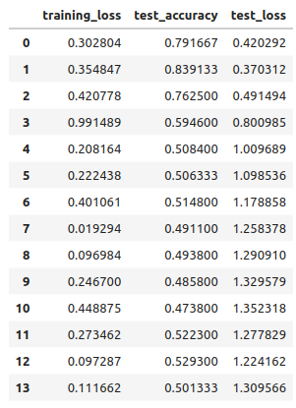
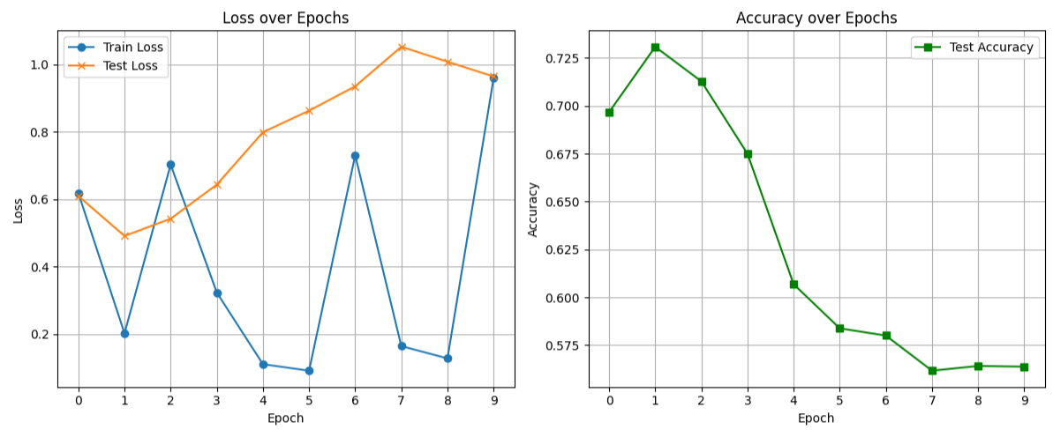
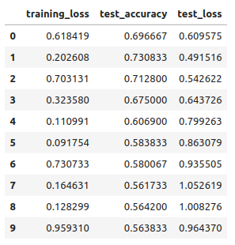
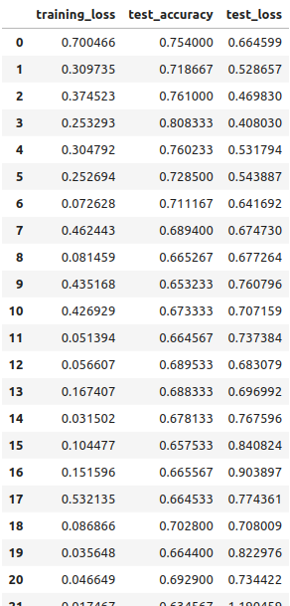
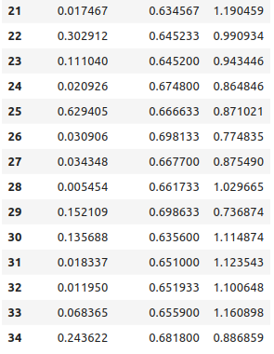
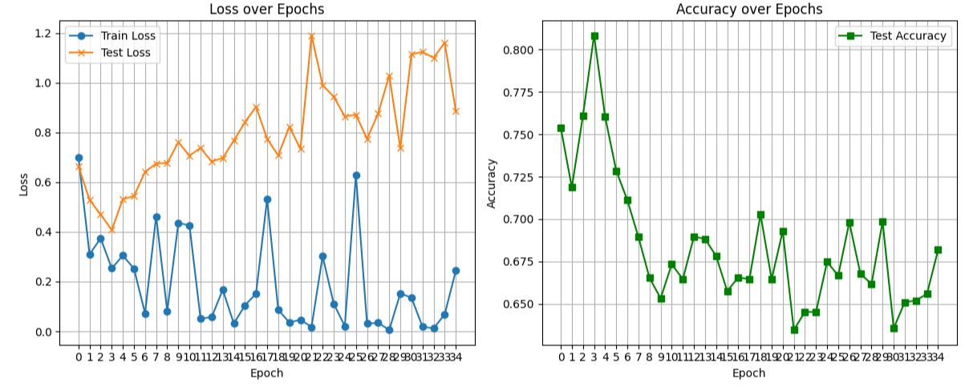
MD2 backbone. 75-150ns x 32 trj.Train: FP7+11+12+18 (p0-p7) Test: FP7+11+12+18 (p8)
A)
4b
B)
C)

Slide 6
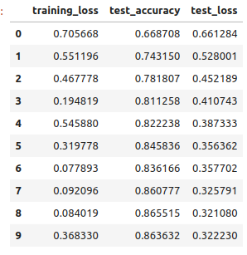
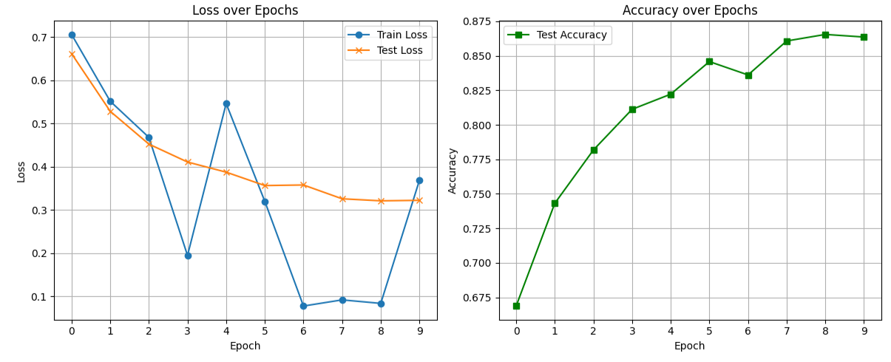
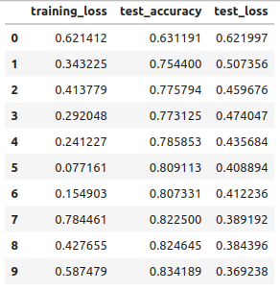
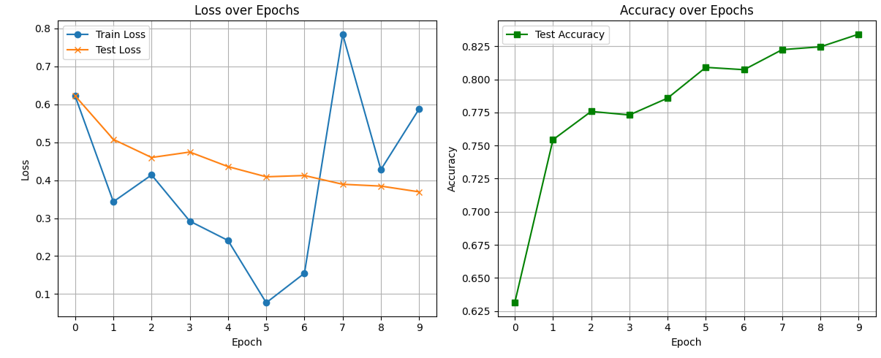
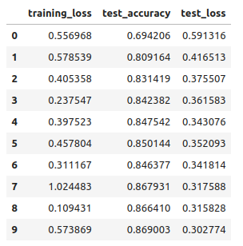
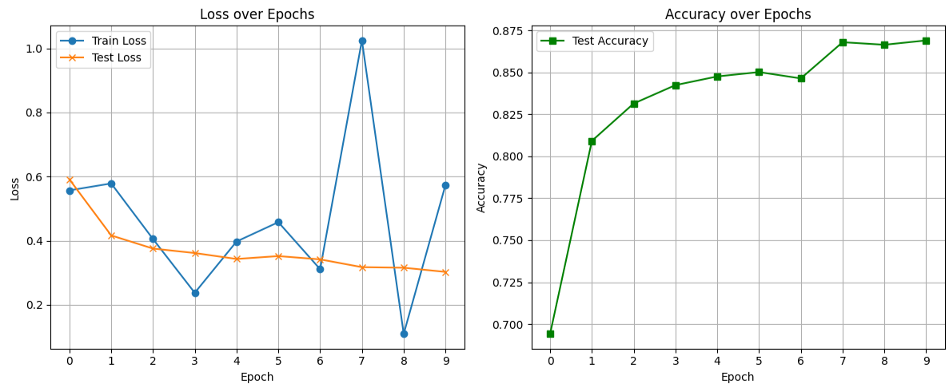
Active region. Chunk_1 ns. 75-150ns x 32 trj. FP7+11+12+18.
5
selection_string = "resid 11 19 20 21 31 33 35 36 48 50 52 54 58 63 65 67 68 74 79 81 89 91 100 102 104 105 106 107 108 109 110 111 118 119 120 122 133 134 136 138 139 140" #Full-atom of active aminoacids (5A) of MD2
A)
B)
C)

Slide 7
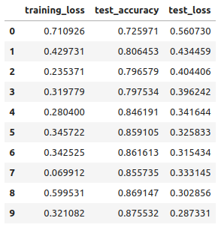
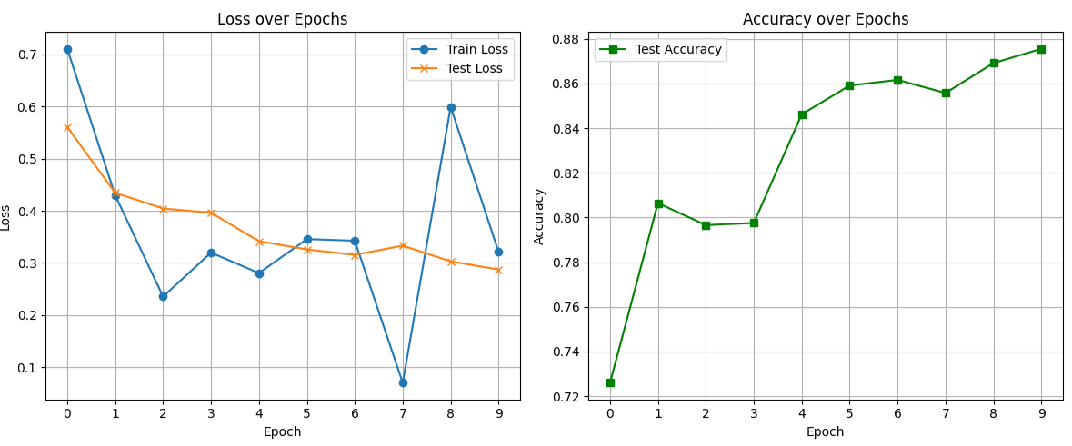
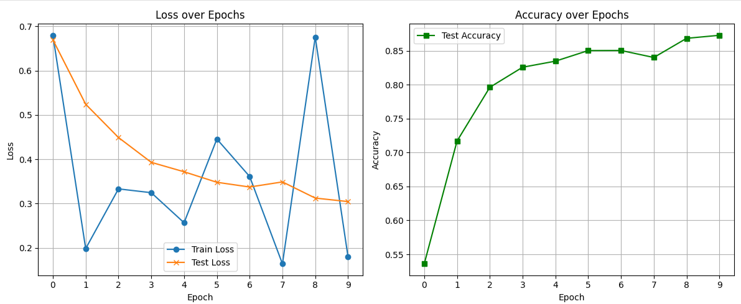
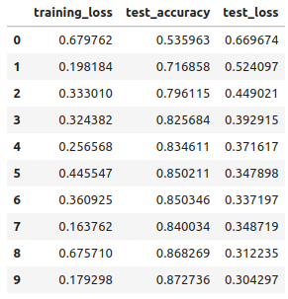
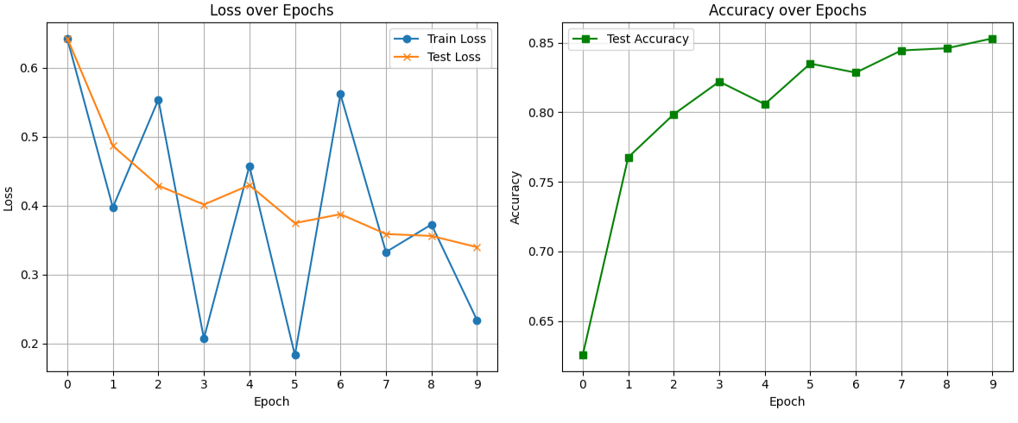
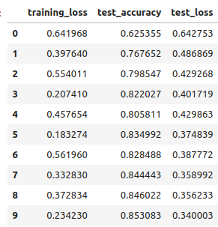
Polar Rim. Chunk_1 ns. 75-150ns x 32 trj. FP7+11+12+18.
6
selection_string = "resid 70 to 117” Polar Rim of MD2
A)
B)
C)

Slide 8
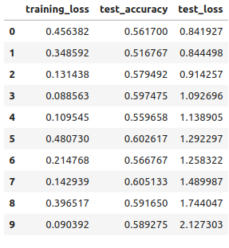
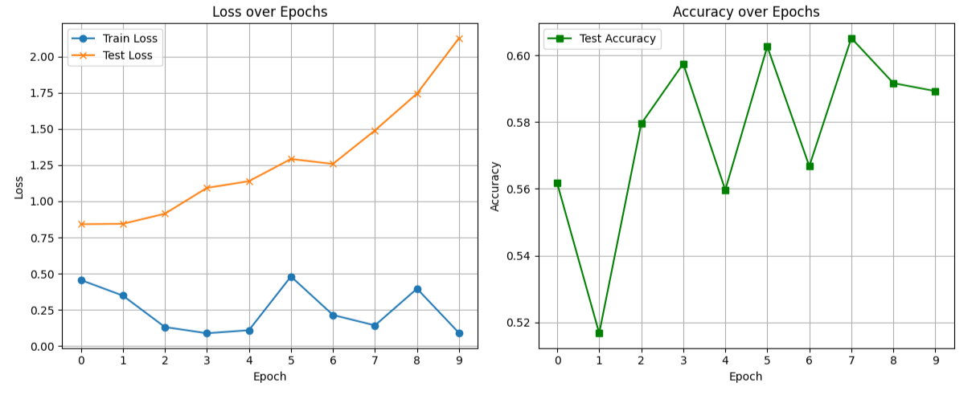
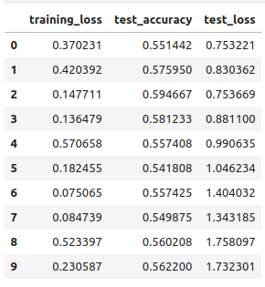
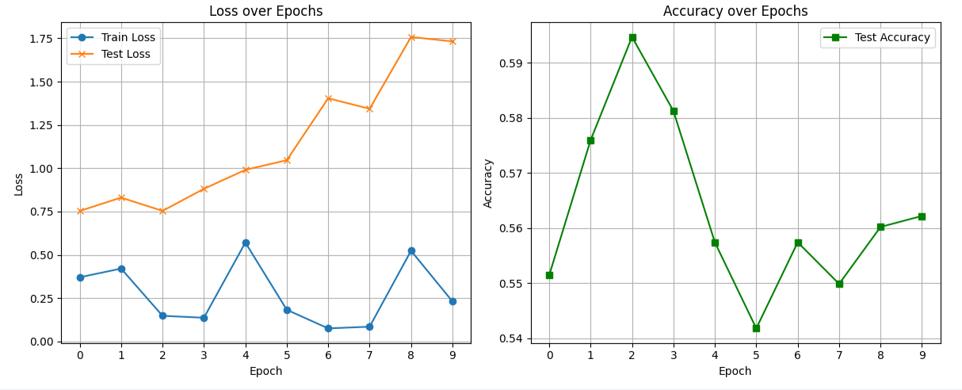
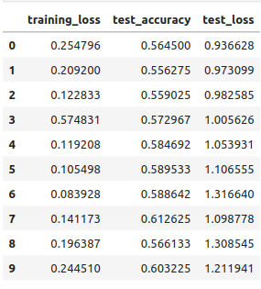
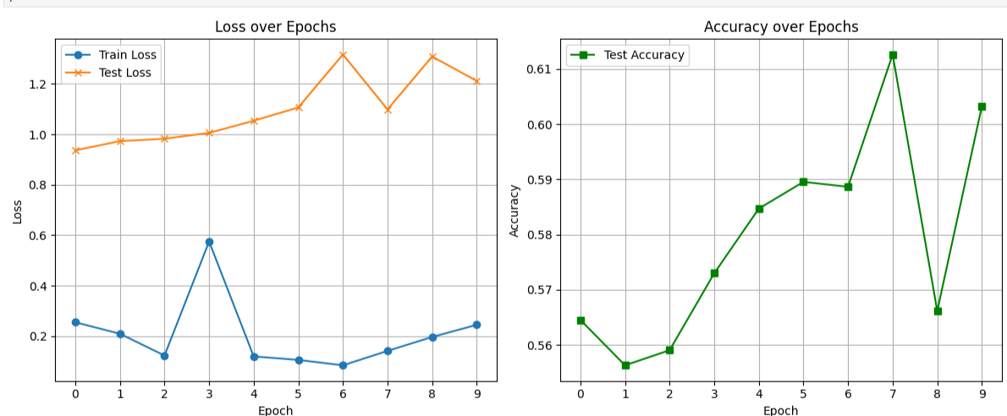
Polar Rim. 75-150ns x 32 trj.Train: FP11 y FP12 Test: FP7+18.
7
selection_string = "resid 70 to 117” Polar Rim of MD2
A)
B)
C)

Slide 9
Polar Rim. 75-150ns x 32 trj.Train: FP7+11+12+18 (p0-p7) Test: FP7+11+12+18 (p8)
selection_string = "resid 70 to 117” Polar Rim of MD2
A)
8
B)
C)

