Slide 1
Exact methods for the Distributed Permutation Flowshop Problem with transport considerations
Levi Ribeiro de Abreu
Bruno de Athayde Prata
Paz Perez-Gonzalez

Slide 2



Index
Introduction
Problem description
DPFS with transportation
Mathematical formulation
Results
New advances
Conclusions
ENSURE

Slide 3
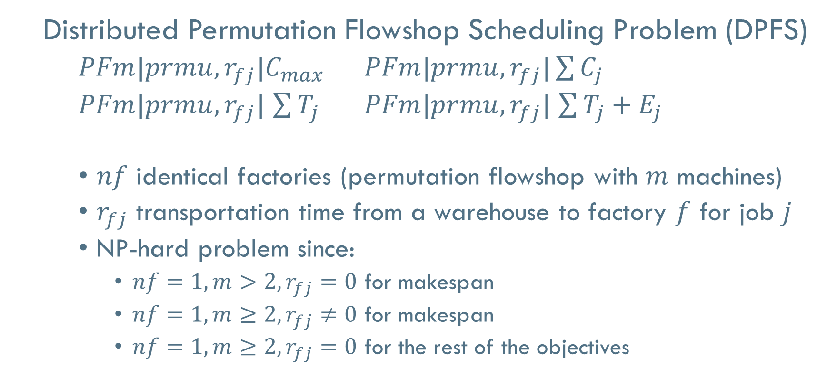
1. Introduction
Distributed Permutation Flowshop Scheduling Problem (DPFS)
$PFm|prmu,r_{fj}|C_{max}$ $PFm|prmu,r_{fj}|\sum{C_{j}}$
$PFm|prmu,r_{fj}|$ $\sum{T_{j}}$ $PFm|prmu,r_{fj}|$ $\sum{T_{j}}+E_{j}$
$nf$ identical factories (permutation flowshop with $m$ machines)
$r_{fj}$ transportation time from a warehouse to factory $f$ for job $j$
NP-hard problem since:
$nf=1, m>2, r_{fj}=0$ for makespan
$nf=1, m≥2, r_{fj}≠0$ for makespan
$nf=1, m≥2, r_{fj}=0$ for the rest of the objectives

Slide 4


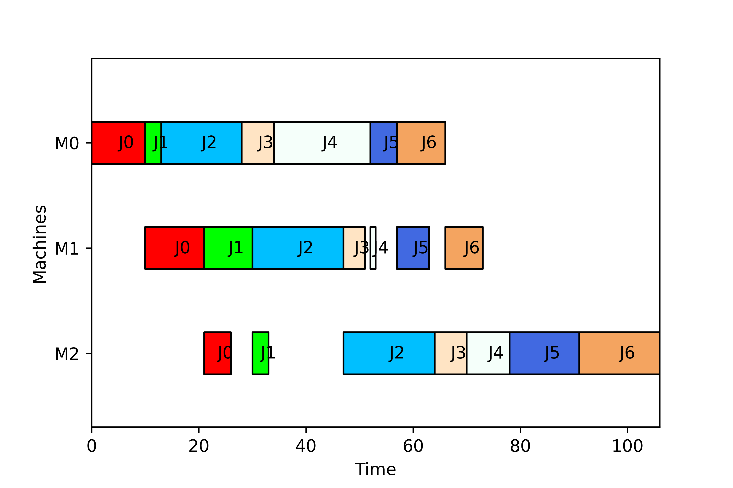




2. Problem description
$$β$$
Raw material
tbp
Semiprocessed product
tdp
Final product
tap
Supplier
Warehouse
Factory
Retailer

Slide 5
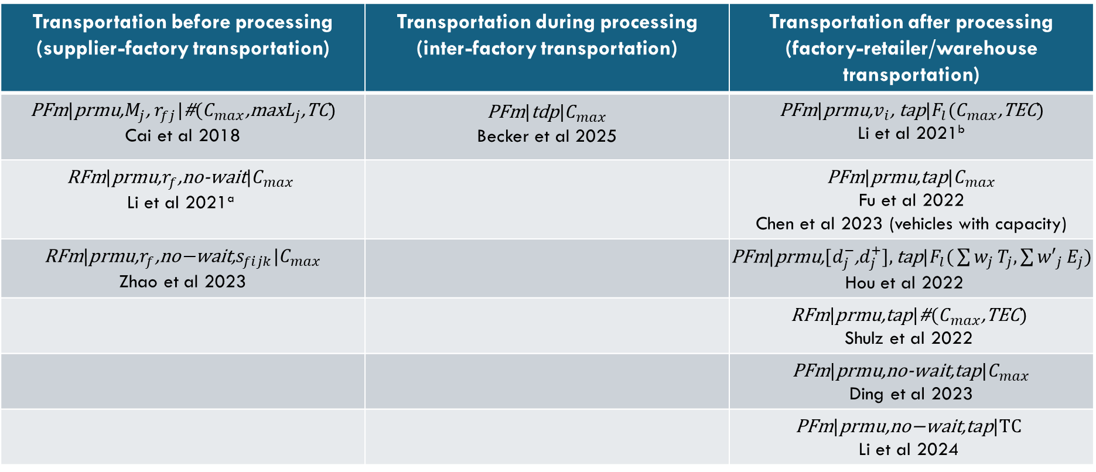
3. DPFS with transportation
VRP problem
Transportation before processing (supplier-factory transportation) | Transportation during processing (inter-factory transportation) | Transportation after processing (factory-retailer/warehouse transportation)
$\text{P}\text{Fm}\text{|}\text{prmu}\text{,}M_{j}\text{, }r_{fj}\text{|}\text{\#}\text{(}C_{max}\text{,}\text{max}L_{j}\text{,}\text{TC}\text{)}$ Cai et al 2018 | $\text{P}\text{Fm}\text{|}\text{tdp}\text{|}C_{max}$ Becker et al 2025 | $\text{P}\text{Fm}\text{|}\text{prmu}\text{,}v_{i}\text{, }\text{tap}\text{|}F_{l}\text{(}C_{max}\text{,}\text{TEC}\text{)}$ Li et al 2021^{b}
$$\text{RFm}\text{|}\text{prmu}\text{,}r_{f}\text{,}\text{no}\text{−}\text{wait}\text{|}C_{max}$$ Li et al 2021ª |  | $\text{P}\text{Fm}\text{|}\text{prmu}\text{,}\text{tap}\text{|}C_{max}$ Fu et al 2022 Chen et al 2023 (vehicles with capacity)
$$\text{RFm}\text{|}\text{prmu}\text{,}r_{f}\text{,}\text{no}\text{−}\text{wait}\text{,}s_{fijk}\text{|}C_{max}$$ Zhao et al 2023 |  | $\text{P}\text{Fm}\text{|}\text{prmu}\text{,}\text{[}d_{j}^{−}\text{,}d_{j}^{+}],\text{tap}\text{|}F_{l}\text{(}\sum{w_{j}}T_{j},\sum{{w′}_{j}}E_{j}\text{)}$ Hou et al 2022
 |  | $$\text{R}\text{Fm}\text{|}\text{prmu}\text{,}\text{tap}\text{|}\text{\#}\text{(}C_{max}\text{,}\text{TEC}\text{)}$$ Shulz et al 2022
 |  | $\text{P}\text{Fm}\text{|}\text{prmu}\text{,}\text{no}\text{−}\text{wait}\text{,}\text{tap}\text{|}C_{max}$ Ding et al 2023
 |  | $$\text{P}\text{Fm}\text{|}\text{prmu}\text{,}\text{no}\text{−}\text{wait}\text{,}\text{tap}\text{|}\text{TC}$$ Li et al 2024

Slide 6
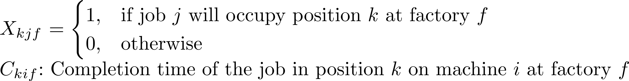
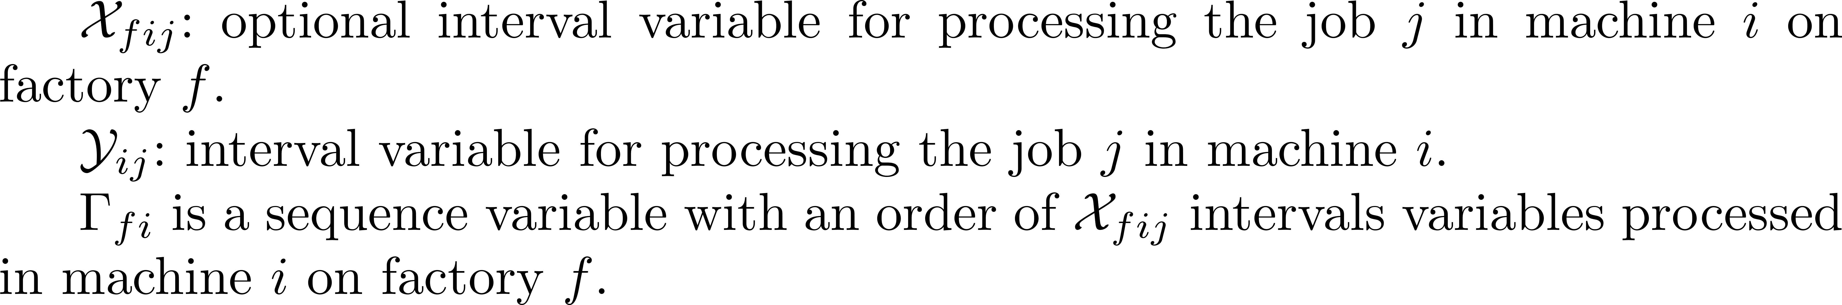
4. Mathematical formulation
MILP
Adapted from Naderi and Ruiz 2010
CP models:
IBM CP Optimizer
Adapted from Naderi and Ruiz 2010
Hexaly

Slide 7
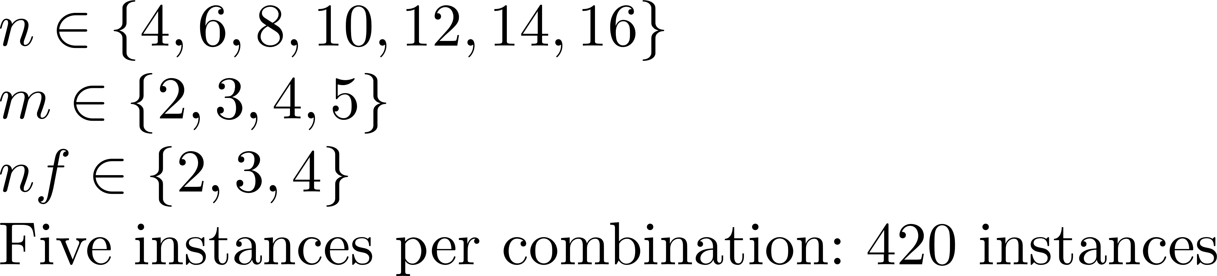
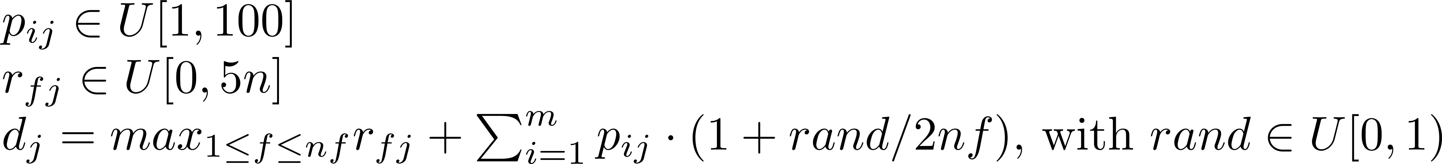
5. Results Exact Methods (Small Instances)

Slide 8
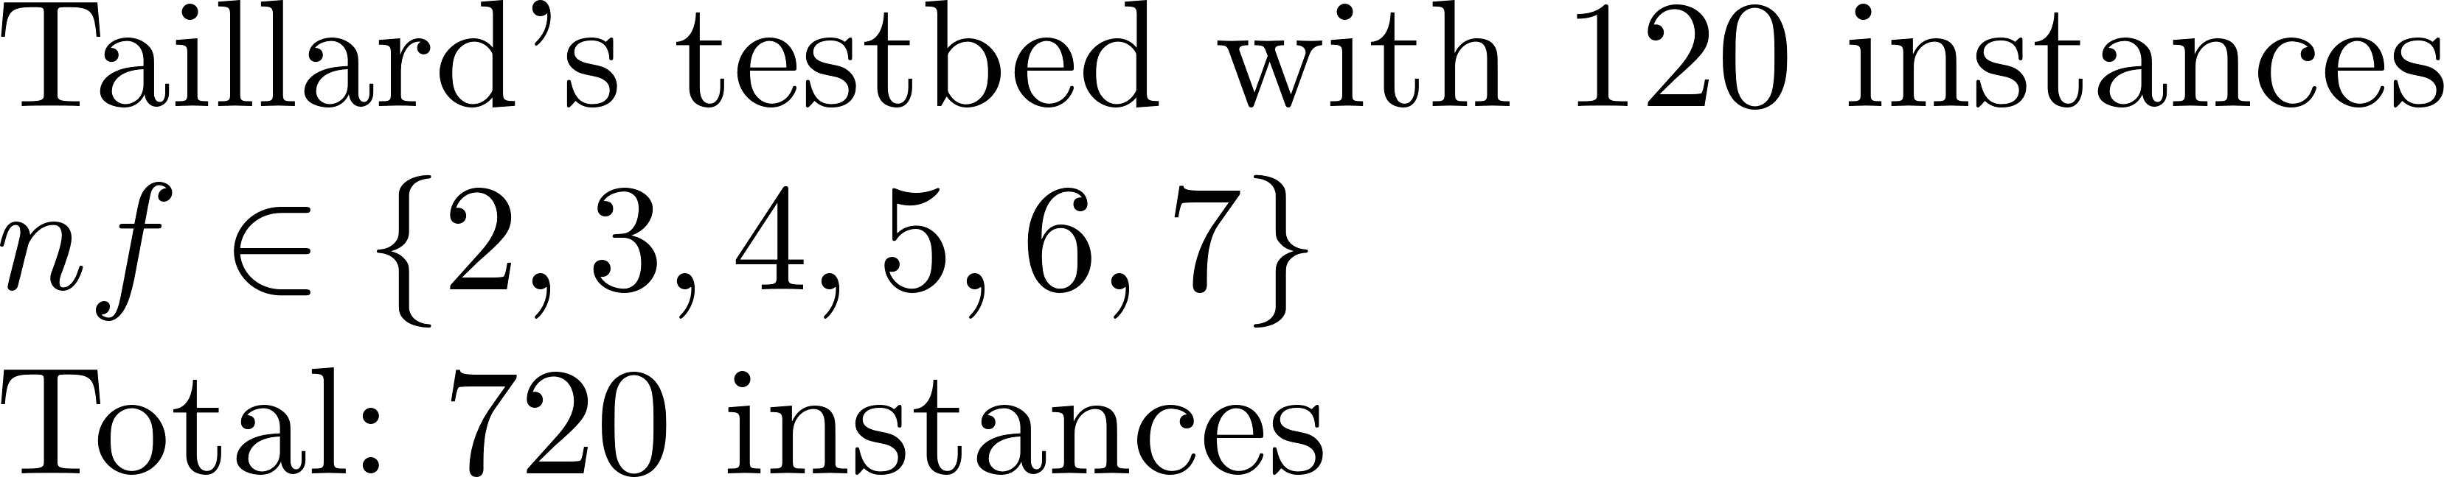
5. Results Exact Methods (Large Instances)

Slide 9
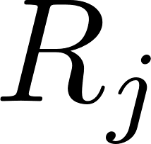
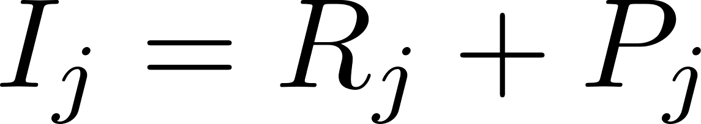
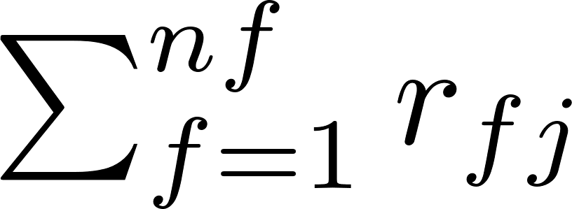
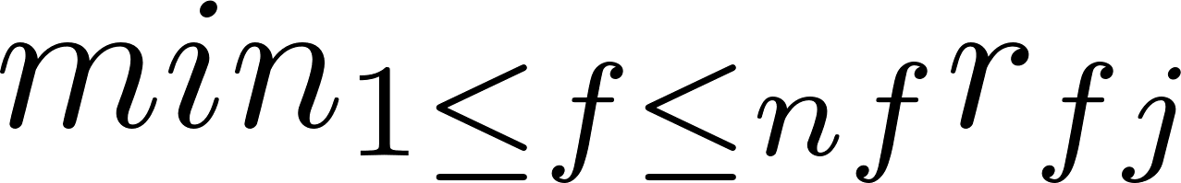
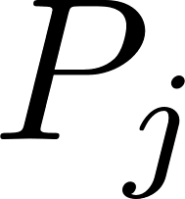
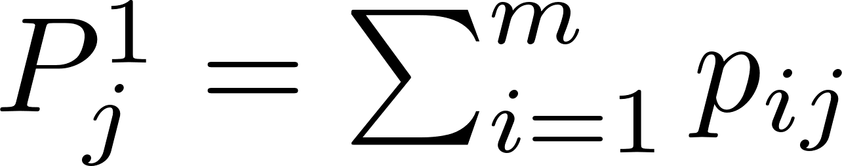
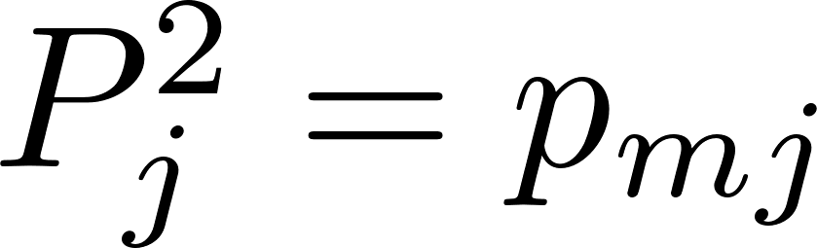
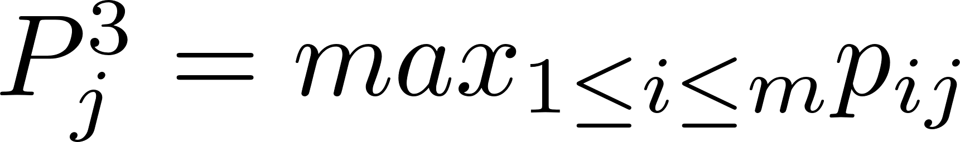
6. New advances: Dispatching rules
Codification: Sequence (permutation) + Earliest Completion Time
 | Increasing | Decreasing | Increasing | Decreasing
 | DR1 | DR2 | DR7 | DR8
 | DR3 | DR4 | DR9 | DR10
 | DR5 | DR6 | DR11 | DR12

Slide 10
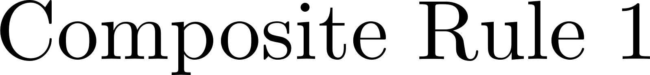
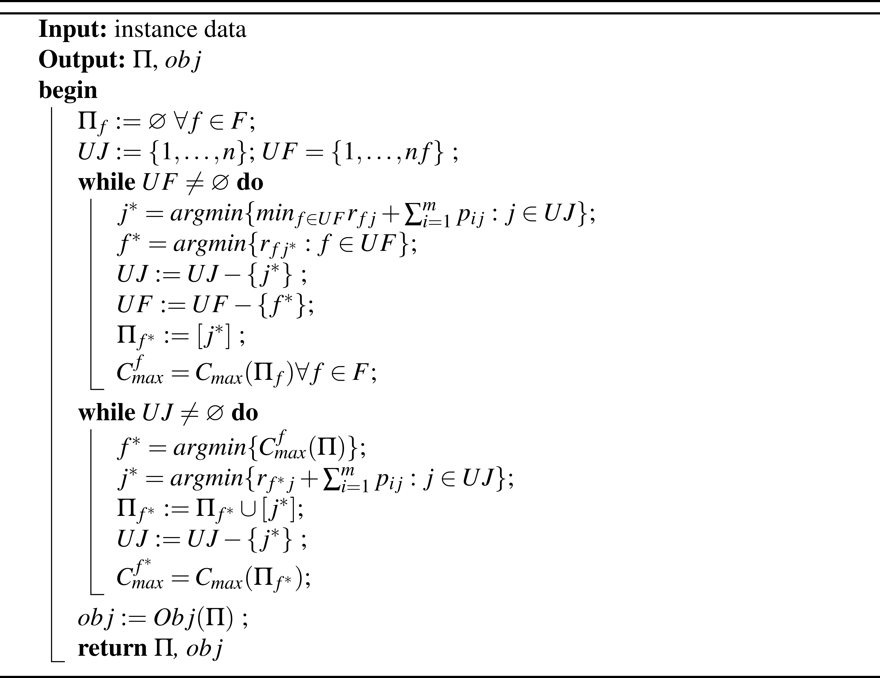
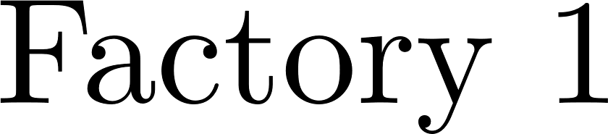
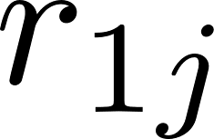
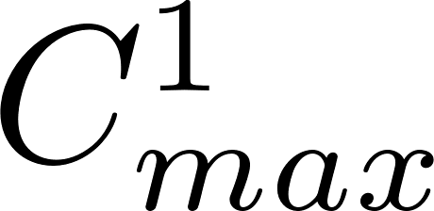
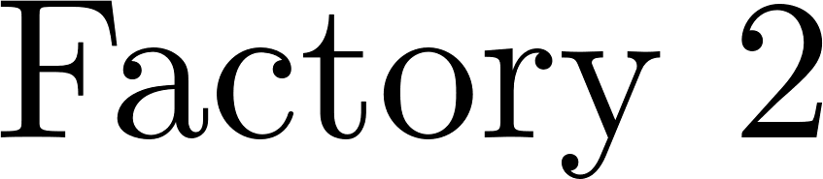
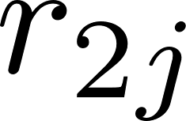
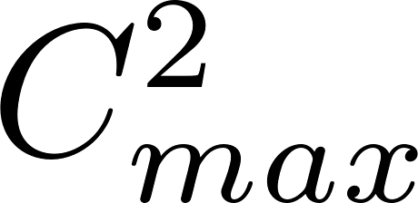
6. New advances: Composite rules

Slide 11
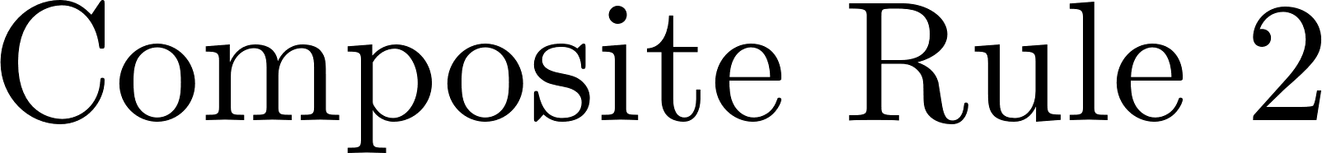
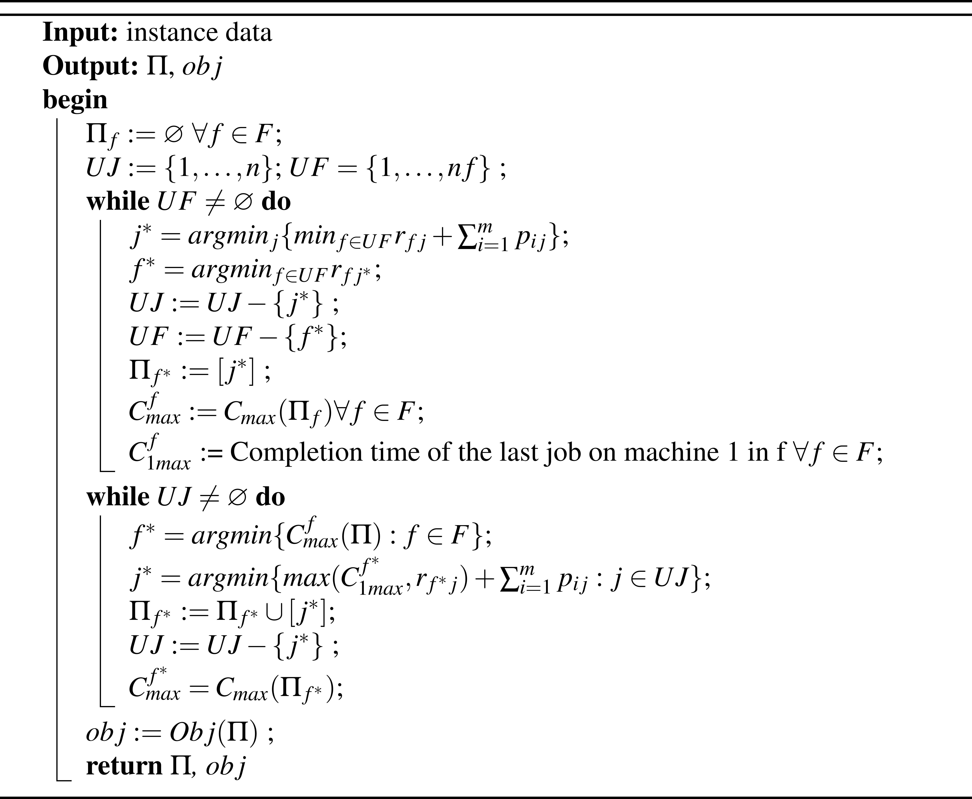
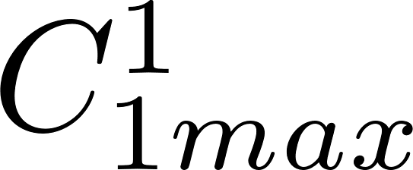
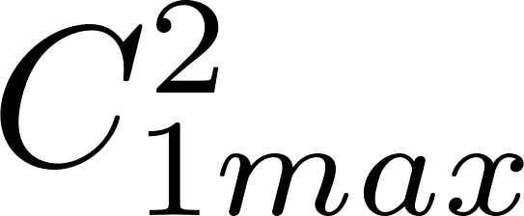
6. New advances: Composite rules

Slide 12
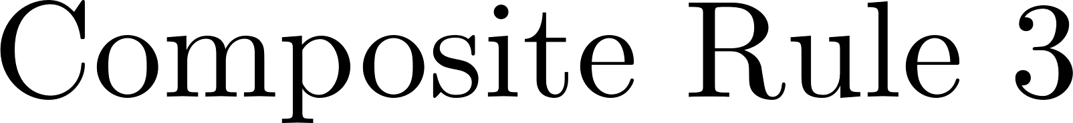
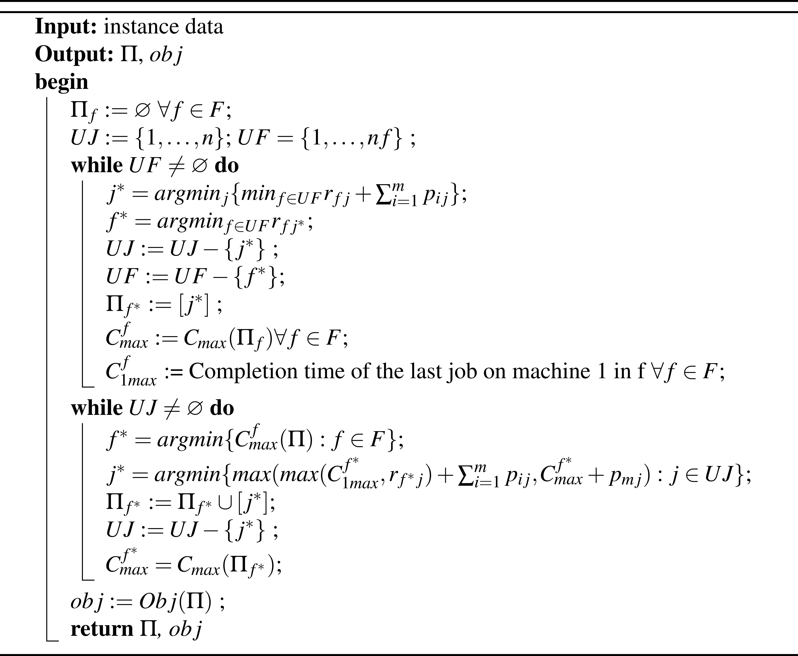
6. New advances: Composite rules

Slide 13
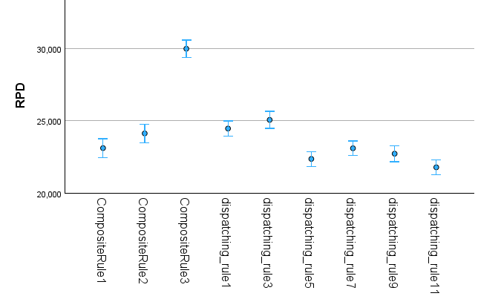
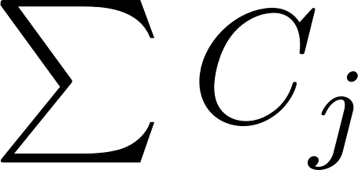
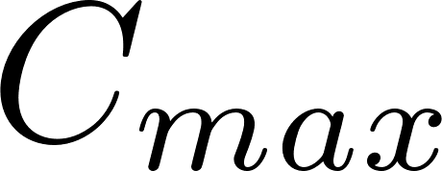
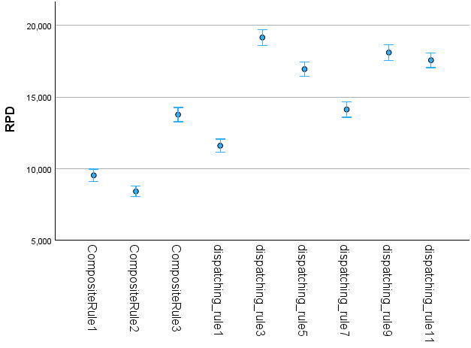
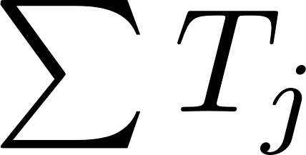
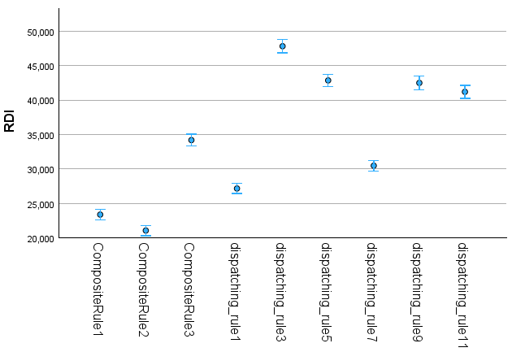
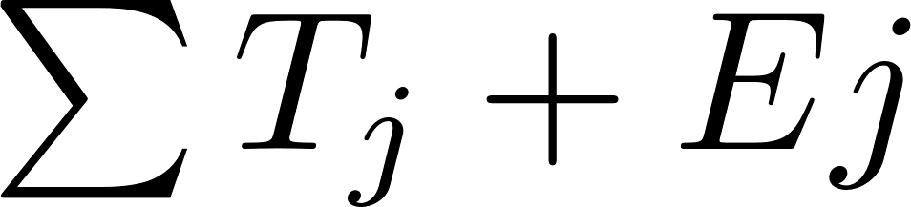
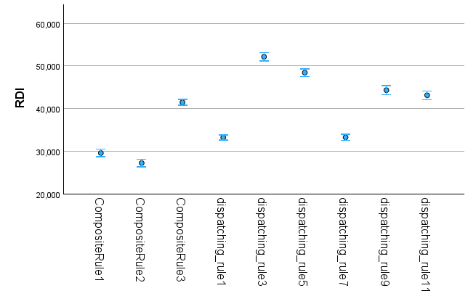
6. New advances: Results (Large instances)

Slide 14
6. Conclusions
IBM CP Optimizer provides the best exact method to solve optimally small instances
Large instances should be solved by efficient approximate methods
Fist step: fast dispatching rules and composite rules
Composite Rule 3 is the most efficient for all the objectives except Cmax
Dispatching Rule 11 is the most efficient for Cmax

Slide 15

7. Past, present and future
Metaheuristics from the literature are available to solve similar problems
We are working on new methods to solve the problem more efficiently
We will compare the existing and the proposals to determine the best methods to solve the problem

