Slide 1




Unlocking Tibetan Canonical Literature through OCR
Scalable Methods for Heterogeneous Textual Sources
Markus Viehbeck & Bruno Lainé
(University of Vienna / Tibetan Manuscript Project Vienna / CIRDIS)

Slide 2
Overview (Part II)
OCR/HTR Workflow
Todos / Work in progress

Slide 3
OCR/HTR: Workflow
Image Processing
OCR App
Raw Data
rKTs Data Base
Noise Reduction
Generated e-texts

Slide 4
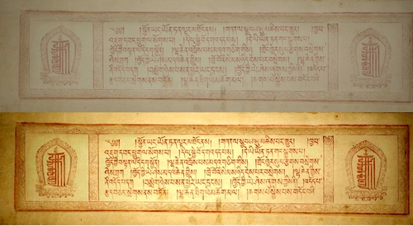
OCR/HTR: Image Processing
Contrast/Luminosity
Sharpening
Image Cropping

Slide 5
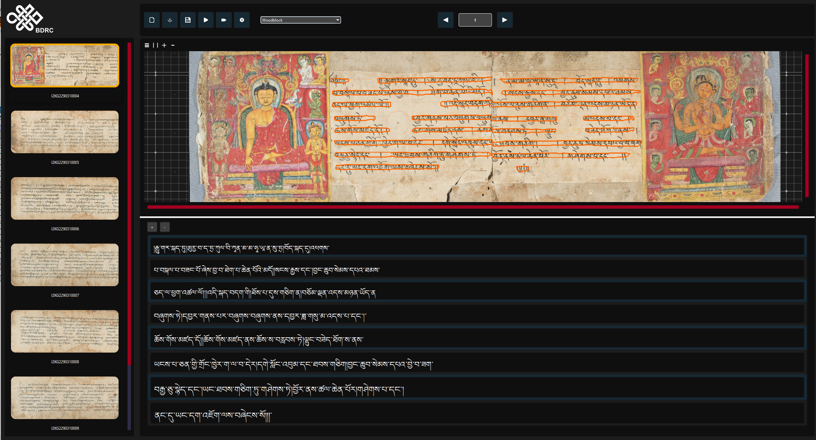
OCR/HTR: Processing - OCR App
Model used for Kanjur and Tanjur collections: "Woodblock"
Model trained with the Derge, Lithang, Lhasa and Namgyal Data.

Slide 6
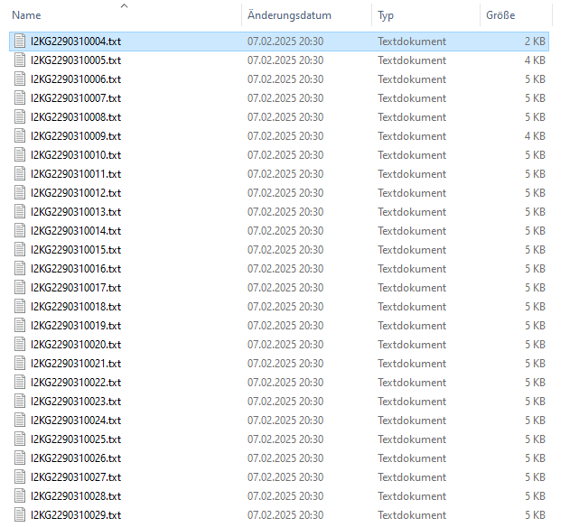
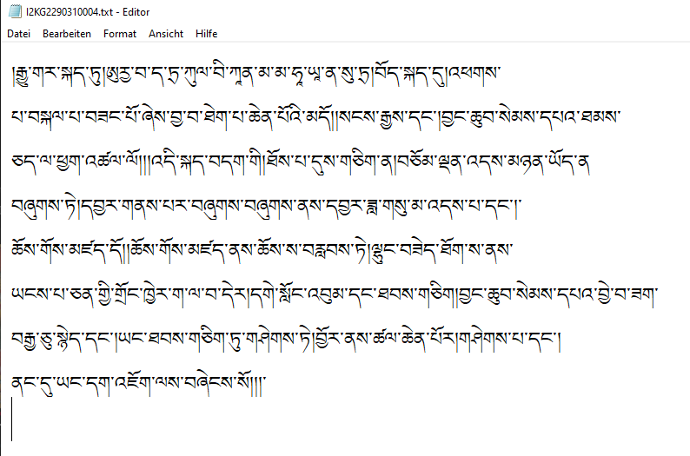
OCR/HTR: Post Processing - Raw Data I
Possibility of .txt, .json or .xml files
One .txt file per page

Slide 7
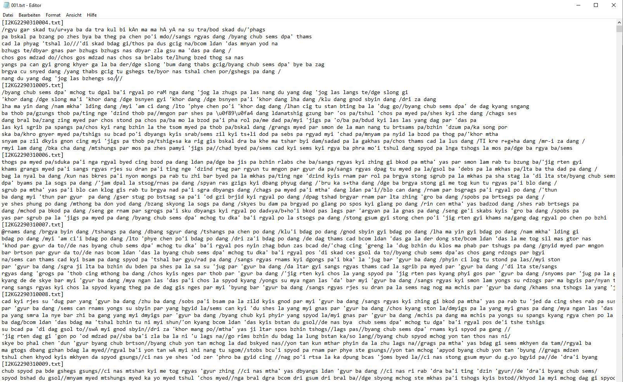
OCR/HTR: Post Processing - Raw Data II

Slide 8
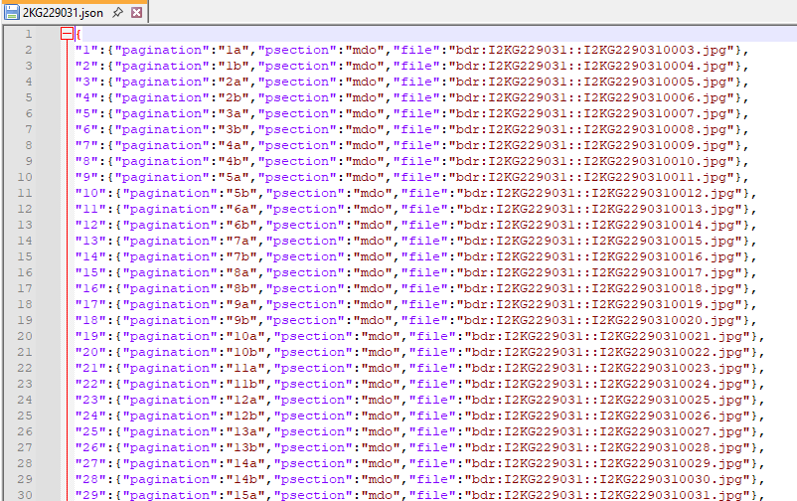
OCR/HTR: Post-processing - rKTs Data Base
Combining rKTs data (json index files of images) with raw .txt files.
Each "pagination" is associated with an index drawn from the image number. For example I2KG2290310004 for 1b.
The corresponding e-text is retrieved from the raw .txt file.

Slide 9
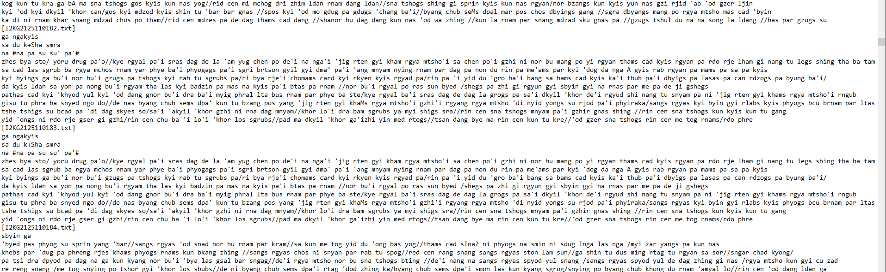
OCR/HTR: Post-processing - Noise reduction

Slide 10
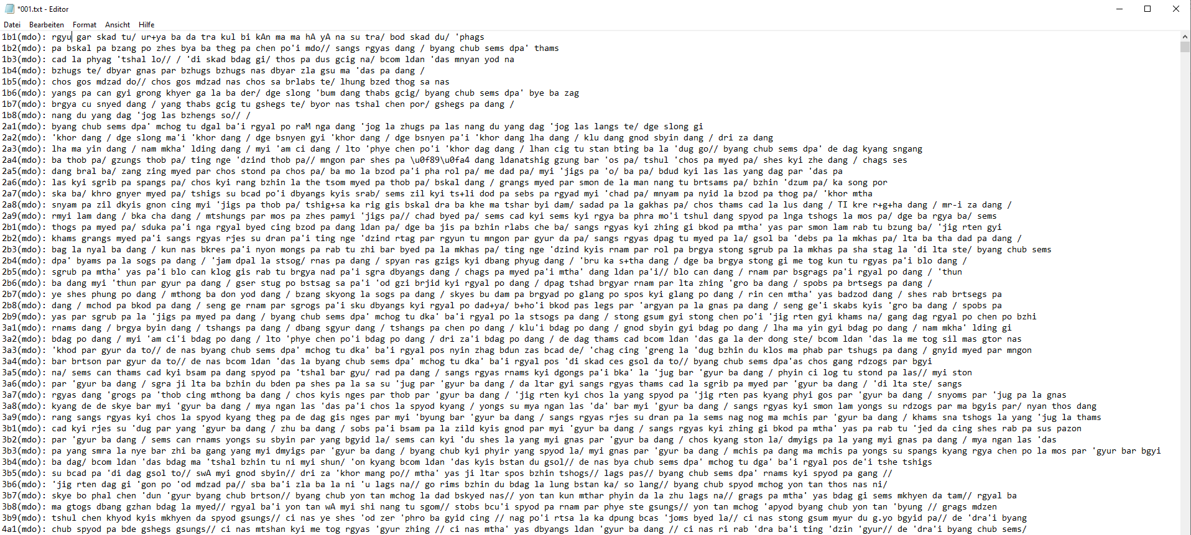
OCR/HTR: Post-processing - Generated e-texts

Slide 11
Todos / Work in Progress
Amelioration of the OCR models:
One model vs. many models?
Post-processing of the e-texts.
  Alignment of various versions
  Automated correction of e-text: challenges
Central repository for canonical e-texts.

Slide 12
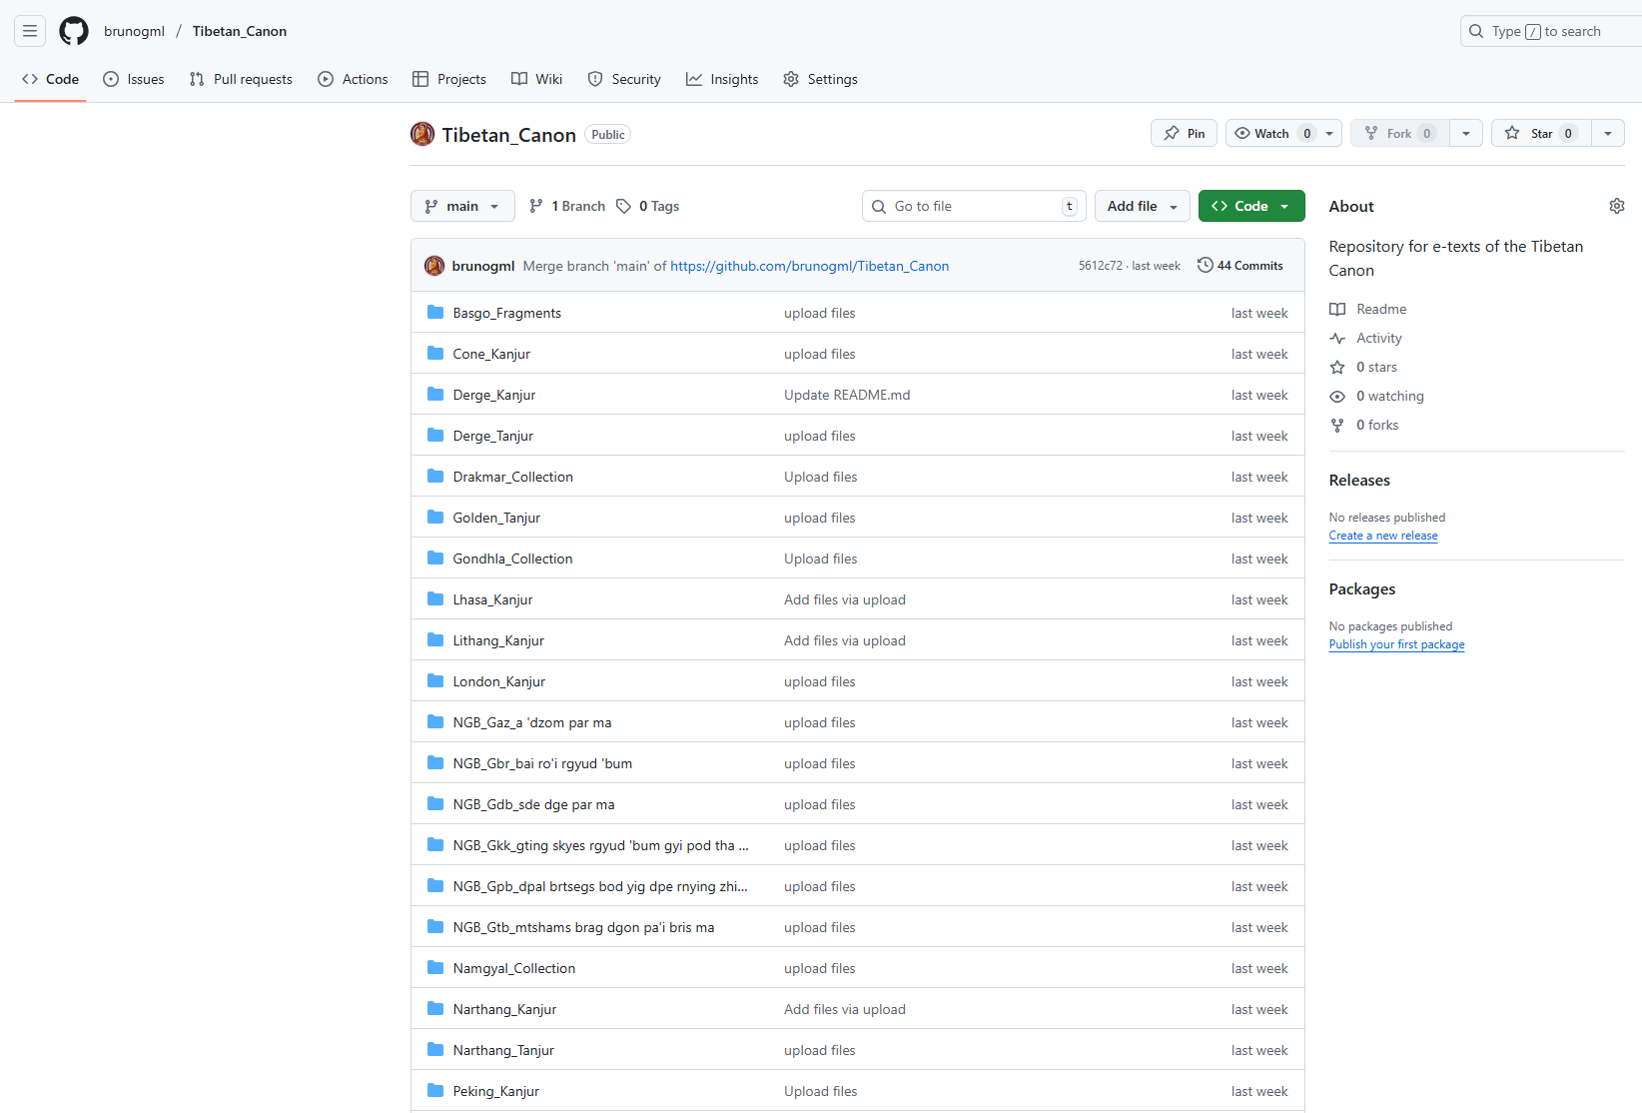
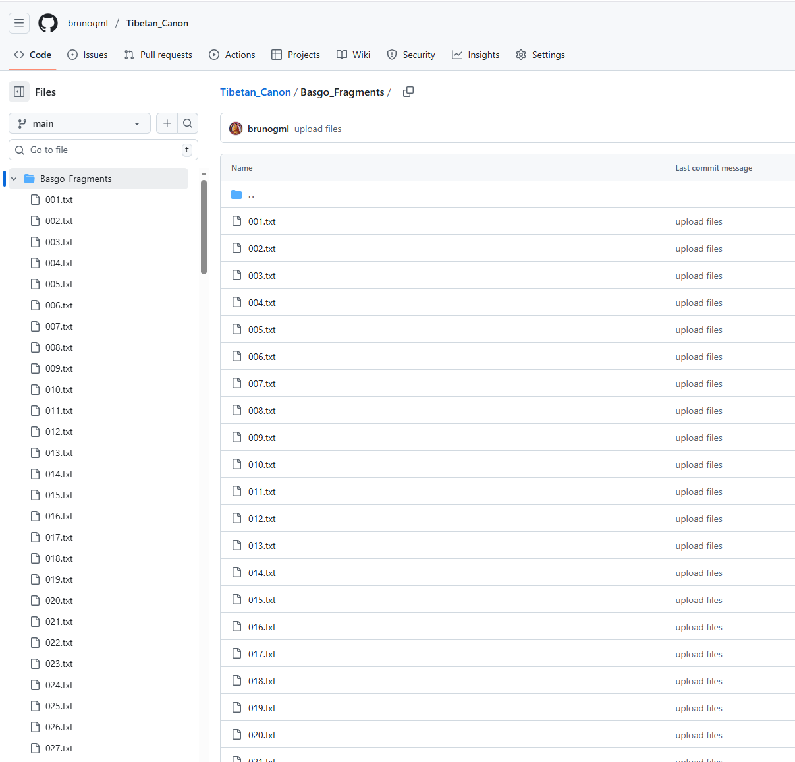
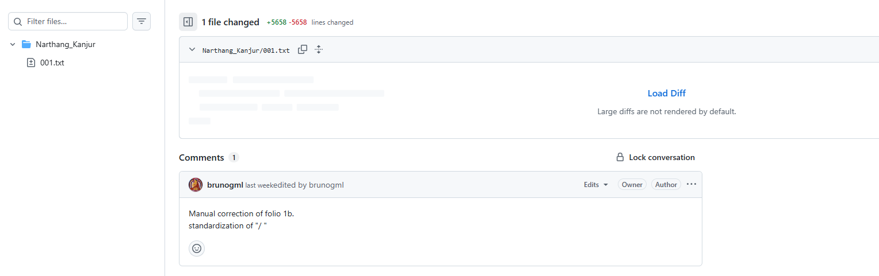
Text repository

Slide 13
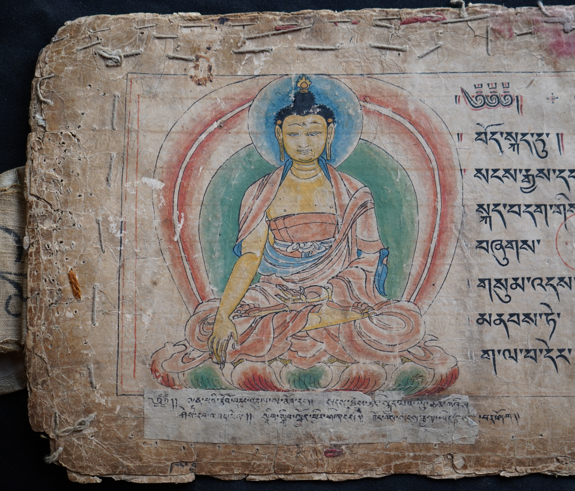
Many thanks!
ཐུགས་རྗེ་ཆེ།

