Slide 1
Frequency generator
Hardware software project
Antoine COLLET & Bruno HOUGARDY
Antoine.COLLET@umons.ac.be – Bruno.HOUGARDY@umons.ac.be

Slide 2
Outline
Context
Tasks & getting started
Hardware implementation
Software implementation
Loading on the board
Running & results

Slide 3
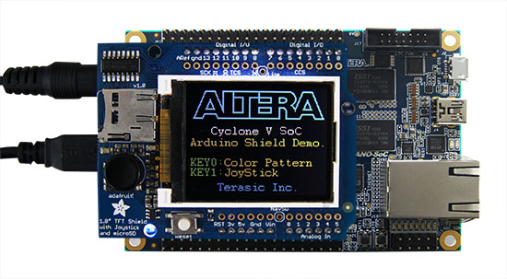
Context
SoC design on a FPGA using VHDL
Quartus environment to create the drivers
Putty program to communicate with the board (USB or Ethernet)
Board : DE0-Nano-SoC development kit

Slide 4
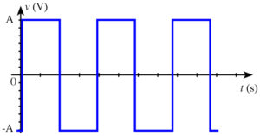
Task
Create a variable frequency generator :
Frequency range : 1 kHz to 1 MHz
Input value stored in an 8-bit vector
Internal clock frequency : 50 MHz
Reset_n : 1 -> 0

Slide 5
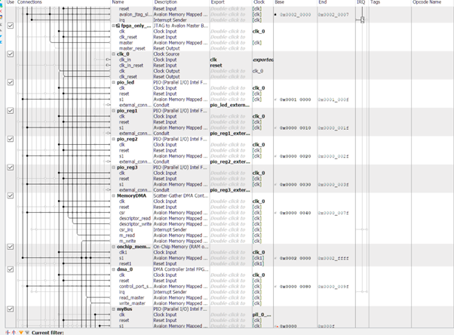
Getting started
Launching the project in Quartus with “FPGA.qpf” file
Display of the Plateform Designer tool :
Provides view of the key components on the board and their interconnections

Slide 6
Hardware implementation
Process file is “FreqOut.vhd”
4 inputs :
- CLK
- Resetn
- reg1enable
- reg0value (input data -> 8 bit vector)
1 output :
- gpio0
Output set at 1 then 0, how long (how much clock period) ?
Internal clock of 50Mhz (period=20ns)
Minimal frequency is 1kHz (1000µs) -> 50 000 clock counts
Maximal frequency is 1 MHz (1µs) -> 50 clock count
Step to navigate the frequency range : (1 Mhz – 1 kHz)/255 = 3917 Hz)
Output pin will stay at 1 then 0 during the corresponding period (pulse)

Slide 7
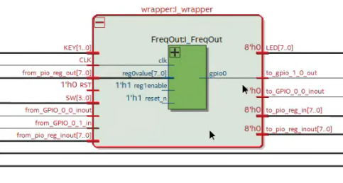
Hardware implementation
Test bench :
Simulation environment for our FreqOut.vhd file
Testing different inputs
Checking of the design
Wrapper:

Slide 8
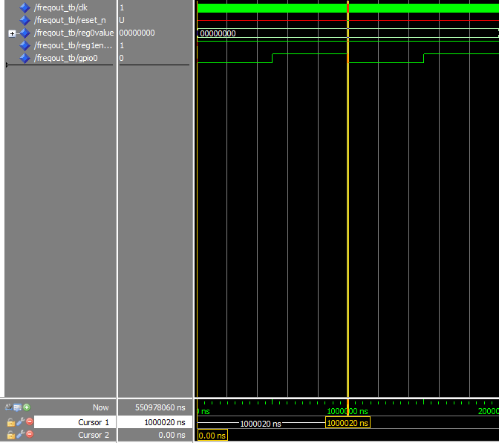
Hardware implementation
Simulation results :
Input is 0000 0000
-> 1 kHz asked
Period seen : 1 000 020 ns ±= 1 000 µs
-> OK !

Slide 9
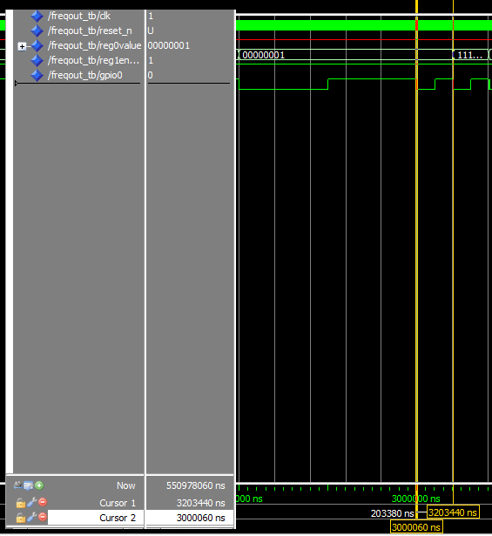
Hardware implementation
Simulation results :
Input is 0000 0001
-> 5 kHz asked
Period seen : 203 380 ns ±= 200 µs
-> OK !

Slide 10
Software implementation
#C environment :
User enters frequency value between 1 kHz & 1 MHz
#C code place the value in the correct frequency range
Write of an 8-bit vector
Example :
1 kHz -> 1st range -> 0000 0000 vector
5 kHz -> 2 nd range -> 0000 0001 vector
etc !
- Software transmits the vector to the FPGA

Slide 11
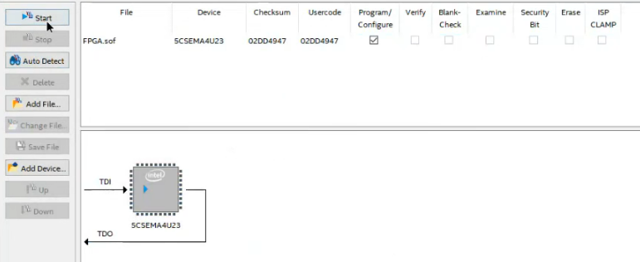
Loading
Programming the FPGA with our driver

Slide 12
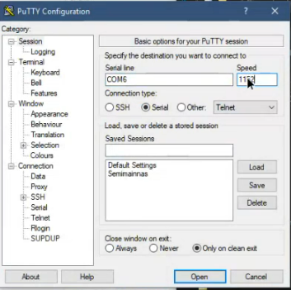
Loading
Establishing the communication between PC and board via Putty :

Slide 13
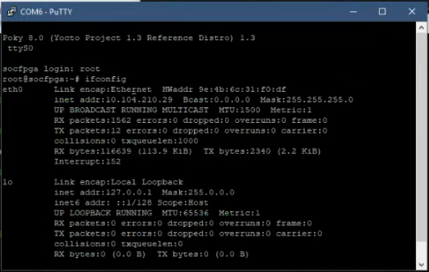
Loading
IP address search : ifconfig command

Slide 14
Loading
Final steps :
Start the SoC EDS shell
Main.c file previously made a executable file for Linux OS of the board -> HPS_app
Transfer HPS_app to the board with this command : « scp HPS_APP root@BOARD_IP:/root:/ »
Running file can now be used on the board with the following command : « ./HPS_APP » in the Putty terminal »

Slide 15
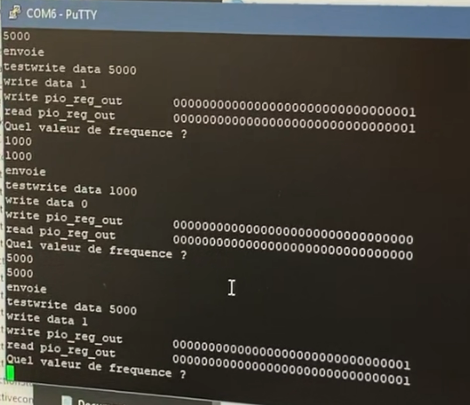
Running
Frequency chosen :
5 kHz

Slide 16
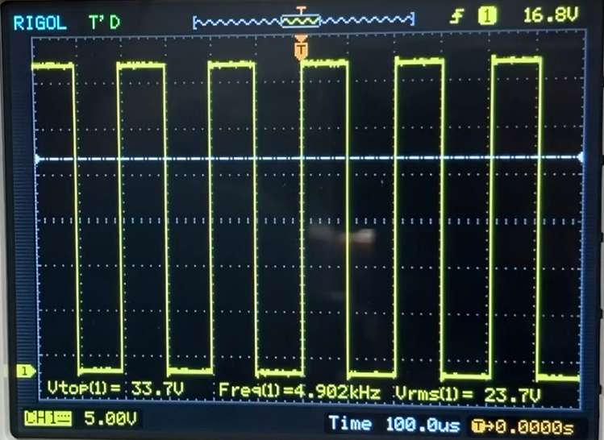
Results

Slide 17
Other informations
Github link : https://github.com/brunohou/Hardware_Software_Frequency_Generator
Youtube video link : https://youtu.be/cjkrS4RvQGY

