Slide 1
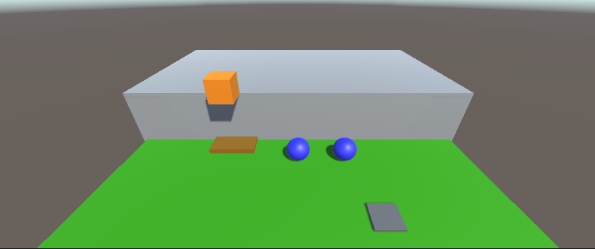
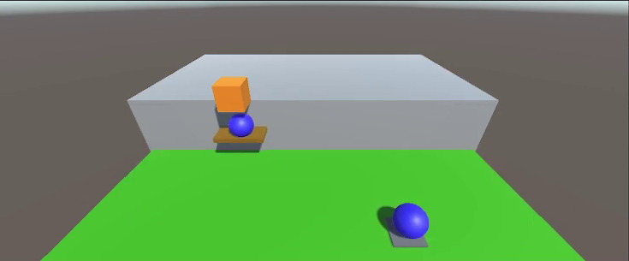
Custom DQN Trainer for Unity ml-agents
+0.5 single reward for agent on platform or on the activator
-0.4 single penalty and -0.1 group penalty for falling
+ 2 group reward if agents are correctly located
-0.1/Max Env Steps group penalty for taking too long
+100 group reward for reaching the target
Vector Observation: 16
Continuous Action: 2

Slide 2
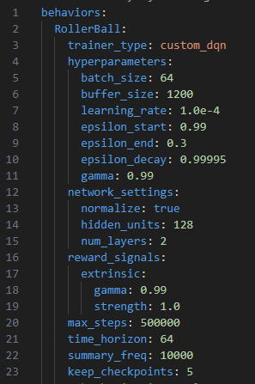
Custom DQN Trainer collect experience from the unity environment and adds it to a replay buffer
Policy evaluates an action with ε-greedy strategy
total_reward = single_reward + group_reward
Compute Q-values for the current observations and actions
Compute Q-values for the next observations
Compute target Q-values
Compute MSE loss and update gradients of Q-Network
Periodically update weights of Q-Target with those of the Q-Network
len(replay_buffer)> batch_size
agent_ball_config.yaml
Update ε value

Slide 3
