Slide 1
High Performance Computing Simulations of Microscale Ion Traps Operated at High Pressure using CITSIM (Collision Ion Trap Simulator)
Bruno Coupier

Slide 2
Staff scientist, Ramsey Lab, UNC 2011-2017
Development of a portable ion trap mass spectrometer based on the technology of microscale ion traps operated in the low vacuum range (~1-10 Torr).
I was in charge of the development of high performance simulation programs for the modelling of the system, CITSIM for Collisional Ion Trap Simulator. It featured:
Ions Trajectories calculation on multicore architecture and GPU
Realistic model of ions-gaz collision
Impact of Rarefied gas flow in microscale ions traps using Lattice Boltzmann Method or Direct Simulation Monte Carlo (DSMC).
Notes:
<number>

Slide 3
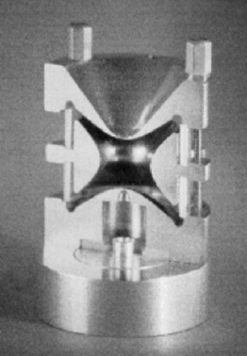
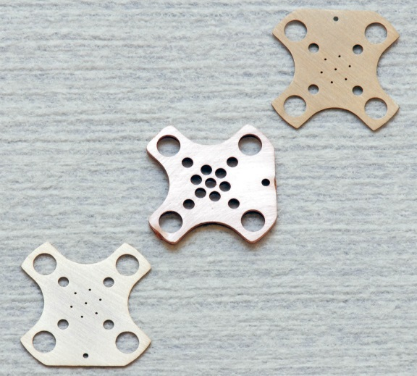

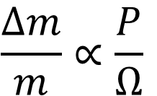
Micro Mass Spec Project
Achieve portability through:
Miniaturization
Allowing mass spectrometry at high pressures
$\frac{∆m}{m}∝\frac{P}{Ω}$
Notes:
<number>

Slide 4
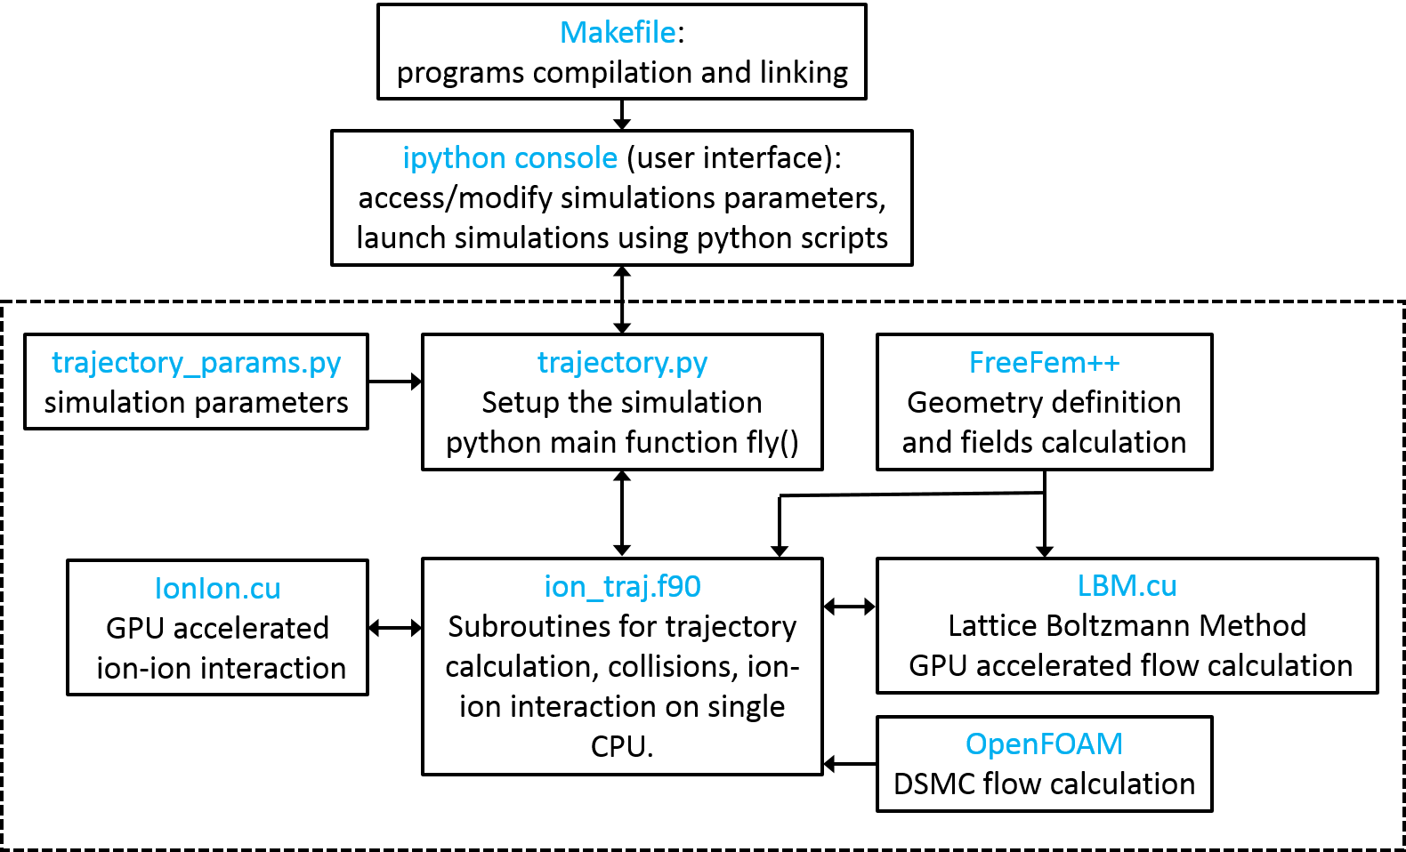
CITSIM Schematic
Subroutines for trajectory calculation, collisions and ion-ion interaction on multi-cores architecture

Slide 5
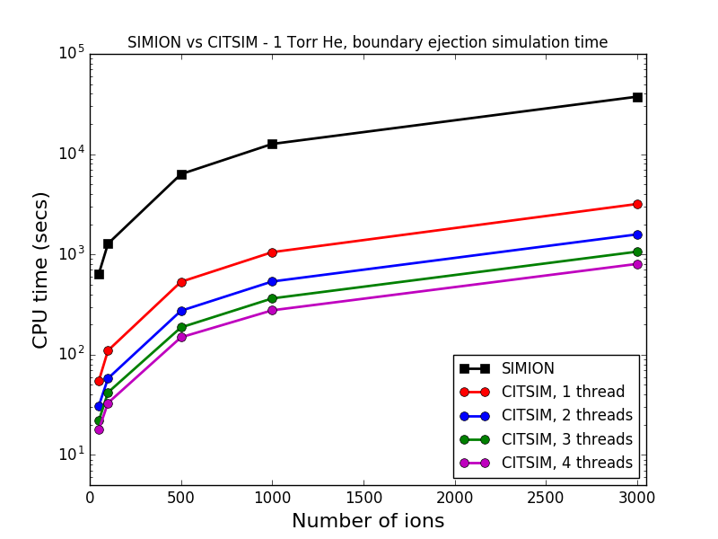
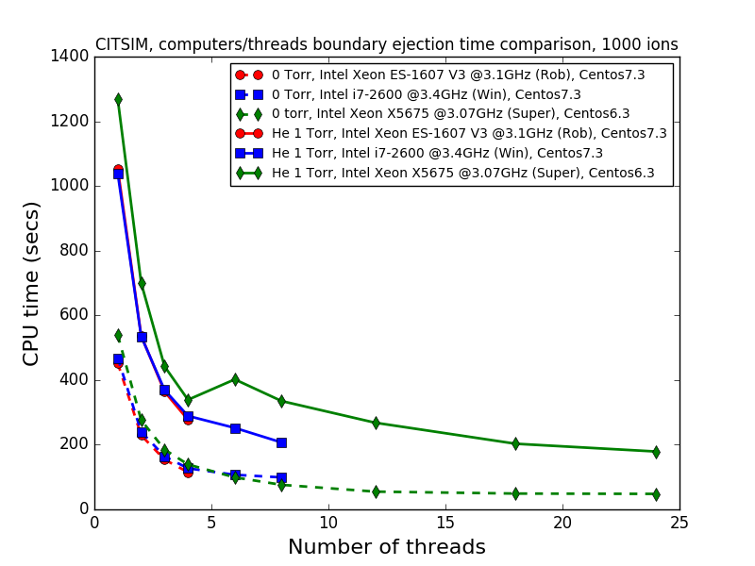
Computational speed improvement compared to Simion3D
A speed up ×46 with respect to SIMION at high pressure and ×200 without collisions.
Use of OpenMP directives to distribute calculations over the cores. A speed up by a factor n roughly achieved by n threads (weak scaling): code is highly parallelizable.
Notes:
Speed *46 with respect to SIMION at high pressure and *200 without collisions
!Define chunk_size(num_threads)
chunk_size=nIons/num_threads
IF (MOD(nIons,num_threads)==0) THEN
chunk_size(num_threads)=nIons/num_threads
ELSE
chunk_size(num_threads)=chunk_size(1)+MOD(nIons,num_threads)
END IF
!~ seed=(/437395160,1404128605,572505362,-1187264075,454383258,&
!~ 525702629,973594203,1758310677/)
!~ call random_seed(put=seed)
!$ call omp_set_num_threads(num_threads)
!$omp parallel do private(thread_num,cindex)
DO c=1,num_threads
cindex=(c-1)*chunk_size(1)
!$omp single
print *, "num_threads=",num_threads
!$omp end single
!IF (.NOT. InTrap(l)) CYCLE
!~ !$omp critical
!~ !$ thread_num = omp_get_thread_num()
!~ !$ print *, "parallel do loop Start !!!!!!!!!!!!!!!!!!!!!!!!!!!!!!!!!!!!!!!!!!!!!!!!!!!!"
!~ !$ print *, "This thread = ",thread_num,", #ion=",l
!~ !$ print *, "tnow=",tnow
!~ PRINT *,"******************************************************************************"
!~ PRINT *,Active
!~ !$omp end critical
!~
DO WHILE (tnow(c)<tfin)
its(c)=its(c)+1 !time steps counter (bruno)
!Active ions are created randomly within the first RF cycle or at regular dtBirths/nIons (bruno)
!~ !$omp critical
!~ !$ print *, "This thread = ",thread_num, ", its=",its,", #ion=",l
!~ !$omp end critical
!~
IF (tnow(c)<RFperiod) THEN
!~ !$omp single
SELECT CASE (tBirth)
CASE (0) ! random times of birth
!~ PRINT *,"tnow(c)=",tnow(c)
!~ PRINT *,"tBirths=",tBirths
WHERE (tnow(c) .GT. tBirths(cindex+1:cindex+chunk_size(c))) Active(cindex+1:cindex+chunk_size(c)) = .TRUE.
!~ PRINT *,"******************************************************************************"
!~ PRINT *,Active
!~ !$ thread_num = omp_get_thread_num()
!~ !$ print *, "This thread = ",thread_num, ", its=",its,", #chunk=",c
!~ CASE (1) ! regular times of birth
!~ nActive = MIN(CEILING((tnow(l)-tini)/dtBirth)*nIons,nIons)
!~ Active(1:nActive) = .TRUE.
CASE (2) ! fixed times of birth
IF (tnow(c)>params(53)) THEN
Active(1:nIons) = .TRUE.
END IF
END SELECT
!~ !$omp end single
END IF
!~ IF (.NOT. Active(l)) THEN
!~ tnow(l)=tnow(l)+dt
!~ CYCLE
!~ END IF
XF(1:nDim,cindex+1:cindex+chunk_size(c)) = X(1:nDim,2,cindex+1:cindex+chunk_size(c)) ! X for forces at midpoint
! Determine if ions still inside the trap
DO l=1,chunk_size(c)
! Conditions to determine if ions are still within the trap
IF (InTrap(cindex+l) .AND. ((XF(1,cindex+l)<0) .OR. (XF(1,cindex+l)>nx) .OR. &
((XF(2,cindex+l)**2+XF(3,cindex+l)**2)>ny**2))) THEN
InTrap(cindex+l) = .FALSE.
!~ InTrapN(cindex+l) = 0.
!nbIonExit=nbIonExit+1
IonExit(cindex+l,0) = tnow(c)
IonExit(cindex+l,1:nDim) = hGrid*X(1:nDim,2,cindex+l) + Xmin(1:nDim)
IonExit(cindex+l,nDim+1:2*nDim) = (X(1:nDim,2,cindex+l)-X(1:nDim,1,cindex+l))/dt*hGrid
IonExit(cindex+l,2*nDim+1:3*nDim) = hGrid*X(1:nDim,1,cindex+l) + Xmin(1:nDim)
!$omp critical
PRINT 1001,cindex+l,mIon(cindex+l),cIon(cindex+l),&
csIon(cindex+l)*1e13,IonExit(cindex+l,1),IonExit(cindex+l,2)&
,IonExit(cindex+l,3),tnow(c),inxtplt(c)+1 !added IonExit(l,3) for 3D
1001 FORMAT('Ion ',i5,' of mass ',F8.1,' amu, charge ', F4.1,'+ and ccs ',E10.4,&
' mm^2 has moved out of trap area at x='&
,F8.4,'(mm) y=',F8.4,'(mm) z=',F8.4,'(mm) t=',F10.5,'(ms) iplt=',i7)
!$omp end critical
!IF (axfmode==2) THEN
! OPEN(UNIT=17,FILE='results/axf_ejection_log.txt',FORM='FORMATTED',POSITION='APPEND')
! WRITE(17,*) 1001,l,mIon(l),cIon(l),csIon(l)*1e13,IonExit(l,1),IonExit(l,2),IonExit(l,3),tnow,inxtplt+1
! CLOSE(17)
!END IF
!~ ELSE IF (InTrap(cindex+l)) THEN
!~ ! Calculate avg KE, avg flight distance, avg dist. to center (DTC) (bruno)
!~ ! saving average velocity2
!~ V2avg(its(c)) = V2avg(its(c)) + SUM((X(:,2,cindex+l) - X(:,1,cindex+l))**2)! need /dt2*hGrid2 for mm2/ms2
!~ d2=(X(cindex+l,1:nDim,2)-X(cindex+l,1:nDim,1))**2
!~ AvgKESum(cindex+l)=AvgKESum(cindex+l)+d2(1)+d2(2)+d2(3) !+d2(3) one more component in 3D (bruno)
!~ AvgDistSum(cindex+l)=AvgDistSum(cindex+l)+SQRT(d2(1)+d2(2)+d2(3))!+d2(3) one more component in 3D (bruno)
!~ AvgDTCSum(cindex+l)=AvgDTCSum(cindex+l)+SQRT((X(cindex+l,1,2)+Xmin(1)/hGrid)**2+&
!~ (X(cindex+l,2,2)-Xmin(2)/hGrid)**2+(X(cindex+l,3,2)-Xmin(3)/hGrid)**2)
END IF
END DO
<number>

Slide 6
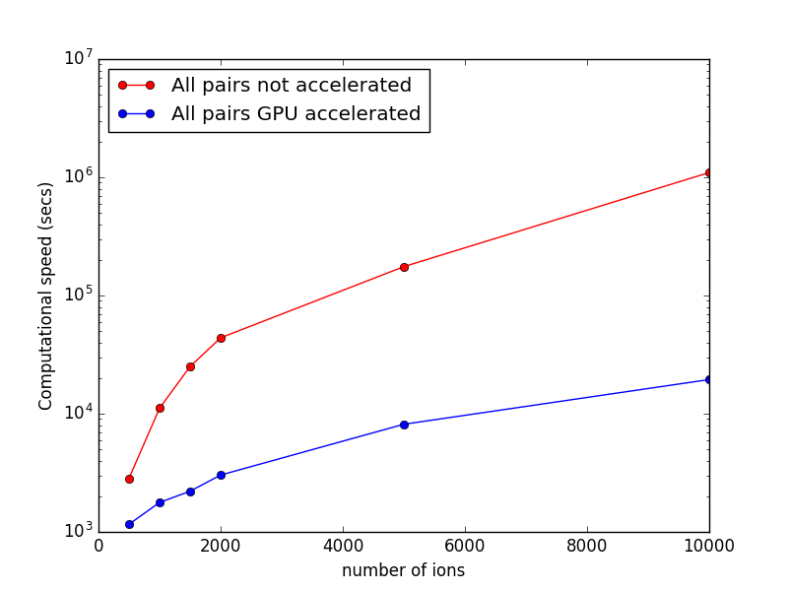
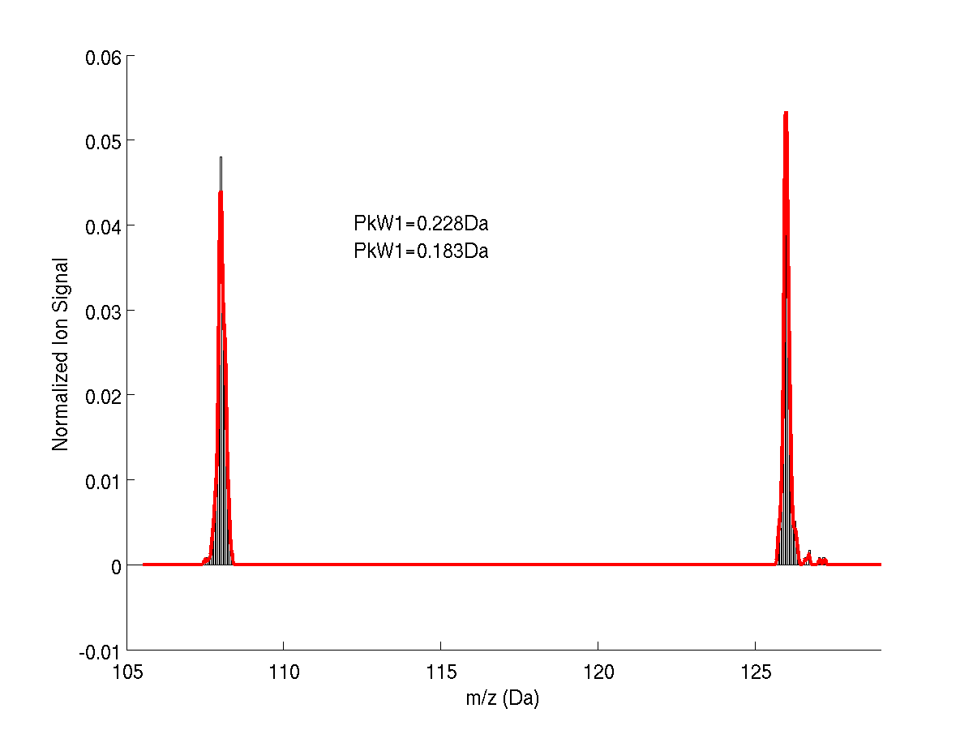
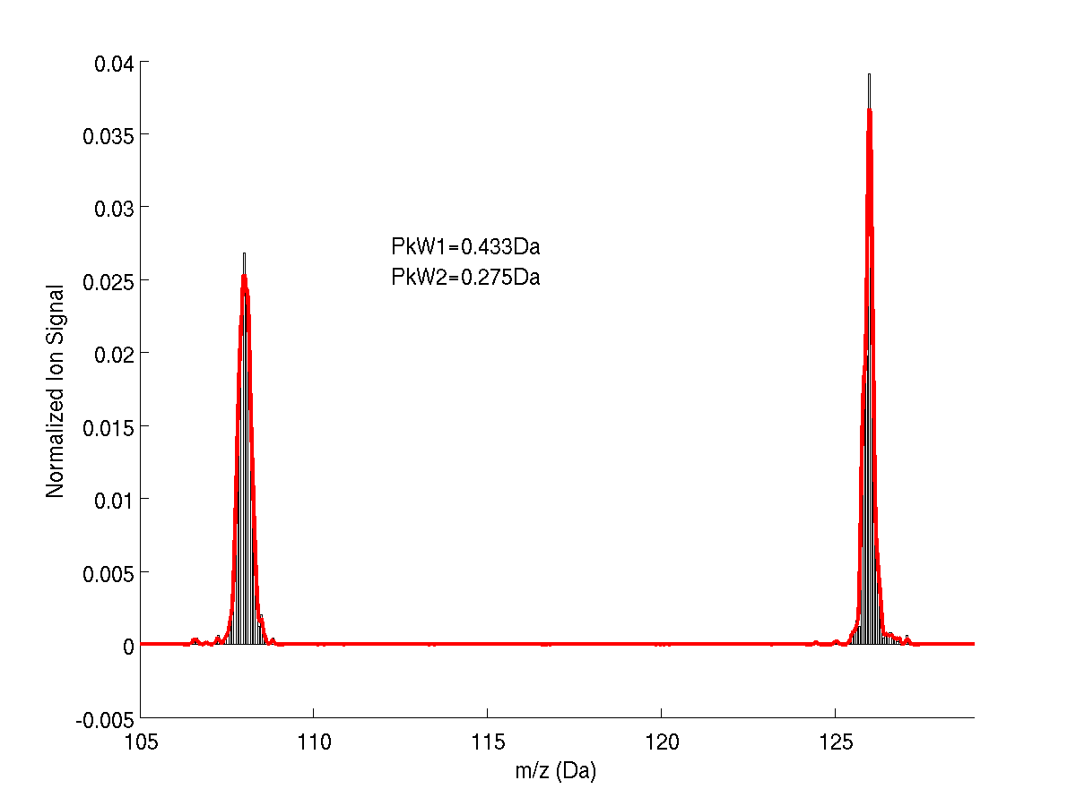
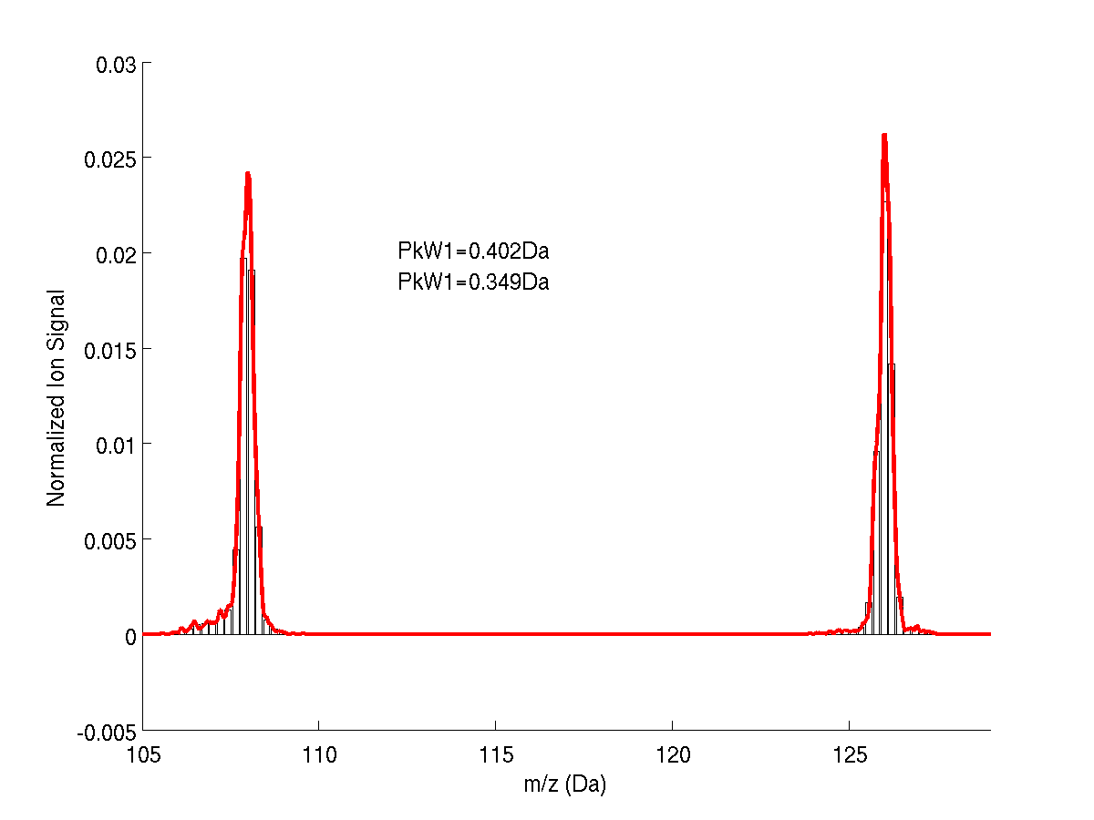
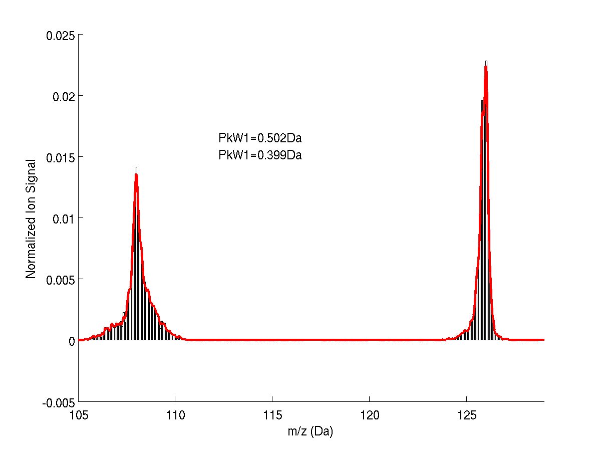
Ion-Ion interaction GPU acceleration
500 ions
2000 ions
5000 ions
10000 ions
Computational complexity is effectively reduced from O(N^2) to nearly O(N) for practical number of ions N: A 0.1 ms flight of N=5000 ions takes 14 mins with the GPU compared to 7 hrs 20 mins with the CPU, N=10000 ions takes 25 mins with the GPU while it would take 30 hours with the CPU!

Slide 7
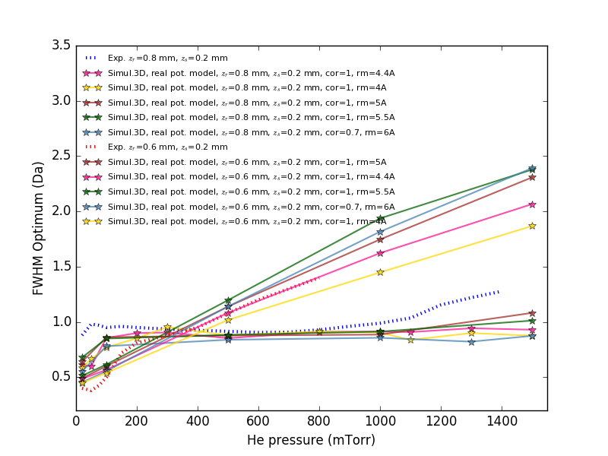
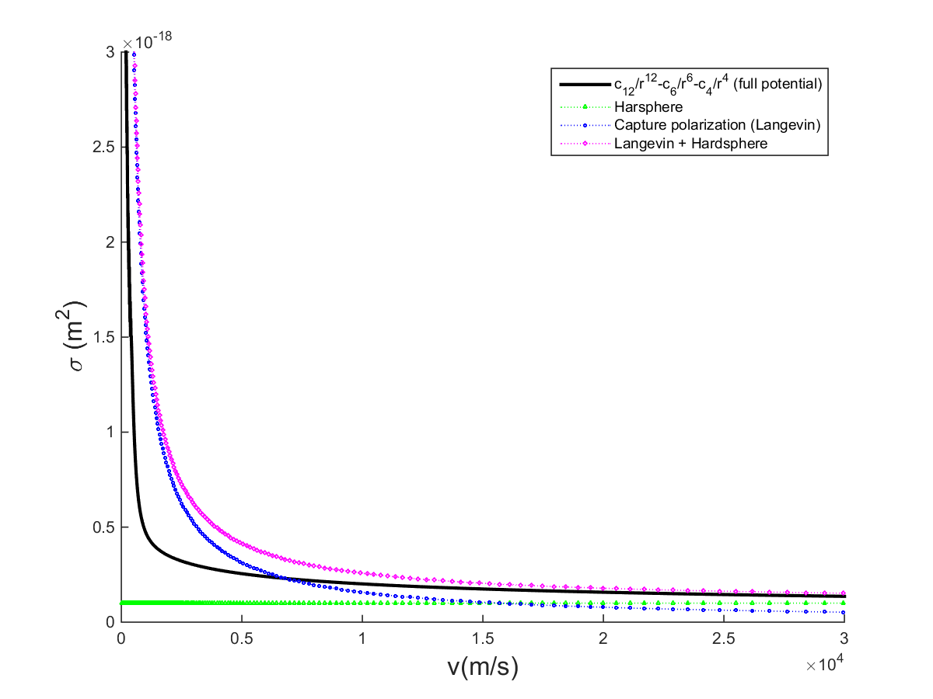
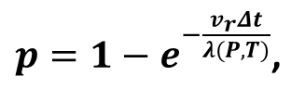
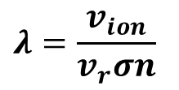
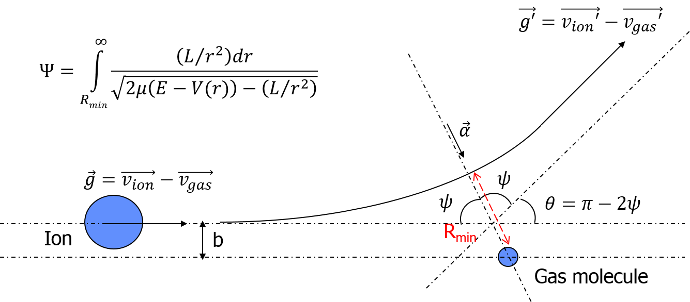
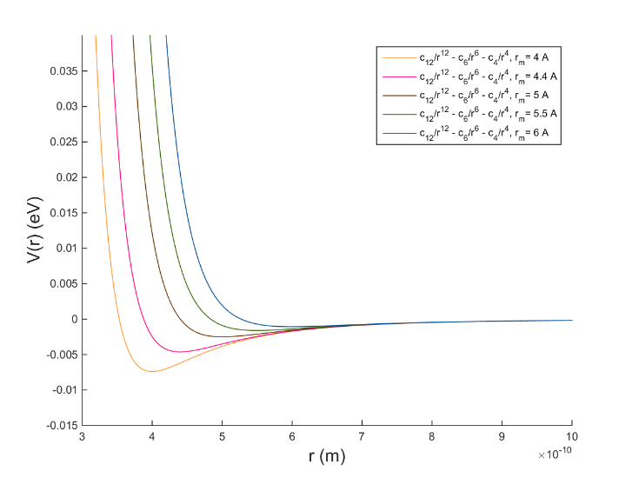
Realistic collision model
,
$λ=\frac{v_{ion}}{v_{r}σn}$

Slide 8
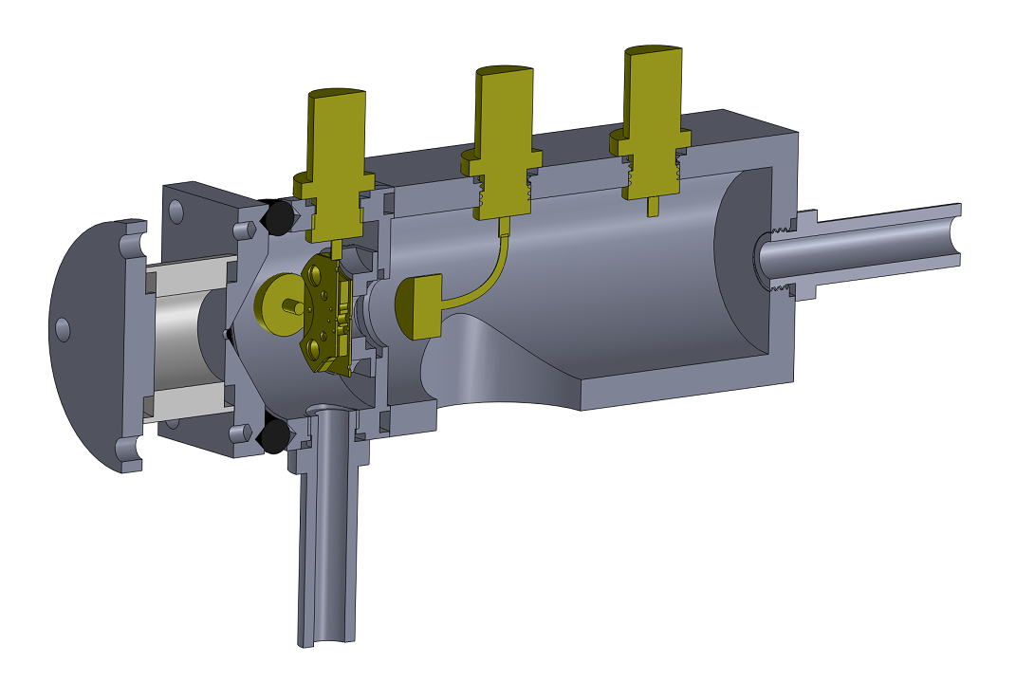
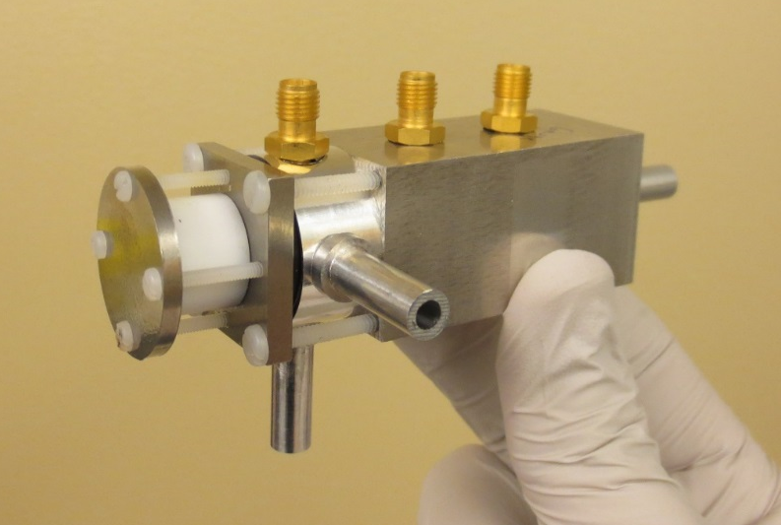
Flow Effect: Experiment
7-Trap
Array
Faraday Cup
Glow
Discharge
Pressure Measurement
P₂: 1-0.1 Torr
P₁: ~1 Torr
Pump
Inlet
+ Pumping
Pressure Measurement
Notes:
<number>

Slide 9
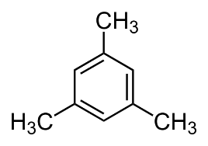
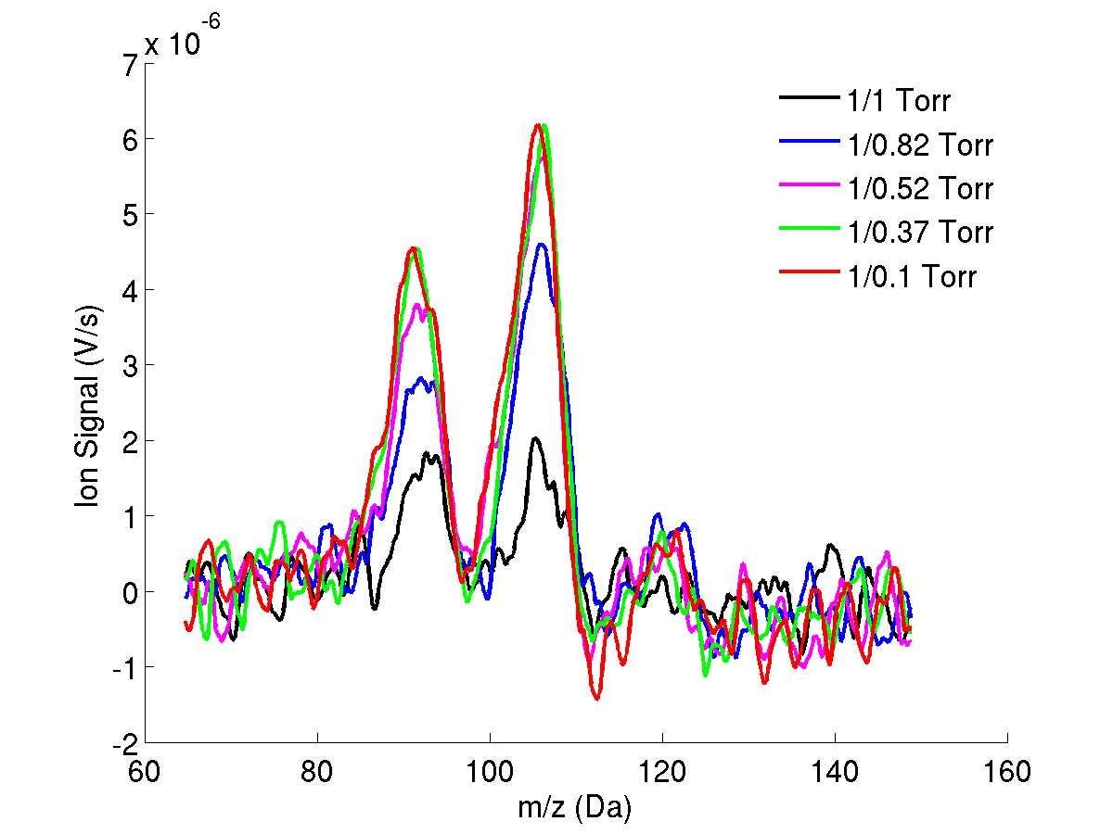
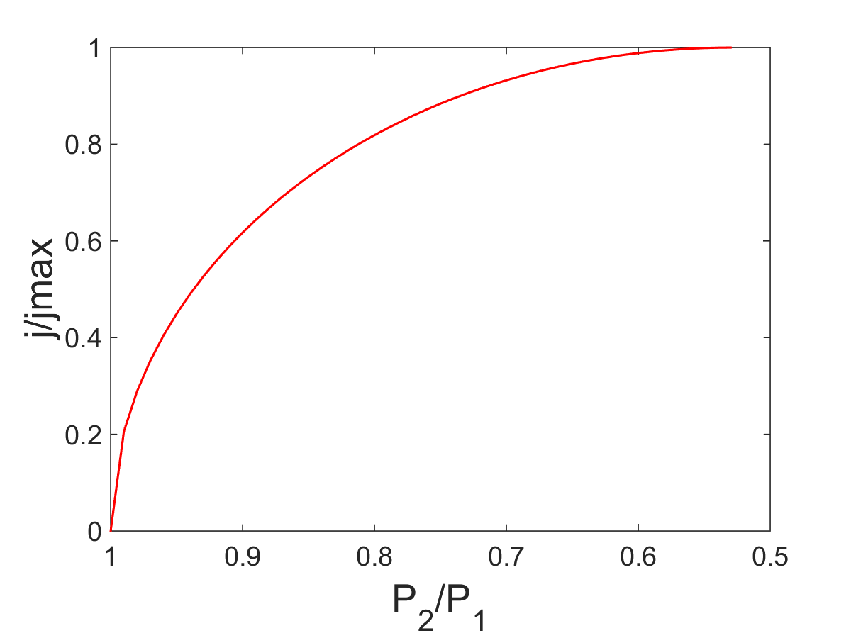
Experimental Result: Ion Signal Enhancement
Theoretical Mass Flow rate j=ρv
P₂*/P₁=0.53
In the continuum flow regime, Bernouilli’s equation for isentropic flow predicts the mass flow j=ρv through a short duct to be choked at a pressure ratio P*₂/P₁ of about 0.53.
Notes:
<number>

Slide 10
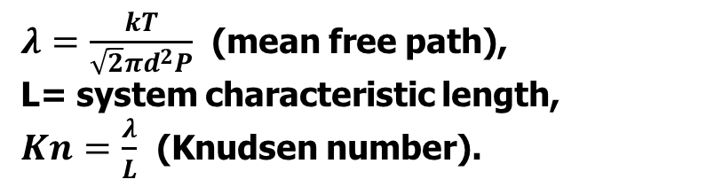
Flow Regime in Micro Ion Traps
Buffer gas | Pressure (mTorr) | MFP λ (mm) | Kn L=1 mm | Kn L=0.1 mm
N₂ | 1 | 54 | 54 | 540
 | 100 | 0.54 | 0.54 | 5.4
 | 500 | 0.11 | 0.11 | 1.1
 | 1000 | 0.054 | 0.054 | 0.54
Kn=0.01
Kn=0.1
Kn=10
free molecular
Continuum
Slip
transition
Navier Stokes
Direct Simulation Monte Carlo
Lattice Boltzmann Method
Notes:
<number>

Slide 11
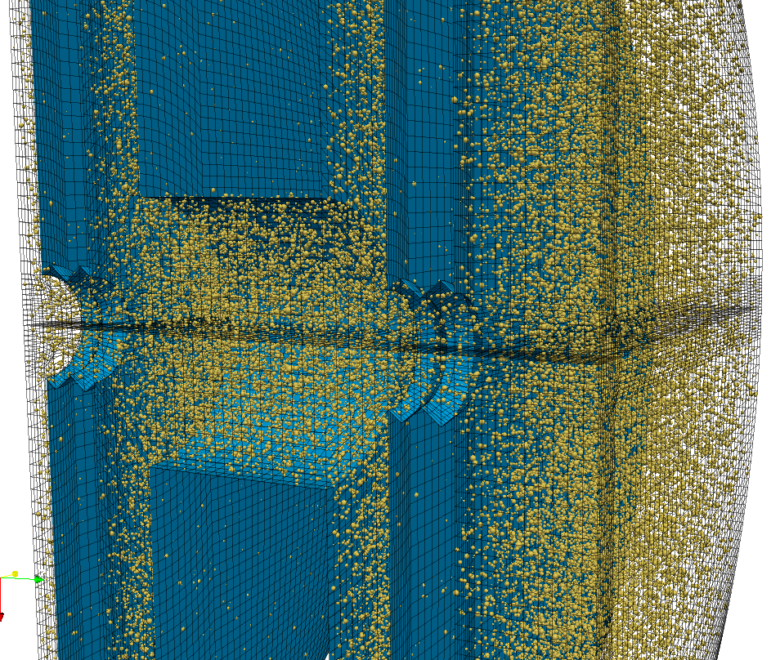
Direct Simulation Monte Carlo (DSMC)
grid size of 50µm ~ λ_{1Torr}
Gold standard method for rarefied flow
dsmcFoamStrath
(Univ. of Strathclyde)
Multiprocessor support
Validated
Computationally intensive
7×10⁵ simulated particles representing
7×10¹² actual particles...
Notes:
<number>

Slide 12
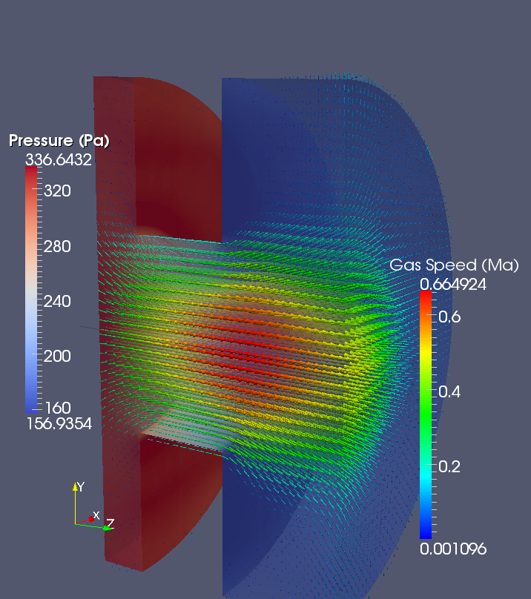
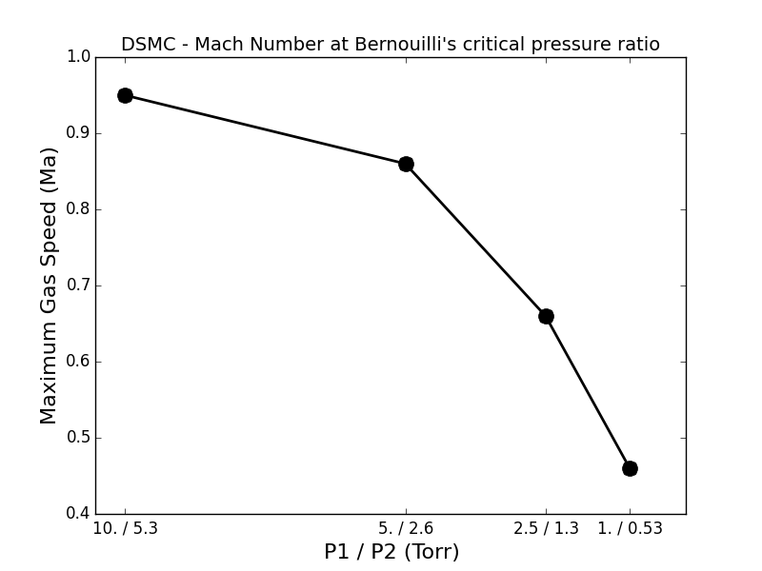
Rarefied Choked Flow
200µm
Continuum
Flow
Slip
Flow
400µm
The critical pressure ratio decreases for rarefied Flow. P₁/P₂*~0.1 for our pressures conditions (1/0.1 Torr)
Notes:
<number>

Slide 13
Gas Flow Configurations
Case 1
Case 2
~1 Torr
~1 Torr
1-0.1 Torr
1-0.1 Torr
Unsealed Trap
Sealed Trap
Notes:
<number>

Slide 14
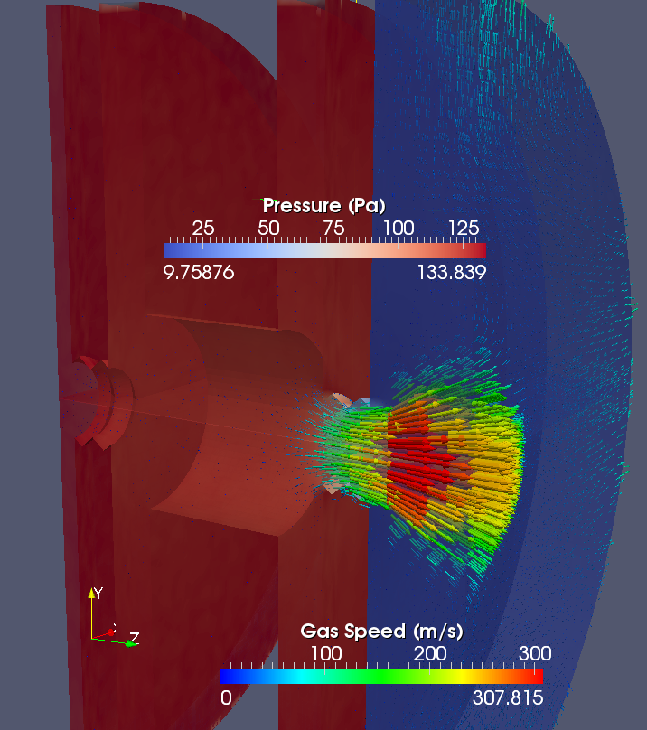
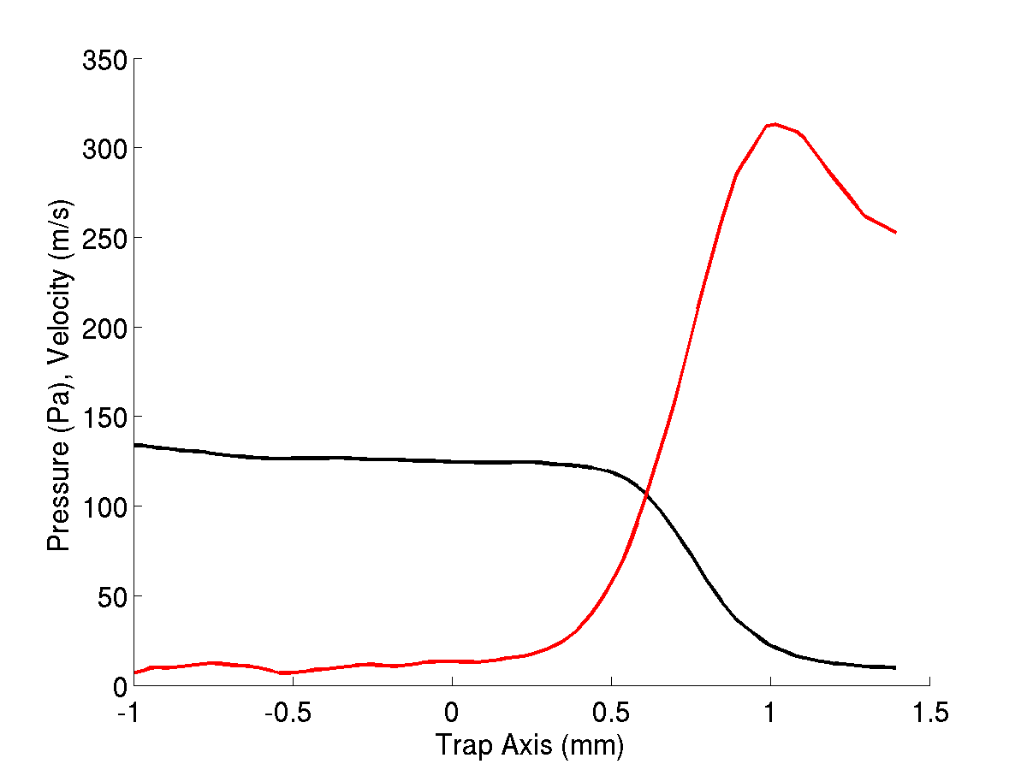
Unsealed Trap: Equalized Pressure
133/13 Pa (1/0.1 Torr)
Gas Velocity
Pressure
Pressure quasi equalized
to 1 Torr (133 Pa) within the trap
Notes:
<number>

Slide 15
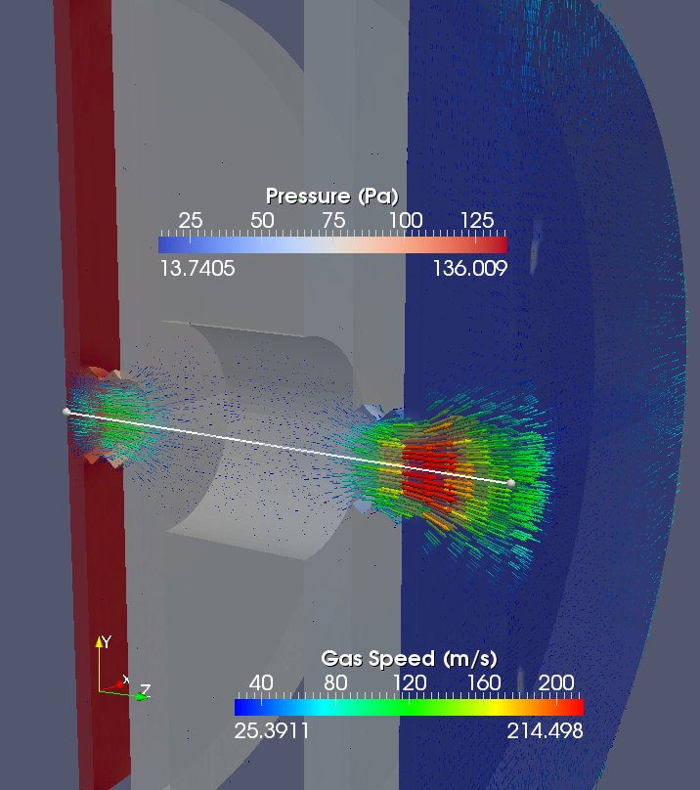
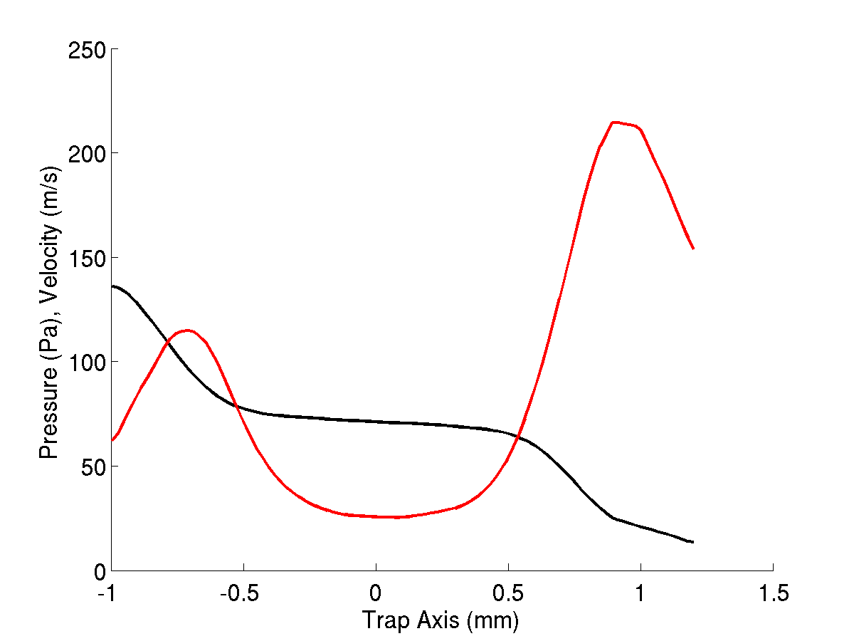

Sealed Trap: Pressure Drop
133/13 Pa (1/0.1 Torr)
Gas Velocity
Pressure
Median pressure 71 Pa
Notes:
<number>

Slide 16
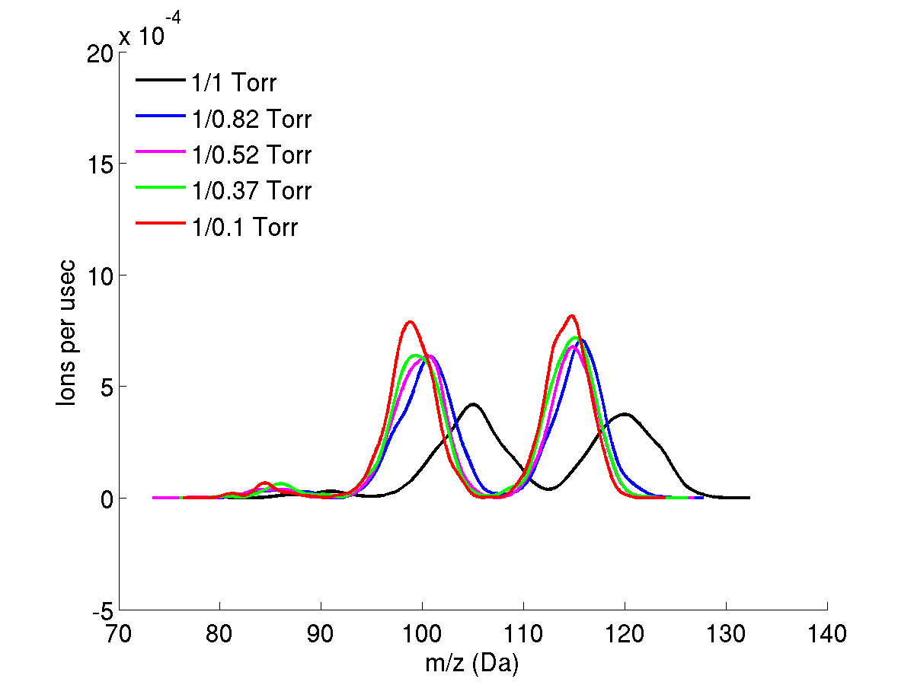
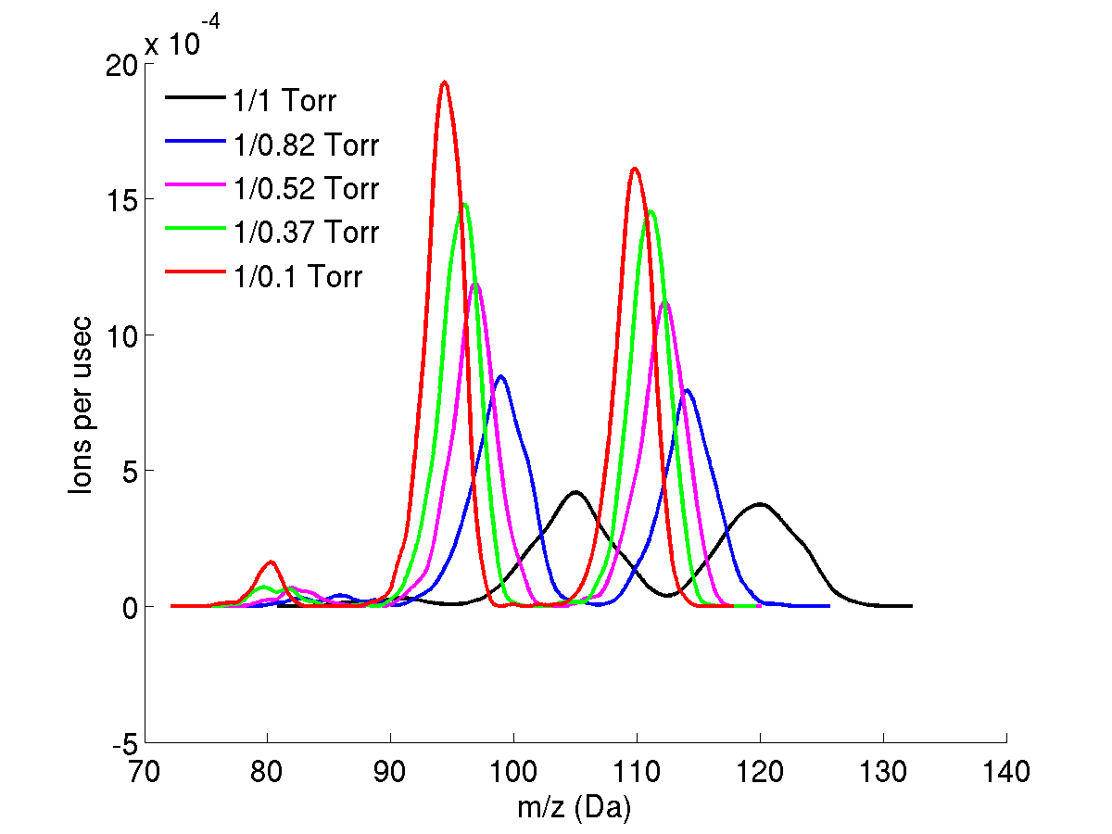
Simulation vs. Experiment
DSMC Unsealed Trap
Experimental
DSMC Sealed Trap
Notes:
<number>

Slide 17
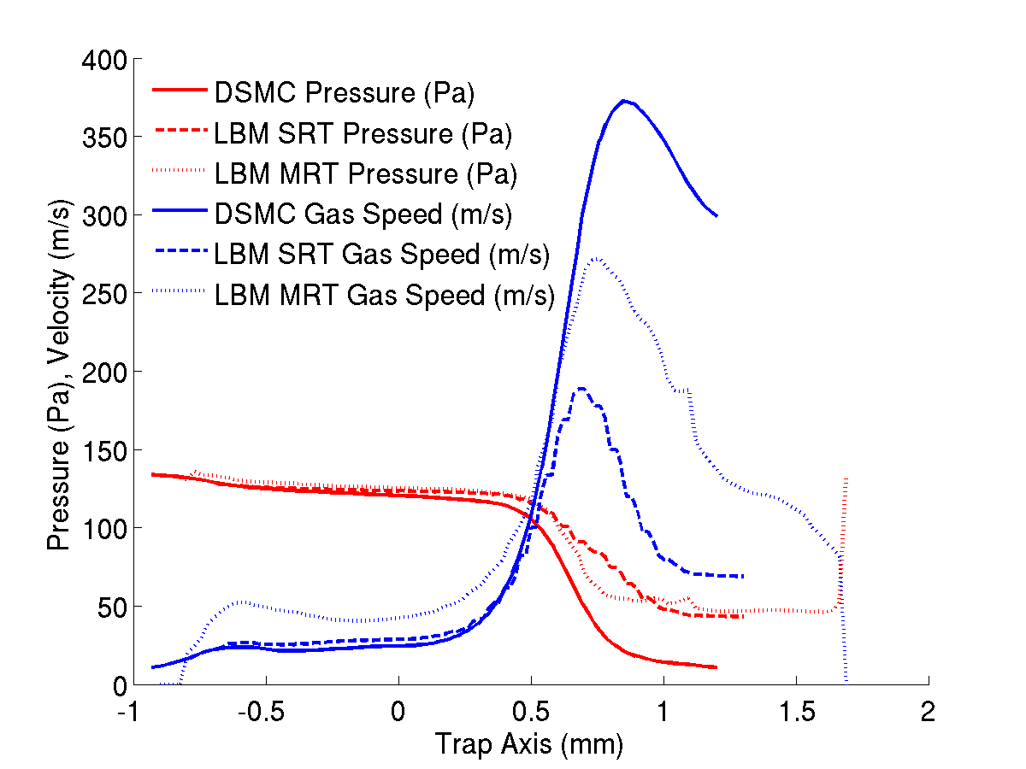
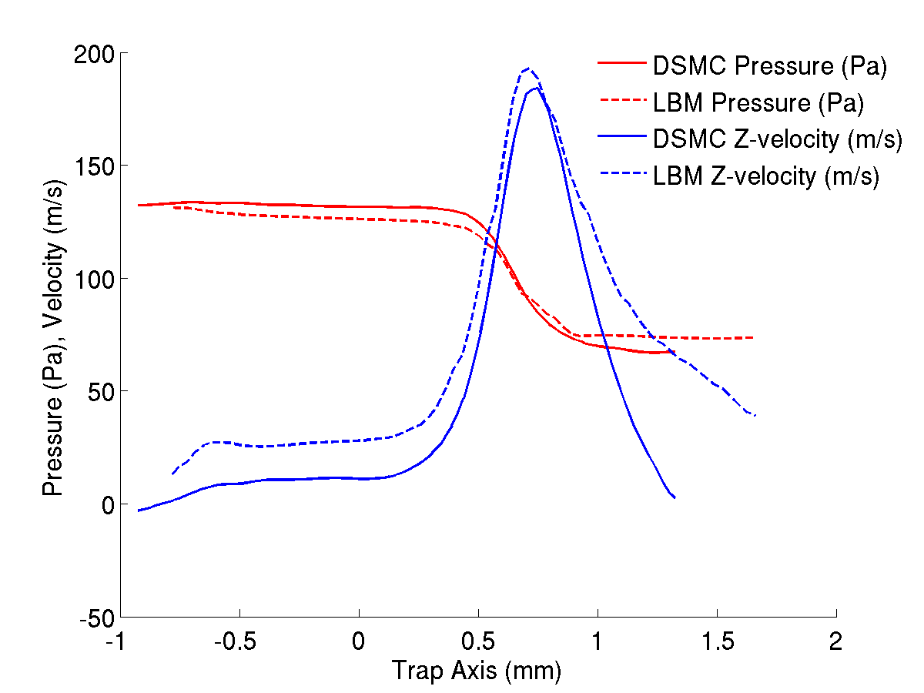
LBM vs DSMC
133/70 Pa
133/13 Pa
LBM Works at all pressure range where DSMC can be used only at low Kn number.
LBM is very fast (minutes), has real time capabilities, while DSMC take hours or days for steady flow calculation.
Simple Model of LBM cannot cope with high speed high Knudsen number flows where compressible and thermic effects cannot be neglected
Notes:
Great advantage of LBM is speed: could even do real time flow calcualtion., whereas it is unthinkable with DSMC.
However LBM models become inadequate for high Knudsen number high speed flow (sonic), still in development.
<number>

Slide 18
Conclusions
With CITSIM, we successfully improved the computational speed combining the use of more suited algorithms and hardware acceleration (GPU, multicore architecture) while maintaining calculation accuracy.
We worked hard on elaborating a collision model using the real potential of interaction and inelasticity. The success of preliminary results in helium buffer gas needs to be confirm in nitrogen.
We worked hard on using Lattice Boltzmann Method for the calculation of rarefied gas flow since it has the great advantage of being much faster and remaining valid over a greater pressure range than the others computational methods.

