Slide 1
Winnig Space Race with Data Science
Bruno Moreno
02-Oct-2022
https://github.com/initiative1972/data-science/blob/master/10-IBM-DS%20capstone-lab7-ML%20prediction.ipynb

Slide 2
Outline
Executive Summary
Introduction
Methodology
Results
Conclusion
Appendix

Slide 3
Executive Summary
Summary of methodologies
Data collection
Data wrangling
EDA with data visualization
EDA with SQL
Building an interactive map with Folium
Building a Dashboard with Plotly Dash
Predictive analysis (Classification)
Summary of all results
EDA results
Interactive analytics
Predictive analysis

Slide 4
Introduction
Project background and context
SpaceX advertises Falcon 9 rocket launches on its website, with a cost of 62 million dollars; other providers cost upward of 165 million dollars each, much of the savings is because SpaceX can reuse the first stage.
Problems you want to find answers
The project task is to predicting if the first stage of the SpaceX Falcon 9 rocket will land successfully

Slide 5
Section 1
Methodology

Slide 6
Methodology
Executive Summary
Data collection methodology:
SpaceX Rest API
Web Scrapping from Wikipedia
Perform data wrangling
One Hot Encoding data fields for Machine Learning and data cleaning of null values and irrelevant columns
Perform exploratory data analysis (EDA) using visualization and SQL
Perform interactive visual analytics using Folium and Plotly Dash
Perform predictive analysis using classification models
LR, KNN, SVM, DT models have been built and evaluated for the best classifier

Slide 7
Data Collection
The following datasets was collected:
SpaceX launch data that is gathered from the SpaceX REST API.
This API will give us data about launches, including information about the rocket used, payload delivered, launch specifications, landing specifications, and landing outcome.
The SpaceX REST API endpoints, or URL, starts with api.spacexdata.com/v4/.
Another popular data source for obtaining Falcon 9 Launch data is web scraping Wikipedia using BeautifulSoup.

Slide 8
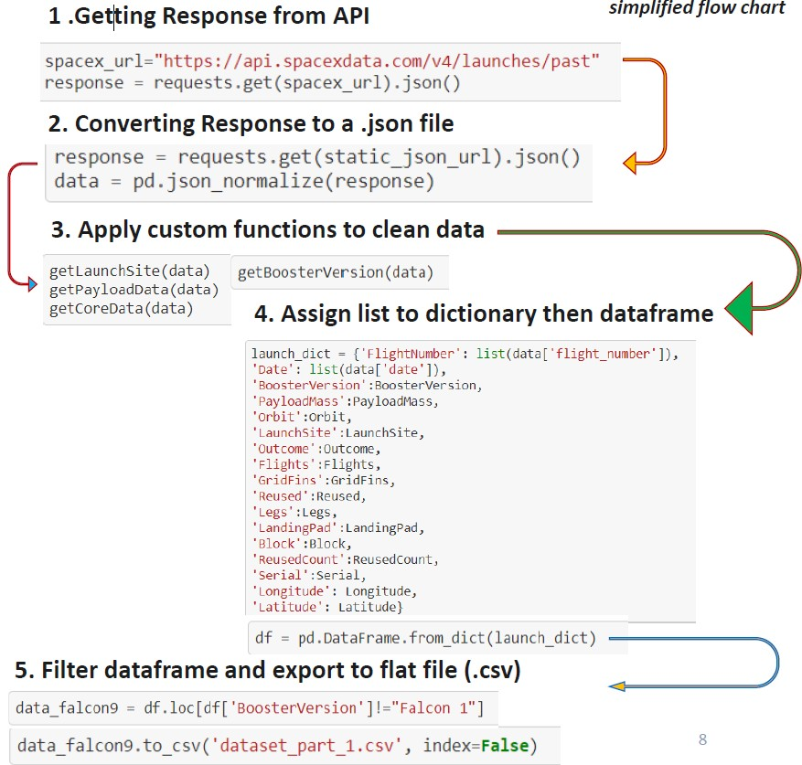
Data Collection – SpaceX API
Data collection with SpaceX REST calls

Slide 9
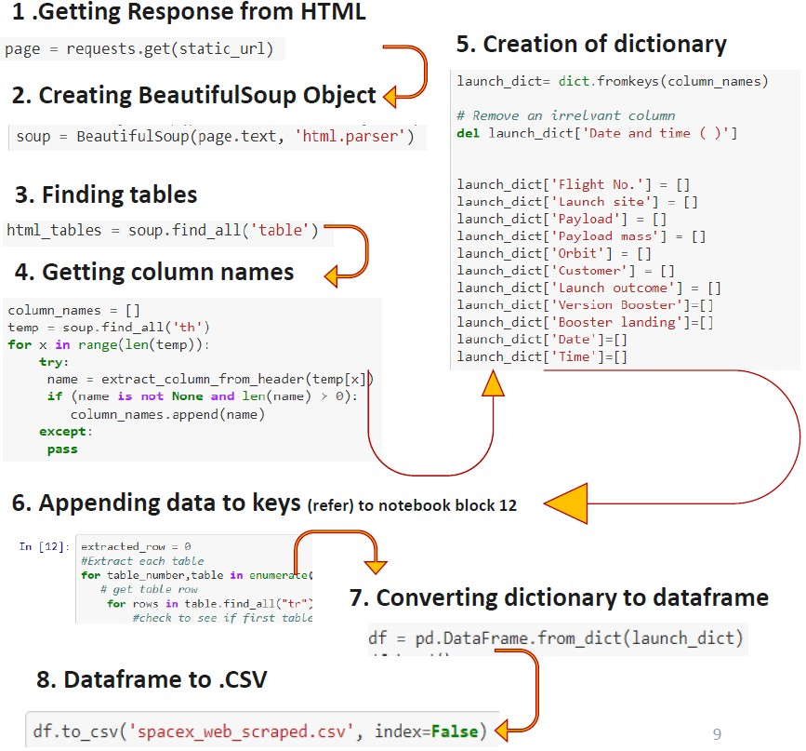
Data Collection - Scraping
Web Scrapping from Wikipedia

