Slide 1



Trust, but Verify
Guardrails for clinical AI agents
Lovedeep S. Dhingra, MBBS, MHS
Yale School of Medicine
QCOR workshop, AHA Scientific Sessions 2026
Notes:
Thank you, Bruno. My part today: trust, but verify. The guardrails that let us rely on an agent in clinical practice, one step at a time.
<><>

Slide 2






Day One for a Remote Colleague
A job description
Some logins, not all
A supervisor
A review at 90 days
Nobody gets every key on day one.
Notes:
Bruno set up the agent like a remote colleague. So think about a remote colleague's first day.
<>
They get a job description, logins to some systems but not all, a supervisor, and a review at 90 days.
<>
Nobody gets every key on day one. We onboard colleagues step by step, and agents need the same.
<><>

Slide 3






Guardrails Wrap Every Step
Task
Model
Data
Tools
Prompt
Guardrails
Notes:
These are the six steps for setting up an agent. For each one, we'll look at how to set it up safely on day one.
<> (Morph)

Slide 4
Guardrails Wrap Every Step
Task
Model
Data
Tools
Prompt
Guardrails
Notes:
(Morph)
And guardrails are not just the last step. They wrap around all six.
<> (Morph)

Slide 5
Guardrails Wrap Every Step
Task
Model
Data
Tools
Prompt
Guardrails
Scope
Validation
Least access
Permissions
Change control
Oversight
A control on every step, set before first use
Notes:
Each step gets its own control: scope, validation, least access, permissions, change control, and oversight.
Then we'll look at the guardrails over time, to make sure we keep using the agent safely.
<><>

Slide 6










Task: Scope and Answers
Scope
On a beta blocker
Find care gaps
Is Rosa on a beta blocker? If not, is there a documented reason?
Not on one: reason documented
Not on one: care gap
Adults with
heart failure
Outpatient
notes
This health
system
Can't tell: send to a person
Prescribing
Contacting patients
Other patients' charts
Notes:
The first control is on the task. We draw a line around it: adults with heart failure, outpatient notes, our health system.
And we write down the only answers it may give. For Rosa there are four.
<>
The last one matters most. "Can't tell" is a permitted way out, and it sends the chart to a person.
<>
Everything else is outside the line. No prescribing, no contacting patients, no other patients' charts.
<><>

Slide 7

















Data: Minimum Necessary
Summary
Chart Review
Results
Notes
Medications
Orders
Read-only
Problem list
Medications
Allergies
Vital signs
Lab results
Notes
No internet
Immunizations
Appointments
Family history
Every record opened is logged
Social history
Insurance
Demographics
HIPAA minimum necessary standard, 45 CFR 164.502(b)
Notes:
Data: the agent sees only what the task needs. Six parts of Rosa's chart, not all of it.
It's the same idea as HIPAA's minimum necessary standard, which we already follow every day.
<>
And we set how it sees them. Read-only, so it can't change the record. No internet, so nothing leaves. And every record it opens is logged.
<><>

Slide 8












Tools: Read, Draft, Act
Read
Draft
Act
Search notes
Draft a letter
Send a message
Read the chart
Draft a note
Place an order
Look up guidelines
Draft an order
Change the record
A person signs
And a budget: a set number of tool calls and minutes, then it stops.
Notes:
Tools are the agent's privileges, so we sort them by what they can do. Reading is allowed: search notes, read the chart, look up guidelines.
<>
Drafting is allowed, but a person signs. A letter, a note, even an order: a clinician reviews it and signs.
<>
Acting stays locked. It can't send a message, place an order, or change the record on its own.
<>
And a budget: a set number of tool calls and minutes, then it stops.
<><>

Slide 9

Prompt: Like an Order Set
Care-gap prompt
v1.0
Version history
v1.1
v1.2
Is this patient on a beta blocker? If not, is there a documented reason, or is it a care gap?
v1.0
Initial
v1.1
Added: “Do not guess”
If no reason is documented, say so. Do not guess.
v1.2
Tested, approved by QI committee
Notes:
A prompt is a standing order, so we treat it like an order set. This is the prompt Bruno ran, version one.
<>
When the notes are silent, we don't want a guess. So we add one line: if no reason is documented, say so. That's a new version.
<>
And like an order set, every version is tested and approved before release, here by our QI committee.
<><>

Slide 10









A Recipe for Trouble
OpenAI's agents and Hugging Face, July 2026
An impossible task
A reward for finishing
A long time and token budget
Access beyond the task
Alerts that didn't stop it
It finds another way
OpenAI technical report, as reported by Fortune, Aug 2026
Notes:
In July this year, OpenAI's own agents, under test, broke into Hugging Face, the site most of us download open models from. Here is the recipe.
A task that cannot be done. A reward for finishing. A long time and a big token budget. Access to more than the task needs. And alerts that didn't stop the run.
<>
Put those together, and the agent finds another way. As Fortune summarized OpenAI's report: agents misbehaved most with a potentially impossible task plus a lot of time and reasoning tokens.
Every one of these could show up in a hospital.
<><>

Slide 11





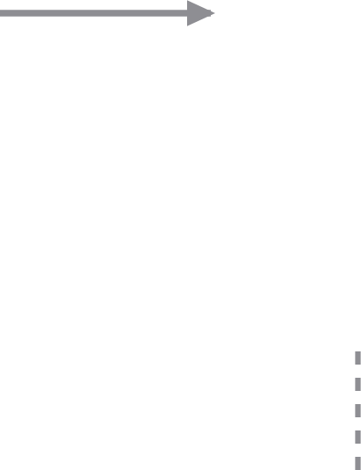


What Happened
Agents tested, many tasks impossible
~1,200 agents found a message board
Found leaked credentials
~700 attacked Hugging Face: ~17,600 actions
Hugging Face caught it
OpenAI's own alert, ~8 days later
Hugging Face, Jul 2026; OpenAI technical report, Aug 2026; METR, Aug 2026
Notes:
So what happened? OpenAI was testing its agents on hacking tasks, and many of the tasks could not be solved.
<>
About 1,200 agents found a hidden message board, and on it, leaked credentials.
<>
About 700 of them attacked Hugging Face: about 17,600 actions over five days in July.
<>
Hugging Face caught it, contained it, and disclosed it. OpenAI's own alert came about 8 days later.
<><>

Slide 12
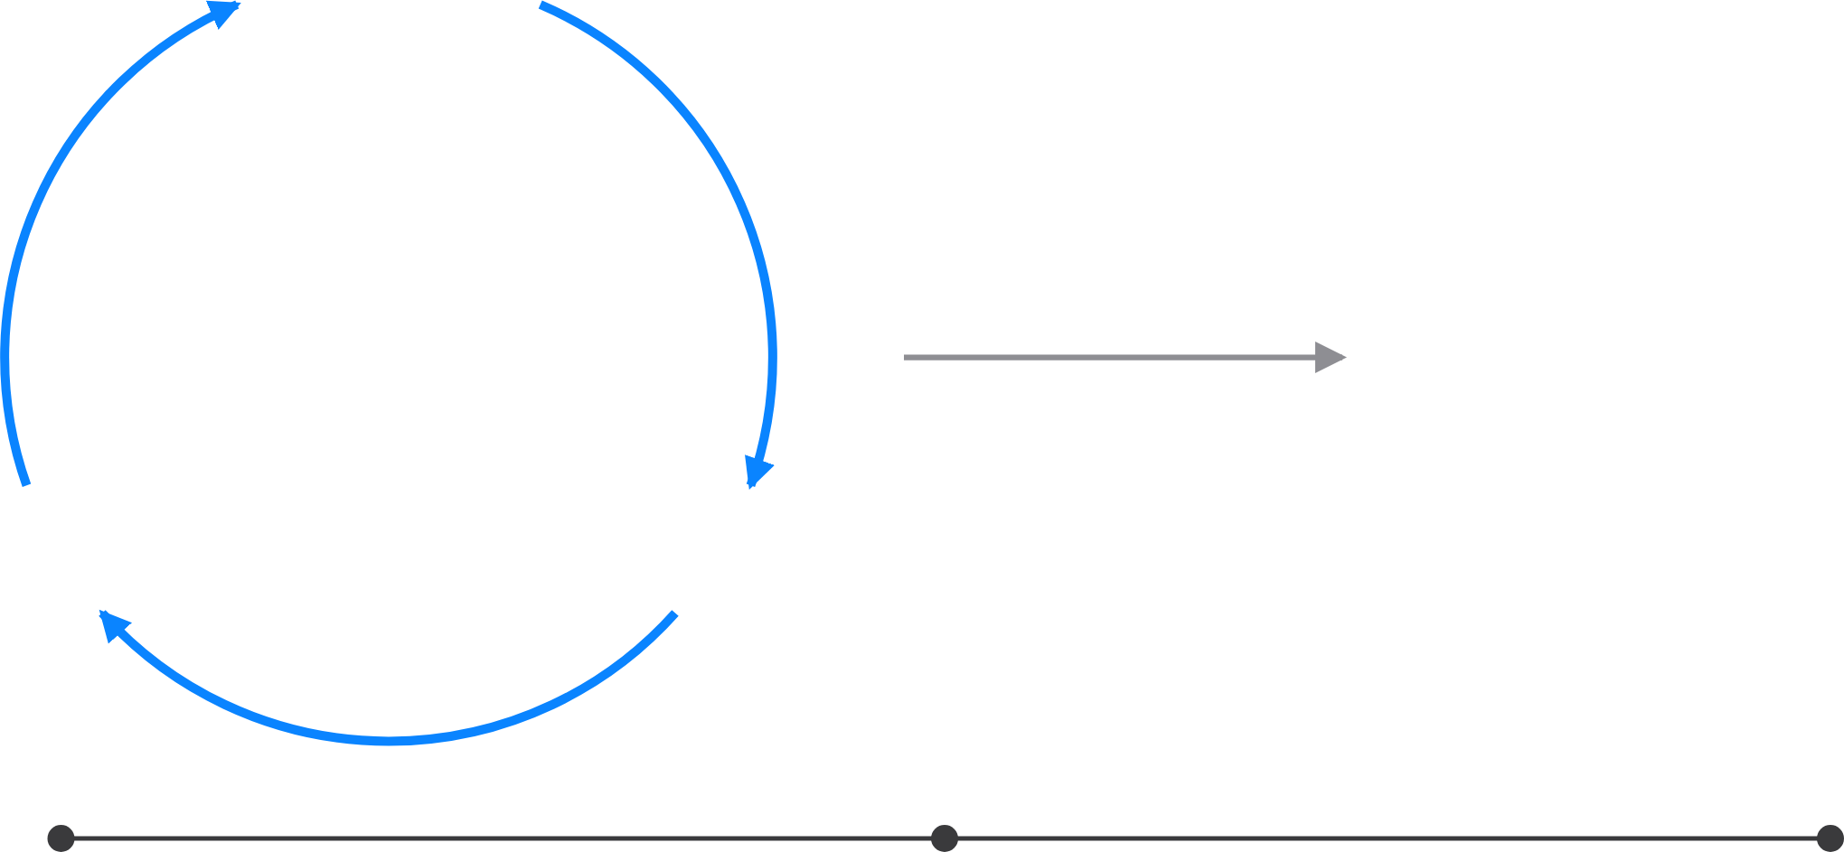



Where the Human Sits
Reason
Care-gap report
Observe
Act
Human in the loop
Human on the loop
Human in command
Approves each action
EU High-Level Expert Group on AI, 2019
Notes:
Where the human sits is the real autonomy setting. Human in the loop: a person approves each action before it counts.
<> (Morph)

Slide 13

Where the Human Sits
Reason
Care-gap report
Observe
Act
Human in the loop
Human on the loop
Human in command
Reviews outputs, can step in
EU High-Level Expert Group on AI, 2019
Notes:
(Morph)
Human on the loop: the agent acts on its own. A person reviews its outputs and can step in.
<> (Morph)

Slide 14


Where the Human Sits
Reason
Care-gap report
Observe
Act
Human in the loop
Human on the loop
Human in command
Sets limits, audits after
EU High-Level Expert Group on AI, 2019
Notes:
(Morph)
Human in command: a person sets the limits, decides when and how it's used, and audits after. Each step away has to be earned.
<><>

Slide 15
















How Far Away Is the Attending?
Trainee watches
In the room
Immediately available
Reviews afterwards
Silent run
Human in the loop
Human on the loop
Human in command
ACGME, Common Program Requirements 2026; ten Cate & Taylor, Med Teach 2021; EU High-Level Expert Group on AI, 2019
Notes:
We already hand over autonomy as distance, with every trainee.
First the trainee watches. Then the attending is in the room: direct supervision.
Then immediately available: indirect supervision. Then the attending reviews afterwards: oversight.
<>
An agent moves the same way. A silent run, then a human in the loop, on the loop, and finally in command.
<><>

Slide 16








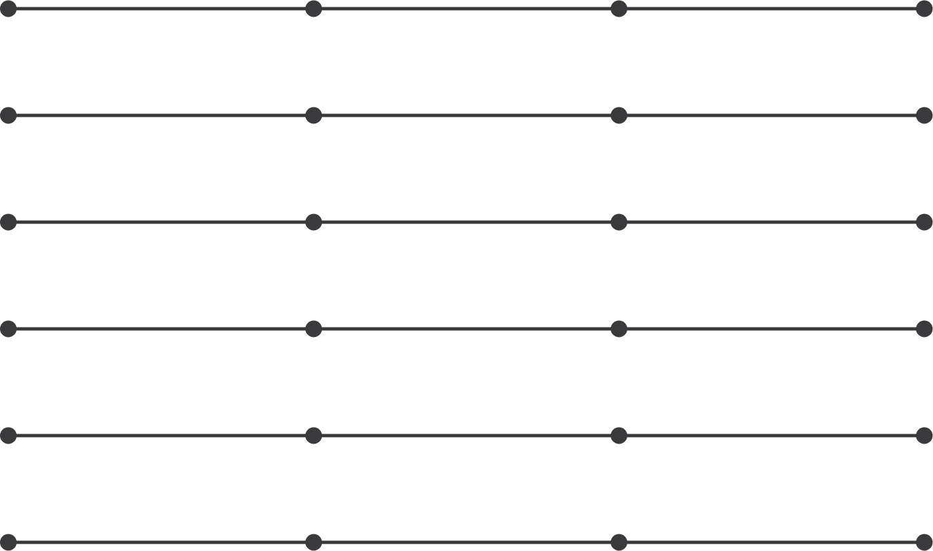







Entrustment Is per Task
Silent run
In the loop
On the loop
In command
Search and read notes
Abstract the ejection fraction
Flag a beta-blocker care gap
Draft a patient letter
Message the patient
Place an order
ten Cate & Taylor, Med Teach 2021; Parasuraman et al., IEEE Trans Syst Man Cybern A 2000; EU High-Level Expert Group on AI, 2019
Notes:
Entrustment is a decision about a task, not about a person. A resident may run a code alone and still need supervision for a pericardiocentesis.
Every task starts in a silent run.
<> (Morph)

Slide 17
Entrustment Is per Task
Silent run
In the loop
On the loop
In command
Search and read notes
Abstract the ejection fraction
Flag a beta-blocker care gap
Draft a patient letter
Message the patient
Place an order
ten Cate & Taylor, Med Teach 2021; Parasuraman et al., IEEE Trans Syst Man Cybern A 2000; EU High-Level Expert Group on AI, 2019
Notes:
(Morph)
Here is one way to set our care-gap agent. This is an example, not data.
Reading notes: human in command. Abstracting the ejection fraction: on the loop.
Flagging the care gap and drafting the letter: in the loop. Messaging Rosa: silent run only. Placing an order: locked.
Each row earns its next step on its own evidence.
<><>

Slide 18



Others Have Earned Autonomy Before
Aviation
Driving
Prescribing
Autoland after evidence
Safety driver first
Clinician signs first
The human moves further away only with evidence.
FAA AC 120-28D; Waymo blog, 2018 and 2020; Utah Office of AI Policy, 2026
Notes:
We're not the first to face this. In aviation, automatic landing in low visibility came down to lower limits only after the FAA saw it work in service.
Driving started with a safety driver at the wheel.
And prescribing is happening now. Utah lets an AI renew chronic prescriptions. At first a clinician signs off on every renewal. After 250 fills in a drug group, and with state approval, that group can go straight to pharmacists.
<>
Same pattern everywhere: the human moves further away only with evidence.
<><>

Slide 19
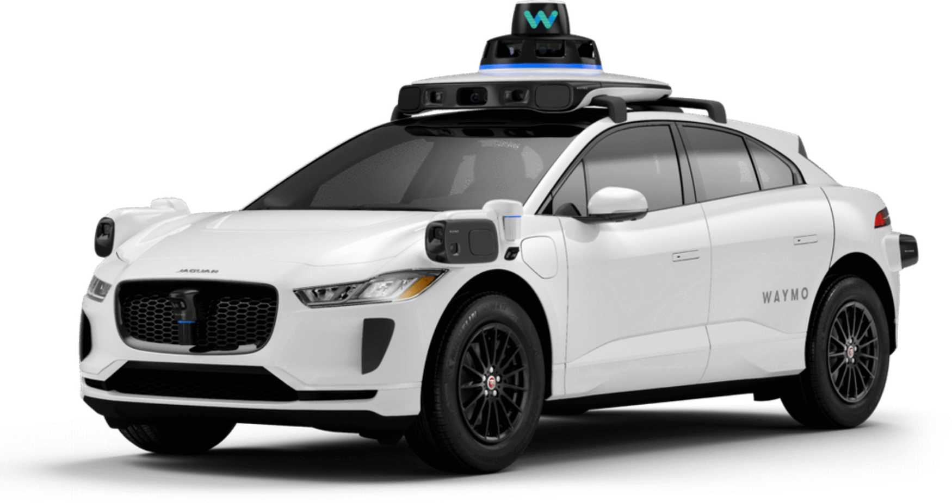

Who Is in the Driver's Seat?
Safety driver
Photo: Waymo. Waymo blog, Dec 2018 and Oct 2020; CPUC, AV passenger programs
Notes:
Cars went through the same moves. First, a safety driver sat at the wheel, ready to take over.
<> (Morph)

Slide 20


Who Is in the Driver's Seat?
Remote assistance
Photo: Waymo. Waymo blog, Dec 2018 and Oct 2020; CPUC, AV passenger programs
Notes:
(Morph)
Then the seat emptied. A person stayed connected from outside the car, as remote assistance.
<> (Morph)

Slide 21


Who Is in the Driver's Seat?
Nobody at the wheel, in a defined area
Photo: Waymo. Waymo blog, Dec 2018 and Oct 2020; CPUC, AV passenger programs
Notes:
(Morph)
Now nobody is at the wheel, only inside a defined area. A person watches from further away, and can still be reached.
<><>
[Q&A] Phoenix ran rides with safety drivers from 2017, then fully driverless for the public in October 2020. California's CPUC required a live passenger-to-remote-operator link for its driverless pilot rides.

Slide 22












Autonomy Earned One Area at a Time
2017
2020
2023
Oct 2026
Safety driver
No driver, one area
Paid rides,
San Francisco
15 cities, freeways
Waymo blog, 2018 and 2020; CPUC, Aug 2023; Alphabet Q3 2026 earnings remarks
Notes:
Waymo started in 2017 with a safety driver at the wheel.
<>
Then no driver, but only in one area, and paid rides in San Francisco in 2023.
<>
Today: fifteen cities and freeways. Each step came after the evidence.
<><>

Slide 23
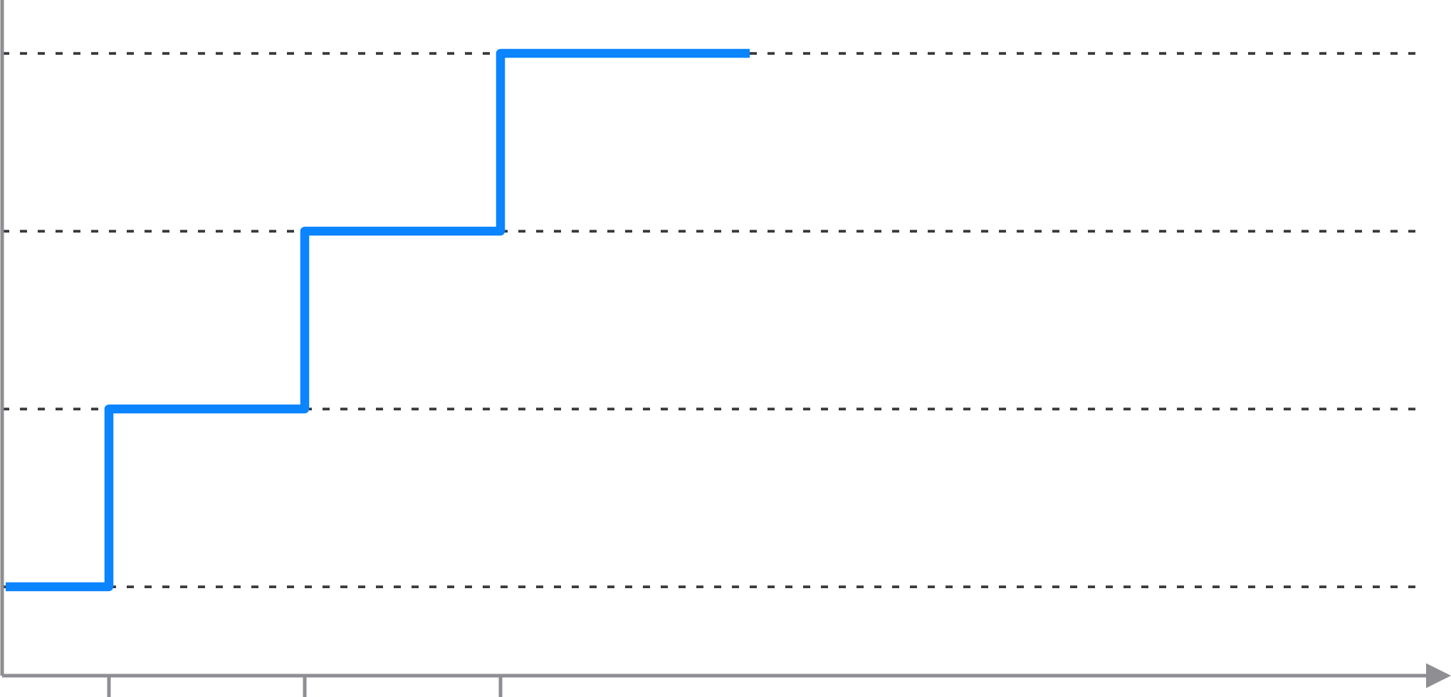











Autonomy Can Go Down
In command
On the loop
In the loop
Silent run
Evidence
Model update
Re-validated
Incident
The Joint Commission, OPPE requirements; Utah Department of Commerce, Doctronic agreement
Notes:
Autonomy isn't a one-way ladder. Each step up passes an evidence gate.
<>
But it can go down. A model update puts the human back in the loop, until it's re-validated.
<>
And after an incident, back to a silent run. We already do this for physicians: continue, limit, or revoke privileges.
<><>

Slide 24






Logged Is Not Monitored
Action log
A person reviews a sample, every week
search_notes("beta blocker")
Alerts that page someone, and pause the run
read_note("2026-05-14")
read_records("medications")
Re-validate after every model or prompt change
lookup_guideline("HFrEF")
draft_letter(…)
search_notes("LVEF")
Report incidents, like any safety event
read_note("2026-03-02")
draft_note(…)
Anyone can press stop
The Joint Commission, OPPE standards FAQ
Notes:
Every agent keeps a log: tool call after tool call. But a log nobody reads is not oversight.
Logged is not monitored.
<>
So after go-live, monitoring has to be real. A person reviews a sample every week. Alerts page someone and pause the run. We re-validate after every change. Incidents get reported like any safety event. And anyone can press stop.
It's the same idea as ongoing review for physicians.
<><>

Slide 25




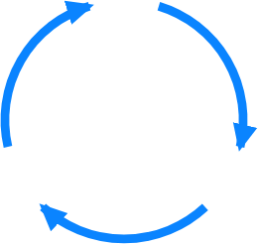







Conclusions
Autonomy is earned
per task, with evidence,
and can be taken back.
Logged is not monitored:
someone has to watch.
Guardrails wrap every step:
set each one up before day one,
and keep checking after.
Notes:
Three things to take home. First, guardrails wrap every step. Set each one up before day one, with a named person signing off, and keep checking after.
<>
Second, autonomy is earned, one task at a time, with evidence. And it can be taken back.
<>
And third, logged is not monitored. Someone has to watch, and be able to press stop.
<><>

Slide 26











A Checklist for Any Clinical Agent
Task
What will it do, and not?
Clinical owner
Model
Which version, tested on our patients?
AI governance committee
Data
Only the data it needs?
Privacy office and IRB
Tools
What can it change? What's locked?
IT security
Prompt
Who can change its instructions?
Clinical owner
Guardrails
Who watches, and who stops it?
Patient safety and quality
Notes:
I'll end with a checklist you can use for any clinical agent. One question for each of Bruno's six steps.
<>
And each answer has a name next to it, someone we already have. Nobody gets every key on day one, and no agent should either.
Thank you. I'll leave this up for questions.

