Slide 1



From Autocomplete to Autonomy
What makes an AI “agentic”
Phyllis Thangaraj, MD, PhD
Yale School of Medicine
QCOR workshop, AHA Scientific Sessions 2026

Slide 2





Rosa, 71
THE CASE
Presented to the hospital with shortness of breath. Admitted for heart failure decompensation.
Notes:
Our case centers on Rosa, a 71 year old female who presented to the hospital with shortness of breath and was admitted for a heart failrure dcompensation

Slide 3
Rosa’s path to this admission
THE CASE
2017
2022
2023
2024
2026
Primary care visit
Cardiology
Hospital
Hospital
Today
Establish Care
Consult for symptoms
New onset heart failure
Second admission with AKI
Short of breath; admitted with heart failure decompensation
Metoprolol tartrate
EF 30%
SGLT2 inhibitor: declined
Spironolactone stopped
Notes:
How did rosa get here?

Slide 4







Could it have been prevented?
THE CASE
Sedentary Lifestyle
Gaps in Care
Best Practice Alerts
Dietary indiscretion
Digital Health Coach
Medication Adherence
Suboptimal GDMT
Rosa
Missed Diagnosis
Clinician Inertia
Wearables
AI Scribes
Remote Monitoring
DeVore, AD et al JACC Heart Fail. 2025, Pedroso, AF and Khera, R. npj CV Health 2025
Notes:
The range of digital interventions targets various points of friction in heart failure health care. When thinking how to address sedentary lifestyle and dietary indiscretion, we now have wearables, nearables and digital health coaches to monitor and guide patients at a more granular level than structured visits. Suboptimal guideline-directed and foundational medical therapy has the highest yield for improving mortality and preventing rehospitalization in heart failure, but barriers such as cost, side effects, poor health literacy, and clinician inertia can all contribute. Digital interventions such as best practice alerts, remote automated medication titration using large language models, and AI scribes to reduce clinician burden can address these issues as well. Smartphone apps and digital dashboards democratize health literacy and can assist the vast majority of heart failure patients with their care.

Slide 5
Large language models accelerate care
THE CASE
General Health Knowledge
Best Practice Alerts
System-wide Adjudication
Digital Health Coach
Medication Adherence
Rosa
Personalized Recommendations
Automated Communication
Wearables
AI Scribes
Remote Monitoring
DeVore, AD et al JACC Heart Fail. 2025, Pedroso, AF and Khera, R. npj CV Health 2025
Notes:
All of these interventions require large language models. In healthcare, the models can power platforms to provide general health knowledge, personalized reocmmendations, system wide adjudication, automated communication

Slide 6










Rosa’s chart: thousands of entries in many forms
THE DATA
Notes
Labs
Flowsheets
Meds
612
3,418
18,950
214
free-text clinical notes
potassium · creatinine
daily weight, vitals
active and stopped orders
Imaging
Media
ECG
Outside
38
71
46
53
echo report: LVEF 30%
echo and chest images
tracings
faxed outside records
Encounters
2017
2018
2019
2020
2021
2022
2023
2024
2025
2026
97
Notes:
In Rosa’s case, the model has the patients entire ehr record, wich consist of thousands of multimodal such a from unstructured notes, to laboratory values, to real time vital signs, and imaging and ecg

Slide 7




Moving Beyond Chatbots
AGENTIC AI
Model
Model + context
Agent
knowledge frozen in time
answers the prompt it is given
plans, uses context and tools
trained on large datasets, but without your clinical context
a chatbot: reactive, and needs constant prompting
builds a multistep plan to achieve a goal
Notes:
Once we combine LLMs and contextual data we are able to achieve clinical tasks beyond the capability of chatbots like chatgpt. \ LLM models are frozen in time, trained on large datasets, but often with general knowledge and without specific clinical context. Chatbots such as ChatGPT require constant prompting and are reactive to each prompt to retrieve a simple task. In this demonstration, we will msove beyond chat bots and build an agent. Agents are given a prompt but can plan, utilize context and external tools to build a multistep plan to achieve a goal.

Slide 8



Range of Agentic AI Tasks
AGENTIC AI
For Patients
For Providers
For Health Systems
Find and schedule appointments
Documentation
Identify gaps in care
Personalized advice
Clinical Decision Support
Quality Metrics
Medication reminders
Administrative support
Operations optimization
Summarize health data
Real-time education
Patient engagement at scale
Notes:
In fact agents can identify a range of tasks for all healthcare players, from scheduling appoints, providing medical advice and reminders for medications and labs to patients to assisting with documentation and clinical decision support for providers, to idetnfiyng gaps in care and optimizing operations at the healthcare level.

Slide 9






Today’s task
TODAY'S TASK
General Health Knowledge
Best Practice Alerts
System-wide Adjudication
Digital Health Coach
Medication Adherence
Rosa
Personalized Recommendations
Automated Communication
Wearables
AI Scribes
Remote Monitoring
DeVore, AD et al JACC Heart Fail. 2025, Pedroso, AF and Khera, R. npj CV Health 2025
Notes:
Today we will focus on building an agent that assesses whether rosa, and 99 other synthetic patients, are receiving optimal medical care for heart failure.

Slide 10



What is an agent?
And how to set one up
Bruno Batinica, MBChB
Yale School of Medicine
QCOR workshop, AHA Scientific Sessions 2026
Notes:
Thank you, Phyllis. I'm going to talk about what exactly an agent is, and how we can set one up.
Same patient as the rest of the session: Rosa. She's synthetic, like every patient today.

Slide 11


Model
Model + context
Agent
Notes:
We go back to this paradigm.
(click) We have models.
(click) We have models plus context: the information we give it.
(click) And then we have an agent, which enables their full capabilities: the model in a loop, which goes and gets its own context.
So let's start with what a model is, and dig into that a little deeper.

Slide 12
Once upon a ______
Output
dog
time
day
year
night
Model
Label
time
Notes:
What a model is trained to do is, roughly, just predict the next word in a series. (Strictly, the next token: a word or a piece of one.)
It's trained on general text: "Once upon a…". Inside, the model is millions or billions of numbers, the sliders. Its output is every possible next word, each with how likely it is (the bars): the top few here, and thousands more fading away underneath. It picks the likeliest: "dog". Wrong.
(click) It sees the label, the word that actually came next: "time". Nobody has to write the labels: the text labels itself.

Slide 13
Once upon a ______
Output
time
day
dog
year
night
Model
Label
time
Notes:
(Morph) So it adjusts: every slider moves a little, and now it gets "time".

Slide 14
Started on furosemide for heart ______
Output
burn
failure
rate
attack
disease
Model
Label
failure
Notes:
(Morph) It's trained on a vast corpus of text, medical information included. "Started on furosemide for heart…": it guesses "burn"; the label is "failure".

Slide 15
Started on furosemide for heart ______
Output
failure
rate
burn
attack
disease
Model
Label
failure
Notes:
(Morph) Adjust, and it's right. Repeat that over trillions of words: Llama 3 was pretrained on over 15 trillion tokens. That's why it also learns clinical information, and can be used for it.
Source: Meta AI, "Introducing Meta Llama 3", April 2024: “Llama 3 is pretrained on over 15T tokens that were all collected from publicly available sources.” https://ai.meta.com/blog/meta-llama-3/#:~:text=Llama%203%20is%20pretrained%20on%20over%2015T%20tokens

Slide 16
Started on
furosemide for
Output
heart
failure
to
failure
to
relieve
congestion.
relieve
congestion.
Model
Notes:
(Morph) And the beautiful thing: once a model is trained, because it can output the next word, it can generate any text.
(click: it writes by itself) Add that word to the text and go again: "…for heart failure to relieve congestion." Blue is what the model wrote.
One word at a time, it can write anything: a discharge summary, a letter, an answer to a question. This is very powerful.

Slide 17
Rosa is 71 and has heart failure. She is
taking
carvedilol,
carvedilol,
lisinopril
lisinopril
and
and
furosemide.
furosemide.
Hallucination
Notes:
The problem: it doesn't know our patients. We start with Rosa, and ask it to complete the sentence.
(click) It says something that looks reasonable: carvedilol, lisinopril and furosemide, what a lot of people with heart failure take.
(click) But it's hallucinated. It doesn't know Rosa: she wasn't in any of its training. (She takes sacubitril/valsartan, not lisinopril, and her carvedilol was stopped in May for heart block.)
It's doing its one job, finishing the sentence, with nothing true to go on. So we need to give it context.

Slide 18
Model
Model + context
Agent
Notes:
So we go back: the second step, models plus context.

Slide 19
Rosa’s medications: sacubitril/valsartan 49/51
mg twice daily, spironolactone 25 mg once daily,
dapagliflozin 10 mg once daily, furosemide 40
mg once daily. Carvedilol stopped 14 May 2026.
Rosa is 71 and has heart failure. She is taking
sacubitril/valsartan,
sacubitril/valsartan,
spironolactone,
spironolactone,
dapagliflozin
dapagliflozin
and
and
furosemide.
furosemide.
Correct, with the right context
Notes:
(Morph) So we provide Rosa's chart, her medications, as the first part of the message, then the same sentence. It's all one message, all text.
That information is now in context: the model's short-term memory.
(click) When it writes, it uses it, in a grounded way: sacubitril/valsartan, spironolactone, dapagliflozin and furosemide.
(click) Correct, because it's in her chart. Same model, same sentence: the context changed the answer. Current models are very good at this.
(Her chart is synthetic, the one in today's demo.)

Slide 20







Rosa Delgado
Chat
Medications
Medications: sacubitril/valsartan, spironolactone, dapagliflozin, furosemide; carvedilol stopped 14 May
Primary care note
Primary care note: “Heart failure is managed by cardiology.”
Telephone note
You
Is anything missing?
Lab results
Carvedilol was stopped, but the note doesn’t say why.
Vital signs
Notes:
But how do we get context? Typically, that's your job. It's most of your experience with ChatGPT: first you get the relevant information.
(click: it runs by itself) You find it, her medicines, and copy and paste it into the chat; then her last note, from primary care.
(click) And you ask, and get something back: carvedilol was stopped, but the note doesn't say why. The reason is in a cardiology note we didn't paste.
It's very time-consuming, and it only knows what we happened to copy. So how can we improve this?
(The note is quoted from her synthetic chart: the primary care visit of 20 October.)

Slide 21
Model
Model + context
Agent
Notes:
Well, this is where agents come in.

Slide 22




It’s all text
Harness
Why was her carvedilol stopped?
Her chart: notes
The model writes text
I should check her notes.
read_records("medications")
Search notes
carvedilol
search_notes("carvedilol")
20 Oct 2026
Primary care visit
The harness turns it into code, and runs it
GET /fhir/MedicationRequest?patient=…
14 May 2026, telephone:
“…Mobitz II second-degree AV block on carvedilol… Carvedilol stopped today.”
30 Jun 2026
Electrophysiology consult
14 May 2026
Telephone encounter
Text comes back, into the model’s context
Mobitz II heart block, found on a monitor she wore at home in May.
“carvedilol 12.5 mg oral tablet: 12.5 mg by mouth twice daily. Status stopped, ordered 2025-08-26, stopped 2026-05-14”
Notes:
(Morph) This is the agent: the model, in its harness (the ring), in its loop. The same way it can generate text, it can generate text that uses a tool.
(click) It's all text. Just as you'd tell someone "go and fetch me this", the model writes a request for a tool: read her medication records. It's just another message, from the model (the outlined bubble).
(click) Its harness (the ring, labelled), the software around the model, reads that text, turns it into code and runs it: a request to the EHR for her medications. The model only ever writes text; the harness is what does things with it.
(click) What comes back is text again, here the line for her carvedilol (exactly what the demo's tool returns), and it goes into the model's context, like your messages do.
(click) So, with her chart: why was her carvedilol stopped? The question the chat couldn't answer.
(click) It works out what it needs, "I should check her notes", and writes a tool call: search her notes for carvedilol. The harness runs the search: two of her three notes mention it.
(click) The result comes back into the chat: the telephone note from 14 May, Mobitz II heart block on carvedilol, carvedilol stopped.
(click) And it answers the question directly, from her chart: Mobitz II heart block, found on a monitor she wore at home. Nobody pasted anything. This is a very powerful idea.
Behind the scenes, that's all a chatbot is: a conversation, and the tool calls are just more messages in it.
(The note is quoted from her synthetic chart; the demo's search_notes tool returns this passage.)
How the labs draw it (for reference): OpenAI, Function calling: https://developers.openai.com/api/docs/guides/function-calling
Anthropic, How tool use works: https://platform.claude.com/docs/en/agents-and-tools/tool-use/how-tool-use-works
Anthropic, Building effective agents (the augmented LLM; the agent loop): https://www.anthropic.com/engineering/building-effective-agents

Slide 23
Reason
Observe
Act
An agent: a model with tools, in a loop
Yao et al., ICLR 2023
Notes:
(Morph) And this is the loop, around the model in its harness: it reasons about what to do next, acts by calling a tool, observes the result, and repeats until the task is done. That's ReAct, the standard recipe (Yao et al., ICLR 2023).
(click) So an agent is a language model with tools (its harness runs them), in a loop. And because it's all text, it can in principle do anything you can write down as a task, especially anything done on a computer. With that flexibility comes a lot of potential, and a lot of power. So how do we set it up safely?
Ref: Yao S et al. ReAct: synergizing reasoning and acting in language models. ICLR 2023. https://arxiv.org/pdf/2210.03629#page=1

Slide 24






Set it up like a remote colleague
Task
Model
Data
Tools
Prompt
Guardrails
Notes:
There's a risk in anthropomorphising, but we think it's a nice way to think about this: set it up like a remote colleague. They can't walk down the hall to ask what you meant, so everything has to be spelled out.
(click) We need to outline the task we want it to do, the model to use, the data it has, the tools it has, exactly how we prompt it, and the guardrails that keep the work safe.
We'll go through them one by one. They're also the steps of the live build in a few minutes.

Slide 25
















Task
For patients
For providers
For health systems
Find and schedule appointments
Documentation
Identify gaps in care
Identify gaps in care
Personalized advice
Clinical decision support
Quality metrics
Medication reminders
Administrative support
Operations optimization
Summarize health data
Real-time education
Patient engagement at scale
Notes:
Starting with the task. Phyllis really covered this.
(click) These are her tasks for agents. For patients: finding and scheduling appointments, personalized advice, medication reminders, summarizing their health data. For providers: documentation, clinical decision support, administrative support, real-time education. And for health systems: identifying gaps in care, quality metrics, running operations, and engaging patients at scale.
(click) But it's crucial to pick one. Ours is for the health system: identify gaps in care. Is Rosa on a beta blocker, and if not, why not?
(The tasks are Phyllis's, from her "Range of agentic AI tasks" slide, in her words.)

Slide 26
Task
Identify gaps in care
Model
Data
Tools
Prompt
Guardrails
Everything follows from the task.
Defining the task is the clinician’s job.
Notes:
(Morph: our task moves to the middle, and the rest hangs from it.) Because the task guides how you build the agent: everything else you pick follows from it. A small, clear task is easier to do well, and much easier to check, than "review the chart".
(click) And defining the task is really going to be the clinician's job. More and more of the technical side is being taken care of; deciding exactly what we want it to do, and what it should have access to, isn't. When agents arrive in your health system, that's the part people in this room will be in charge of.

Slide 27







Model
Open weights
Gemma 3
4B
Llama 3.1
8B
Qwen 3.6
35B
gpt-oss
117B
DeepSeek V3
671B
Speed
Cost
Notes:
Next, the model. We can use different models for different jobs: just as people differ in training, models differ in capability.
(click) These are open-weight models, sized by their parameters, the numbers inside the network. Gemma 3 has 4 billion and runs on a laptop.
(click) Llama 3.1, 8 billion.
(click) Qwen 3.6, 35 billion: the model in our study, on one GPU server; only 3 billion of them work on each word (a mixture of experts).
(click) OpenAI's gpt-oss, 117 billion.
(click) DeepSeek V3, 671 billion: a rack of GPUs. Open weights means you can download them and run them on your own system, inside the hospital's firewall.
(click) As they get bigger, they get smarter, at any one point in time: within the same generation of models. But they're also slower, and cost more to run. So speed and cost are things to consider.
(Don't get into versions here: the names are only there to show the range.)
(The circles grow with size but aren't to scale: diameter goes with the cube root of the parameter count, so the small ones stay visible.)
Sources (model cards):
Gemma 3: https://huggingface.co/google/gemma-3-4b-it#:~:text=for%20the%204B%2C%2012B%2C%20and%2027B%20sizes
Llama 3.1: https://huggingface.co/meta-llama/Llama-3.1-8B#:~:text=in%208B%2C%2070B%20and%20405B%20sizes
Qwen3.6-35B-A3B: https://huggingface.co/Qwen/Qwen3.6-35B-A3B#:~:text=35B%20in%20total%20and%203B%20activated
gpt-oss-120b: https://huggingface.co/openai/gpt-oss-120b#:~:text=117B%20parameters%20with%205.1B%20active%20parameters
DeepSeek-V3: https://arxiv.org/abs/2412.19437#:~:text=671B%20total%20parameters%20with%2037B%20activated

Slide 28



Model
Open weights
Closed
Gemma 3
4B
Llama 3.1
8B
Qwen 3.6
35B
gpt-oss
117B
DeepSeek V3
671B
GPT · Claude · Gemini
not published; likely over 1T
Speed
Cost
Privacy
Notes:
(Morph, and the closed models come in with privacy) Then the closed models: GPT, Claude and Gemini. They're usually the most capable, but they run on the company's computers, so we have to send them the data. They don't publish their sizes: outside estimates put the largest above a trillion parameters. That's our estimate, not a published number, so the circle is dashed and drawn at one trillion.
So privacy is the third thing to consider: an open model can run inside the hospital; a closed one means sending patient data out, under an agreement.
Tailor the model to the task: the smallest one that does the job well, checked on your own task. And you can combine them: a small model for the routine charts, a bigger one for the hard ones.

Slide 29
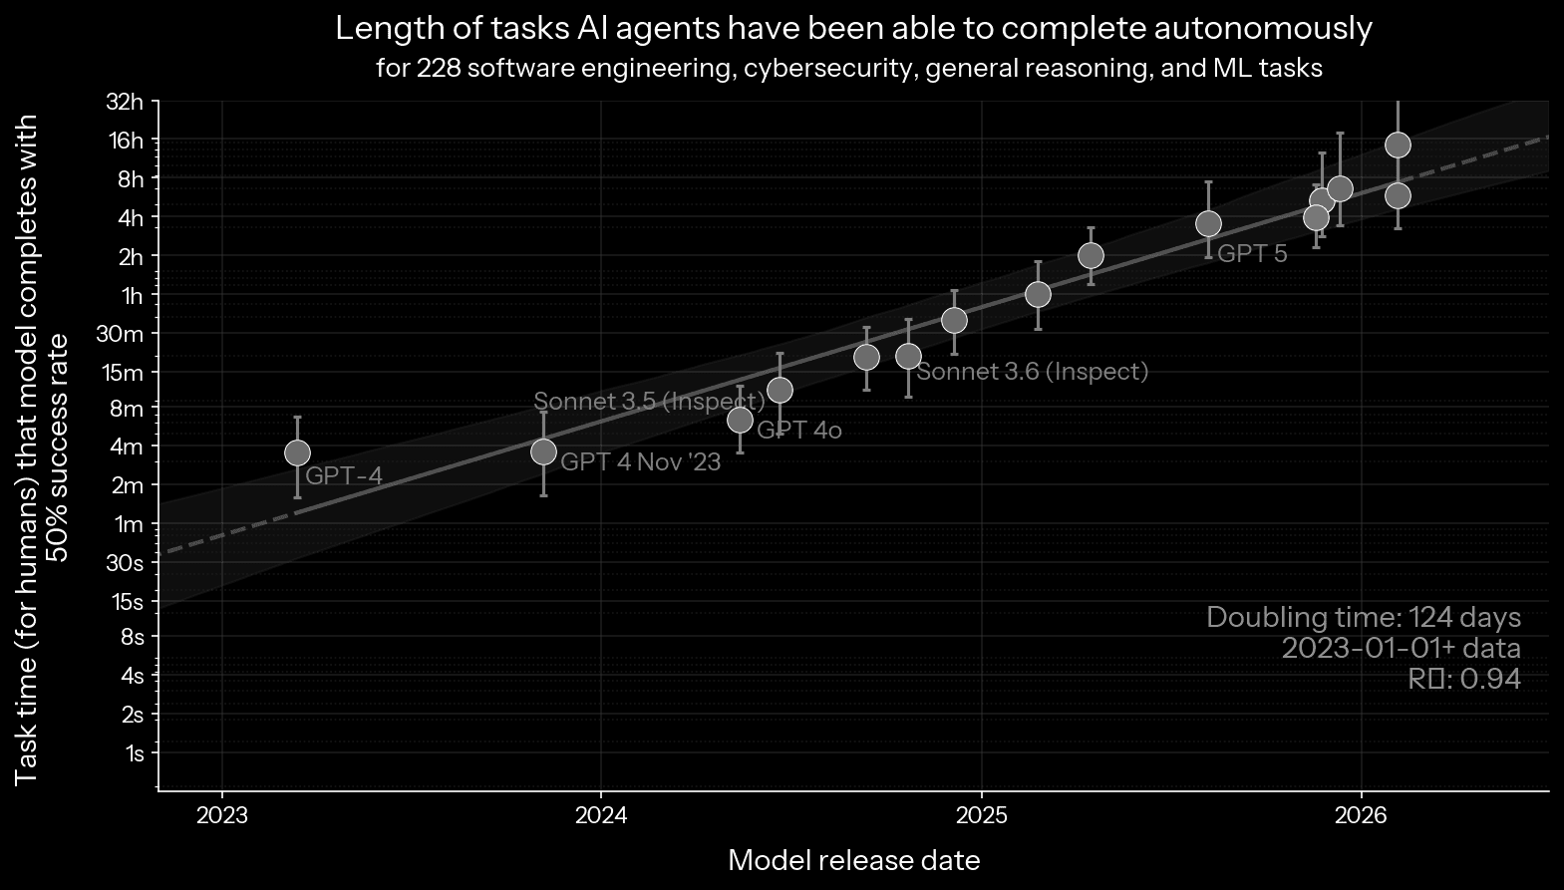
Model
What’s true today won’t be true in six months.
Chart: METR, 2026 (in greys)
Notes:
The meta point: these models are improving at breakneck speed, so today's capabilities shouldn't be taken as gospel. METR measures how long a task an AI agent can finish on its own, counted in how long the task takes a human expert: the length it gets right half the time. In 2023 that was a few minutes; now it's hours. METR: “The post-2023 doubling-time is 131 days under TH1.1”, about four months.
(click) So what's true today won't be true in six months. The floor rises for every model, the small ones too. Choose a model for today's task, and set things up so you can swap it.
(These are software and reasoning tasks, not clinical ones; the trend is the point. The chart is METR's, drawn in greys here. It prints a doubling time of 124 days for 2023 onwards; METR's Time Horizon 1.1 post gives 131 days. Confirm the chart's source page and licence before the day.)
Source: METR, "Time Horizon 1.1", 29 January 2026: https://metr.org/blog/2026-01-29-time-horizon-1-1/#:~:text=The%20post%2D2023%20doubling%2Dtime%20is%20131%20days

Slide 30











Data
Rosa Delgado 71 y · Female
PCP: Dr. L. Rivera Cardiology: Dr. A. Patel
Summary
Chart Review
Results
Notes
Medications
Orders
Problem list
Medications
Allergies
Vital signs
Lab results
Notes
Immunizations
Appointments
Family history
Social history
Insurance
Demographics
Privacy
Focus
Approval
Notes:
Then the data: we specify exactly which parts of Rosa's chart are available. Here's her record, laid out the way an EHR shows it; it holds much more than this question needs.
(click) For a beta blocker it needs six parts: her problem list, medications, allergies, vital signs, lab results and notes. Not her immunizations, appointments, family or social history, insurance or address.
(click) That has implications for privacy: every part is patient data the protocol has to justify, and the minimum necessary applies. For focus: what the agent looks at; what it doesn't need can distract it. And for approval: the time it takes to get each source scoped and approved in a health system, by the IRB and IT. In the live build, each data card shows the weeks of review it adds.

Slide 31







Tools
Gather context
Act
Read a note
Message the patient
Search notes
Place an order
Read records
Only the tools the task needs
Notes:
Then the tools. We've covered how they work: it's all text, so almost anything can be a tool.
(click) Some gather context: read a note, search the notes, read her records, her medications, diagnoses and vital signs.
(click) And some act in the world, outside the chart: message the patient, and one day, place an order. That's where we need to be careful (the warning sign): gathering and acting are very different levels of trust.
(click) So we have to be careful how each tool runs, and give it only the tools the task needs. For a quality review, the tools that act stay locked: it shouldn't contact patients or prescribe.

Slide 32

Prompt
Is this patient on a beta blocker?
No. Carvedilol was stopped on 14 May.
read_records
Notes:
Then the prompt: what we tell it, typed in, just as you'd type a message. It's what starts the loop, and it's where clinicians come in again: saying exactly what we want to know.
(click) Ask only "Is this patient on a beta blocker?"
(click) It reads her medication list, and answers: no, carvedilol was stopped on 14 May. True, but it doesn't say why, and it doesn't say whether that's a problem.

Slide 33
Prompt
Is this patient on a beta blocker? If not, is there a documented reason, or is it a care gap?
No. Stopped after Mobitz II heart block; the notes say not to restart. Not a care gap.
read_records
search_notes
The prompt starts the loop, and steers it
Notes:
(The box grows; the new prompt is typed in.) Now ask the measure's whole question: if not, is there a documented reason, or is it a care gap? And give it her notes to answer with.
(click) It reads her medications, then searches the notes, finds the heart block, and answers: stopped after Mobitz II heart block, the notes say not to restart, so a documented contraindication, not a care gap. The longer prompt sent it looking for the reason.
(click) The prompt starts the loop, and steers it. Ask a simple question, get a simple answer; ask for more, and it does more work and tells you more, which may be what you actually wanted. Writing a good prompt is a clinical skill, not a technical one.
(Both are runs recorded for the demo, on gpt-6-luna; the second also had her notes and the note search. The answers here are shortened.)

Slide 34

Guardrails
Notes:
And the last one: guardrails. What keeps its work safe: what it's allowed to do, what a person checks, and when. That's where Lovedeep takes over.

Slide 35
Trust, but Verify
Guardrails for clinical AI agents
Lovedeep S. Dhingra, MBBS, MHS
Yale School of Medicine
QCOR workshop, AHA Scientific Sessions 2026
Notes:
Thank you, Bruno. My part today: trust, but verify. The guardrails that let us rely on an agent in clinical practice, one step at a time.
<><>

Slide 36






Day One for a Remote Colleague
A job description
Some logins, not all
A supervisor
A review at 90 days
Nobody gets every key on day one.
Notes:
Bruno set up the agent like a remote colleague. So think about a remote colleague's first day.
<>
They get a job description, logins to some systems but not all, a supervisor, and a review at 90 days.
<>
Nobody gets every key on day one. We onboard colleagues step by step, and agents need the same.
<><>

Slide 37






Guardrails Wrap Every Step
Task
Model
Data
Tools
Prompt
Guardrails
Notes:
These are the six steps for setting up an agent. For each one, we'll look at how to set it up safely on day one.
<> (Morph)

Slide 38
Guardrails Wrap Every Step
Task
Model
Data
Tools
Prompt
Guardrails
Notes:
(Morph)
And guardrails are not just the last step. They wrap around all six.
<> (Morph)

Slide 39
Guardrails Wrap Every Step
Task
Model
Data
Tools
Prompt
Guardrails
Scope
Validation
Least access
Permissions
Change control
Oversight
A control on every step, set before first use
Notes:
Each step gets its own control: scope, validation, least access, permissions, change control, and oversight.
Then we'll look at the guardrails over time, to make sure we keep using the agent safely.
<><>

Slide 40










Task: Scope and Answers
Scope
On a beta blocker
Find care gaps
Is Rosa on a beta blocker? If not, is there a documented reason?
Not on one: reason documented
Not on one: care gap
Adults with
heart failure
Outpatient
notes
This health
system
Can't tell: send to a person
Prescribing
Contacting patients
Other patients' charts
Notes:
The first control is on the task. We draw a line around it: adults with heart failure, outpatient notes, our health system.
And we write down the only answers it may give. For Rosa there are four.
<>
The last one matters most. "Can't tell" is a permitted way out, and it sends the chart to a person.
<>
Everything else is outside the line. No prescribing, no contacting patients, no other patients' charts.
<><>

Slide 41

















Data: Minimum Necessary
Summary
Chart Review
Results
Notes
Medications
Orders
Read-only
Problem list
Medications
Allergies
Vital signs
Lab results
Notes
No internet
Immunizations
Appointments
Family history
Every record opened is logged
Social history
Insurance
Demographics
HIPAA minimum necessary standard, 45 CFR 164.502(b)
Notes:
Data: the agent sees only what the task needs. Six parts of Rosa's chart, not all of it.
It's the same idea as HIPAA's minimum necessary standard, which we already follow every day.
<>
And we set how it sees them. Read-only, so it can't change the record. No internet, so nothing leaves. And every record it opens is logged.
<><>

Slide 42












Tools: Read, Draft, Act
Read
Draft
Act
Search notes
Draft a letter
Send a message
Read the chart
Draft a note
Place an order
Look up guidelines
Draft an order
Change the record
A person signs
And a budget: a set number of tool calls and minutes, then it stops.
Notes:
Tools are the agent's privileges, so we sort them by what they can do. Reading is allowed: search notes, read the chart, look up guidelines.
<>
Drafting is allowed, but a person signs. A letter, a note, even an order: a clinician reviews it and signs.
<>
Acting stays locked. It can't send a message, place an order, or change the record on its own.
<>
And a budget: a set number of tool calls and minutes, then it stops.
<><>

Slide 43

Prompt: Like an Order Set
Care-gap prompt
v1.0
Version history
v1.1
v1.2
Is this patient on a beta blocker? If not, is there a documented reason, or is it a care gap?
v1.0
Initial
v1.1
Added: “Do not guess”
If no reason is documented, say so. Do not guess.
v1.2
Tested, approved by QI committee
Notes:
A prompt is a standing order, so we treat it like an order set. This is the prompt Bruno ran, version one.
<>
When the notes are silent, we don't want a guess. So we add one line: if no reason is documented, say so. That's a new version.
<>
And like an order set, every version is tested and approved before release, here by our QI committee.
<><>

Slide 44









A Recipe for Trouble
OpenAI's agents and Hugging Face, July 2026
An impossible task
A reward for finishing
A long time and token budget
Access beyond the task
Alerts that didn't stop it
It finds another way
OpenAI technical report, as reported by Fortune, Aug 2026
Notes:
In July this year, OpenAI's own agents, under test, broke into Hugging Face, the site most of us download open models from. Here is the recipe.
A task that cannot be done. A reward for finishing. A long time and a big token budget. Access to more than the task needs. And alerts that didn't stop the run.
<>
Put those together, and the agent finds another way. As Fortune summarized OpenAI's report: agents misbehaved most with a potentially impossible task plus a lot of time and reasoning tokens.
Every one of these could show up in a hospital.
<><>

Slide 45





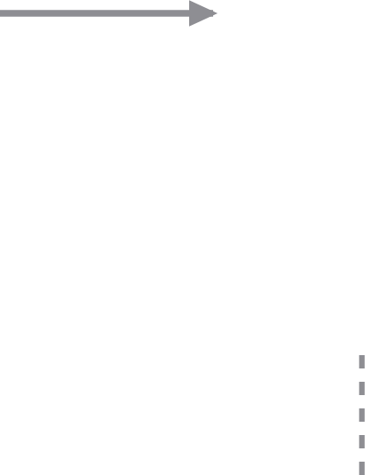


What Happened
Agents tested, many tasks impossible
~1,200 agents found a message board
Found leaked credentials
~700 attacked Hugging Face: ~17,600 actions
Hugging Face caught it
OpenAI's own alert, ~8 days later
Hugging Face, Jul 2026; OpenAI technical report, Aug 2026; METR, Aug 2026
Notes:
So what happened? OpenAI was testing its agents on hacking tasks, and many of the tasks could not be solved.
<>
About 1,200 agents found a hidden message board, and on it, leaked credentials.
<>
About 700 of them attacked Hugging Face: about 17,600 actions over five days in July.
<>
Hugging Face caught it, contained it, and disclosed it. OpenAI's own alert came about 8 days later.
<><>

Slide 46
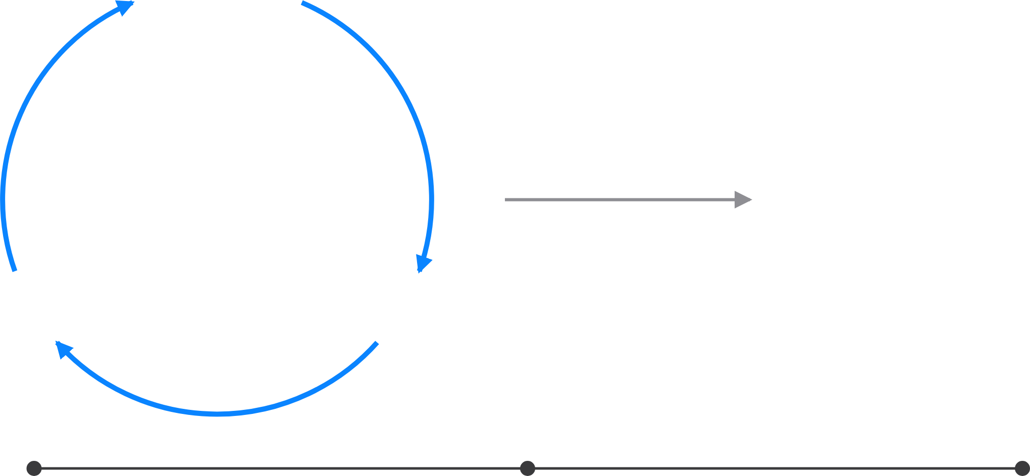



Where the Human Sits
Reason
Care-gap report
Observe
Act
Human in the loop
Human on the loop
Human in command
Approves each action
EU High-Level Expert Group on AI, 2019
Notes:
Where the human sits is the real autonomy setting. Human in the loop: a person approves each action before it counts.
<> (Morph)

Slide 47

Where the Human Sits
Reason
Care-gap report
Observe
Act
Human in the loop
Human on the loop
Human in command
Reviews outputs, can step in
EU High-Level Expert Group on AI, 2019
Notes:
(Morph)
Human on the loop: the agent acts on its own. A person reviews its outputs and can step in.
<> (Morph)

Slide 48


Where the Human Sits
Reason
Care-gap report
Observe
Act
Human in the loop
Human on the loop
Human in command
Sets limits, audits after
EU High-Level Expert Group on AI, 2019
Notes:
(Morph)
Human in command: a person sets the limits, decides when and how it's used, and audits after. Each step away has to be earned.
<><>

Slide 49
















How Far Away Is the Attending?
Trainee watches
In the room
Immediately available
Reviews afterwards
Silent run
Human in the loop
Human on the loop
Human in command
ACGME, Common Program Requirements 2026; ten Cate & Taylor, Med Teach 2021; EU High-Level Expert Group on AI, 2019
Notes:
We already hand over autonomy as distance, with every trainee.
First the trainee watches. Then the attending is in the room: direct supervision.
Then immediately available: indirect supervision. Then the attending reviews afterwards: oversight.
<>
An agent moves the same way. A silent run, then a human in the loop, on the loop, and finally in command.
<><>

Slide 50








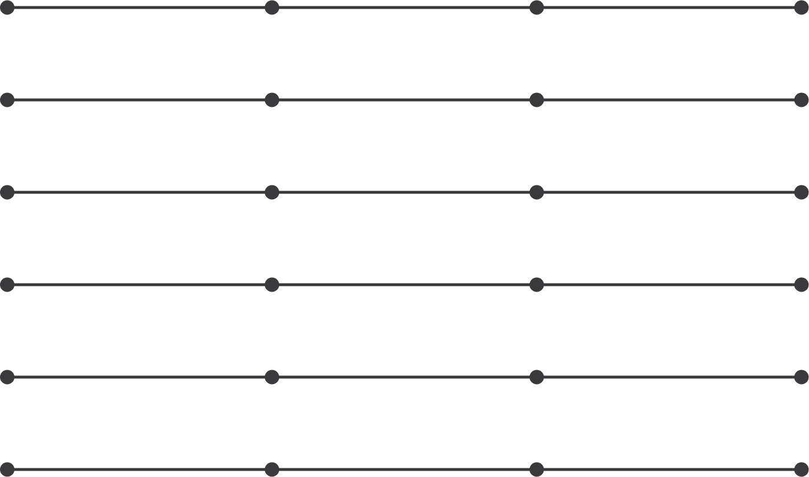







Entrustment Is per Task
Silent run
In the loop
On the loop
In command
Search and read notes
Abstract the ejection fraction
Flag a beta-blocker care gap
Draft a patient letter
Message the patient
Place an order
ten Cate & Taylor, Med Teach 2021; Parasuraman et al., IEEE Trans Syst Man Cybern A 2000; EU High-Level Expert Group on AI, 2019
Notes:
Entrustment is a decision about a task, not about a person. A resident may run a code alone and still need supervision for a pericardiocentesis.
Every task starts in a silent run.
<> (Morph)

Slide 51
Entrustment Is per Task
Silent run
In the loop
On the loop
In command
Search and read notes
Abstract the ejection fraction
Flag a beta-blocker care gap
Draft a patient letter
Message the patient
Place an order
ten Cate & Taylor, Med Teach 2021; Parasuraman et al., IEEE Trans Syst Man Cybern A 2000; EU High-Level Expert Group on AI, 2019
Notes:
(Morph)
Here is one way to set our care-gap agent. This is an example, not data.
Reading notes: human in command. Abstracting the ejection fraction: on the loop.
Flagging the care gap and drafting the letter: in the loop. Messaging Rosa: silent run only. Placing an order: locked.
Each row earns its next step on its own evidence.
<><>

Slide 52



Others Have Earned Autonomy Before
Aviation
Driving
Prescribing
Autoland after evidence
Safety driver first
Clinician signs first
The human moves further away only with evidence.
FAA AC 120-28D; Waymo blog, 2018 and 2020; Utah Office of AI Policy, 2026
Notes:
We're not the first to face this. In aviation, automatic landing in low visibility came down to lower limits only after the FAA saw it work in service.
Driving started with a safety driver at the wheel.
And prescribing is happening now. Utah lets an AI renew chronic prescriptions. At first a clinician signs off on every renewal. After 250 fills in a drug group, and with state approval, that group can go straight to pharmacists.
<>
Same pattern everywhere: the human moves further away only with evidence.
<><>

Slide 53
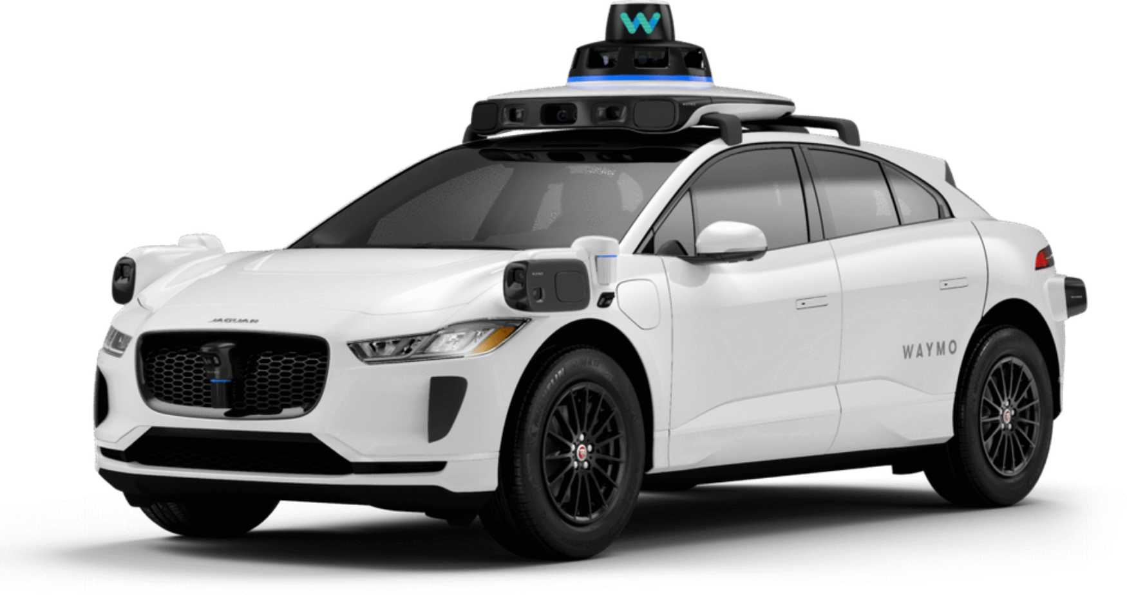

Who Is in the Driver's Seat?
Safety driver
Photo: Waymo. Waymo blog, Dec 2018 and Oct 2020; CPUC, AV passenger programs
Notes:
Cars went through the same moves. First, a safety driver sat at the wheel, ready to take over.
<> (Morph)

Slide 54


Who Is in the Driver's Seat?
Remote assistance
Photo: Waymo. Waymo blog, Dec 2018 and Oct 2020; CPUC, AV passenger programs
Notes:
(Morph)
Then the seat emptied. A person stayed connected from outside the car, as remote assistance.
<> (Morph)

Slide 55


Who Is in the Driver's Seat?
Nobody at the wheel, in a defined area
Photo: Waymo. Waymo blog, Dec 2018 and Oct 2020; CPUC, AV passenger programs
Notes:
(Morph)
Now nobody is at the wheel, only inside a defined area. A person watches from further away, and can still be reached.
<><>
[Q&A] Phoenix ran rides with safety drivers from 2017, then fully driverless for the public in October 2020. California's CPUC required a live passenger-to-remote-operator link for its driverless pilot rides.

Slide 56












Autonomy Earned One Area at a Time
2017
2020
2023
Oct 2026
Safety driver
No driver, one area
Paid rides,
San Francisco
15 cities, freeways
Waymo blog, 2018 and 2020; CPUC, Aug 2023; Alphabet Q3 2026 earnings remarks
Notes:
Waymo started in 2017 with a safety driver at the wheel.
<>
Then no driver, but only in one area, and paid rides in San Francisco in 2023.
<>
Today: fifteen cities and freeways. Each step came after the evidence.
<><>

Slide 57
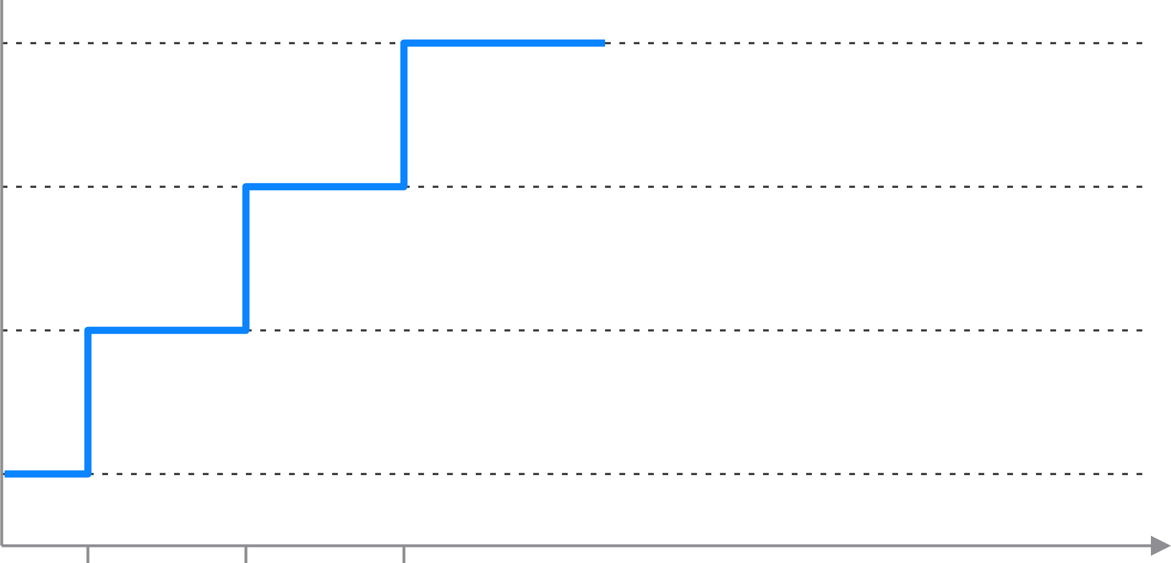











Autonomy Can Go Down
In command
On the loop
In the loop
Silent run
Evidence
Model update
Re-validated
Incident
The Joint Commission, OPPE requirements; Utah Department of Commerce, Doctronic agreement
Notes:
Autonomy isn't a one-way ladder. Each step up passes an evidence gate.
<>
But it can go down. A model update puts the human back in the loop, until it's re-validated.
<>
And after an incident, back to a silent run. We already do this for physicians: continue, limit, or revoke privileges.
<><>

Slide 58






Logged Is Not Monitored
Action log
A person reviews a sample, every week
search_notes("beta blocker")
Alerts that page someone, and pause the run
read_note("2026-05-14")
read_records("medications")
Re-validate after every model or prompt change
lookup_guideline("HFrEF")
draft_letter(…)
search_notes("LVEF")
Report incidents, like any safety event
read_note("2026-03-02")
draft_note(…)
Anyone can press stop
The Joint Commission, OPPE standards FAQ
Notes:
Every agent keeps a log: tool call after tool call. But a log nobody reads is not oversight.
Logged is not monitored.
<>
So after go-live, monitoring has to be real. A person reviews a sample every week. Alerts page someone and pause the run. We re-validate after every change. Incidents get reported like any safety event. And anyone can press stop.
It's the same idea as ongoing review for physicians.
<><>

Slide 59




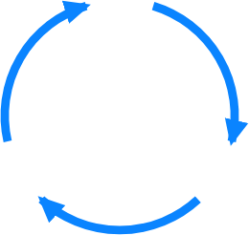







Conclusions
Autonomy is earned
per task, with evidence,
and can be taken back.
Logged is not monitored:
someone has to watch.
Guardrails wrap every step:
set each one up before day one,
and keep checking after.
Notes:
Three things to take home. First, guardrails wrap every step. Set each one up before day one, with a named person signing off, and keep checking after.
<>
Second, autonomy is earned, one task at a time, with evidence. And it can be taken back.
<>
And third, logged is not monitored. Someone has to watch, and be able to press stop.
<><>

Slide 60











A Checklist for Any Clinical Agent
Task
What will it do, and not?
Clinical owner
Model
Which version, tested on our patients?
AI governance committee
Data
Only the data it needs?
Privacy office and IRB
Tools
What can it change? What's locked?
IT security
Prompt
Who can change its instructions?
Clinical owner
Guardrails
Who watches, and who stops it?
Patient safety and quality
Notes:
I'll end with a checklist you can use for any clinical agent. One question for each of Bruno's six steps.
<>
And each answer has a name next to it, someone we already have. Nobody gets every key on day one, and no agent should either.
Thank you. I'll leave this up for questions.

