Slide 1
Rosa, 71
Presented to the hospital with shortness of breath, Admitted for heart failure decompensation.

Slide 2

Could it have been prevented?
Best Practice Alerts
Sedentary Lifestyle
Gaps in Care
Digital Health Coach
Medication Adherence
Dietary indiscretion
Suboptimal GDMT
AI Scribes
Wearables
Missed Diagnosis
Clinician Inertia
Remote Monitoring
DeVore, AD et al JACC Heart Fail. 2025, Pedroso, AF and Khera, R. npj CV Health 2025
Notes:
The range of digital interventions targets various points of friction in heart failure ehatlh care. When thinking how to address sedentary lifestyle and dietary indiscresion, we now have wearables, nearables and digital health coaches to monitor and guide patients at a more granular level that structured visits. Suboptimal guideline-directed and foundational medical therapy has the highest yield for improving mortality and preventing rehospitalizaiton in heart failure, but barriers such as cost, side effects, poor health literacy, and clinician inertia can all contribute. Digtial interventions such as best practice alerts, remote automated medication titration using large language models, and AI scribes to reduce clinicial burden for clinicians can address these issues as well. Smartboard apps and digital dashboards democratize health literacy and can assist the vast majority of heart failure patients with their care. We also now have wireless scales and invasive pulmonary pressure measurements that can help guide diuresis and prevent decompensation. Finally, AI-ECG and wearable screening are accurately identifying patients with structural heart disease and treatable cardiomyopathies such as attr amyloid cardiopyopathy early in the disease, potentially democratizing and allowing for earlier screening of these diseases.

Slide 3
Large language models accelerate care
Best Practice Alerts
System-wide
Adjudication
General Health Knowledge
Digital Health Coach
Medication Adherence
AI Scribes
Wearables
Personalized Recommendations
Automated Communication
Remote Monitoring
DeVore, AD et al JACC Heart Fail. 2025, Pedroso, AF and Khera, R. npj CV Health 2025
Notes:
The range of digital interventions targets various points of friction in heart failure ehatlh care. When thinking how to address sedentary lifestyle and dietary indiscresion, we now have wearables, nearables and digital health coaches to monitor and guide patients at a more granular level that structured visits. Suboptimal guideline-directed and foundational medical therapy has the highest yield for improving mortality and preventing rehospitalizaiton in heart failure, but barriers such as cost, side effects, poor health literacy, and clinician inertia can all contribute. Digtial interventions such as best practice alerts, remote automated medication titration using large language models, and AI scribes to reduce clinicial burden for clinicians can address these issues as well. Smartboard apps and digital dashboards democratize health literacy and can assist the vast majority of heart failure patients with their care. We also now have wireless scales and invasive pulmonary pressure measurements that can help guide diuresis and prevent decompensation. Finally, AI-ECG and wearable screening are accurately identifying patients with structural heart disease and treatable cardiomyopathies such as attr amyloid cardiopyopathy early in the disease, potentially democratizing and allowing for earlier screening of these diseases.

Slide 4
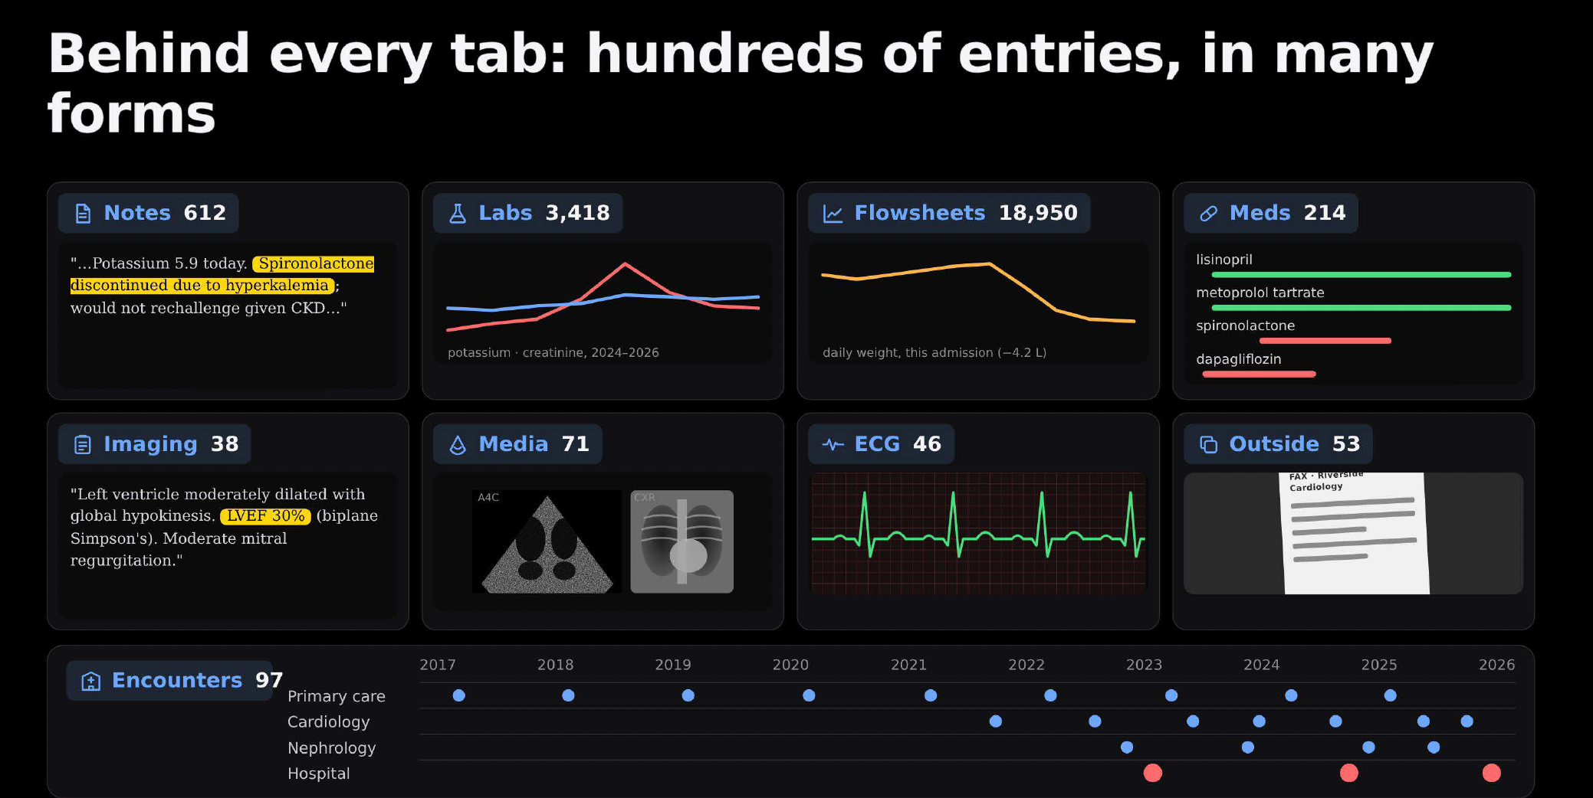
Multimodal Data Capability
Notes:
Could this hospitalization have been prevented?
If we break down what

Slide 5


Moving Beyond Chatbots
Model
Model + context
Agent
Notes:
LLM models are frozen in time, trained on large datasets, but often with general knowledge and without specific clinical context. . Chatbots such as chatgpt, require frequent constant prompting and are reactive to each prompts to rerieve a simple task. Agents are given a prompt but can plan, utilize context and external tools to build a multistep plan to achieve a goal.

Slide 6
Range of Agentic AI Tasks
For Patients
For Providers
For Health Systems
Find and schedule appointments
Personalized advice
Medication remainders
Summarize health data
Documentation
Clinical Decision Support
Administrative support
Real-time education
Identify gaps in care
Quality Metrics
Operations optimization
Patient engagement at scale

Slide 7
Today’s task
Best Practice Alerts
System-wide
Adjudication
General Health Knowledge
Digital Health Coach
Medication Adherence
AI Scribes
Wearables
Personalized Recommendations
Automated Communication
Remote Monitoring
DeVore, AD et al JACC Heart Fail. 2025, Pedroso, AF and Khera, R. npj CV Health 2025
Notes:
The range of digital interventions targets various points of friction in heart failure ehatlh care. When thinking how to address sedentary lifestyle and dietary indiscresion, we now have wearables, nearables and digital health coaches to monitor and guide patients at a more granular level that structured visits. Suboptimal guideline-directed and foundational medical therapy has the highest yield for improving mortality and preventing rehospitalizaiton in heart failure, but barriers such as cost, side effects, poor health literacy, and clinician inertia can all contribute. Digtial interventions such as best practice alerts, remote automated medication titration using large language models, and AI scribes to reduce clinicial burden for clinicians can address these issues as well. Smartboard apps and digital dashboards democratize health literacy and can assist the vast majority of heart failure patients with their care. We also now have wireless scales and invasive pulmonary pressure measurements that can help guide diuresis and prevent decompensation. Finally, AI-ECG and wearable screening are accurately identifying patients with structural heart disease and treatable cardiomyopathies such as attr amyloid cardiopyopathy early in the disease, potentially democratizing and allowing for earlier screening of these diseases.

