Slide 1

Information Encoding Standards Secure API with JWT TokeN
Bruno simoes
200439932
Brunosimoes@gmail.com
Bruno.AndradePintoSimoes@MyGeorgian.ca

Slide 2

About me:
Graduated as a computer technician in 2002 (Degree) – COTEMIG - Brazil;
Graduated in computer networking in 2010 (COLLEGE DEGREE) – Pitágoras – Brazil;
MBA in Business intelligence and big data (2017) – metrocamp – brazil;
Eight and a half years at ibm brazil several positions;
Started in it in 1998 (do the math, I’m not giving up my age);

Slide 3
My project
I made a ASP.NET secure API, that can connect to a local SQL Server Database, and trough the web API query and manipulate the data in the Database.
For the security I decided to go with JWT Tokens due to the wide range of security features that it can provide.

Slide 4
The proposed challenge
1 - How can we transfer personal data securely within their network?
To transfer the personal data securely across a network I decided to build a web api that will act as a middleware between the users consuming the data and the SQL Server database.

Slide 5
The security implementation
2 - What security protocol is best for transferring personal files?
Among the several options used to provide a security layer between the middleware I decided to use the JWT authentication, due to its options, variety, and it’s several security features.

Slide 6
The options of jwt
Issuer
Subject
Audience
Expiration Time
Not Before
Full name
Given name(s) or first name(s)
Surname(s) or last name(s)
Middle name(s)
Shorthand name by which the End-User wishes to be referred to
Source: https://www.iana.org/assignments/jwt/jwt.xhtml

Slide 7
Web Imaging
3 - Can we encode and encrypt images?
It’s planed to the next software iterations, I have a code ready but it failed to be implemented in the current version of the secure API.

Slide 8
Why is API security important?
Businesses use APIs to connect services and to transfer data. Broken, exposed, or hacked APIs are behind major data breaches. They expose sensitive medical, financial, and personal data for public consumption. That said, not all data is the same nor should be protected in the same way. How you approach API security will depend on what kind of data is being transferred.
Source: https://www.redhat.com/en/topics/security/api-security

Slide 9
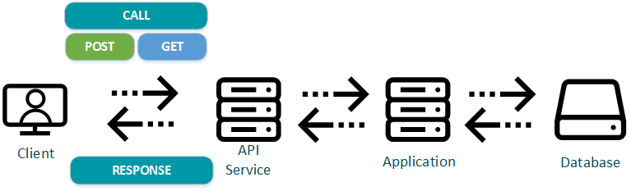
How a api WORKS

Slide 10
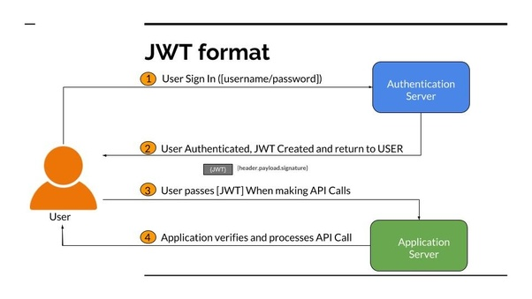
How a secure api with jWt works

Slide 11
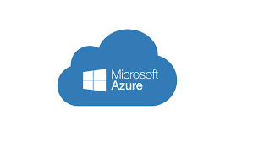
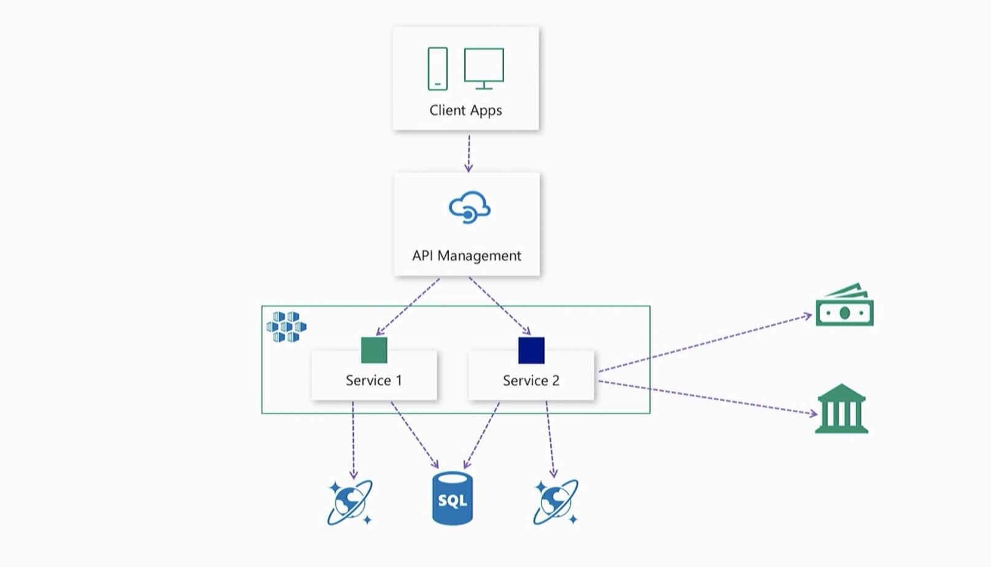
Recommended api frameworks
Microsoft Azure API Framework

Slide 12
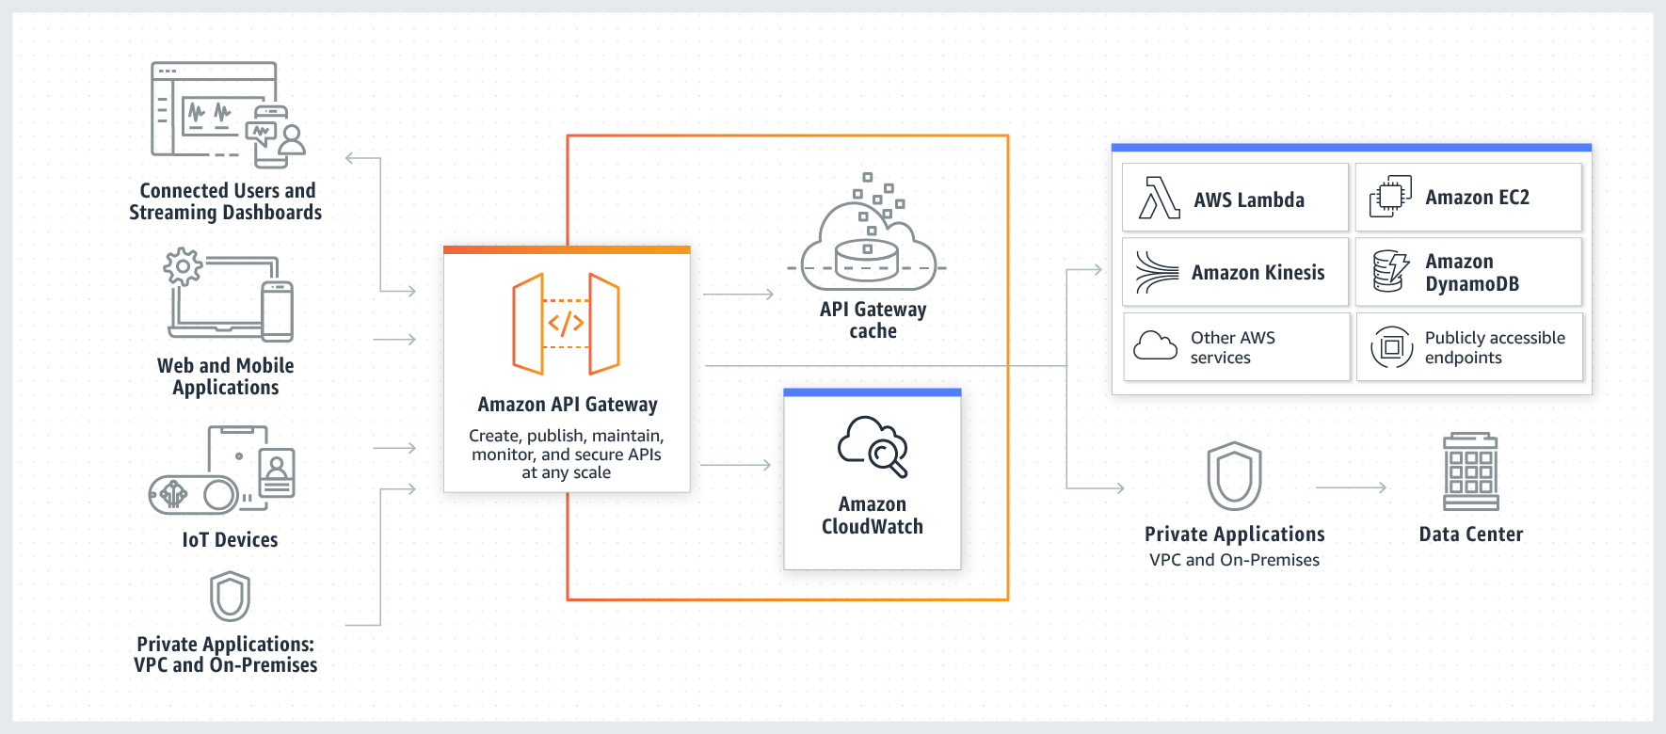

Recommended api frameworks
Amazon AWS API Gateway

Slide 13
Data interexchange and transportation format
JSON is the pattern and almost the only format for transportation and interexchange being used nowadays, using JSON will keep the data in a format that permits the API to communicate with other applications if needed, and make the application ready for future scalability like mobile and IOT.

Slide 14
Storing data in other locations
My recommendation would be to also store the data in JSON files, and to replicate the centralized API solution as a local solution using local servers. This would prevent accidental data changes, unauthorized access to sensitive data, maintain the data quality and keep the security layers that the data may require.

Slide 15
Ethical concerns regarding personal data
Data regarding several industries need trained personnel to be able to be able to even look at it such as HIPAA (Health Insurance Portability and Accountability Act).
General Data Protection Regulation (GDPR) and Personal Information Protection Act (PIPA) are considered good guidelines regarding data protection.

Slide 16
Ethical concerns regarding personal data
All people handling the data should receive proper training.
Consider adopting Non Disclosure agreements, and codes of conduct.
Consider following best practices such as the DAMA DMBOK for Data Governance or similar.

Slide 17
Ethical concerns regarding personal data
Have regular trainings to ensure that data is not only an corporate asset, personal data, as the name implies is data about someone, about they health, they financial security, and that this data is linked to a real life person.

Slide 18

Thank You and solution demo

