Slide 1


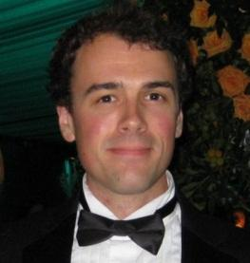

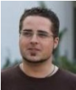
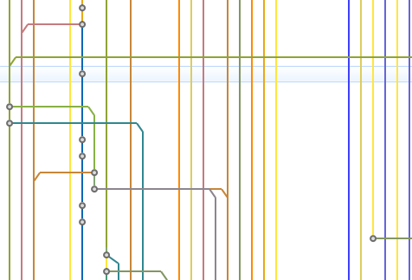
Chris Aniszczyk
(Twitter)
Stefan Lay (SAP)
Kevin Sawicki (GitHub)
The Git Tutorial
EclipseCon 2012
http://eclipse.org/jgit
http://eclipse.org/egit
http://code.google.com/p/gerrit
Matthias Sohn (SAP)
Benjamin Muskalla (Tasktop)

Slide 2
Agenda
Introduction
Exercises
Setup & Cloning the Sample Repository
Local Development with EGit
Gerrit Code Review Mylyn Integration
GitHub Eclipse Support
Q & A
Copyright © C. Aniszczyk, S. Lay, B. Muskalla, K. Sawicki, M. Sohn

Slide 3


Git
… a distributed revision control system built by the Linux project to facilitate code review
Distributed means no central repository
No central authority!
Easy offline usage
Easy to branch a project
Protected against manipulation by cryptographic hashes
Really good at merging
Coordination only needed "after the fact”
Easier to rejoin (or refresh) branches
Structured around commits (i.e. patches)
Tools for identifying problem commits (git bisect)
Tools for restructuring branches w/ specific commits
Copyright © C. Aniszczyk, S. Lay, B. Muskalla, K. Sawicki, M. Sohn

Slide 4

Git at Eclipse
JGit is a lightweight Java library implementing Git
http://www.eclipse.org/jgit/
EGit is an Eclipse Team provider for Git based on JGit
http://www.eclipse.org/egit/
Gerrit Code Review is a Git server based on JGit adding permission control and review workflow
http://code.google.com/p/gerrit
Gerrit @ Eclipse went live
https://git.eclipse.org/r/
Copyright © C. Aniszczyk, S. Lay, B. Muskalla, K. Sawicki, M. Sohn

Slide 5
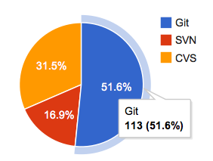
Eclipse is Moving to Git
CVS has been deprecated and will be retired end of 2012
Project & code repository breakdown as of 2012-03-25
http://eclipse.org/projects/scmcountdown.php
Copyright © C. Aniszczyk, S. Lay, B. Muskalla, K. Sawicki, M. Sohn, S. Zivkov

Slide 6
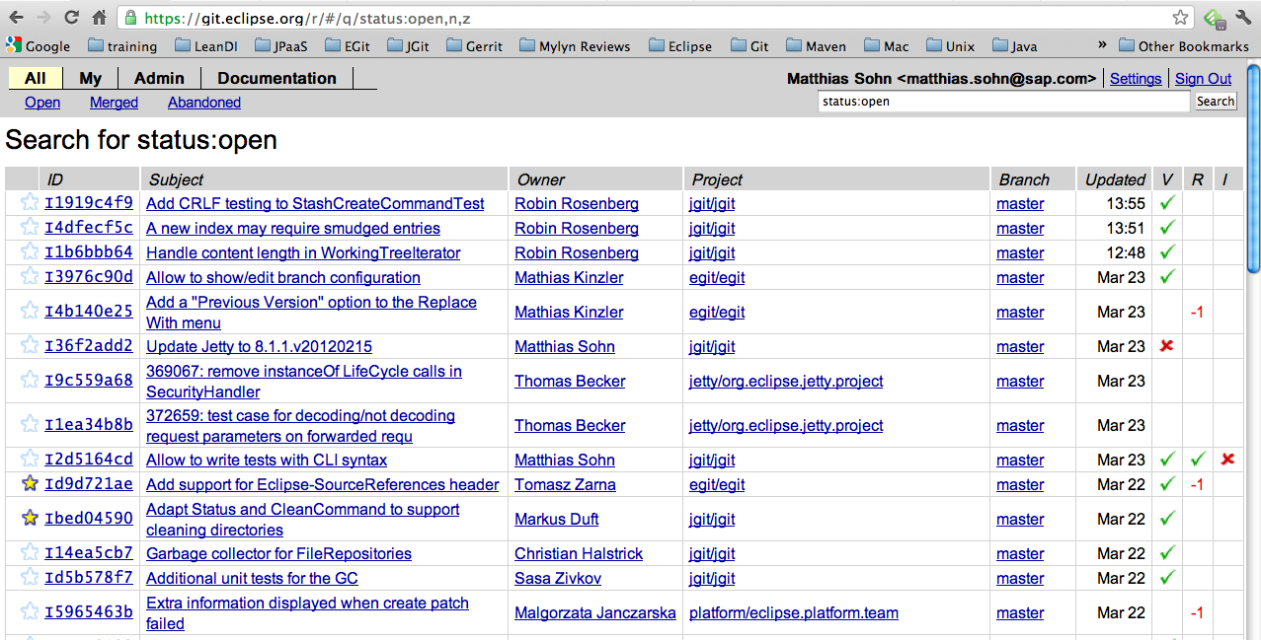
Gerrit Code Review @ Eclipse
https://git.eclipse.org/r/ is now available for all projects
now used by:
EGit, Jetty, JGit,
Jubula, Libra, Lyo,
Mylyn, Platform, R4E,
Recommenders,
Skalli, Tycho
Copyright © C. Aniszczyk, S. Lay, B. Muskalla, K. Sawicki, M. Sohn, S. Zivkov

Slide 7
Modern Code Review – What is it ?
Guido van Rossum [1]
When one developer writes code, another developer is asked to review that code
A careful line-by-line critique
Happens in a non-threatening context
Goal is cooperation, not fault-finding
Integral part of coding process
Otherwise this will happen:
Debugging someone else's broken code
– Involuntary code review: Not so good; emotions may flare
[1] http://code.google.com/p/rietveld/downloads/detail?name=Mondrian2006.pdf
Copyright © C. Aniszczyk, S. Lay, B. Muskalla, K. Sawicki, M. Sohn

Slide 8
Code Review – Benefits
Guido van Rossum [1]
Four eyes catch more bugs
Catch bugs early to save hours of debugging
Mentoring of new developers / contributors
Learn from mistakes without breaking stuff
Establish trust relationships
Prepare for more delegation
Good alternative to pair programming
asynchronous and across locations
Coding standards
Keep overall readability & code quality high
[1] http://code.google.com/p/rietveld/downloads/detail?name=Mondrian2006.pdf
Copyright © C. Aniszczyk, S. Lay, B. Muskalla, K. Sawicki, M. Sohn

Slide 9






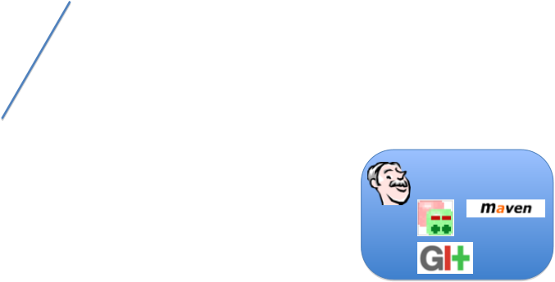
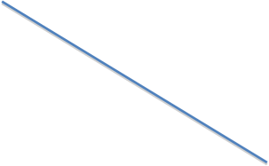







Gerrit
git
git
git
git
- verify proposed changes
- continuous integration builds
- clone repository
- fetch / push changes
Developer PC
Developer PC
Hudson
git
git
Copyright © C. Aniszczyk, S. Lay, B. Muskalla, K. Sawicki, M. Sohn

Slide 10
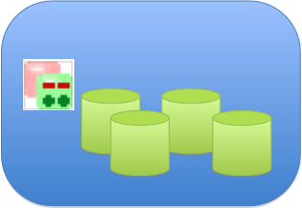
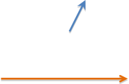
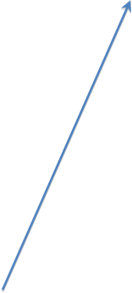

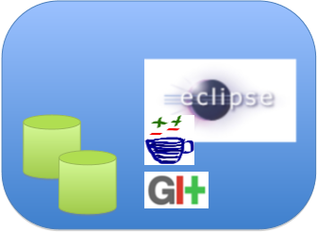
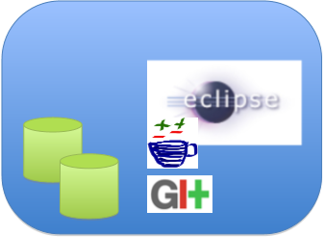
Gerrit
git
git
git
git
master
change 12
submit accepted
change 12
change 10
change 23
fetch master to get updates
fetch change 23
to try it
push improved
change 10
Developer PC
Developer PC
git
git
git
git
Copyright © C. Aniszczyk, S. Lay, B. Muskalla, K. Sawicki, M. Sohn

Slide 11
Local Development with EGit
Copyright © C. Aniszczyk, S. Lay, B. Muskalla, K. Sawicki, M. Sohn

Slide 12













Gerrit
git
git
git
git
clone repository
Developer PC
Developer PC
git
git
Copyright © C. Aniszczyk, S. Lay, B. Muskalla, K. Sawicki, M. Sohn

Slide 13
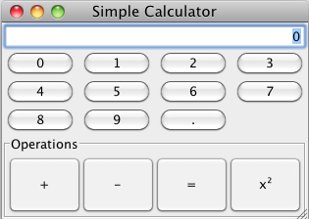
Sample Application
Copyright © C. Aniszczyk, S. Lay, B. Muskalla, K. Sawicki, M. Sohn

Slide 14
Git Exercises
1 Setup & Clone the example repository
2 Develop a feature
3 Develop 2nd feature and use staging view
4 Work on branches in parallel
5 Fetch the latest state
6 Merging, Rebasing, Resolving Conflicts
Copyright © C. Aniszczyk, S. Lay, B. Muskalla, K. Sawicki, M. Sohn
Notes:
Distribute per mail? Shared folder?
*

Slide 15
Git Exercises
7 History view
8 Reset branch to previous state
9 Change a series of commits
10 Git blame
11 Stash
12 Submodules
Copyright © C. Aniszczyk, S. Lay, B. Muskalla, K. Sawicki, M. Sohn
Notes:
*

Slide 16
Gerrit Code Review
Copyright © C. Aniszczyk, S. Lay, B. Muskalla, K. Sawicki, M. Sohn

Slide 17

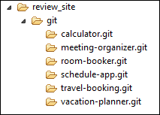
Gerrit
Server managing central Git repositories
Gerrit
Copyright © C. Aniszczyk, S. Lay, B. Muskalla, K. Sawicki, M. Sohn

Slide 18
Gerrit
Access Control
Gerrit
Copyright © C. Aniszczyk, S. Lay, B. Muskalla, K. Sawicki, M. Sohn
Notes:
Git itself has no access controls. There are various tools to add access controls for Git, Gerrit is one of them.
*

Slide 19

Gerrit
Access Control
Gerrit
git push
Copyright © C. Aniszczyk, S. Lay, B. Muskalla, K. Sawicki, M. Sohn

Slide 20
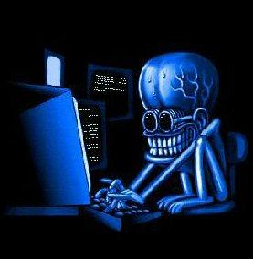
Gerrit
Access Control
Gerrit
Copyright © C. Aniszczyk, S. Lay, B. Muskalla, K. Sawicki, M. Sohn

Slide 21
Gerrit
Access Control
Gerrit
Copyright © C. Aniszczyk, S. Lay, B. Muskalla, K. Sawicki, M. Sohn
Notes:
Access rights fine granular on branch level and per Gerrit action.

Slide 22
Gerrit
Code Review
Gerrit
Copyright © C. Aniszczyk, S. Lay, B. Muskalla, K. Sawicki, M. Sohn

Slide 23
Gerrit
Code Review
Gerrit
git push
Copyright © C. Aniszczyk, S. Lay, B. Muskalla, K. Sawicki, M. Sohn

Slide 24
Gerrit
Code Review
Gerrit
git push
Copyright © C. Aniszczyk, S. Lay, B. Muskalla, K. Sawicki, M. Sohn

Slide 25


Gerrit
Code Review
Gerrit
git push <for_review>
Copyright © C. Aniszczyk, S. Lay, B. Muskalla, K. Sawicki, M. Sohn
Notes:
Gerrit behaves as normal git server

Slide 26
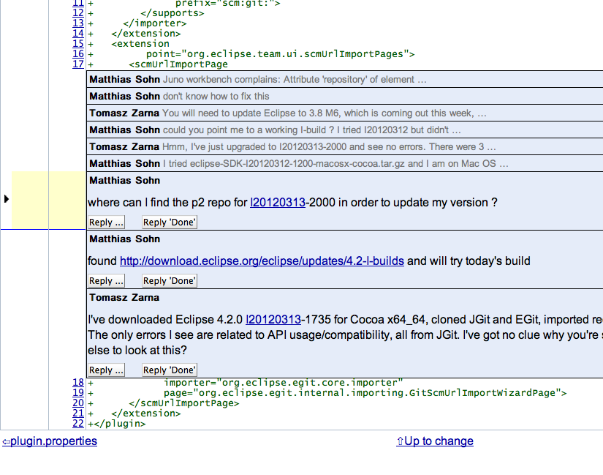
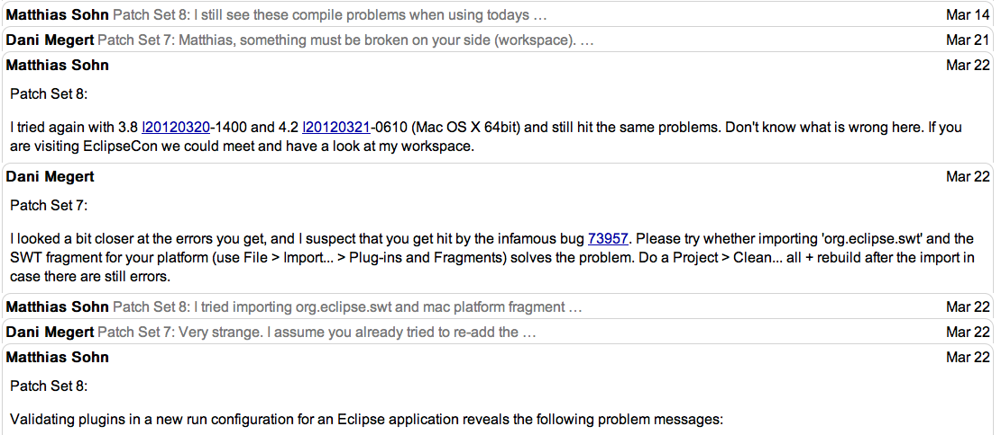
Gerrit
Commenting
Copyright © C. Aniszczyk, S. Lay, B. Muskalla, K. Sawicki, M. Sohn

Slide 27
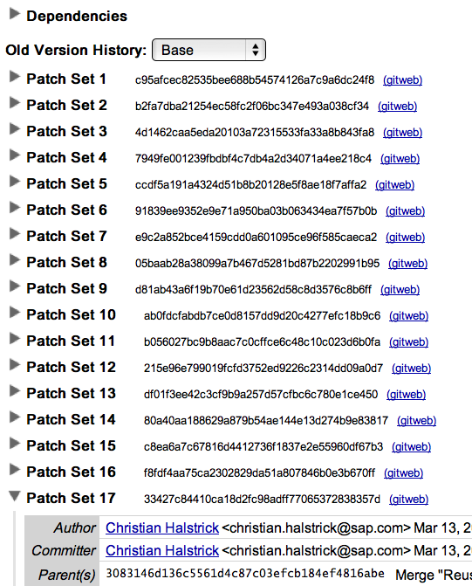
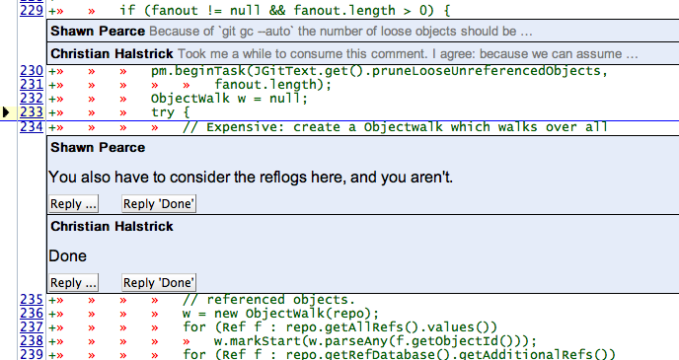
Gerrit
Discussing & Improving
Copyright © C. Aniszczyk, S. Lay, B. Muskalla, K. Sawicki, M. Sohn

Slide 28
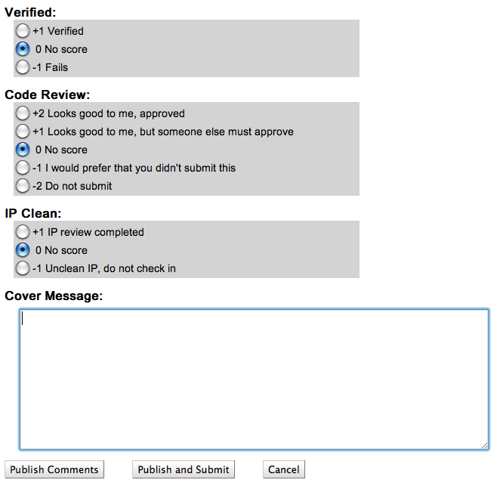
Gerrit
Voting
Copyright © C. Aniszczyk, S. Lay, B. Muskalla, K. Sawicki, M. Sohn

Slide 29
Gerrit
Do not miss:
Talk by Shawn Pearce (Gerrit founder and Project Lead)
Harnessing Peer Code Reviews
Wednesday, 14:15, Ballroom A
Copyright © C. Aniszczyk, S. Lay, B. Muskalla, K. Sawicki, M. Sohn
Notes:
r

Slide 30
http://git.eclipse.org/r/
Gerrit
git
git
git
git
- verify proposed changes
- continuous integration builds
- clone repository
- fetch / push changes
Developer PC
Developer PC
Hudson
git
git
Copyright © C. Aniszczyk, S. Lay, B. Muskalla, K. Sawicki, M. Sohn

Slide 31
Gerrit Exercises
1 Configure push to Gerrit
2 Push change to Gerrit
3 Review change
4 Improve a change
5 Submit a change to the codebase
6 View Gerrit review notes
7 Starting Demo Gerrit Server (backup)
Copyright © C. Aniszczyk, S. Lay, B. Muskalla, K. Sawicki, M. Sohn
Notes:
*

Slide 32
Mylyn Integration
Copyright © C. Aniszczyk, S. Lay, B. Muskalla, K. Sawicki, M. Sohn

Slide 33
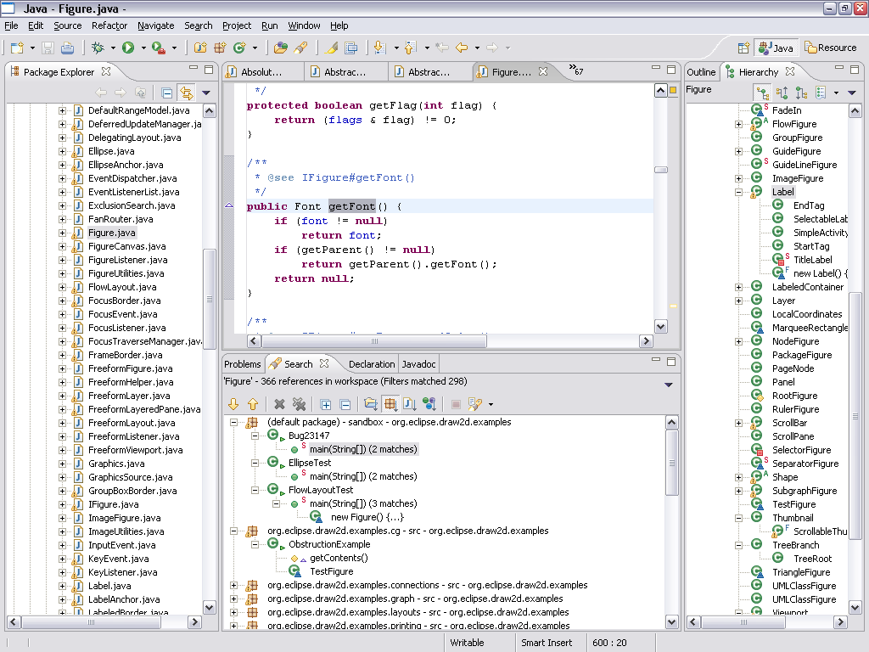
90% Irrelevant
Copyright © C. Aniszczyk, S. Lay, B. Muskalla, K. Sawicki, M. Sohn

Slide 34
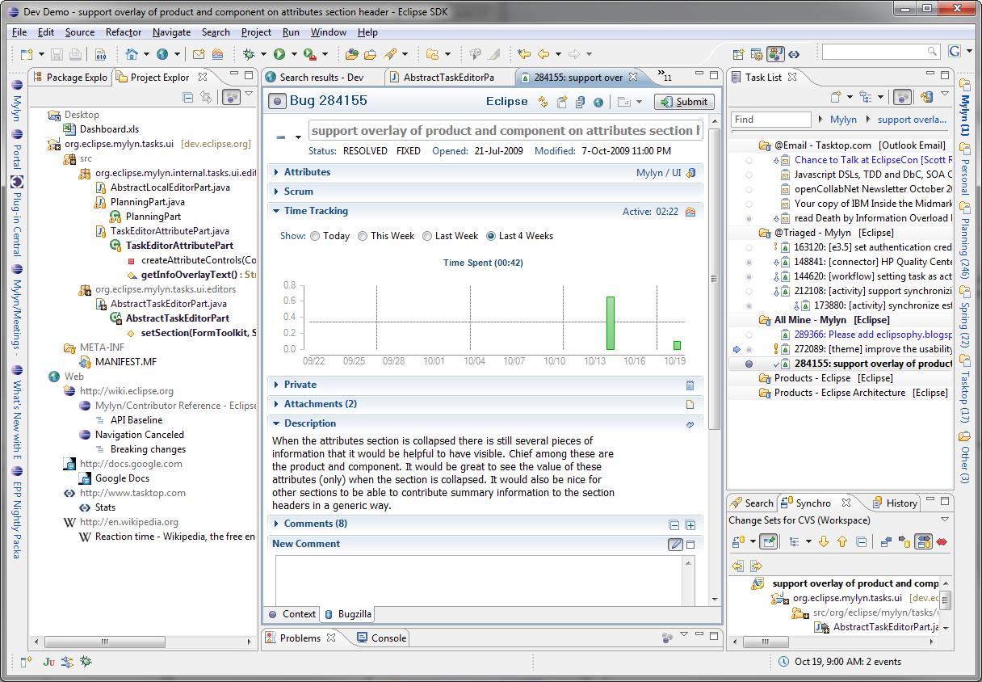
Task-focused IDE
Copyright © C. Aniszczyk, S. Lay, B. Muskalla, K. Sawicki, M. Sohn

Slide 35
< Demo >
Copyright © C. Aniszczyk, S. Lay, B. Muskalla, K. Sawicki, M. Sohn

Slide 36
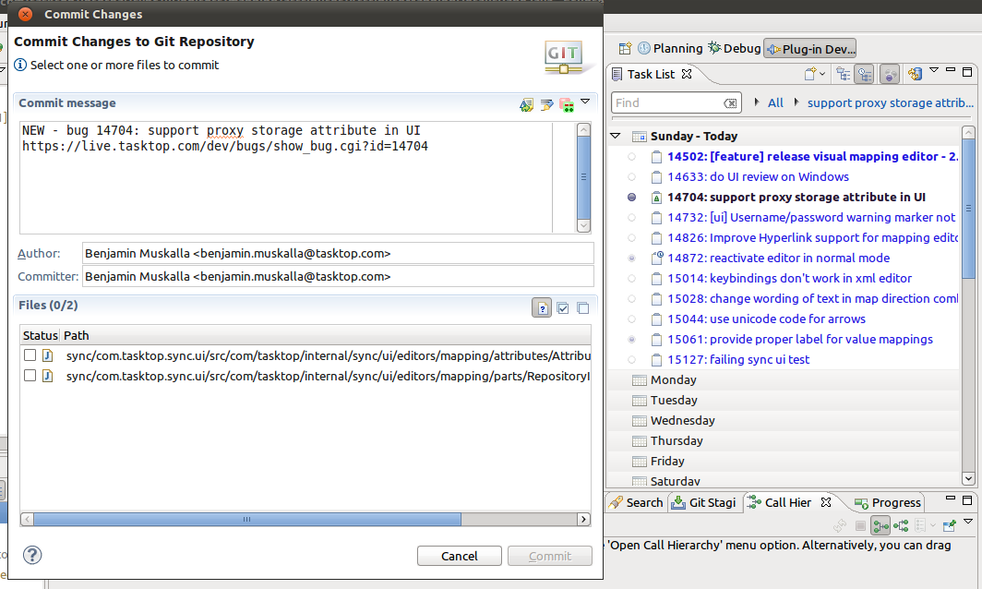
Exercises: Mylyn Integration
1 Mylyn / EGit Integration
Copyright © C. Aniszczyk, S. Lay, B. Muskalla, K. Sawicki, M. Sohn

Slide 37
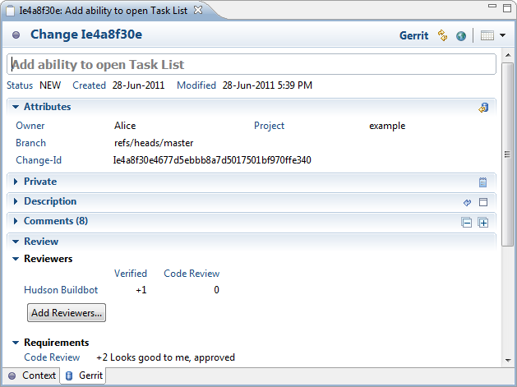
Exercises: Mylyn Integration
2 Use Gerrit from within the IDE
Copyright © C. Aniszczyk, S. Lay, B. Muskalla, K. Sawicki, M. Sohn

Slide 38
Exercises: Mylyn Integration
1 Mylyn / EGit Integration
2 Use Gerrit from within the IDE
Related talk
Wednesday, 1:30PM - 2:15PM
Build, Stage, Review, Merge: Task-focused Development the Eclipse Mylyn Way
Copyright © C. Aniszczyk, S. Lay, B. Muskalla, K. Sawicki, M. Sohn

Slide 39

GitHub Eclipse Support
Copyright © C. Aniszczyk, S. Lay, B. Muskalla, K. Sawicki, M. Sohn

Slide 40
GitHub Eclipse Support
https://github.com/eclipse
248 mirrored repositories
Browsing source code
Comparing branches and tags
Activity feeds
Charts & graphs
Downloading snapshots
Copyright © C. Aniszczyk, S. Lay, B. Muskalla, K. Sawicki, M. Sohn

Slide 41
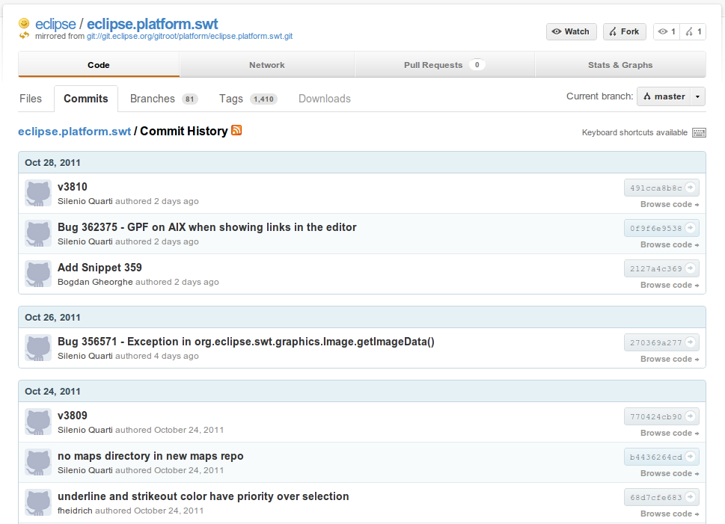
GitHub Eclipse Support

Slide 42
GitHub EGit Integration
GitHub Mylyn Connector
Issues
Gists
Pull Requests
Import Wizard
GitHub Java API
Maven plugins
Reporting
Automating tasks
Copyright © C. Aniszczyk, S. Lay, B. Muskalla, K. Sawicki, M. Sohn

Slide 43
GitHub Exercises: EGit Integration
1 Setup Share on GitHub
Copyright © C. Aniszczyk, S. Lay, B. Muskalla, K. Sawicki, M. Sohn

Slide 44
Q&A
Copyright © C. Aniszczyk, S. Lay, B. Muskalla, K. Sawicki, M. Sohn

Slide 45
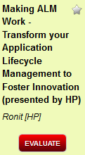
Give Feedback on the Sessions
1
Sign In: www.eclipsecon.org
2
Select Session Evaluate
3
Vote
Notes:
*

