Slide 1
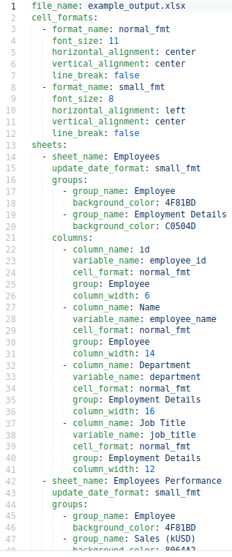

Slide 2
Workbook Configurations

Slide 3
Sheet 1 Configurations

Slide 4
Sheet 2 Configurations

Slide 5
Workbook Configurations

Slide 6
Workbook Configurations
Cell format 1

Slide 7
Workbook Configurations
Cell format 2

Slide 8
Sheet 1 Configurations

Slide 9
Sheet 1 Configurations
Sheet Groups

Slide 10
Sheet 1 Configurations
Sheet Columns

Slide 11
Sheet 1 Configurations
Sheet Groups

Slide 12
Sheet 1 Configurations
Sheet Groups
Group 1

Slide 13
Sheet 1 Configurations
Sheet Groups
Group 2

Slide 14
Sheet 1 Configurations
Sheet Columns

Slide 15
Sheet 1 Configurations
Sheet Columns
Column 1

Slide 16
Sheet 1 Configurations
Sheet Columns
Column 2

Slide 17
Sheet 1 Configurations
Sheet Columns
Column 3

Slide 18
Sheet 1 Configurations
Sheet Columns
Column 4

Slide 20
Name to be displayed in Excel

Slide 21
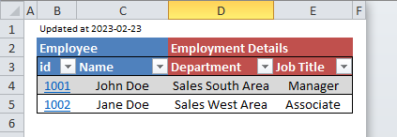
Name to be displayed in Excel

Slide 22
Name to be displayed in Excel

Slide 24
Variable name from data

Slide 25
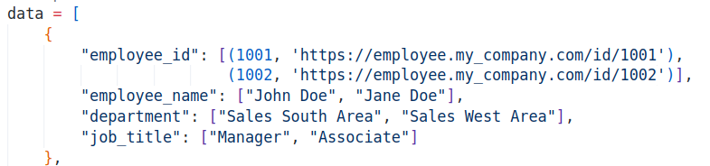
Variable name from data

Slide 26
Variable name from data

Slide 28
Previously defined Cell Format

Slide 29
Previously defined Cell Format

Slide 31
Previously defined Group

Slide 32
Previously defined Group

Slide 33
Previously defined Group

Slide 34
Previously defined Group

Slide 36
Workbook Configurations
Cell format 1
Cell format 2
Sheet 1 Configurations
Sheet Groups
Group 1
Group 2
Sheet Columns
Column 1
Column 2
Column 3
Column 4
Sheet 2 Configurations

Slide 37
Name to be displayed in Excel
Variable name from data
Previously defined Cell Format
Previously defined Group

