Slide 1
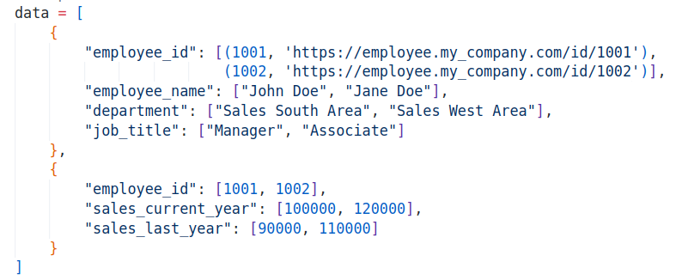

Slide 2
Sheet 1

Slide 3
Sheet 2

Slide 4
Column 1
Sheet 2

Slide 5
Column 2
Sheet 2

Slide 6
Sheet 2
Column 3

Slide 8
Cell with hyperlink

Slide 9
Value

Slide 10
URL

