Slide 1
DCC Week 2023
Explicação da técnica

Slide 2
Resumo do processo
ECG Data
Embedding
Boosting
Hyperparameter Tuning
Augmentation
Neural Network
(Classification Pretrain)
Shift
Scaling
Noise

Slide 3
Arquitetura da rede neural
Input Layer
(4096x12)
Embedding
ResNetBlock
FFTBlock
SignalEmbedding
ResNetBlock
Input
Input
Input
x8
FFTBlock
Conv1D
Conv1D
Conv1D
MaxPool1D
Conv1D
FFT
Conv1D (Softmax)
BatchNorm
BatchNorm
Embedding
Flatten
Dropout
Dropout
Dense
512x1
Dense
256x1
Output
7x1

Slide 4
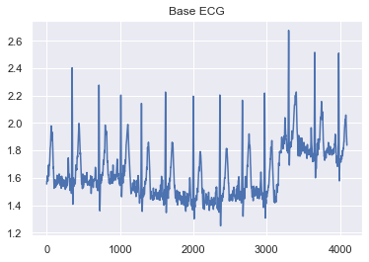
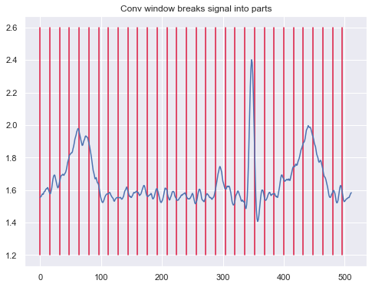
SignalEmbedding Block
SignalEmbedding
Input
Conv1D
Conv1D (Softmax)
Embedding
Conv1D (Softmax)
Embedding

Slide 5
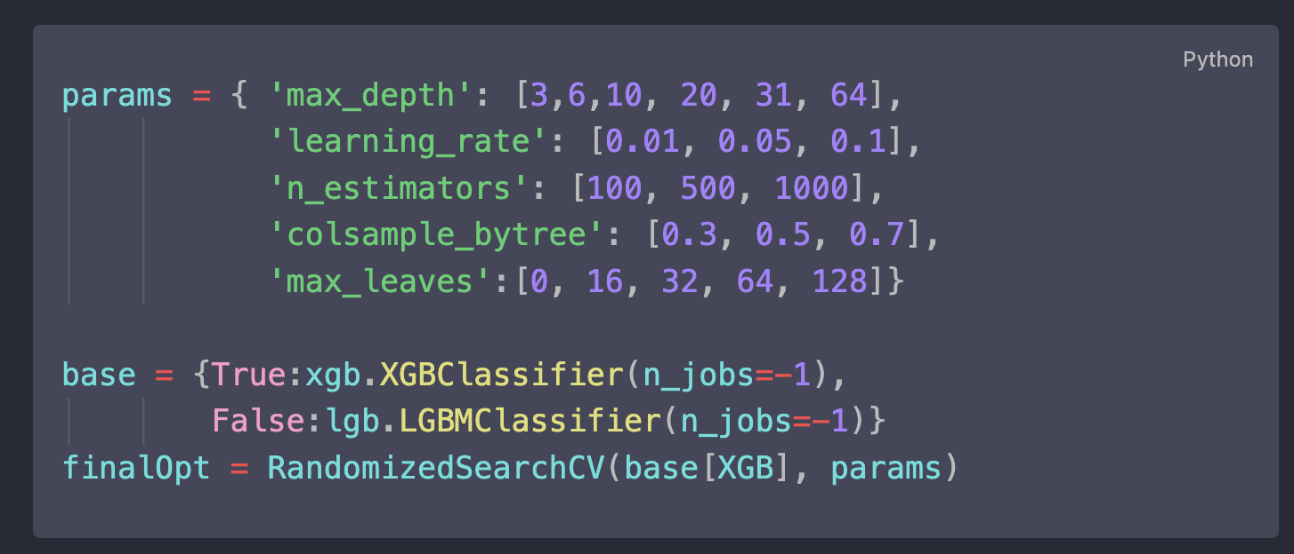
Tuning de Hiperparâmetros

Slide 6
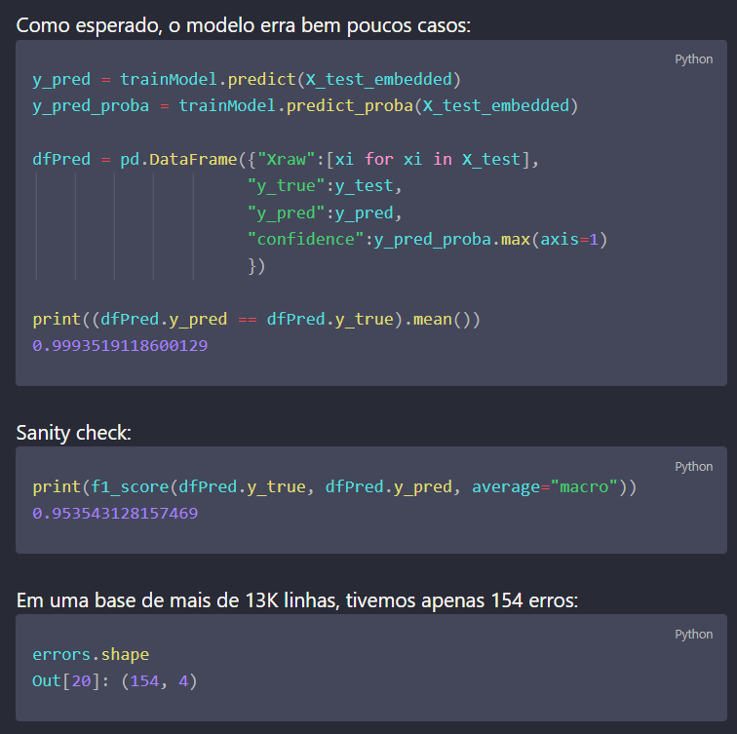
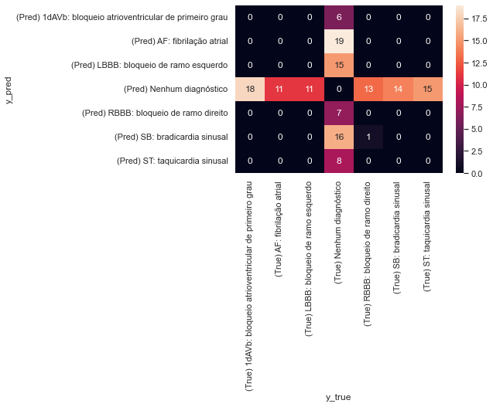
Erros do modelo

Slide 7
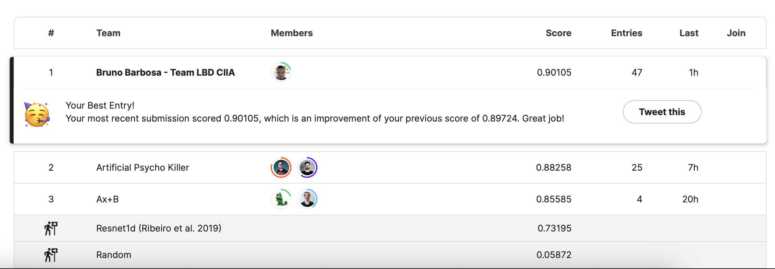
Resultado

