Slide 1

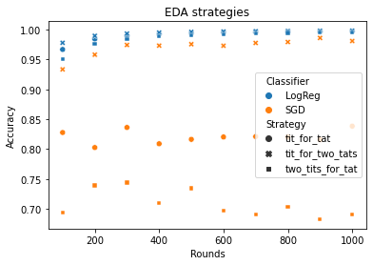
Pascal and Bruno
Predicting the next decision
in the prisoner’s dilemma using ML
Based only on the vector of decisions made previously by the opponent, we tried to predict the next decision using different classification algorithms and engineered features.
Takeaways (all of these points only apply using the specific features we choose, still some patterns seem to be very strong):
“Tit for two tats” seems to the easiest algorithm to predict, which comes as a surprise, as ”tit for tat” would seem less complex
LogReg performs better through-out the analysis
Because of the playing-algorithm’s simplicity, there is not much more to learn after 200 rounds. To further improve the prediction, one would have to engineer better features or use Neural Network based approaches
Important to note, is the fact that we did not only measure these results, but our code allows for the testing of all possible playing-algorithms in combination with all classification approaches for a selected number of rounds.
Features used
Total True | After False | After True | Last 1 | Last 2 | Last 3 | Correlation 1 and 2 | Correlation 1 and 3
Normalized number of True | Average response to False | Average response to True | Opponent’s last response | Opponent’s penultimate response | Opponent’s third to last response | Opponent’s last response * own penultimate response | Opponent’s last response * own third to last response

