Slide 1
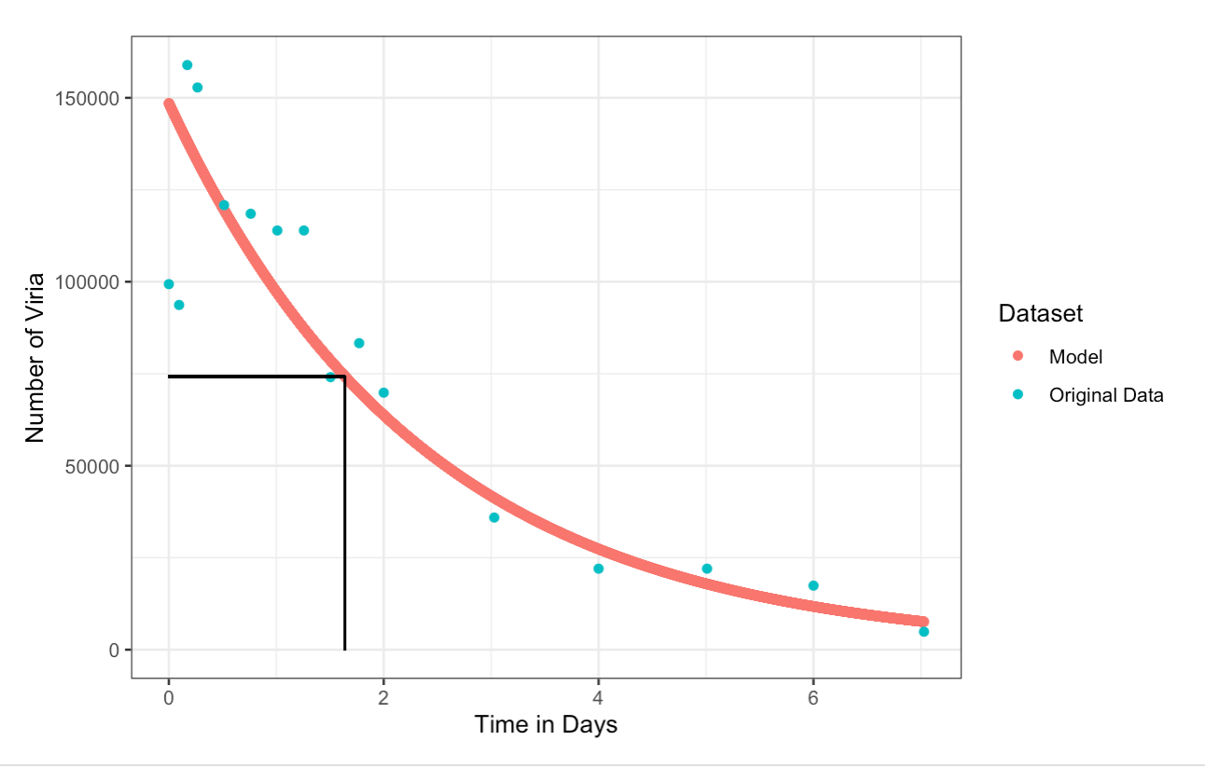
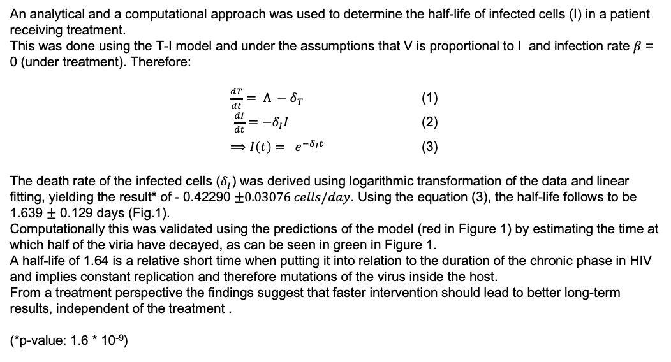
Determination of the half-life of infected Cells in HIV using Virus Load Data from treated patients (~1.638 d)
An analytical and a computational approach was used to determine the half-life of infected cells (I) in a patient receiving treatment.
This was done using the T-I model and under the assumptions that V is proportional to I and infection rate $β$ = 0 (under treatment). Therefore:
$\frac{dT}{dt}= Λ −δ_{T}$ (1)
$\frac{dI}{dt}=−δ_{I}I$ (2)
$⟹$ $I\left(t\right)= e^{−δ_{I}t}$ (3)
The death rate of the infected cells ($δ_{I}$) was derived using logarithmic transformation of the data and linear fitting, yielding the result* of - 0.42290 $±0.03076 cells/day$. Using the equation (3), the half-life follows to be 1.639 $±$ 0.129 days (Fig.1).
Computationally this was validated using the predictions of the model (red in Figure 1) by estimating the time at which half of the viria have decayed, as can be seen in green in Figure 1.
A half-life of 1.64 is a relative short time when putting it into relation to the duration of the chronic phase in HIV and implies constant replication and therefore mutations of the virus inside the host.
From a treatment perspective the findings suggest that faster intervention should lead to better long-term results, independent of the treatment .
(*p-value: 1.6 * 10⁻⁹)
Figure 1: Decay of Viria in a treated patient. The original data is depicted in blue and the predicted data from a linear model in red. The computationally determined half-time is marked in black.
Gioia Wick, Bruno Palau

