Slide 1
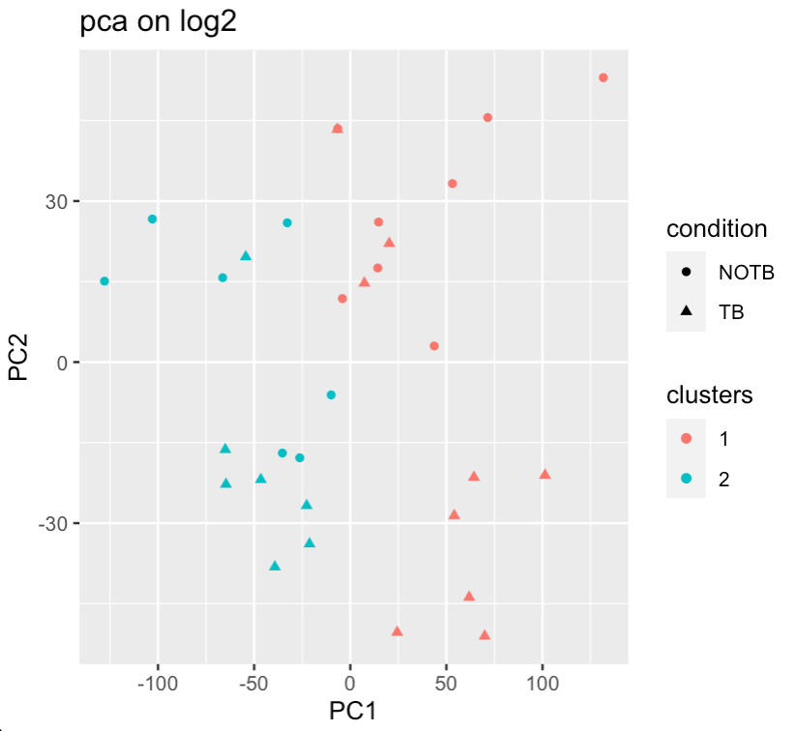
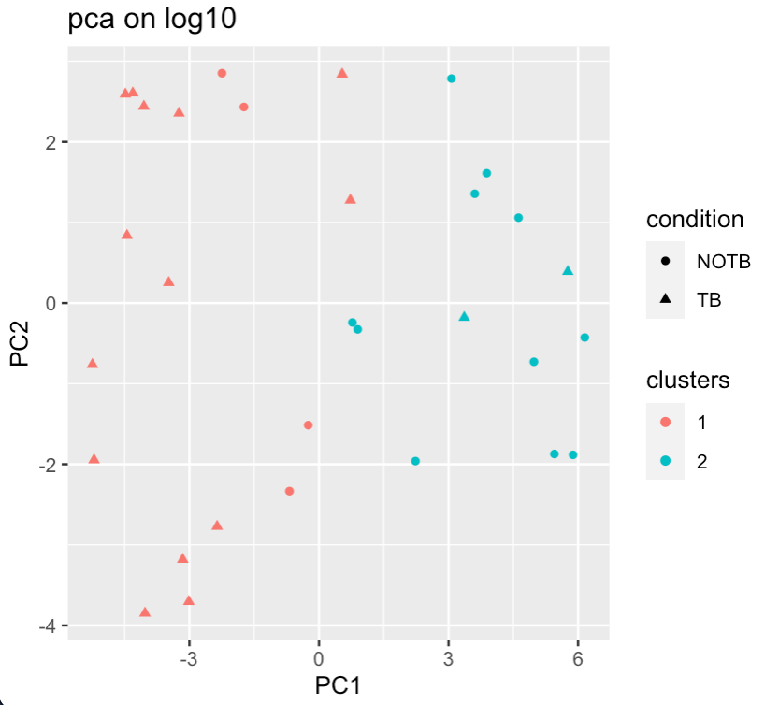
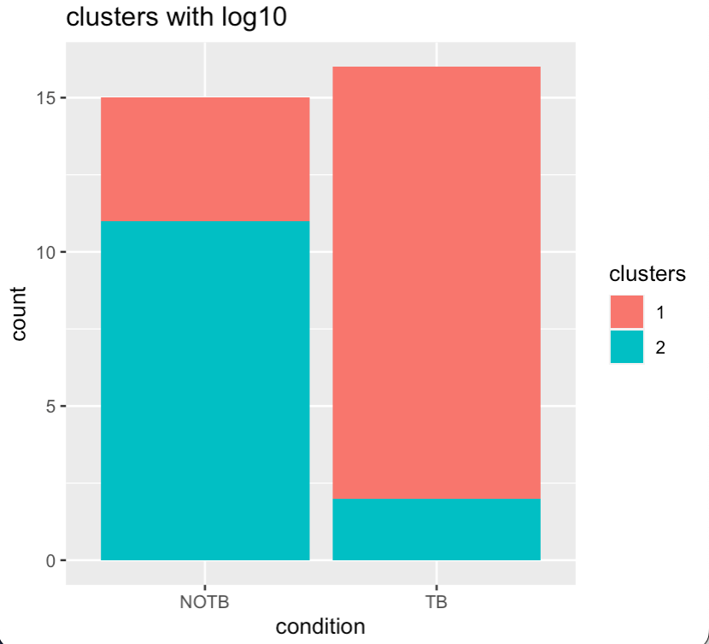
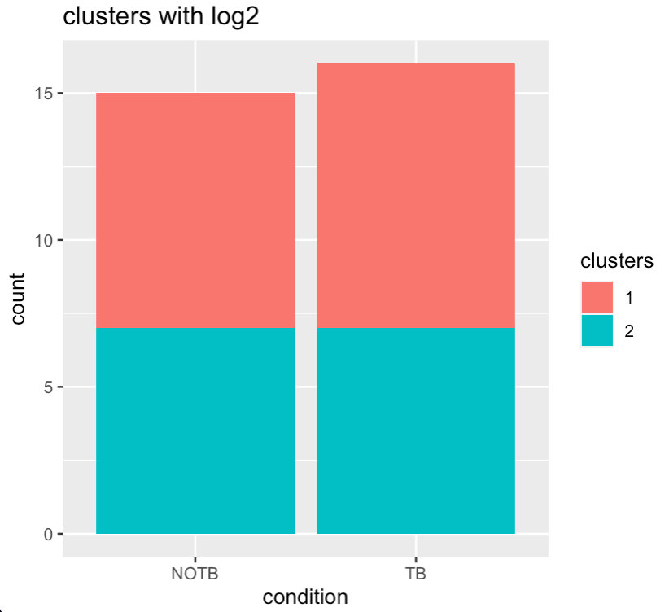
Log-transformation influences PCA results and further clustering
There is a significant difference in the visualization of the data structure in the PCA-space depending on the priorly used log-transformation.
Furthermore, clustering of the sample is heavily influenced and allows for different conclusion to be drawn.
-> Dimensionality reduction must be taken with a grain of salt
-> Data transformation must be done carefully and
designed with consideration
Evelin Pandiamakkal, Bruno Palau

