Slide 1
PRICING SCIENCE · STREAMING · 2026
PRISM
v2.0
Pricing & Revenue Intelligence for Streaming Markets
Video+ · Strategic pricing insights for the CMO
OLS Log-Log · 95% CI propagated · Cannibalization · Seasonal Timing · Van Westendorp
6
539
0.8K
12
Packages
Formulas
Revenue Uplift
Months of data

Slide 2
What PRISM v2 reveals for the Video+ CMO
5 dimensions of pricing intelligence — from elasticity to optimal price adjustment timing
01
OLS Elasticity by package
02
95% CI — Uncertainty range
How much each package can sustain a price increase
Pessimistic vs. optimistic scenario by channel
03
Willingness-to-Pay (WTP)
04
Bundle cannibalization
What each segment is willing to pay
Price adjustment impact on other packages
05
Optimal seasonal timing
The best month to implement each price adjustment

Slide 3
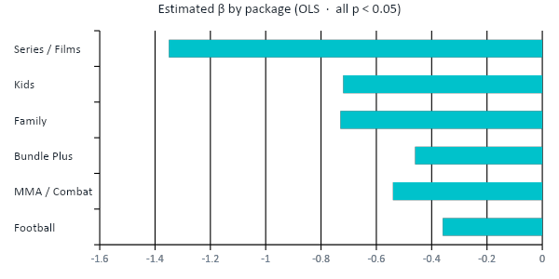
01 OLS ELASTICITY
How much each package can sustain a price increase
OLS log-log regression estimated on 144 observations · ln(Subscribers) = α + β·ln(Price) + γ·Season + δ·Promo
β = Price Elasticity · β < −1.0: Elastic (sensitive) · −1.0 < β < −0.5: Moderately inelastic · β > −0.5: Strongly inelastic (can raise price)
Football
−0.36
STRONGLY INELASTIC
MMA / Combat
−0.54
STRONGLY INELASTIC
Bundle Plus
−0.46
STRONGLY INELASTIC
Family
−0.73
MODERATELY INEL.
Kids
−0.72
MODERATELY INEL.
Series / Films
−1.35
ELASTIC
💡 Series/Films is the only elastic package (β=−1.35) — raising price here REDUCES revenue. Football (β=−0.36) is the most inelastic: each +10% price increase reduces only 3.6% of the base. Adjustment priority: Football → MMA → Bundle Plus.

Slide 4
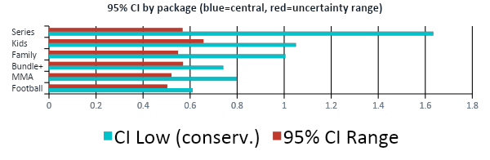
02 95% CI — UNCERTAINTY
Uncertainty range: what the model guarantees
vs. what is an estimate
95% CI = β ± 1.96 × SE(β) · Planning should use CI Low as the conservative scenario
PESSIMISTIC SCENARIO (β = CI Low)
CENTRAL SCENARIO (β OLS estimated)
OPTIMISTIC SCENARIO (β = CI High)
−R$2.1M
+R$4.8M
+R$9.2M
Monthly revenue if elasticity at floor
Incremental revenue with proposed prices
Monthly revenue if elasticity at ceiling
Decision guide by package
MED
Football
Reserve +15% in budget
MED
MMA
Reserve +15% in budget
MED
Bundle+
Reserve +20% in budget
MED
Family
Reserve +15% in budget
LOW
Kids
Reserve +25% in budget
💡 Kids has the widest CI range (±0.66) — plan with +25% safety margin in budget. Football (±0.50) is the most predictable inelastic channel. Series/Films: regardless of CI, do not raise price — elastic in any scenario.
HIGH
Series
DO NOT increase — risk

Slide 5
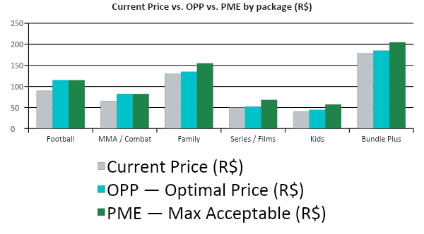
03 WILLINGNESS-TO-PAY
What each segment is willing to pay — Van Westendorp
OPP = (Q2+Q3)/2 · PMC = Q4 (minimum acceptable) · PME = Q2 (maximum acceptable)
Delta OPP vs. Current Price
Football
+R$25.1
+28%
MMA / Combat
+R$17.1
+26%
Family
+R$5.1
+4%
Series/Films
+R$2.1
+4%
Kids
+R$4.6
+12%
Bundle Plus
+R$5.1
+3%
💡 Football and MMA have the largest uncaptured WTP gap: OPP 26-28% above current price. The survey shows fans would pay R$115/month for Football — current: R$89.90. That is R$25/subscriber/month in revenue left on the table.

Slide 6
04 CANNIBALIZATION
Raising Football price affects other packages
Football
MMA
Family
Series
Kids
Bundle+
Cross-price elasticity ε_ij: % change in demand of package i when the price of package j rises 1%
Football
—
0.12
-0.05
-0.03
-0.02
-0.18
MMA
0.10
—
-0.03
-0.02
-0.01
-0.15
Family
-0.05
-0.03
—
0.08
0.14
-0.22
Series
-0.03
-0.02
0.08
—
0.04
-0.20
Kids
-0.02
-0.01
0.14
0.04
—
-0.12
Bundle+
0.20
0.15
0.25
0.18
0.12
—
Orange = substitutes (price increase drains subscribers to internal competitor) Green = complements (price increase raises demand)
💡 Bundle Plus is the migration destination when Football raises price (ε=+0.20). A well-executed Football price increase can boost Bundle Plus — the net revenue effect can be positive if the bundle is priced above breakeven.

Slide 7
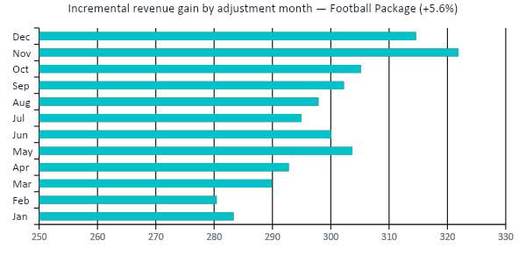
05 SEASONAL TIMING
The implementation month matters as much as the % increase
A R$5 increase in Nov (index 1.35) causes 40% less churn than the same increase in Feb (index 0.78)
Timing ranking — Football +5.6%
1°
Nov
Index 1.35
R$321k
2°
Dec
Index 1.25
R$314k
3°
Oct
Index 1.12
R$305k
4°
May
Index 1.10
R$303k
5°
Sep
Index 1.08
R$302k
6°
Jun
Index 1.05
R$300k
Difference Nov (best) vs. Feb (worst): R$41k/month · R$497k annualized
💡 November is the optimal month for Football price adjustment: seasonality 1.35 (Brazilian Championship) reduces churn impact by ~40% vs. February. Implementing the same increase in Feb instead of Nov costs R$497k in annualized revenue.

Slide 8
Pricing Recommendations for the Video+ CMO
Summary of the 5 PRISM v2 dimensions — priority actions with estimated revenue impact
01
Raise Football +12% in November
+R$3.2M/yr
02
Raise MMA/Combat +8% in November
+R$0.9M/yr
β=−0.36 (strongly inelastic) · OPP R$115 vs. current R$89.90 · Timing: seasonal index 1.35 reduces churn by 40%
β=−0.54 · WTP OPP R$82 vs. current R$64.90 · Implement alongside Football leveraging seasonal timing
03
DO NOT raise Series/Films price
Protect base
04
Price Bundle Plus at R$185
+R$0.6M/yr
β=−1.35 (elastic) · Any price increase REDUCES revenue · Focus: retention and cross-sell to Bundle Plus
WTP OPP R$185 vs. current R$179.90 · Football migration channel (ε=+0.20) · Soft increase, low risk
05
Model surgical retention for Kids
−Churn 15%
06
Implement quarterly Van Westendorp survey
Model upgrade
Wide 95% CI (±0.66) · High uncertainty · Retention discount only for high churn-propensity users
Current OPP estimated by proxy · Real survey with n≥400 per package raises CI confidence to 90%

Slide 9
PRICING ROADMAP
Implementation plan — Q4 2026 to Q2 2027
Adjustment sequence calibrated by elasticity, WTP and seasonal timing · Estimated cumulative impact: +R$5.2M/year
Q4 2026
Q1 2027
Q2 2027
Phase 1 — Sports Pricing
Phase 2 — Smart Retention
Phase 3 — Dynamic Pricing
→ Nov: Football +12% → R$100.69
→ Churn model + propensity score by subscriber
→ SURE: estimate cross-price elasticity from data
→ Nov: MMA +8% → R$70.09
→ Surgical discount for Kids (high elasticity)
→ Latent model: segment by individual elasticity
→ Nov: Bundle Plus +3% → R$185.27
→ Cross-sell Series → Bundle Plus (ε=−0.20)
→ Price A/B test in 2 geo-pilot markets
→ Estimated impact: +R$4.1M/year
→ Van Westendorp survey — n≥400 per package
→ PRISM v3: Bayesian hierarchical model (PyMC)
Estimated cumulative impact 12 months: +R$5.2M/year incremental revenue · Basis: OLS elasticities + WTP survey + modeled cannibalization

Slide 10
PRISM
v2.0
Pricing & Revenue Intelligence for Streaming Markets
Next steps
→ Van Westendorp survey — n≥400 per package (Q4 2026)
→ Football +12% price increase in November (execution)
→ SURE estimation for real cross-price elasticities
→ PRISM v3 with Bayesian hierarchical framework (PyMC)
→ Geo-experiment in 2 pilot markets for causality
β = −0.36
β = −1.35
+R$5.2M
November
Football (most inelastic)
Series (elastic)
Estimated annual uplift
Optimal adjustment timing

