Slide 1
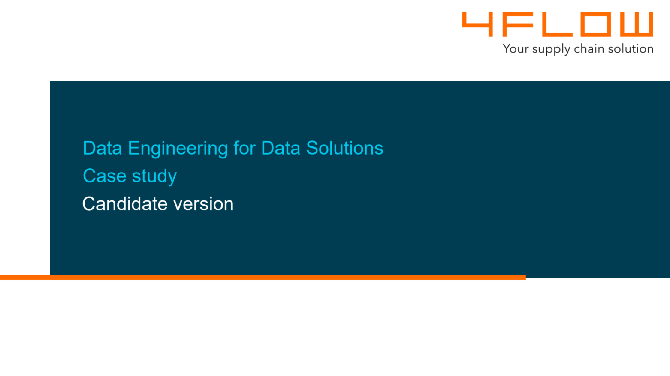

Slide 2
Business problem
Parcel servisse (delivery)
Increasing number of complaints
Root cause is nuclear
Tight monitoring to get hotspots

Slide 3
Deliverables
Report 1:
  What are the pick-up stations that received complaints in the last 14 days?
    Pickup Station ID
    Pickup Station Name
    Pickup Station Zip code
    Number of claims
Report 2:
  What are the final recipientes and the associated stations with more than 5 complaints in last 2 months?
    Final recipiente name
    Final recipiente address
    Pickup Station IDs

Slide 4
Goals
Design a data pipeline
Bring the delivery events data into the pipeline
Bring the complaints events into the pipeline
Use Microsoft Azure platform to aid in the process

Slide 5
Available data
Delivery events files (CSV, XML and JSON)
  Delivery timestamp
  Pickup station ID
  Final recipient’s name and address
  Driver ID
  Parcel ID
  Purchase Order ID
Complaints (CSV, XML and JSON)
  Timestamp of the complaint
  Pickup station ID
  Final recipient’s name and address
  Parcel ID (optional)
  Purchase Order ID (optional)
List of Pickup stations (database)
  Pickup station ID
  Name
  City
  Zip code
  Street

Slide 6
Assumptions
We are using Azure PostgreSQL database
Pickup IDs in complaints data are congruent with the reference database
Pickup IDs in delivery events data are not consolidated with reference database
Delivery events and complaints files fall into two diferente folders in the central server

Slide 7
Pipeline architecture
Three layers for improved control and governance
  Landing zone
  Staging zone
  Data Warehouse zone
Orchestration will be made mostly by pipelines in Azure Data Factory
Reports will be exposed as views

Slide 8
1) bring raw data into landing zone
Azure Data Factory Pipelines
  Daily triggered
  Get metadata
  ForEach file
  Copy activity
  SQL Script (INSERT)
Copies raw data into Azure Data Lake Storage Gen2
Updates landing_file control table

Slide 9
2) Parse raw CSV/XML/JSON into staging zone
Azure Data Factory Pipeline
  Trigger
  LookUp “RECEIVED” in landing_file
  If COUNT greater than zero
  Calls Python parser function or container
Python parser inserts data into suitable staging table (stg_delivery_events or stg_complaints)
For each parsed file updates landing_file with “PARSED” or “FAILED”

Slide 10
3) copy reference data into staging zone
Azure Data Factory Pipelines
  Trigger
  SQL Script (INSERT)
Creates a fingerprint to be used in later JOINs
Creates a HASH with name, city, zip code and street to easily test if anything has changed

Slide 11
4) update SCD2 dim_pickup_station in dw zone
Azure Data Factory Pipeline
  Trigger
  SQL Script (ADD)
  SQL Script (UPDATE CLOSE)
  SQL Script (UPDATE INSERT)
  SQL Script (REMOVE)
Update the SCD2by adding new entries, closing and inserting entries that changed and deactivating removed entries.
Creates a canonical ID.

Slide 12
5) Update fact tables in dw zone
Azure Data Factory Pipeline
  Trigger
  SQL Script (INSERT)
Inserts data from staging.stg_delivery_events into dw.fact_delivery_events
Inserts data from staging.stg_complaints into dw.fact_complaints joining with dw.dim_pick-up_station via Pickup Station ID

Slide 13
6) monitoring data integration
Azure Data Factory Pipeline
  Trigger
  SQL Script (INSERT)
Inserts into dw.monitoring_complaints the number os complaints processed in the current day and the number of complaints that didn’t get a pickup ID match with dw.dim_pickup_station.

Slide 14
7) reports
Once they are views, they are instantly updated
Report 1 is exposed in dw. rpt_pickup_station_claims_14d
Report 2 is exposed in dw. rpt_recipients_over5_complaints_2m

Slide 15
8) next steps
Improve monitoring stages in pipeline
Correlate complaints and delivery events using parcel_id or purchase_order_id whenever possible
Create a crosswalk table allowing a more precise conection between delivery events and complaints
Draw insights from drivers, recipients and stations in terms of number of deliveries and number of complaints
Use LLM to evaluate the claims contents

