Slide 1

ALGORITMO AIMD
Bruno P. Pozzebon

Slide 2
Cliente
Servidor
InitTimerCount()
SEQ=1
WINDOW
SIZE
SEQ=2
1
2
3
4
SEQ=3
SEQ=4
1
2
Socket.soTimeOut(timer)
3
4
SEQ=1
WINDOW SIZE
SEQ=2
1
2
3
4
SEQ=3
SEQ=4
Não Estoura TimeOut
EndTimerCount()
WINDOW.INCREASE()

Slide 3
Cliente
Servidor
InitTimerCount()
SEQ=1
WINDOW
SIZE
SEQ=2
1
2
3
4
SEQ=3
SEQ=4
1
Socket.soTimeOut(timer)
SEQ=1
WINDOW SIZE
1
2
3
4
SEQ=1
SEQ=1
Estoura TimeOut
EndTimerCount()
WINDOW.DECREASE()

Slide 4
Interface
Slow START
WindowIncrease increase() {
if(windowSize * 2 < sst) {
return new SlowStart(windowSize * 2 , sst)
}else {
return new CongestionAvoidance(windowSize , sst)
}
}
WindowIncrease decrease() {
return SlowStart( 1 , windowSize / 2)
}
Window increase()
Window decrease()
int getWindowSize()
WindowIncrease.java

Slide 5
Interface
Congestion AVOIDANCE
WindowIncrease increase() {
if(windowSize==1)
windowSize ++;
else
windowSize += 10;
return new CongestionAvoidance(windowSize , sst)
}
WindowIncrease decrease() {
return new SlowStart(1,windowSize / 2);
}
Window increase()
Window decrease()
int getWindowSize()
WindowIncrease.java

Slide 6
UDP

Slide 7
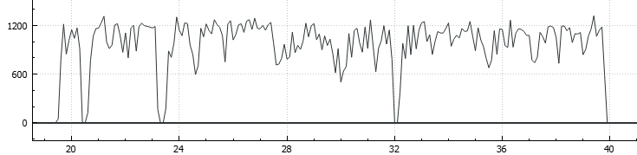
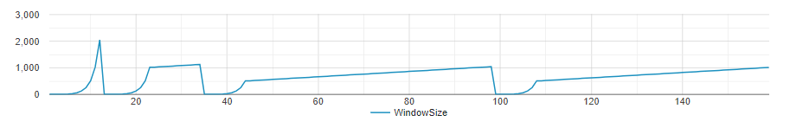
UDP sem iperf

Slide 8
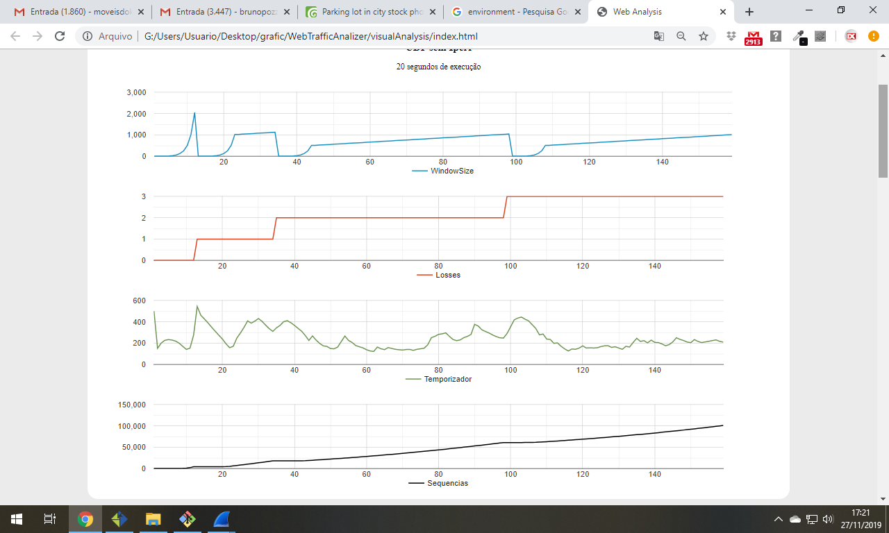




20 segundos
100.000 pacotes
UDP sem iperf

Slide 9
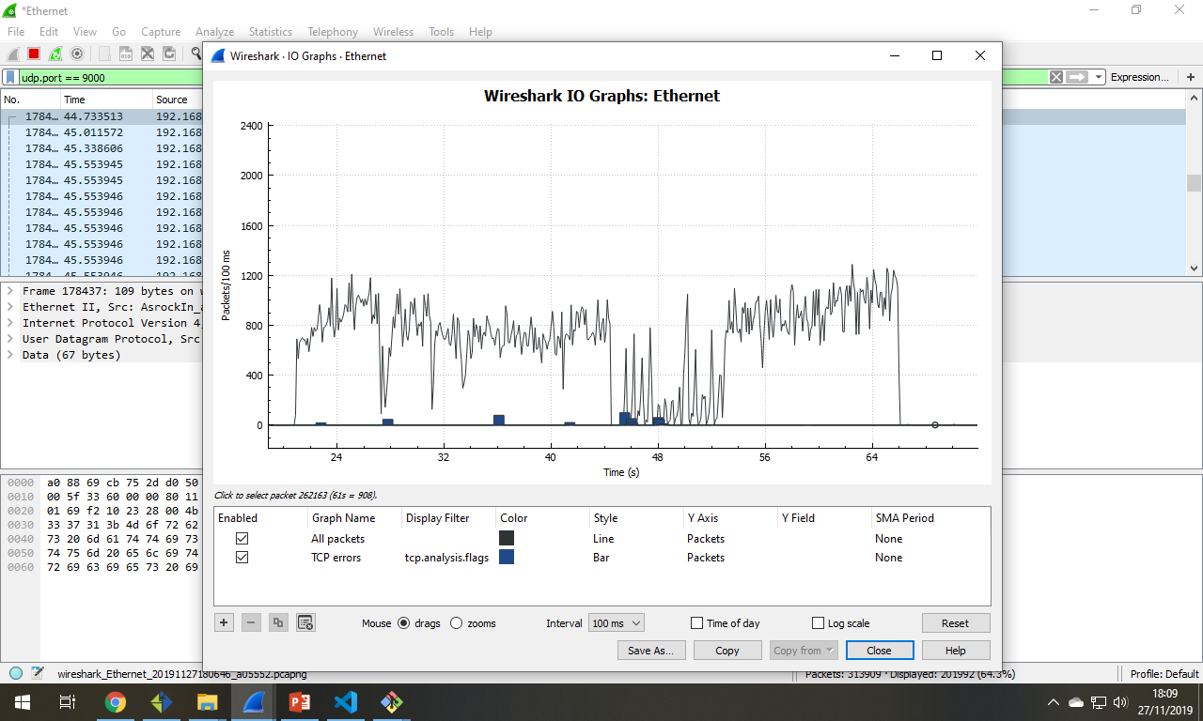
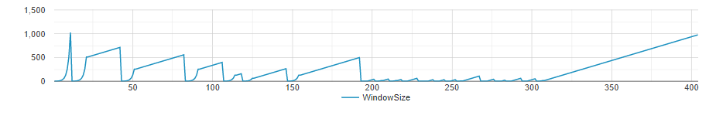
UDP com iperf

Slide 10

iperf3.exe
-f M
-i 0.1
-t 40
-c <IP>
-p 9010
44 segundos
100.000 pacotes
UDP com iperf

Slide 11
TCP

Slide 12
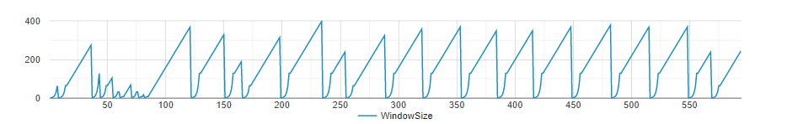
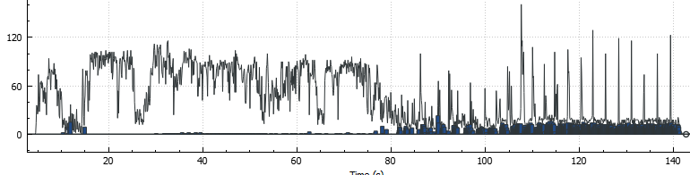
TCP sem iperf

Slide 13
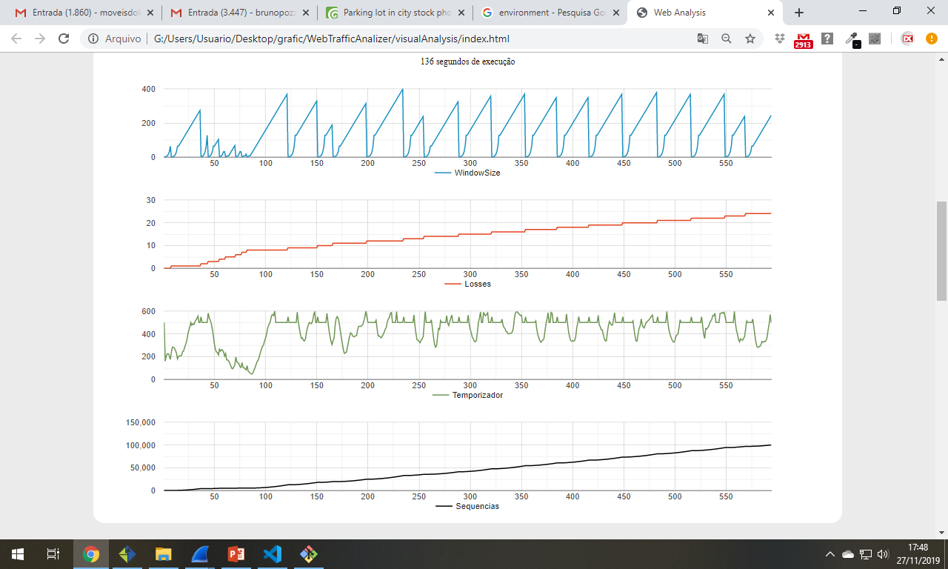
136 segundos
100.000 pacotes
TCP sem iperf

Slide 14
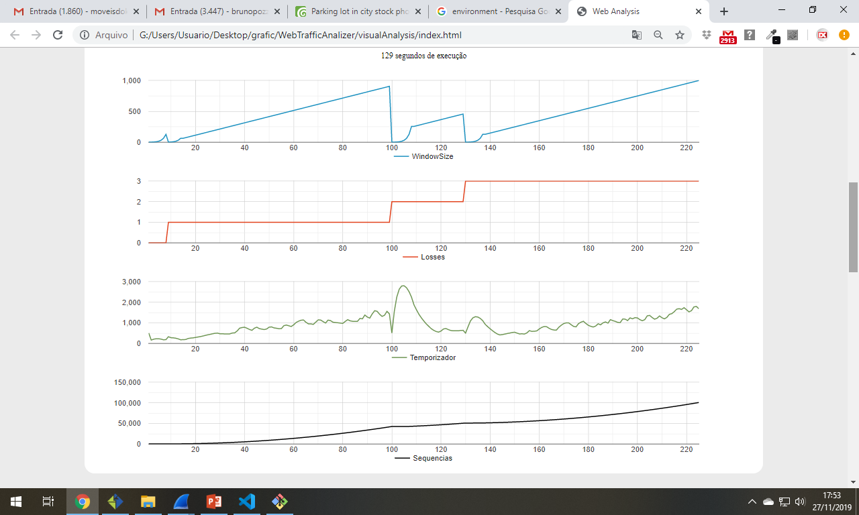
Timer Ilimitado
129 segundos
100.000 pacotes
TCP sem iperf

Slide 15
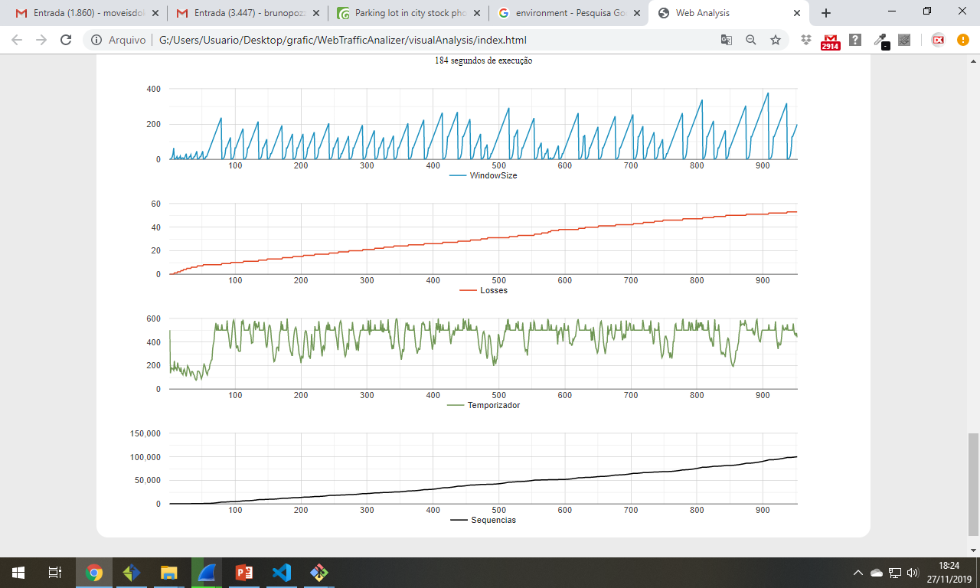
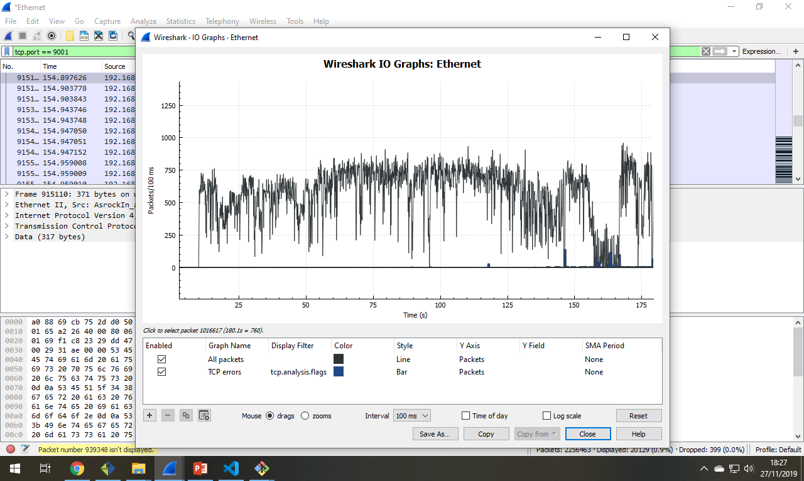
TCP com iperf

Slide 16
iperf3.exe
-f M
-i 0.1
-t 40
-c <IP>
-p 9010
184 segundos
100.000 pacotes
TCP com iperf

