Slide 1

ALGORITMO AIMD
Bruno P. Pozzebon

Slide 2
Cliente
Servidor
InitTimerCount()
SEQ=1
WINDOW
SIZE
SEQ=2
1
2
3
4
SEQ=3
SEQ=4
1
2
Socket.soTimeOut(timer)
3
4
SEQ=1
WINDOW SIZE
SEQ=2
1
2
3
4
SEQ=3
SEQ=4
Não Estoura TimeOut
EndTimerCount()
WINDOW.INCREASE()

Slide 3
Cliente
Servidor
InitTimerCount()
SEQ=1
WINDOW
SIZE
SEQ=2
1
2
3
4
SEQ=3
SEQ=4
1
Socket.soTimeOut(timer)
SEQ=1
WINDOW SIZE
1
2
3
4
SEQ=1
SEQ=1
Estoura TimeOut
EndTimerCount()
WINDOW.DECREASE()

Slide 4
Interface
Slow START
WindowIncrease increase() {
if(windowSize * 2 < sst) {
return new SlowStart(windowSize * 2 , sst)
}else {
return new CongestionAvoidance(windowSize , sst)
}
}
WindowIncrease decrease() {
return SlowStart( 1 , windowSize / 2)
}
Window increase()
Window decrease()
int getWindowSize()
WindowIncrease.java

Slide 5
Interface
Congestion AVOIDANCE
WindowIncrease increase() {
if(windowSize==1)
windowSize ++;
else
windowSize += 10;
return new CongestionAvoidance(windowSize , sst)
}
WindowIncrease decrease() {
return new SlowStart(1,windowSize / 2);
}
Window increase()
Window decrease()
int getWindowSize()
WindowIncrease.java

Slide 6
UDP

Slide 7
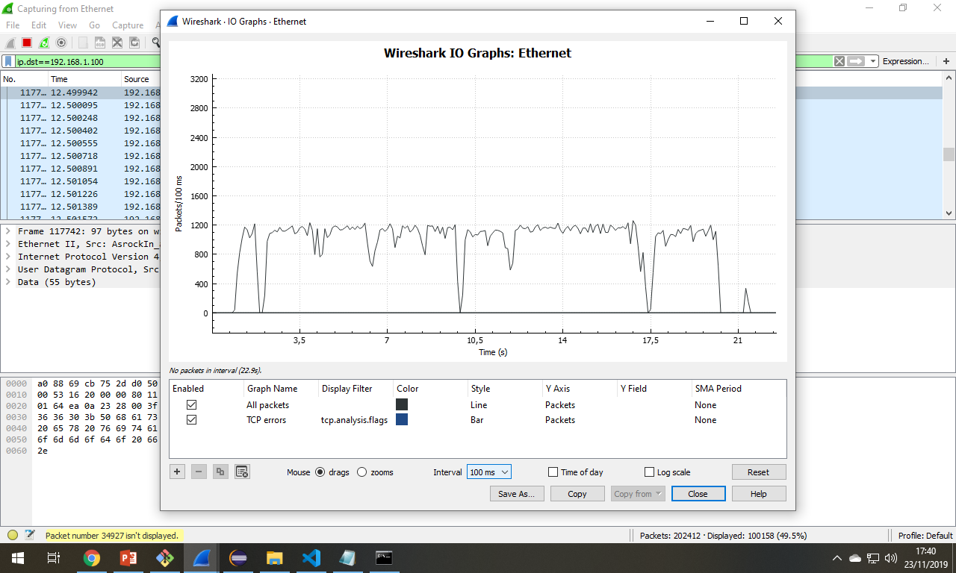
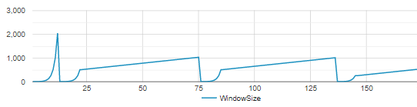
UDP sem iperf

Slide 8
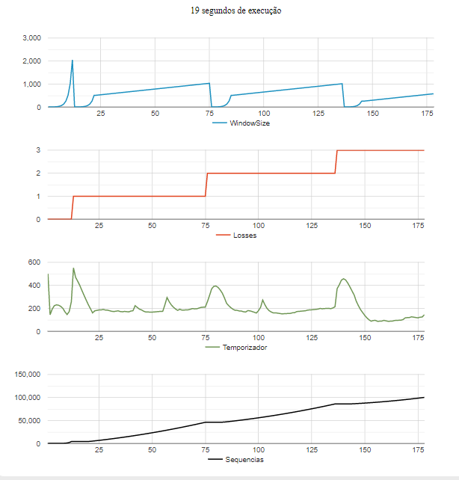




UDP sem iperf

Slide 9
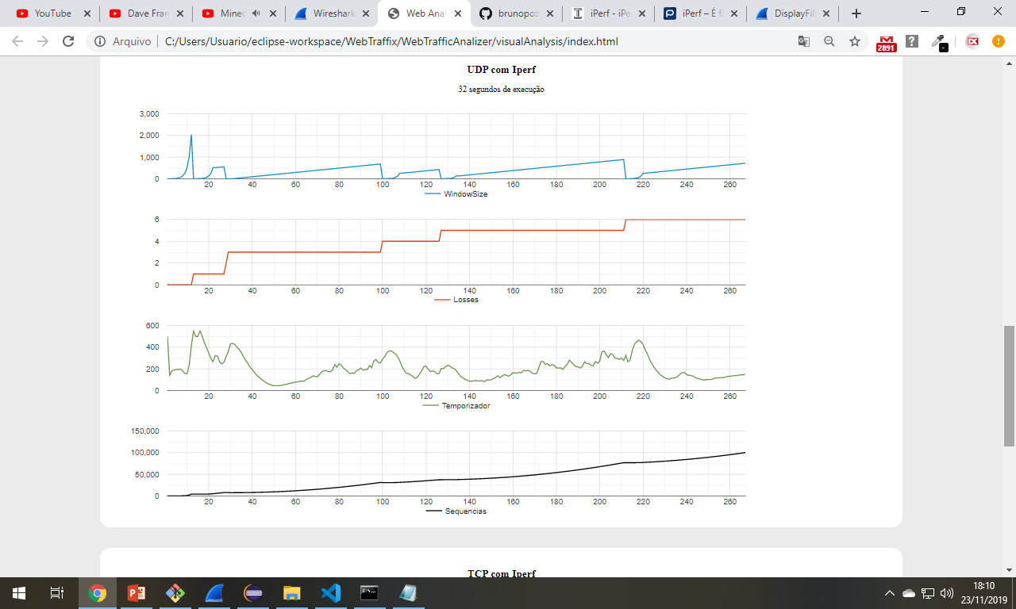
iperf3.exe
-f M
-i 0.1
-t 30
-c <IP>
-p 9010
UDP com iperf

