Slide 1
The escape problem
Anish Narkhede (012417769)
Neeraj Kulkarni (012413739)

Slide 2
Problem Statement
Given a set of m sources in a 2-dimensional grid, determine if it is possible to connect all sources to m points on the grid boundary using a set of vertex-disjoint paths starting from source vertices .

Slide 3
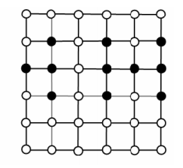
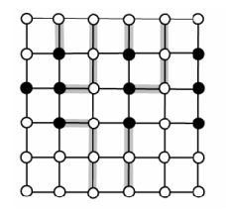
Escape Problem
Determine if it is possible to connect each from the given set of starting vertices to any of the 4n – 4 boundary vertex.

Slide 4
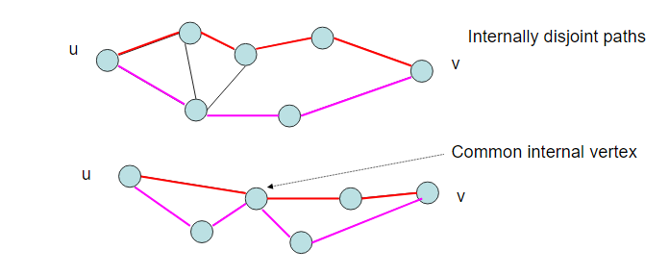
Vertex-disjoint Paths
Two paths from vertex u to vertex v are said to be internally disjoint / vertex disjoint if they do not contain any common internal vertex in them.

Slide 5
Implementation
Converting Escape problem to Single Source – Single Sink Maximum flow path.(Converting simple undirected graph G into directed graph for vertex disjoint paths G’ and applying max-flow algorithm)
Add two artificial vertices : source and sink.
For each vertex u in the set of starting vertices for escape problem, add an edge from s to u_{in} with unit capacity of 1.
Split each vertex v in the graph into two vertices: v_{in} and v_{out} (except source s & sink t)
For each vertex v, add an edge of unit capacity of 1 from v_{in} to v_{out}

Slide 6
Implementation (contd..)
For each of the grid boundary vertices v, add an edge from v_{out} to t with unit capacity of 1.
Maximum flow from s-t is calculated using Edmonds-Karp Algorithm.
s-t max-flow gives the maximum number of s-t vertex disjoint paths
If Maximum s-t flow = |V’|, where V’ is set of vertices in the certifier set,
Then all the vertices in the V’ can reach boundary vertices in the grid using vertex disjoint paths.

Slide 7
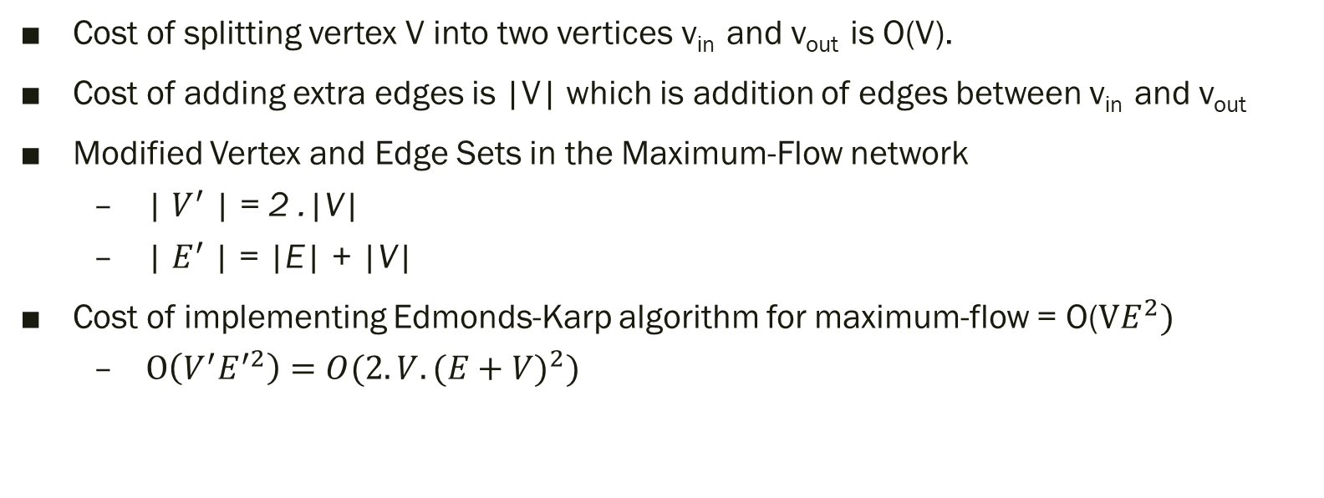
Analysis
Cost of splitting vertex V into two vertices v_{in} and v_{out} is O(V).
Cost of adding extra edges is |V| which is addition of edges between v_{in} and v_{out}
Modified Vertex and Edge Sets in the Maximum-Flow network
| $V^{′}$| = 2 .|V|
| $E^{′}$| = |E| + |V|
Cost of implementing Edmonds-Karp algorithm for maximum-flow = O($VE^{2})$
$O\left(V^{′}E^{′2}\right)=O(2.V.{(E+V)}^{2})$

Slide 8

Total Algorithmic Complexity
Total Escape problem complexity = Graph Modification cost + Max-flow Algorithm cost
$=O\left(V\right)+ O\left(2V.{\left(E+V\right)}^{2}\right)$= $O\left(2V.{\left(E+V\right)}^{2}\right)$
Escape problem performance might vary depending upon the selection of Max-flow algorithm

Slide 9
Thank You!

