Slide 1
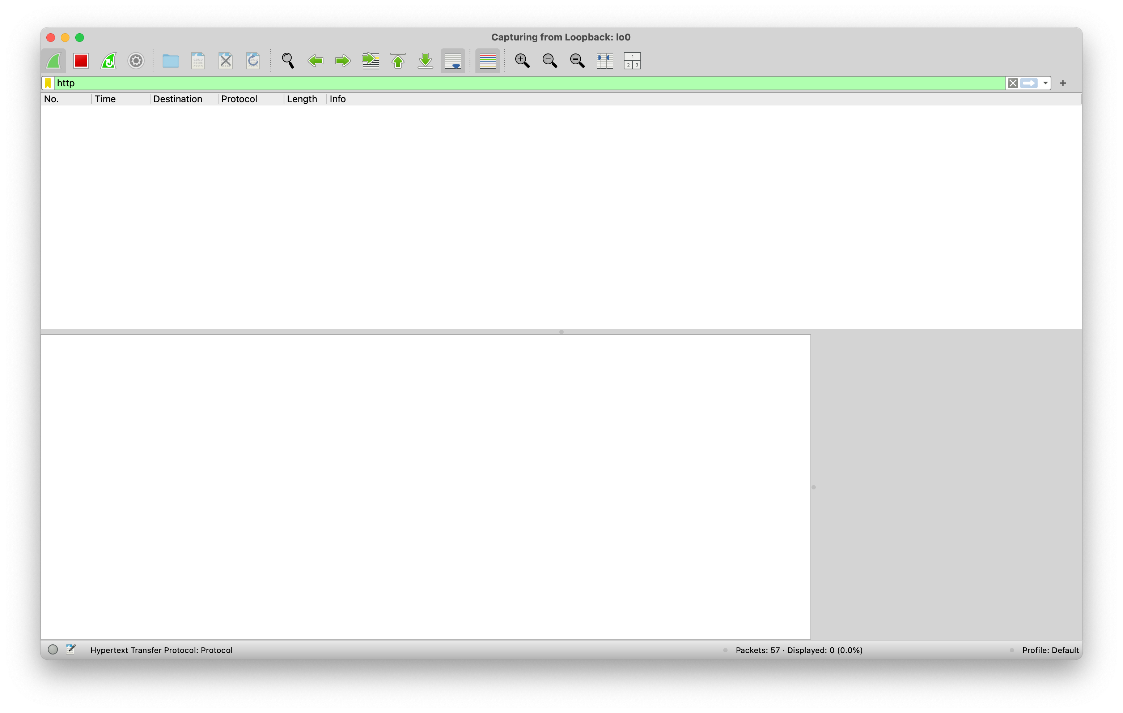

Slide 2
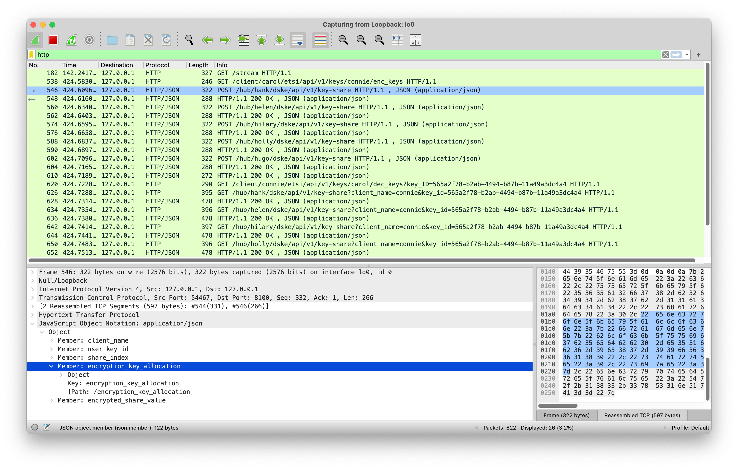

Slide 3
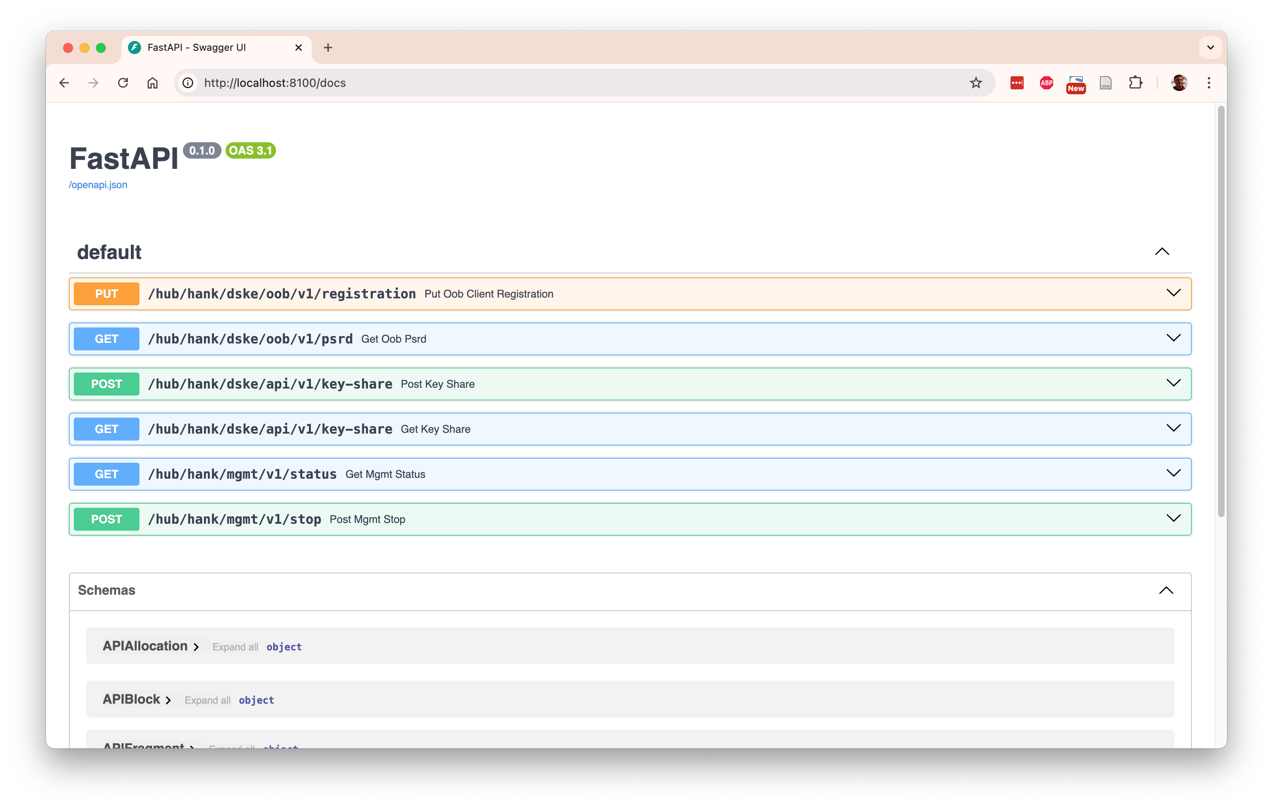

Slide 4
Encryptors
Patrick
Encrypted connection
Porter
Key delivery interface
Clients
Carol
Celia
Cindy
Conny
Curtis
DSKE interface
Hubs
Hank
Helen
Hilary
Holly
Hugo

Slide 5
Client Carol
Hub Hank
RNG
Key share 1
Encryption
Key 1
PSRD Pool
PSRD Pool
Encryption
Key 1
XOR
DSKE out-of-band protocol
PSRD block
Encrypted
Key share 1
Encrypted
Key share 1
DSKE in-band protocol
Encrypted key share
Encryption key meta-data
XOR
RNG
Key share 1
Shamir
Secret
Sharing
...
Key
...
RNG
Key share n
Encryption
Key n
PSRD Pool
PSRD Pool
Encryption
Key n
XOR
Encrypted
Key share n
Encrypted
Key share n
XOR
Key share n
Hub Hugo

Slide 6
Hub Hank
Client Conny
RNG
Key share 1
Encryption
Key 1
PSRD Pool
PSRD Pool
Encryption
Key 1
XOR
DSKE out-of-band protocol
PSRD block
Encrypted
Key share 1
Encrypted
Key share 1
DSKE in-band protocol
Encrypted key share
Encryption key meta-data
XOR
Key share 1
Hub Hugo
...
...
RNG
Shamir
Secret
Sharing
Key
Key share n
...
Encryption
Key n
PSRD Pool
PSRD Pool
Encryption
Key n
XOR
Encrypted
Key share n
Encrypted
Key share n
XOR
Key share n

Slide 7

A
B
C
QKD protocol: establish key A-B
QKD protocol: establish key A-B
Relay green key encrypted with red key

Slide 8
Carol
Hank
...
Hugo
Conny
PUT registration
GET psrd
PUT registration
GET psrd
PUT registration
GET psrd
PUT registration
GET psrd

Slide 9
Patrick
Carol
Hank
...
Hugo
Conny
Patrick
GET key
POST key-share
Key + Key-ID
POST key-share
Relay Key-ID
GET key-share
GET key-with-key-ID
GET key-share
Key

Slide 10
Unallocated
allocated = false
consumed = false
value = set
Allocate
Deallocate
Allocated
allocated = true
consumed = false
value = set
Consume
Consume
Consumed
allocated = true
consumed = true
value = zeroed

Slide 11
11
block_uuid
c593d7e2-feae-4e8f-8cba-a3a61e037186
size
12
owned
True
data
11
22
33
44
55
66
00
00
00
00
bb
cc
allocated
1
1
1
1
0
0
1
1
1
1
0
0
consumed
0
0
0
0
0
0
1
1
1
1
0
0
Block
block
block
start_byte
0
start_byte
6
size
3
size
4
value
11
22
33
value
77
88
99
aa
consumed
False
consumed
False
Fragment
Fragment

