Slide 1
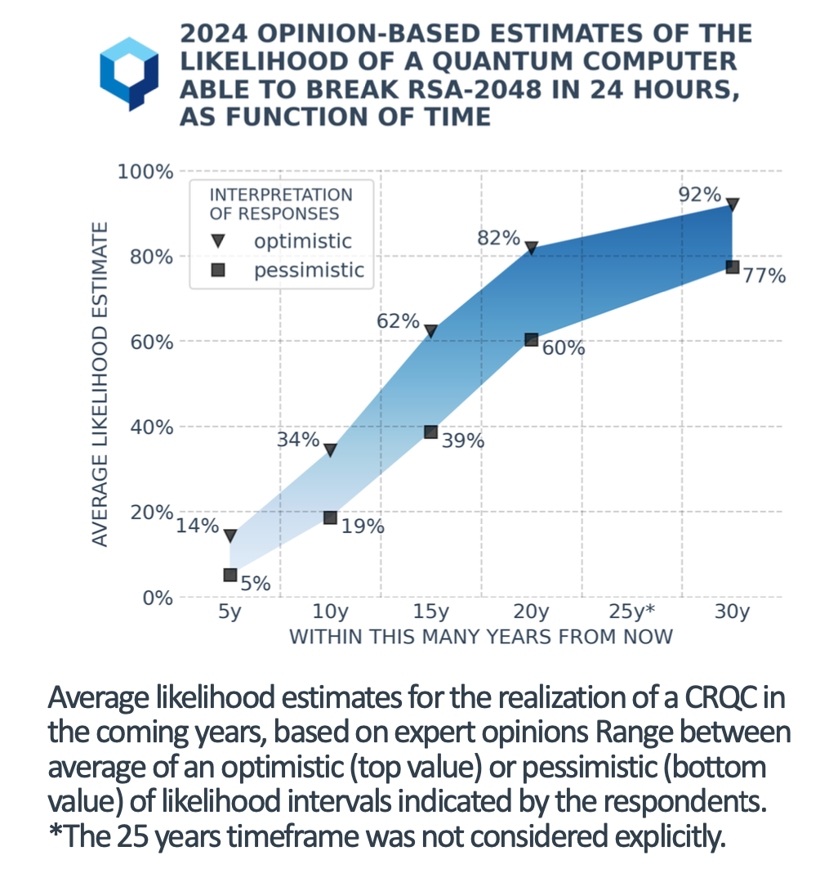
Source: “Quantum Threat Timeline Report 2024 Executive Summary”, Global Risk Institute

Slide 2
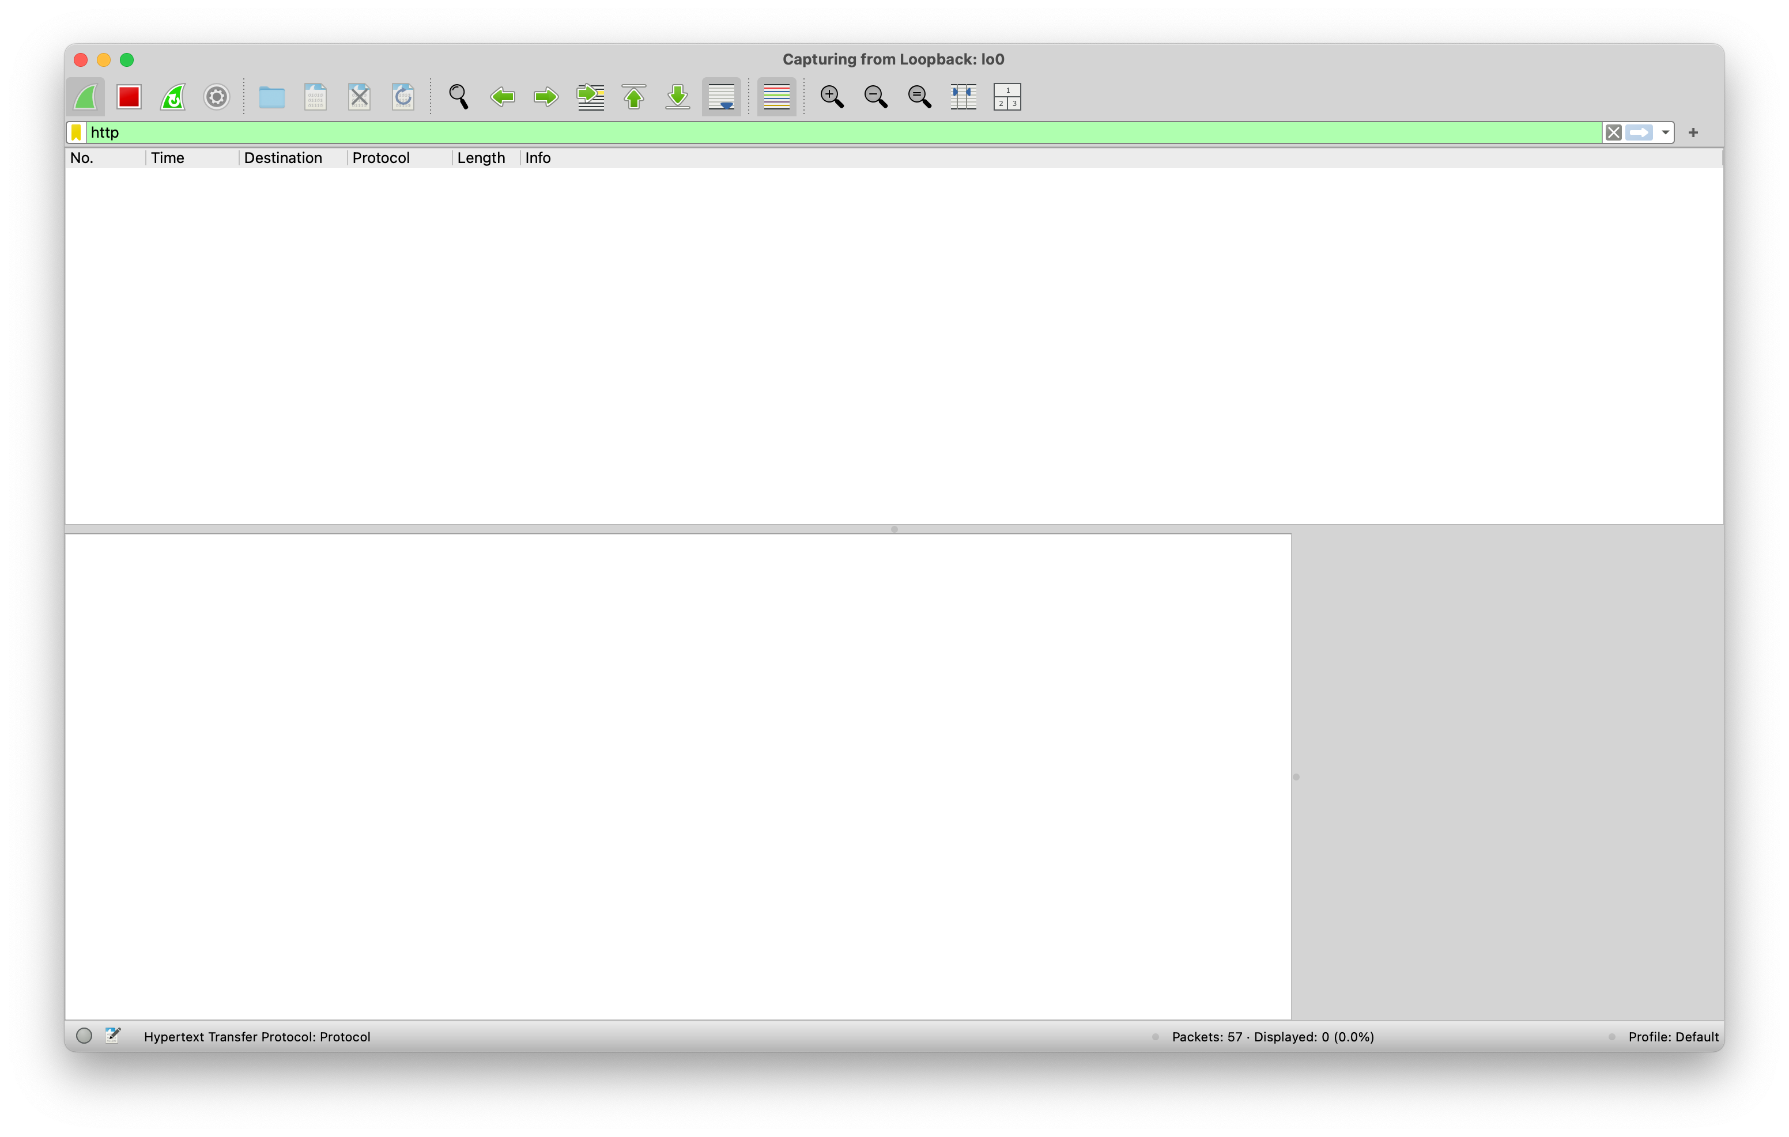

Slide 3
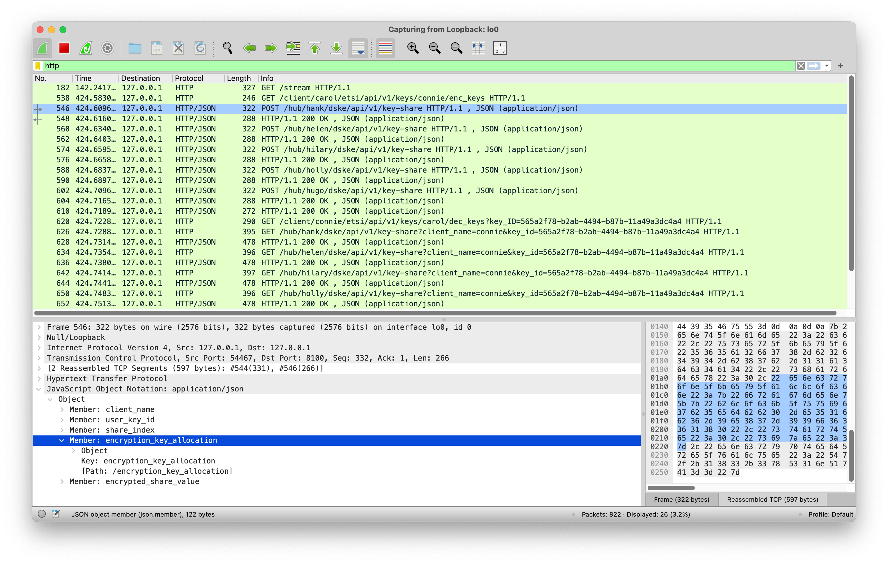

Slide 4
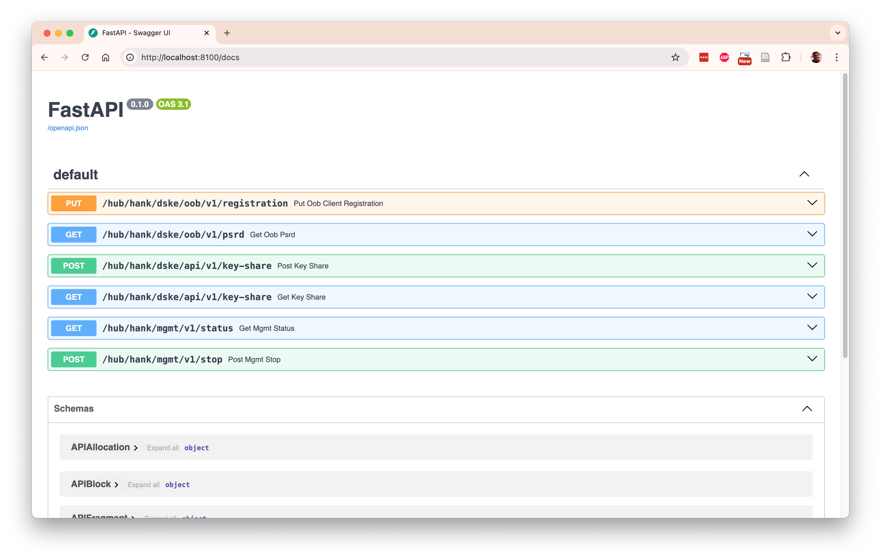

Slide 5
Encryptors
Patrick
Encrypted connection
Porter
Key delivery interface
Clients
Carol
Celia
Cindy
Conny
Curtis
DSKE interface
Hubs
Hank
Helen
Hilary
Holly
Hugo

Slide 6
Client Carol
Hub Hank
RNG
Key share 1
Encryption
Key 1
PSRD Pool
PSRD Pool
Encryption
Key 1
XOR
DSKE out-of-band protocol
PSRD block
Encrypted
Key share 1
Encrypted
Key share 1
DSKE in-band protocol
Encrypted key share
Encryption key meta-data
XOR
RNG
Key share 1
Shamir
Secret
Sharing
...
Key
...
RNG
Key share n
Encryption
Key n
PSRD Pool
PSRD Pool
Encryption
Key n
XOR
Encrypted
Key share n
Encrypted
Key share n
XOR
Key share n
Hub Hugo

Slide 7
Hub Hank
Client Conny
RNG
Key share 1
Encryption
Key 1
PSRD Pool
PSRD Pool
Encryption
Key 1
XOR
DSKE out-of-band protocol
PSRD block
Encrypted
Key share 1
Encrypted
Key share 1
DSKE in-band protocol
Encrypted key share
Encryption key meta-data
XOR
Key share 1
Hub Hugo
...
...
RNG
Shamir
Secret
Sharing
Key
Key share n
...
Encryption
Key n
PSRD Pool
PSRD Pool
Encryption
Key n
XOR
Encrypted
Key share n
Encrypted
Key share n
XOR
Key share n

Slide 8

A
B
C
QKD protocol: establish key A-B
QKD protocol: establish key A-B
Relay green key encrypted with red key

Slide 9

Client Carol
Hub Hank
RNG
Signing
Key
PSRD Pool
PSRD Pool
Signing
Key
DSKE out-of-band protocol
PSRD block
Unsigned
DSKE protocol message
Sign
Check
Signature
Signature
Signing key
meta-data
Signature
Signing key
meta-data
Signed
DSKE protocol message
Signed
DSKE protocol message
DSKE in-band protocol
Signed DSKE protocol message
Signing key meta-data

Slide 10
Carol
Hank
...
Hugo
Conny
PUT registration
GET psrd
PUT registration
GET psrd
PUT registration
GET psrd
PUT registration
GET psrd

Slide 11
Initiator
Encryptor
(SAE)
Initiator
Client
(KME)
Responder
Client
(KME)
Responder
Encryptor
(SAE)
Patrick
Carol
Hank
...
Hugo
Conny
Porter
GET key
POST key-share
Key + Key-ID
POST key-share
Relay Key-ID
GET key-share
GET key-with-key-ID
GET key-share
Key

Slide 12
Unallocated
allocated = false
consumed = false
value = set
Allocate
Deallocate
Allocated
allocated = true
consumed = false
value = set
Consume
Consume
Consumed
allocated = true
consumed = true
value = zeroed

Slide 13
owner
LOCAL
blocks
Pool
block_uuid
11111111-1111-1111-1111-111111111111
block_uuid
22222222-2222-2222-2222-222222222222
size
12
size
12
data
00
00
00
44
55
66
77
88
99
aa
bb
cc
data
dd
ee
ff
00
11
22
33
44
55
66
77
88
allocated
1
1
1
1
1
1
1
1
1
1
1
1
allocated
1
1
0
0
0
0
0
0
0
0
0
0
consumed
1
1
1
0
0
0
0
0
0
0
0
0
consumed
0
0
1
0
0
0
0
0
0
0
0
0
Block
Block
block
block
block
start_byte
0
start_byte
3
start_byte
0
size
3
size
9
size
2
value
11
22
33
value
44
55
66
77
88
99
aa
bb
cc
value
dd
ee
consumed
True
consumed
False
consumed
False
Fragment
Fragment
Fragment
fragments
fragments
value
11
22
33
value
44
55
66
77
88
99
aa
bb
cc
dd
ee
consumed
True
consumed
False
Allocation
Allocation

Slide 14
11
block_uuid
c593d7e2-feae-4e8f-8cba-a3a61e037186
size
12
data
00
00
33
44
55
66
77
88
99
aa
bb
cc
allocated
1
1
1
1
1
1
1
0
0
0
0
0
consumed
1
1
1
0
0
0
0
0
0
0
0
0
Block
block
block
start_byte
0
start_byte
3
size
3
size
4
value
11
22
33
value
44
55
66
77
consumed
True
consumed
False
Fragment
Fragment

