Slide 1
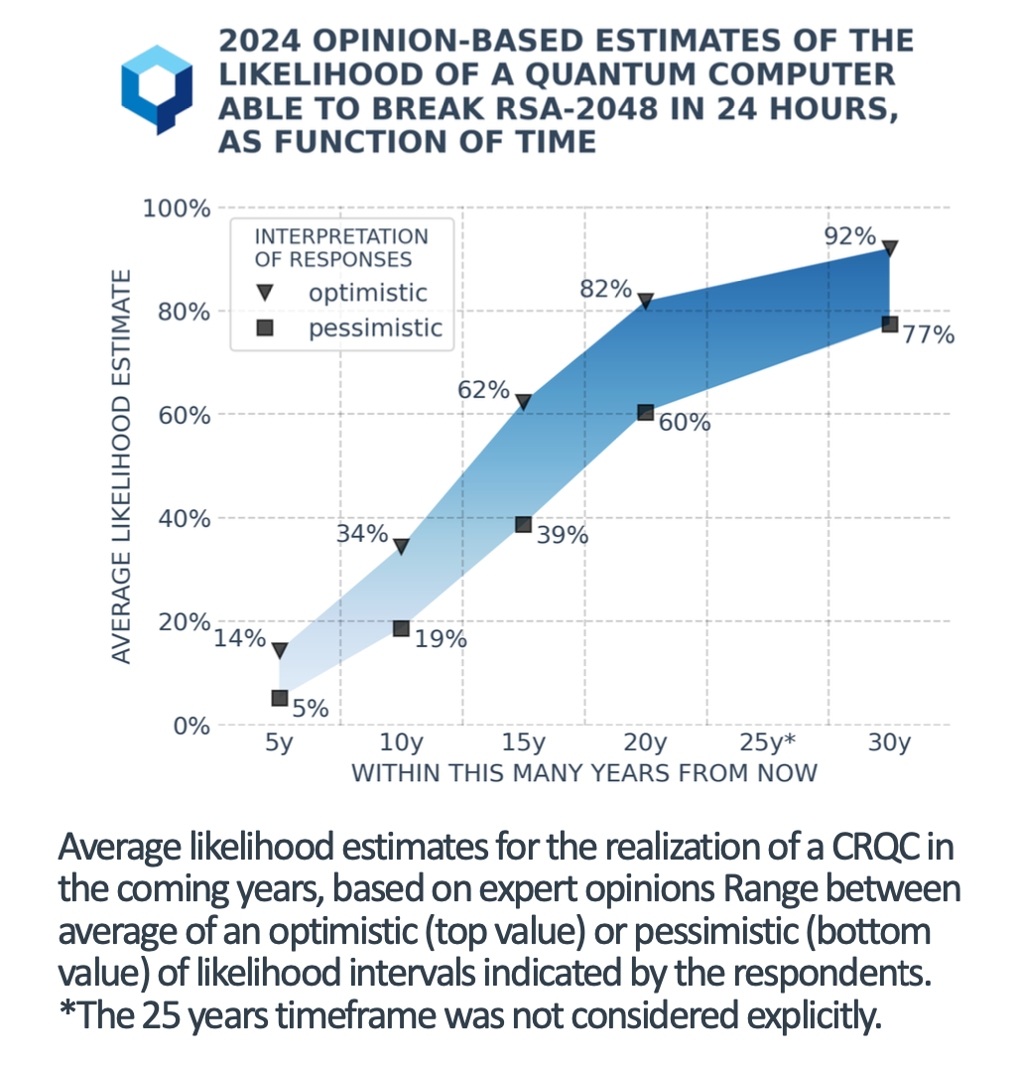
Source: “Quantum Threat Timeline Report 2024 Executive Summary”, Global Risk Institute

Slide 2
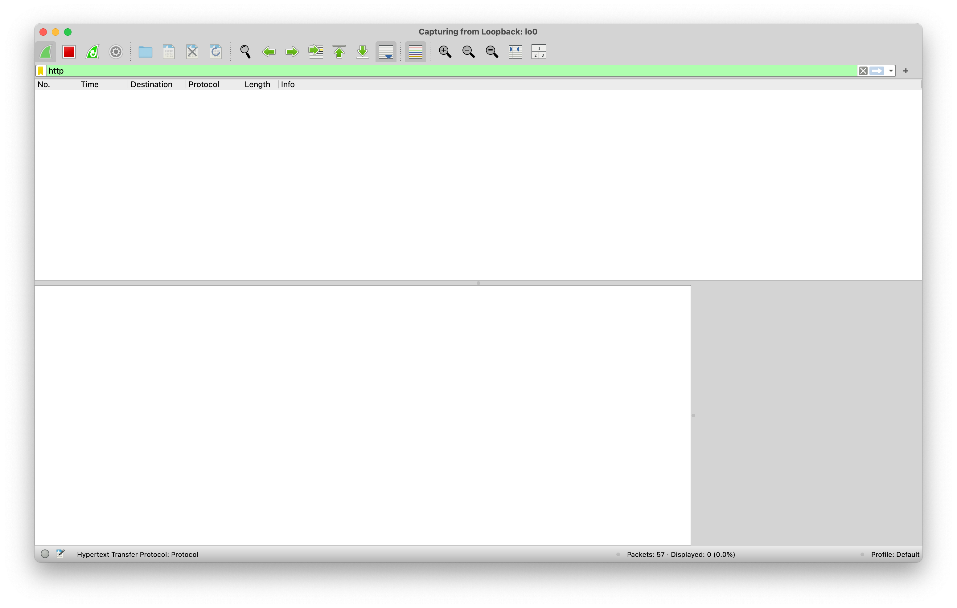

Slide 3
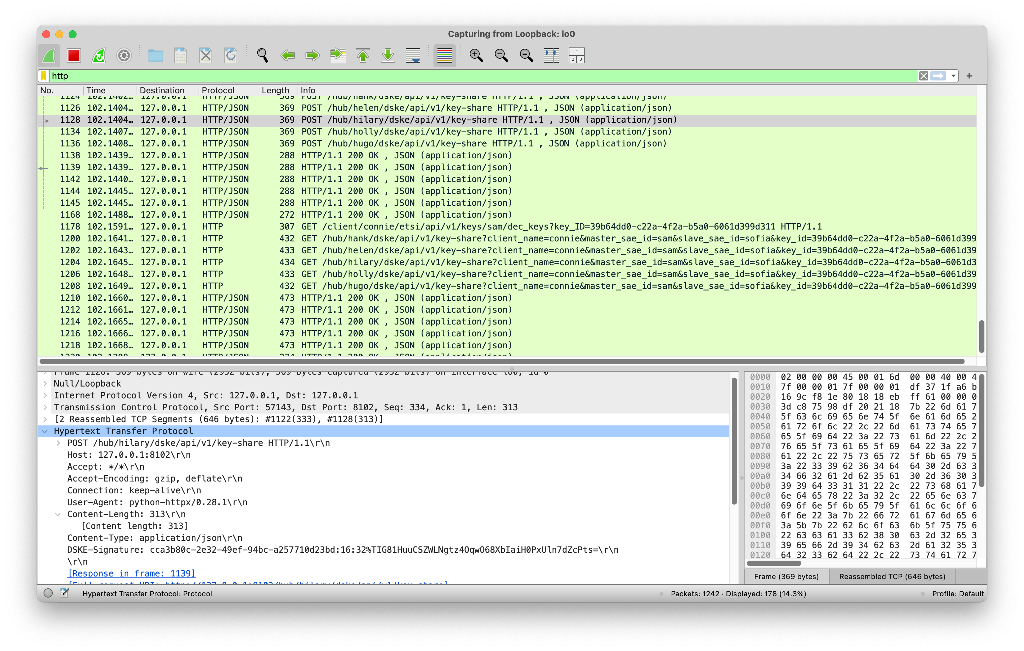

Slide 4
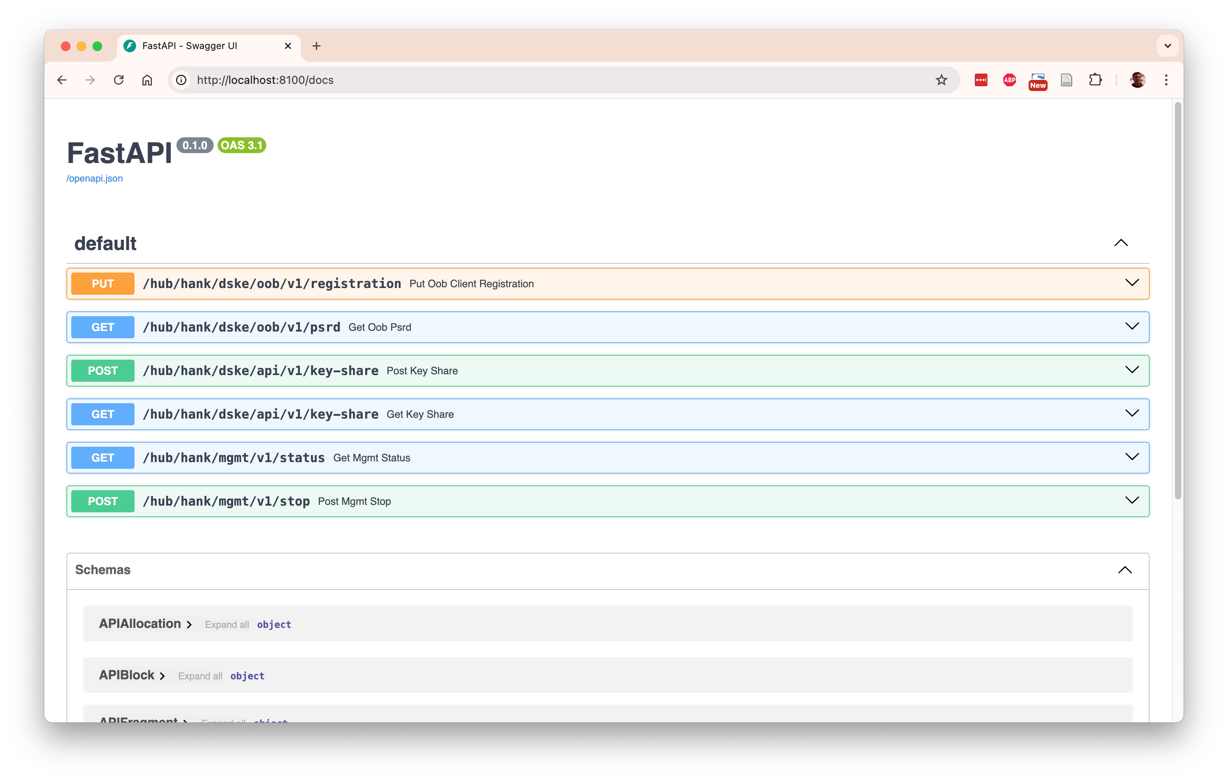

Slide 5
Encrypted connection
Encryptors
(SAEs)
sam
serena
sofia
sunny
susan
Key delivery interface
Clients
(KMEs)
carol
Celia
Cindy
conny
Curtis
DSKE interface
Hubs
hank
helen
hilary
holly
hugo

Slide 6
Client Carol
Hub Hank
RNG
Key share 1
Encryption
Key 1
PSRD Pool
PSRD Pool
Encryption
Key 1
XOR
DSKE out-of-band protocol
PSRD block
Encrypted
Key share 1
Encrypted
Key share 1
DSKE in-band protocol
Encrypted key share
Encryption key meta-data
XOR
RNG
Key share 1
Shamir
Secret
Sharing
...
Key
...
RNG
Key share n
Encryption
Key n
PSRD Pool
PSRD Pool
Encryption
Key n
XOR
Encrypted
Key share n
Encrypted
Key share n
XOR
Key share n
Hub Hugo

Slide 7
Hub Hank
Client Conny
RNG
Key share 1
Encryption
Key 1
PSRD Pool
PSRD Pool
Encryption
Key 1
XOR
DSKE out-of-band protocol
PSRD block
Encrypted
Key share 1
Encrypted
Key share 1
DSKE in-band protocol
Encrypted key share
Encryption key meta-data
XOR
Key share 1
Hub Hugo
...
...
RNG
Shamir
Secret
Sharing
Key
Key share n
...
Encryption
Key n
PSRD Pool
PSRD Pool
Encryption
Key n
XOR
Encrypted
Key share n
Encrypted
Key share n
XOR
Key share n

Slide 8

A
B
C
QKD protocol: establish key A-B
QKD protocol: establish key A-B
Relay green key encrypted with red key

Slide 9

Client Carol
Hub Hank
RNG
Signing
Key
PSRD Pool
PSRD Pool
Signing
Key
DSKE out-of-band protocol
PSRD block
Unsigned
DSKE protocol message
Sign
Check
Signature
Signature
Signing key
meta-data
Signature
Signing key
meta-data
Signed
DSKE protocol message
Signed
DSKE protocol message
DSKE in-band protocol
Signed DSKE protocol message
Signing key meta-data

Slide 10
Carol
Hank
...
Hugo
Conny
PUT registration
GET psrd
PUT registration
GET psrd
PUT registration
GET psrd
PUT registration
GET psrd

Slide 11
Initiator
Encryptor
(SAE)
Initiator
Client
(KME)
Responder
Client
(KME)
Responder
Encryptor
(SAE)
Patrick
Carol
Hank
...
Hugo
Conny
Porter
GET key
POST key-share
Key + Key-ID
POST key-share
Relay Key-ID
GET key-share
GET key-with-key-ID
GET key-share
Key

Slide 12
name
hank
owner
LOCAL
blocks
Pool
block_uuid
11111111-1111-1111-1111-111111111111
block_uuid
22222222-2222-2222-2222-222222222222
size
12
size
12
data
00
00
00
44
55
66
77
88
99
aa
bb
cc
data
00
00
ff
00
11
22
33
44
55
66
77
88
used
1
1
1
1
1
1
1
1
1
1
1
1
used
1
1
0
0
0
0
0
0
0
0
0
0
Block
Block
block
block
block
start
0
start
3
start
0
size
3
size
9
size
2
data
11
22
33
data
44
55
66
77
88
99
aa
bb
cc
data
dd
ee
Fragment
Fragment
Fragment
fragments
fragments
Allocation
Allocation

