Slide 1
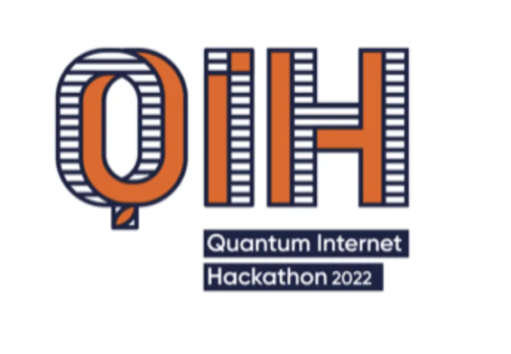



Team Q-Harmonics
Team Members
Project
Abdullah K
B Akash Reddy Bruno Rijsman Kiran Kaur Sai Ganesh Manda
Tyler Cowan
DQFT
Distributed Quantum Fourier Transformation
Implementation, Validation, Benchmarking
GitHub
https://github.com/brunorijsman/quantum-internet-hackathon-2022

