Slide 1
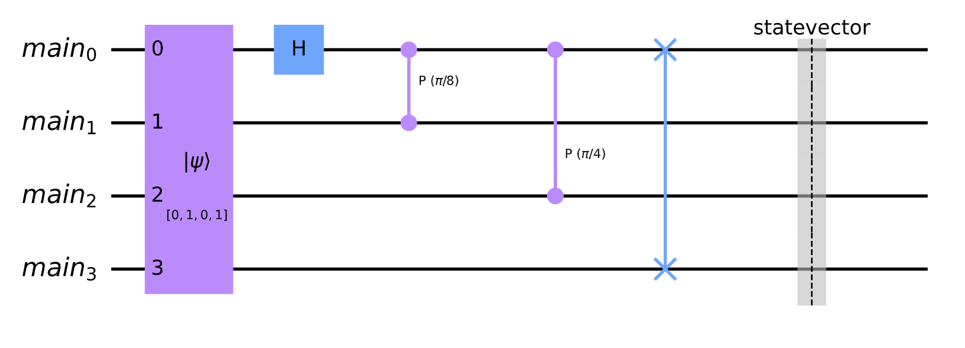
figures-0 : monolithic-quantum-computer-circuit-example

Slide 2
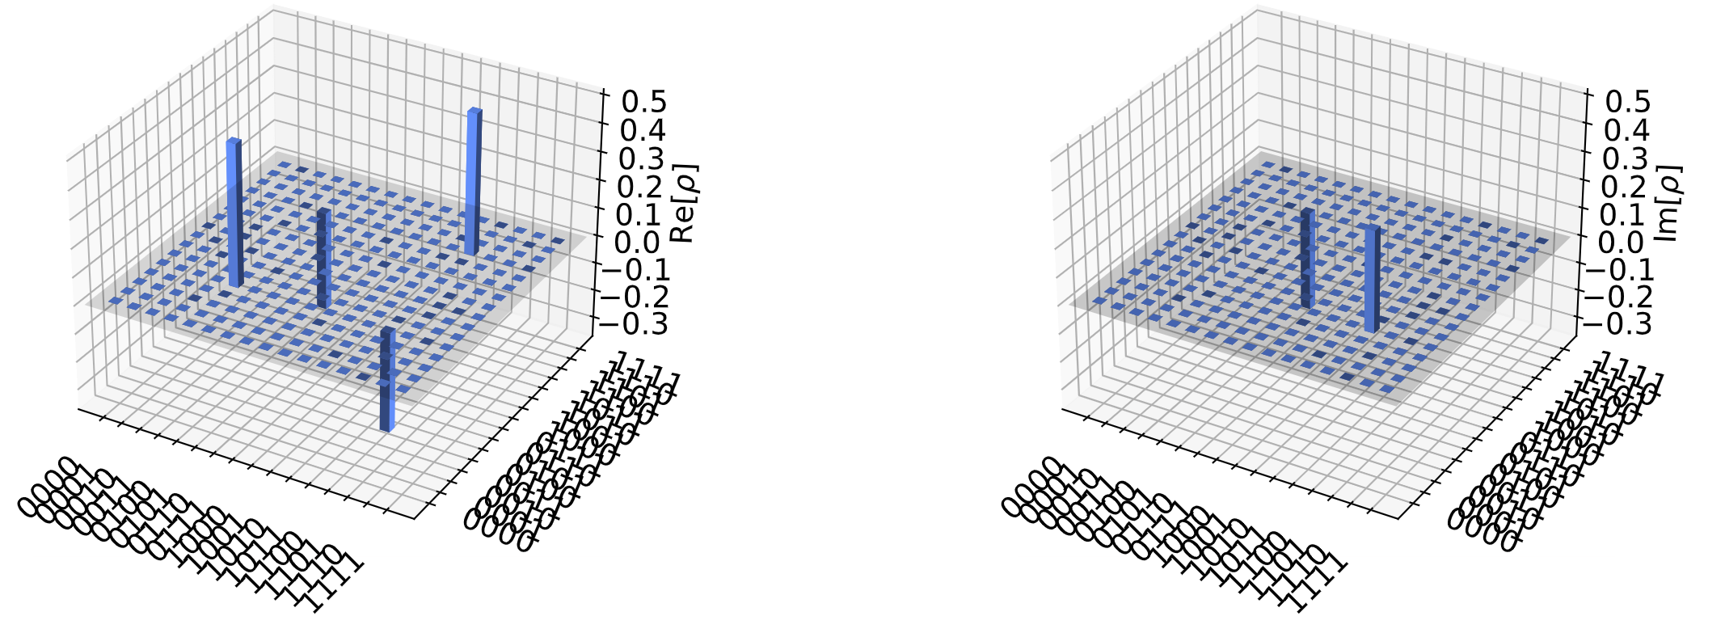
figures-1 : monolithic-quantum-computer-city-plot

Slide 3
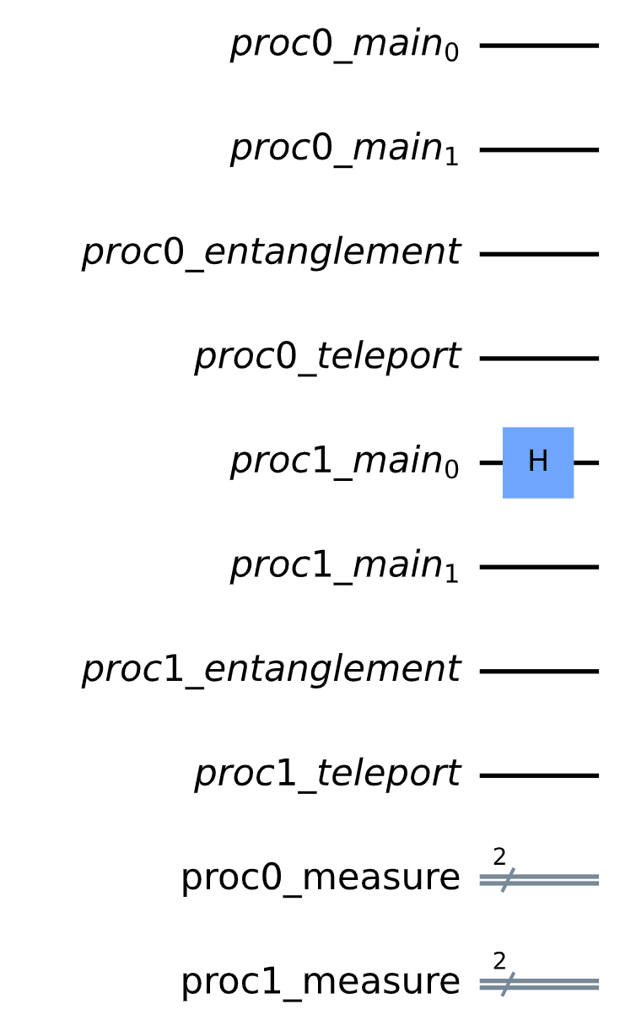
figures-2 : single-qubit-gate-global-to-local-mapping

Slide 4
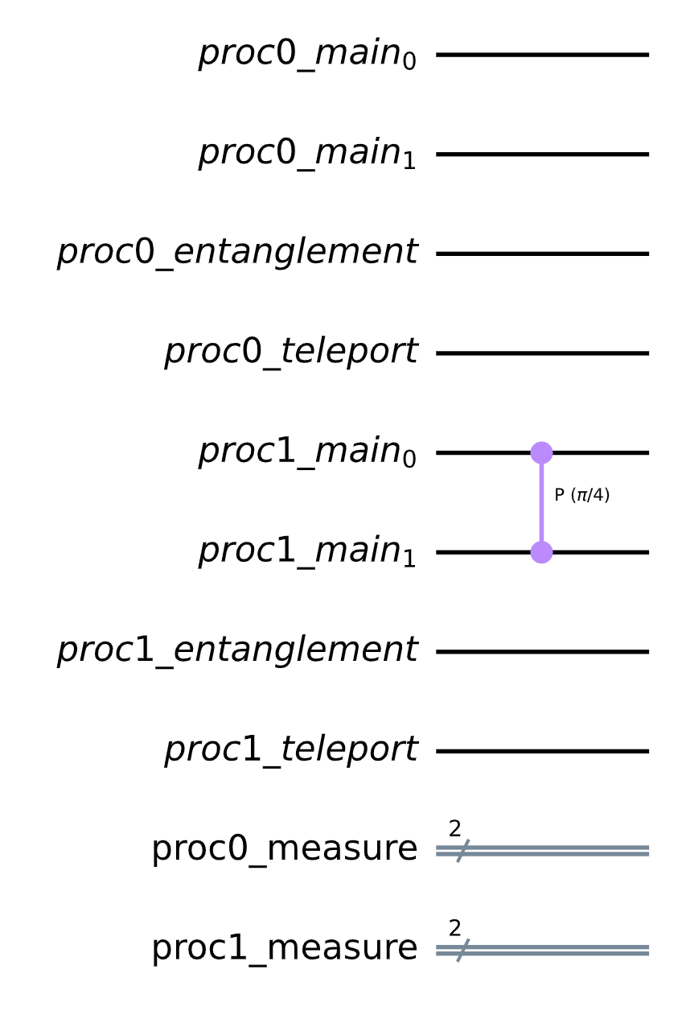
figures-3 : two-qubit-gate-global-to-local-mapping-same-processor

Slide 5
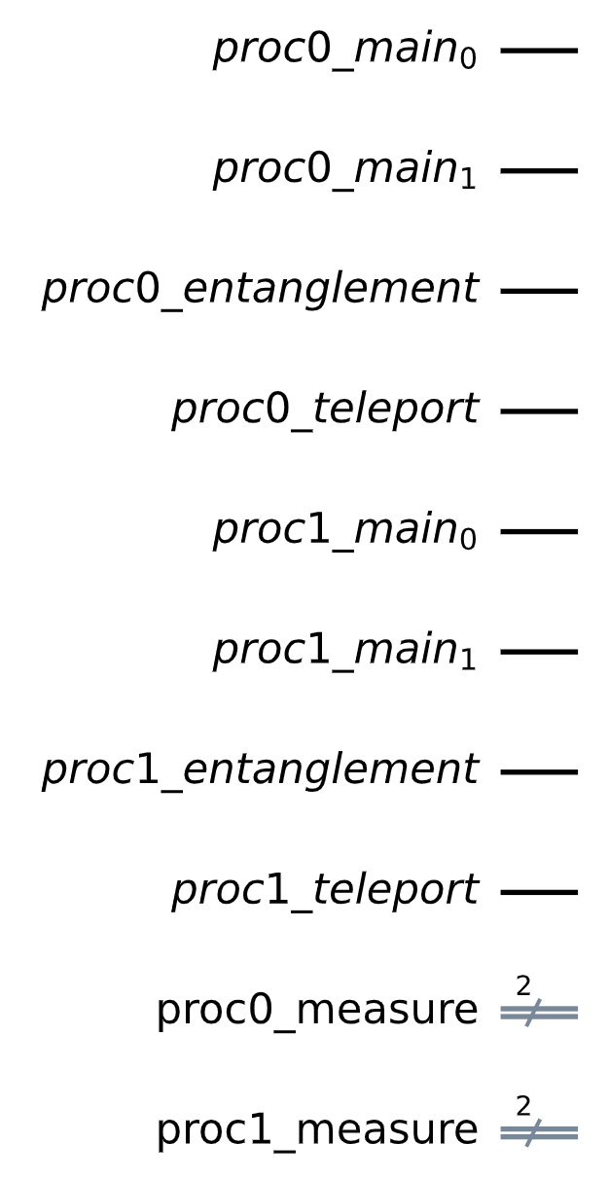
Processor index 0 qubits
Processor index 1 qubits
Processor index 0 classical bits
Processor index 1 classical bits
figures-4 : quantum processor registers

Slide 6
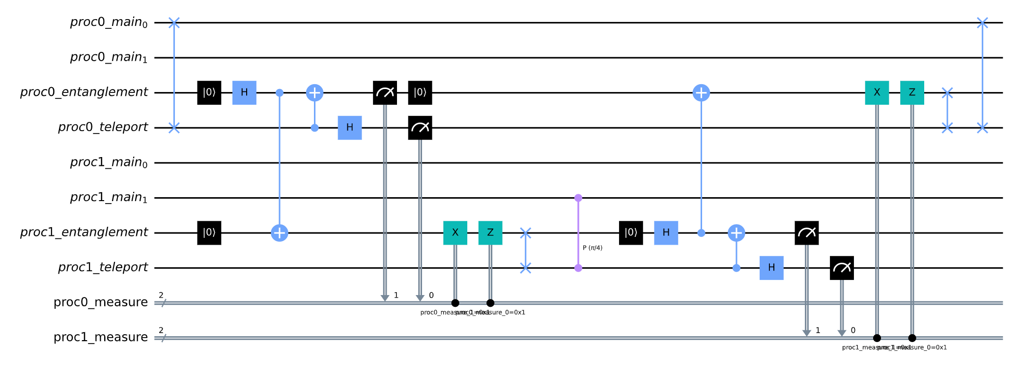
Step 1
Step 5
Step 2
Step 4
Step 3
figures-5 : two-qubit-gate-global-to-local-mapping-different-processor-using-teleportation

Slide 7
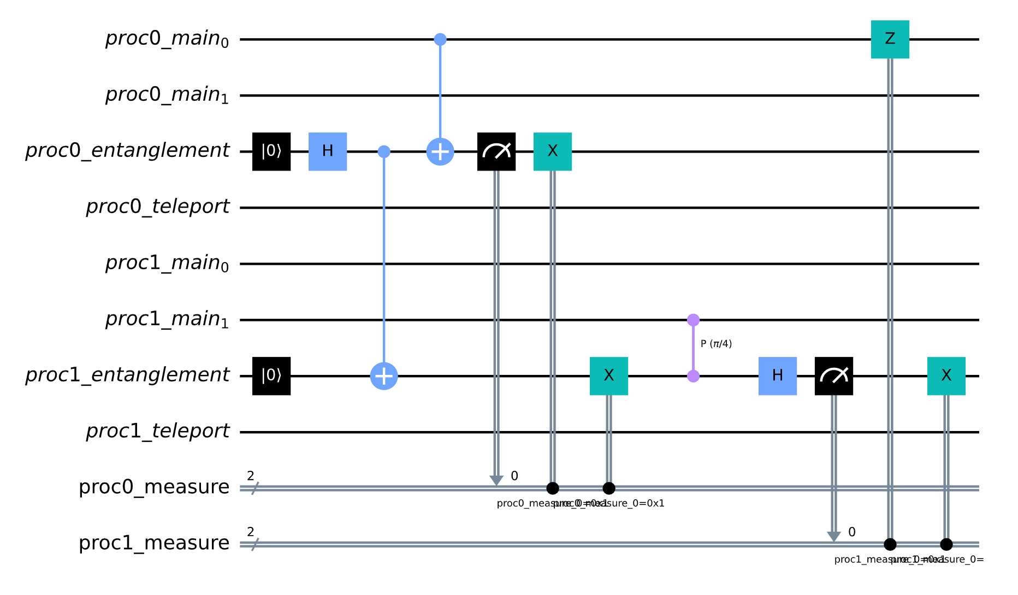
Step 1
Step 3
Step 2
figures-6 : two-qubit-gate-global-to-local-mapping-different-processor-using-cat-state

Slide 8
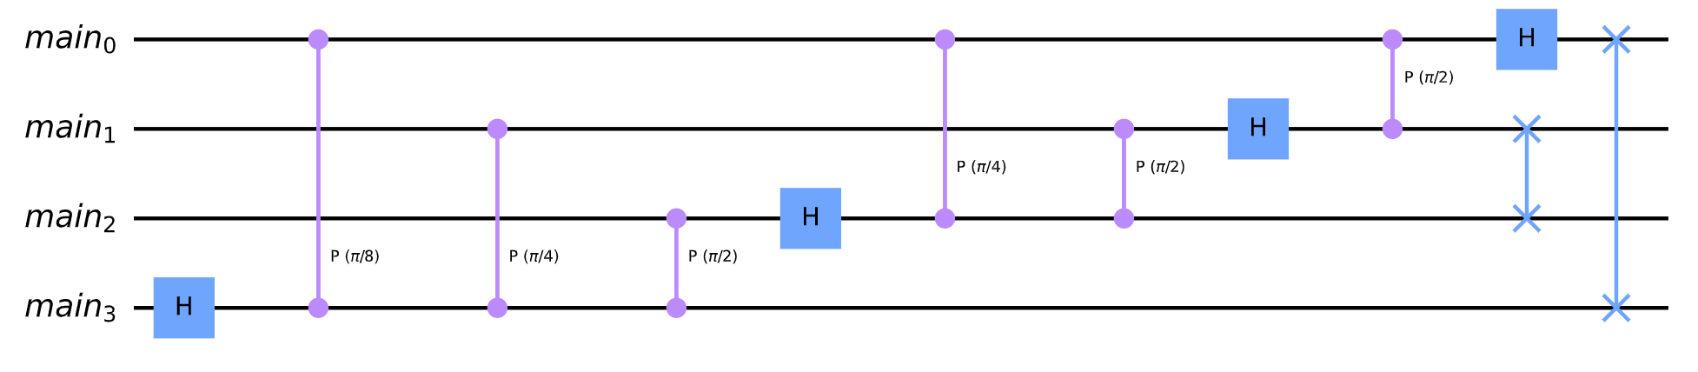
figures-7 : 4-bit-local-quantum-fourier-transformation

Slide 9
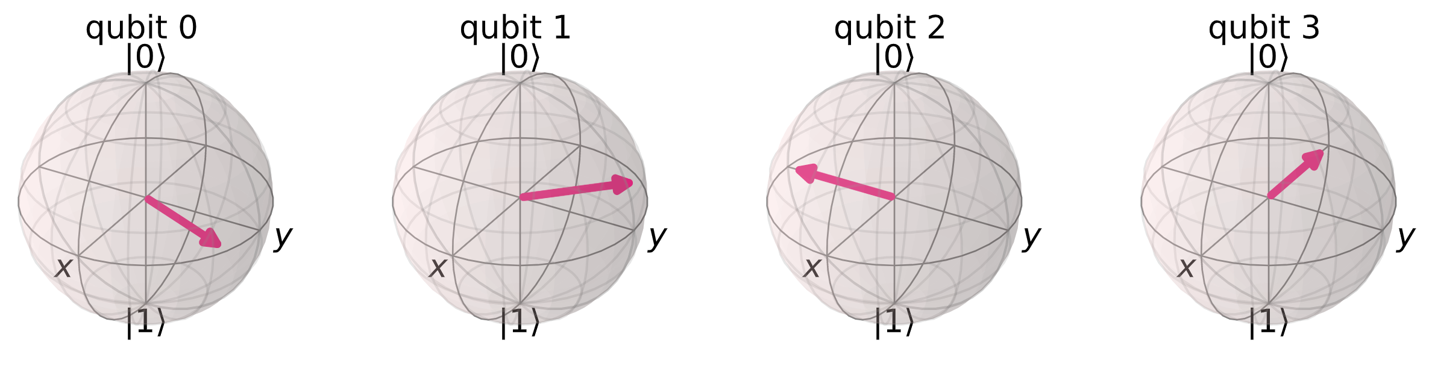
figures-8 : Bloch multi-vector for 4-bit QFT with input 3

Slide 10
figures-9 : 4-bit-distributed-quantum-fourier-transformation-using-teleportation

Slide 11
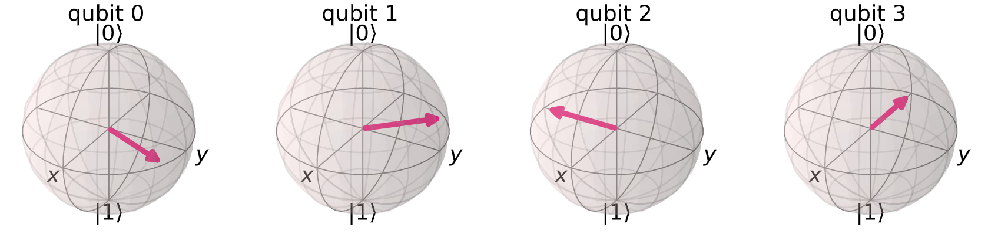
figures-10 : bloch-multi-vector-for-4-bit-distributed-qft-teleport-with-input-3.png

Slide 12
QNE Cloud-hosted environment
Graphical user interface
Local development environment
Distributed quantum Fourier transformation
Quantum network application
upload
Distributed quantum Fourier transformation
Quantum network application
QNE-ADK
Application development kit
NetQASM
NetQASM
Quantum network API
QNE-CLI
Command line interface
SquidASM
Map NetQASM to NetSquid
SquidASM
Real Quantum Network
(Future)
NetSquid
Quantum network simulator
NetSquid
figures-11 :Components of QNE

