Slide 1




Team Q-Harmonics
Team Members
Project
Abdullah K
B Akash Reddy Bruno Rijsman Kiran Kaur Sai Ganesh Manda
Tyler Cowan
DQFT
Distributed Quantum Fourier Transformation
Implementation, Validation, Benchmarking, Documentation
GitHub
https://github.com/brunorijsman/quantum-internet-hackathon-2022

Slide 2

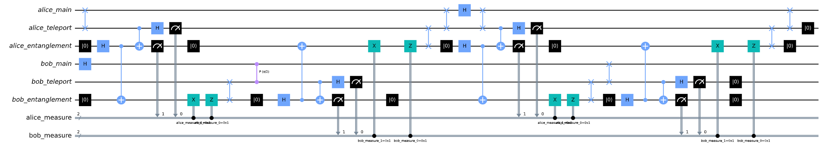
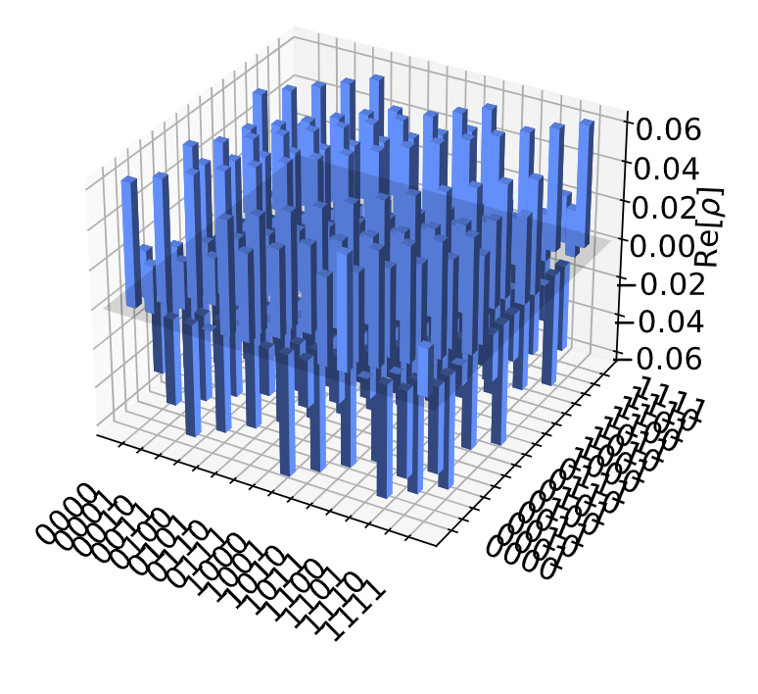
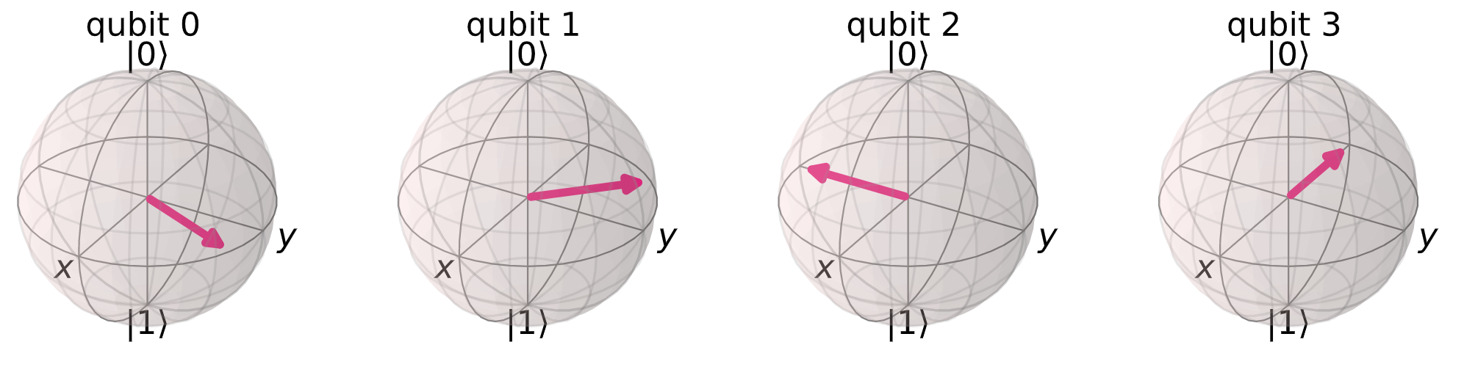
How did we do it?
DQFT circuit generation
DQFT circuit validation
Python classes and scripts
Cluster and processor abstractions
Teleportation and cat state abstractions
QFT and DQFT algorithms
Python classes and scripts
Use states and counts from simulator
Compare histograms
Compare state vectors
Compare density matrices
DQFT execution and visualization
Jupyter notebooks

Slide 3
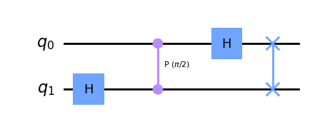
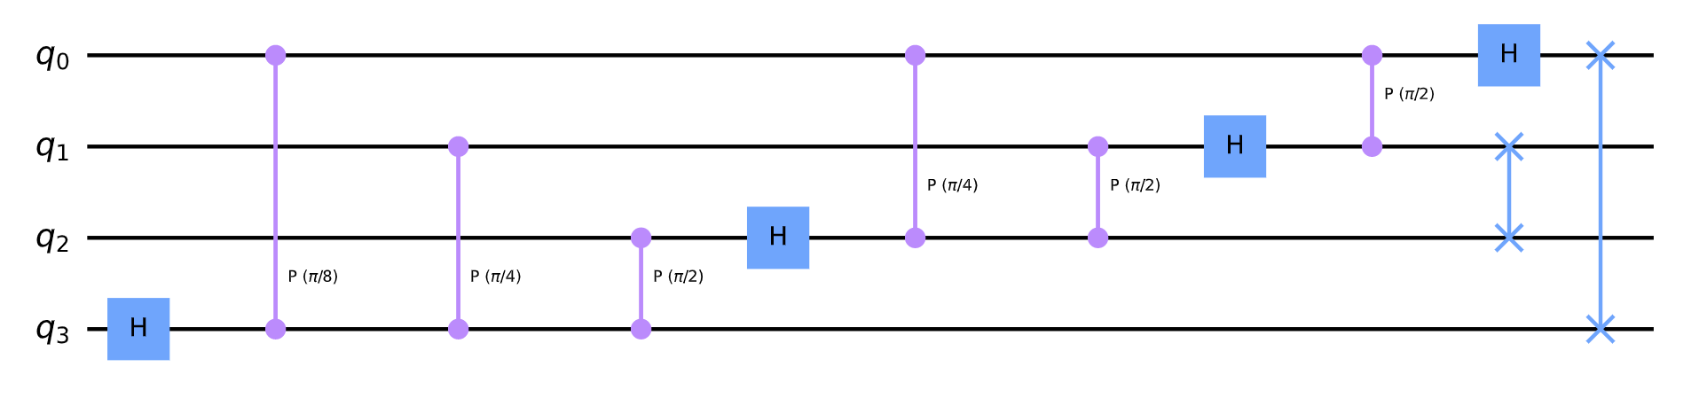
Some example non-distributed QFT circuits
2-qubit non-distributed QFT
4-qubit non-distributed QFT

Slide 4
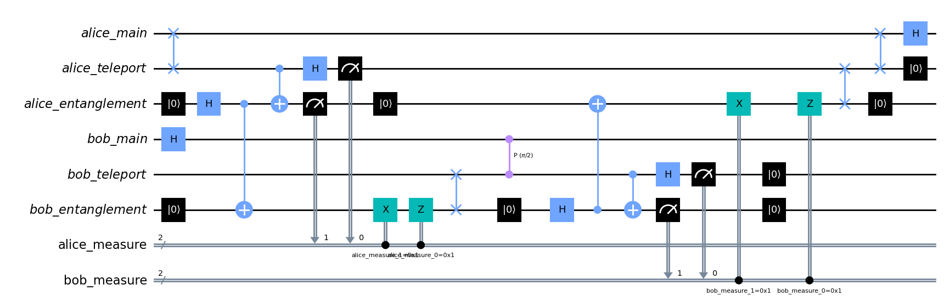
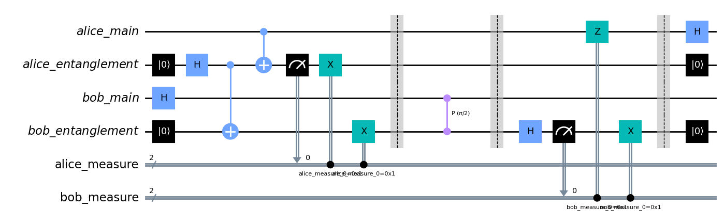
Some example distributed QFT circuits
2-qubit distributed QFT using teleportation
2-qubit distributed QFT using cat states

Slide 5


How far did we get?
Non-distributed QFT
Distributed QFT using teleportation
Distributed QFT using cat-states
Validation using histograms
Validation using state vector / DM
Documentation and visualization

