Slide 1
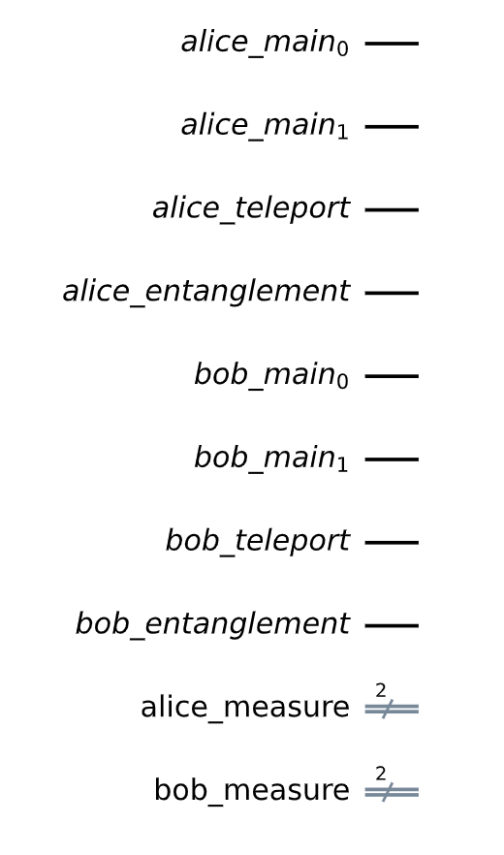
Processor #0 (Alice) qubits
Processor #1 (Bob) qubits
Processor #0 (Alice) classical bits
Processor #1 (Bob) classical bits
figures-0 : Quantum Processor Registers

Slide 2
Second slide

