Slide 1




Team Q-Harmonics
Team Members
Project
Abdullah K
B Akash Reddy Bruno Rijsman Kiran Kaur Sai Ganesh Manda
Tyler Cowan
DQFT
Distributed Quantum Fourier Transformation
Implementation, Validation, Benchmarking, Documentation
GitHub
https://github.com/brunorijsman/quantum-internet-hackathon-2022

Slide 2




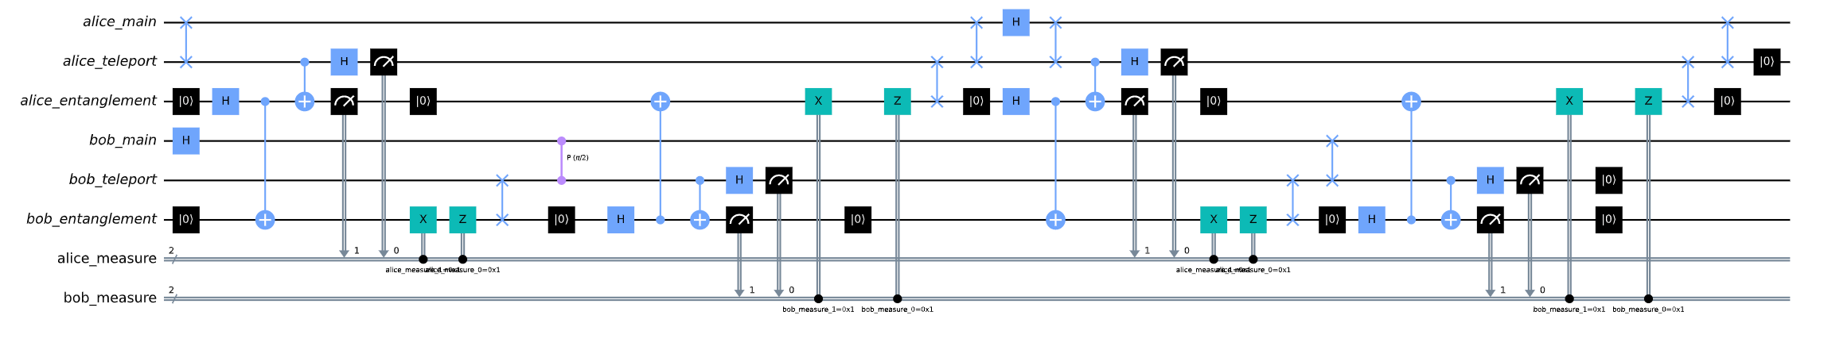
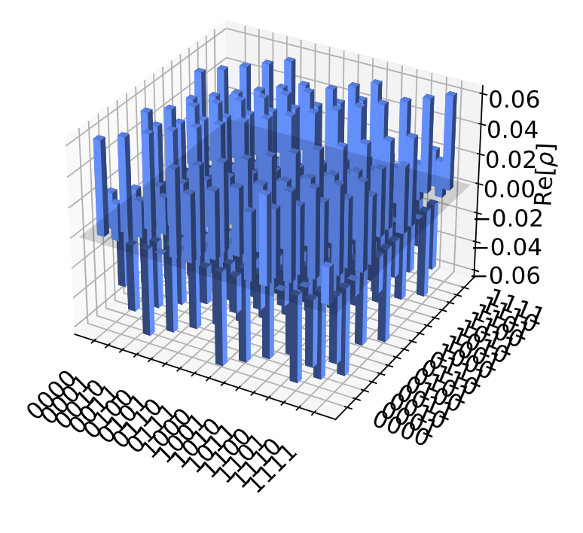
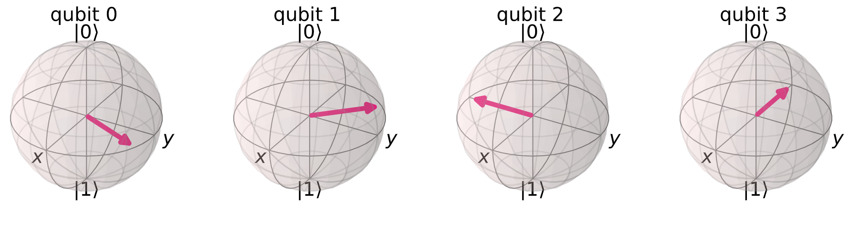
Progress
Circuit generation and validation
Local QFT
Teleport-based DQFT
Cat-state-based DQFT
Histogram-based validation
State-based validation
Benchmarking
Documentation
Python classes and scripts
Qiskit Terra and Aer
Clusters and processors
Teleportation and cat states
QFT and DQFT
Histogram comparison
Visualization
Jupyter notebooks

