Slide 1
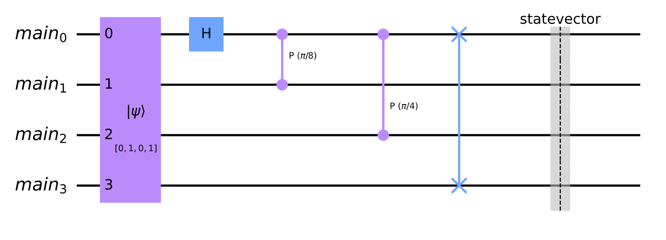
figures-0 : monolithic-quantum-computer-circuit-example

Slide 2
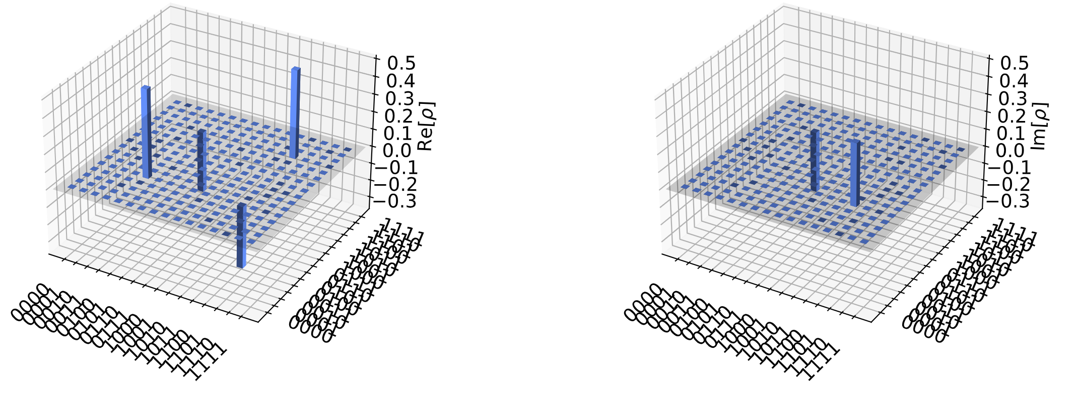
figures-1 : monolithic-quantum-computer-city-plot

Slide 3
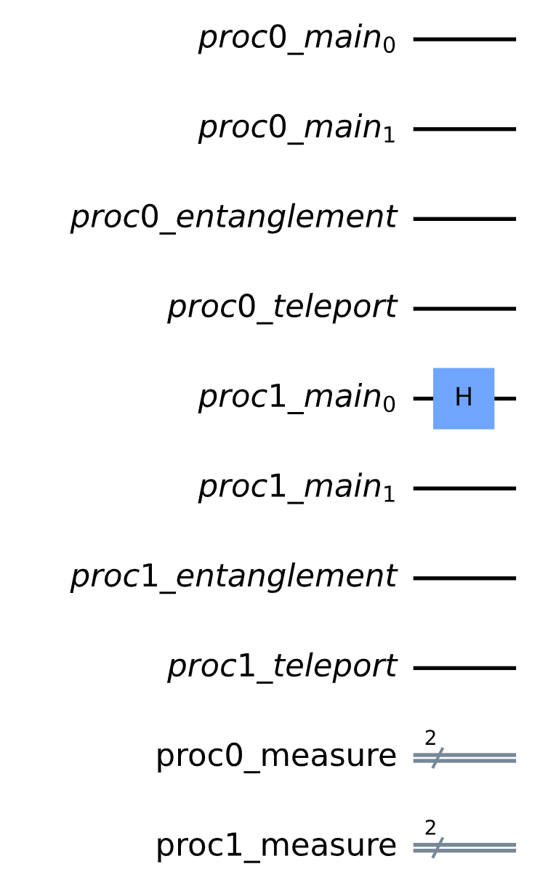
figures-2 : single-qubit-gate-global-to-local-mapping

Slide 4
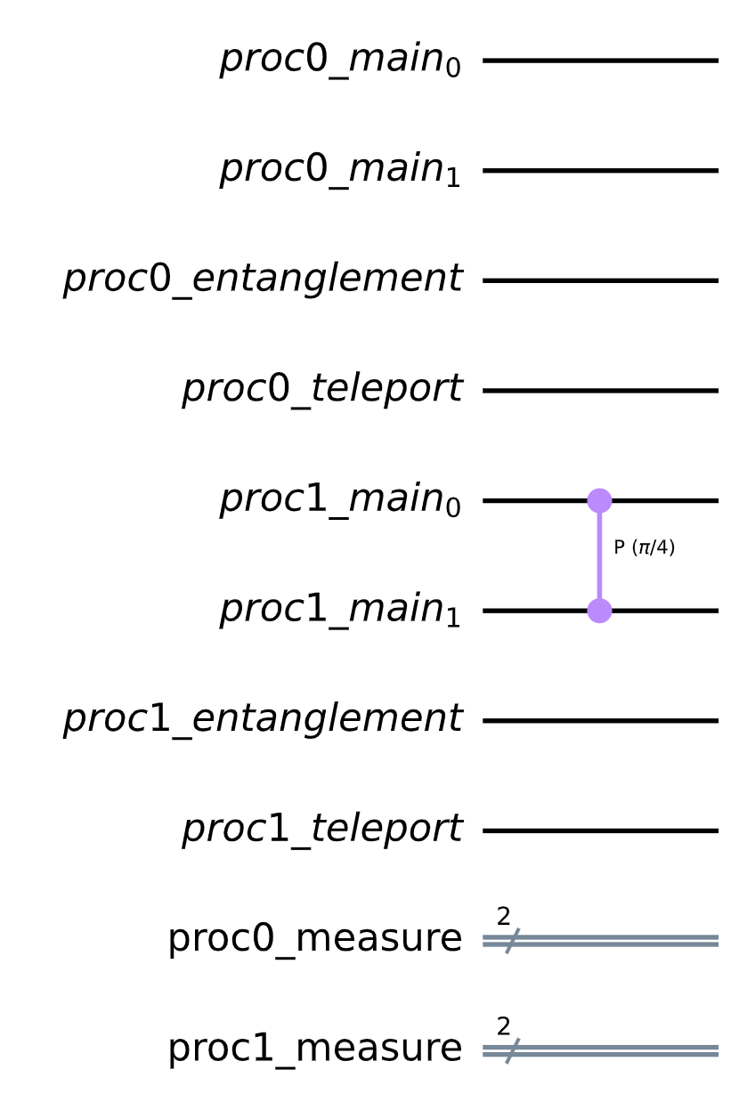
figures-3 : two-qubit-gate-global-to-local-mapping-same-processor

Slide 5
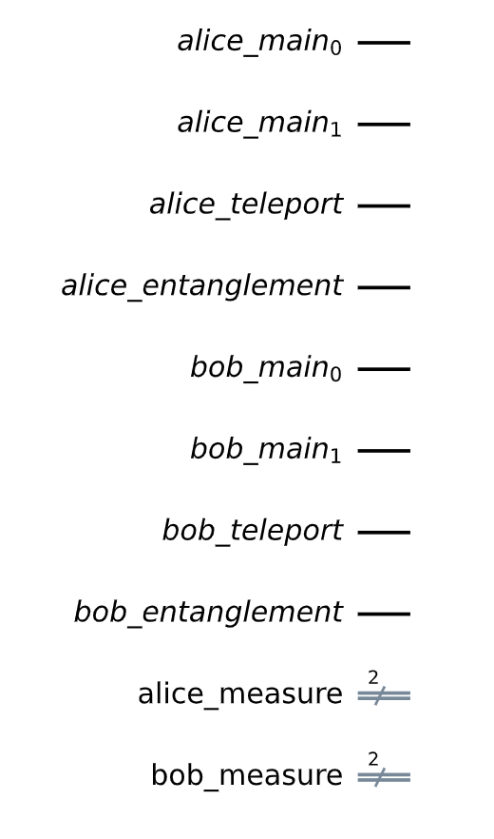
Processor #0 (Alice) qubits
Processor #1 (Bob) qubits
Processor #0 (Alice) classical bits
Processor #1 (Bob) classical bits
figures-4 : quantum processor registers

Slide 6
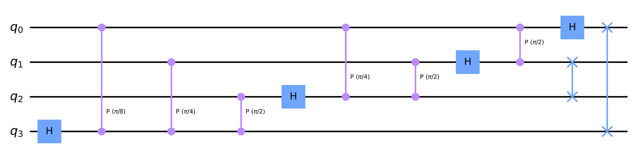
figures-5 : 4-bit local quantum Fourier transformation

Slide 7
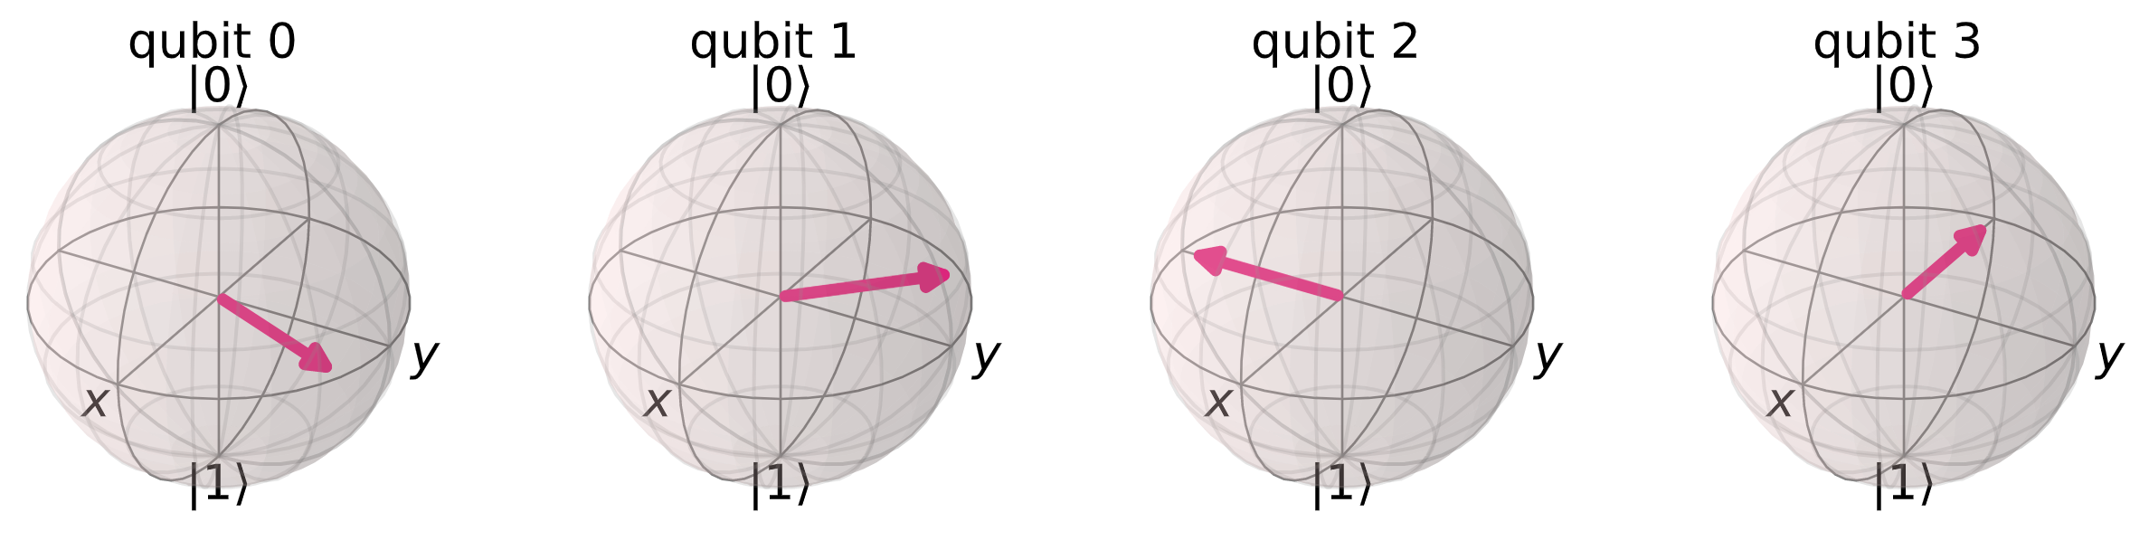
figures-6 : Bloch multi-vector for 4-bit QFT with input 3

Slide 8
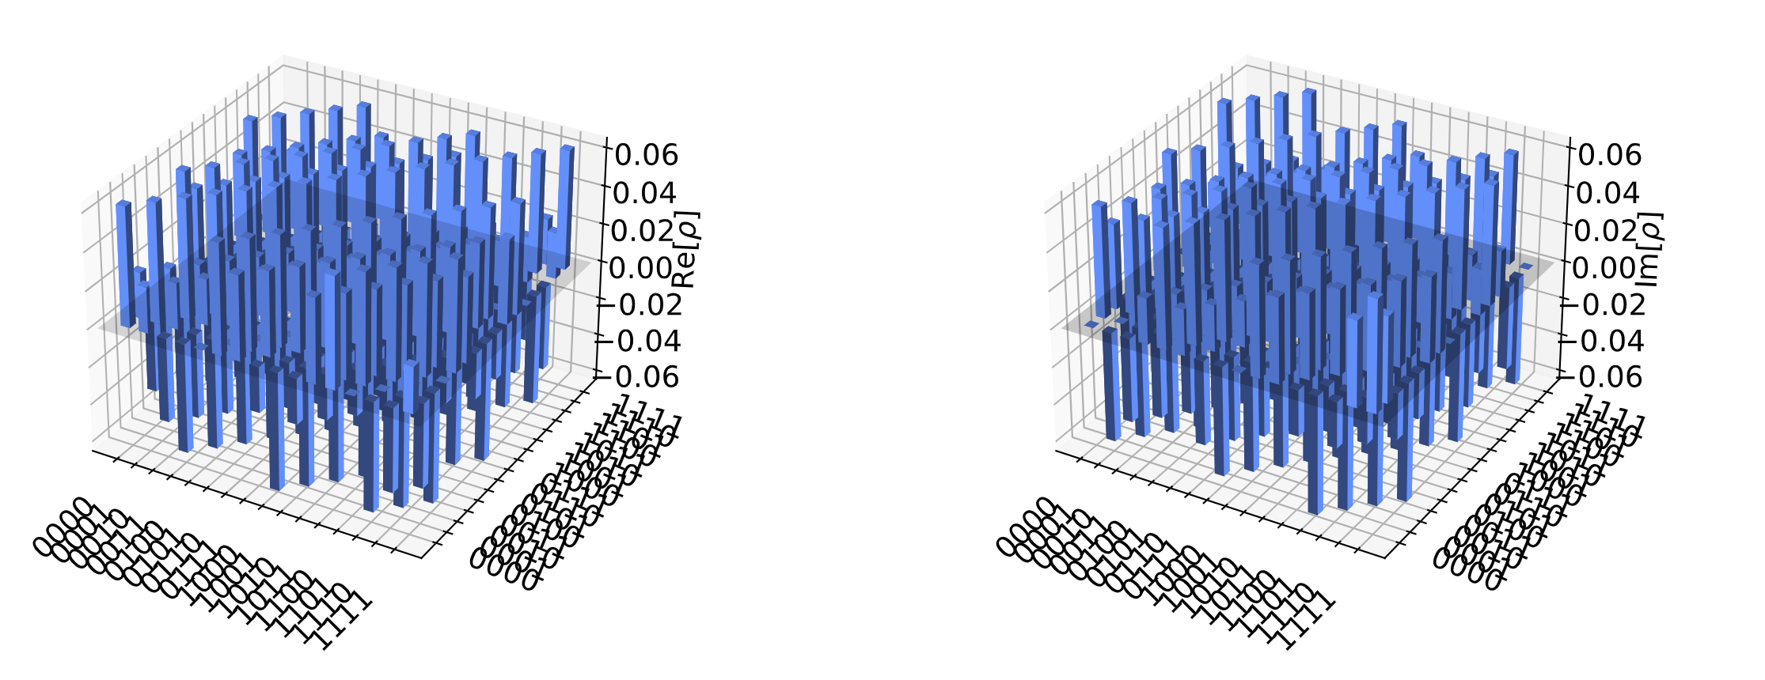
figures-7 : Density matrix city plot for 4-bit QFT with input 3

