Slide 1
AI Computer Vision Based Signature Recognition Sargunan R

Slide 2
Cross-domain datasets
CEDAR Dataset
Indian Language Dataset
Given Dataset from Competition

Slide 3
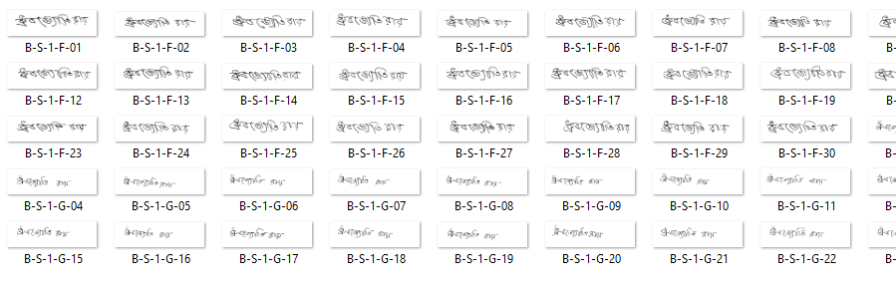
Data set overview

Slide 4
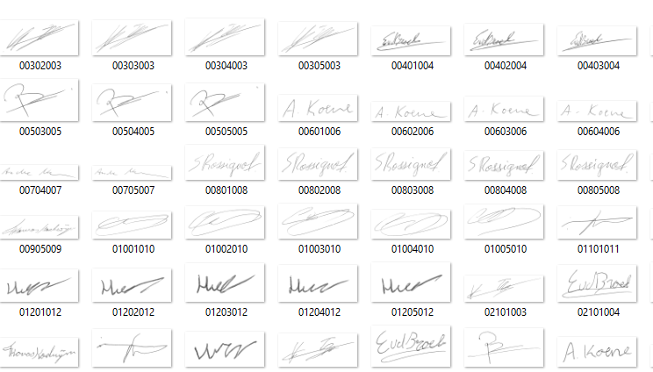
Dataset Overview (cont..)

Slide 5
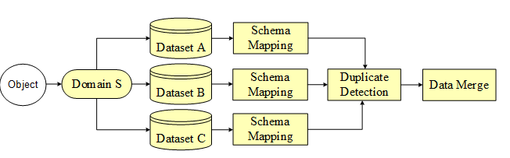
Model
Experiments conducted on cross-domain datasets
.

Slide 6
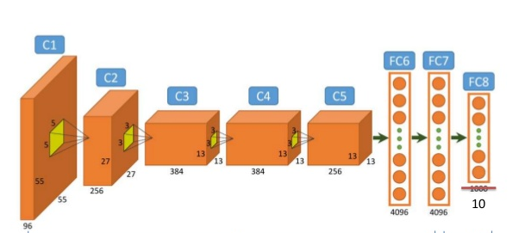


Architecture [Sesame neural network]
EC D
Image Matched or Not
Image Dataset
Deep Learning Framework
CNN Based Algorithm
Image Dataset
Deep Learning Framework
CNN Based Algorithm
Accuracy : 80 +

Slide 7
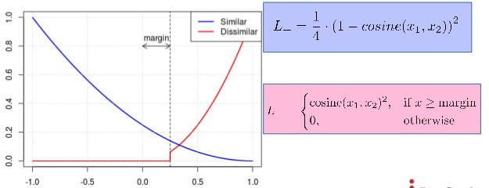
Accuracy
Accuracy Achieved : 80% ( 80%+ For original and 80% for forgeries)
Contrastive loss function
It is a Distance-based Loss function

Slide 8


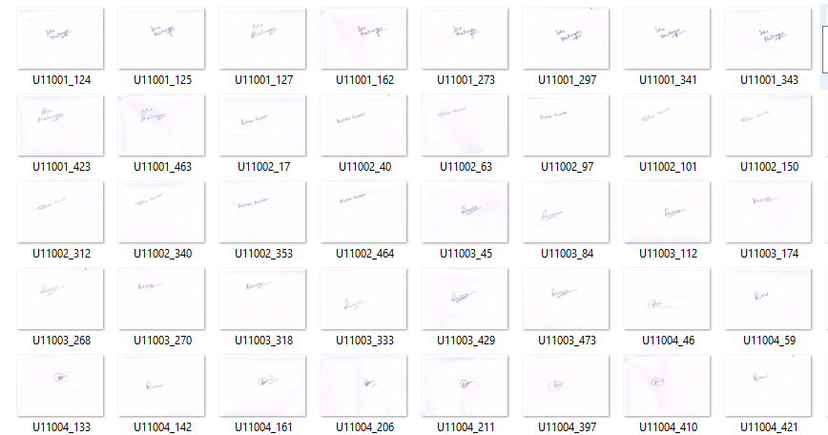
Axis Bank Dataset

Slide 9
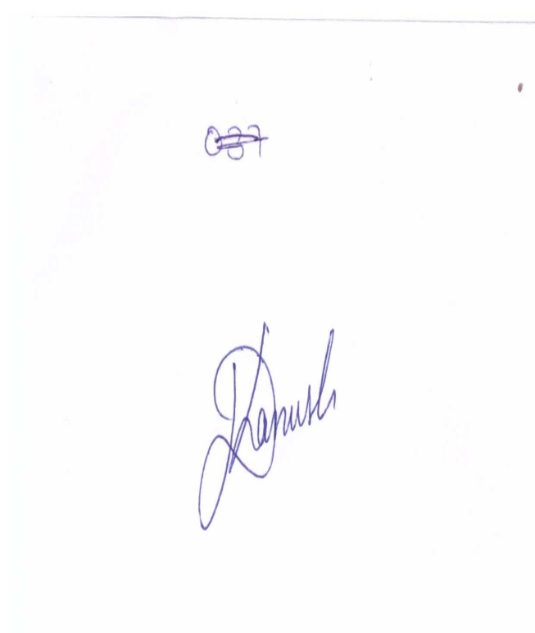

AXIS Image Dataset Pre-processing
Input image
Pre-processed image

Slide 10
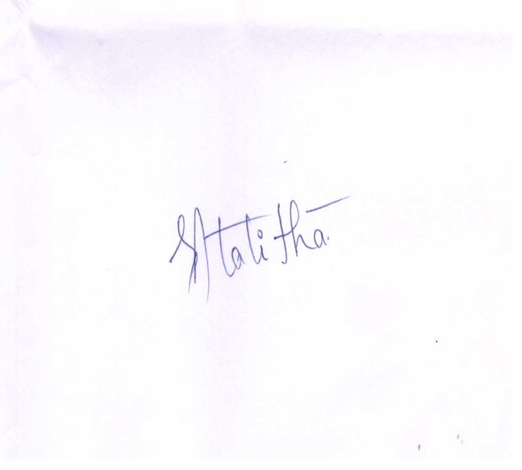

Pre-processing
Input image
Pre-processed image

Slide 11
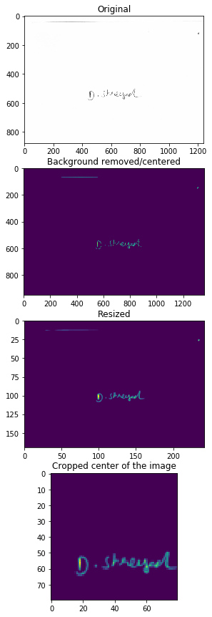
Pre-processing
1. Original Image
2. Normalized Image
3. Resized Image
4.Cropped Image

Slide 12

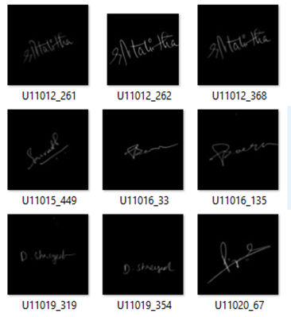
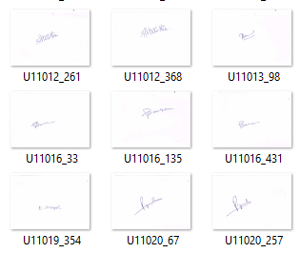
Final Image Result

Slide 13
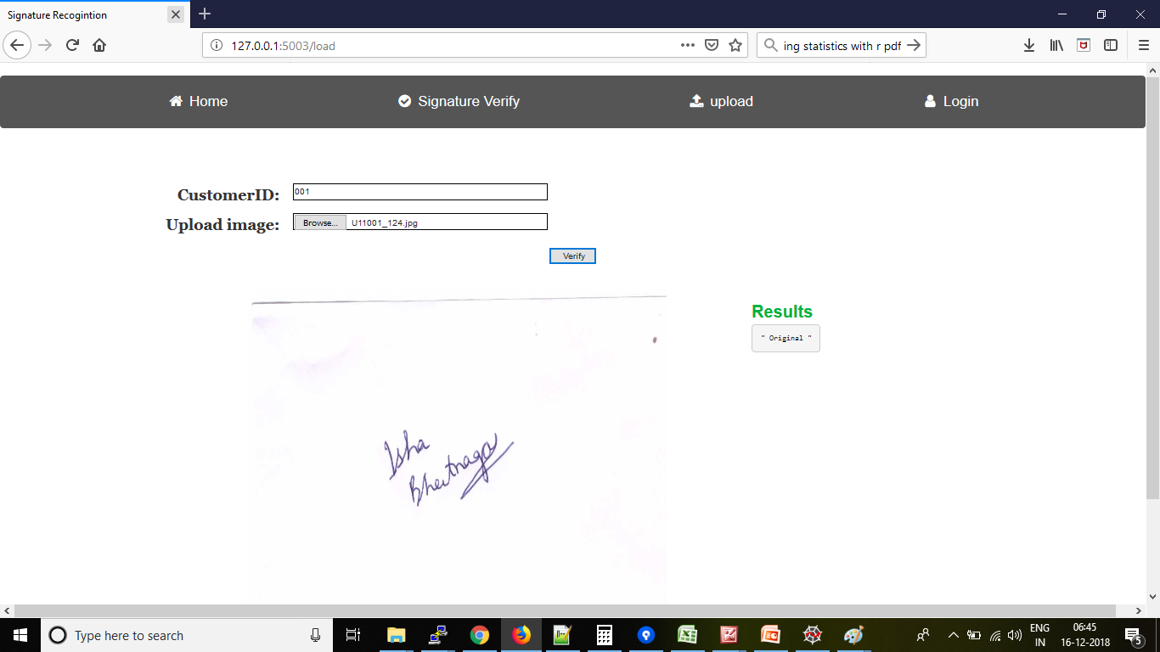
Verification Screen Shot

Slide 14
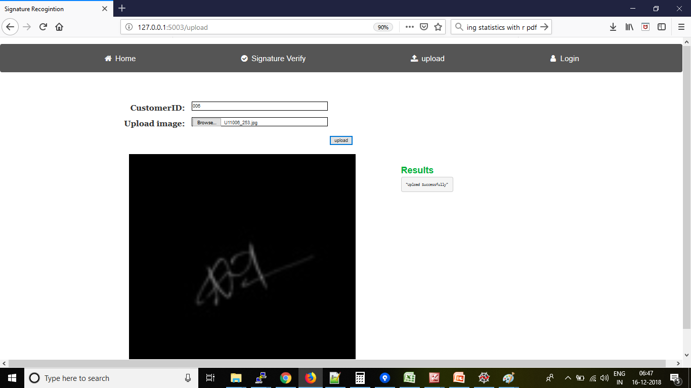
Upload Screen Shot

Slide 15
Summary
Accomplished:
Accuracy above 80+ ( 80%+ For original and 80% for forgeries)
Cross domain dataset for dataset 2 is used for model training
web app is developed to upload the dataset and verification
To do:
Fine Tuning pre processing steps

Slide 16
Result in video
https://youtu.be/HrVEKQ_5GtQ

Slide 17


