Slide 1
COMS W6156
Project Demo
Bruno Martins - bm2787

Slide 2

Research Questions
1: Is it feasible to port parts of a big C/C++ project to Rust?
2: Is it worth it?

Slide 3

Rust
New programming language
Heavy focus on safety
Binary compatibility with C

Slide 4

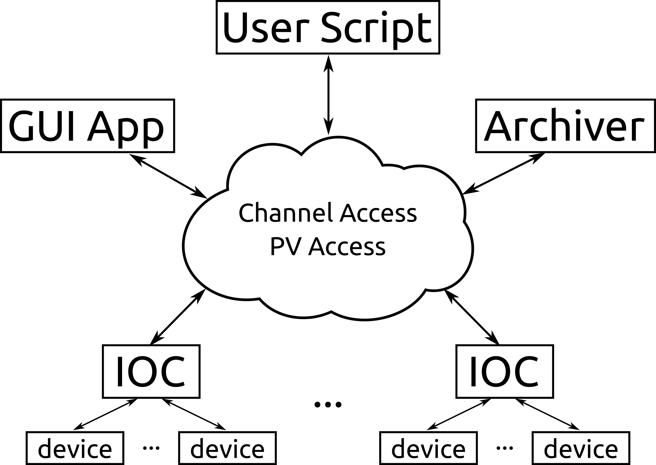
EPICS Architecture

Slide 5
Demo
iocsh

Slide 6
Research Questions
1: Is it feasible to port parts of a big C/C++ project to Rust?
Yes, but it can be very difficult
2: Is it worth it?
Not for a project like this one (old & large)

