Slide 1
nopCommerce + OpenTelemetry
Checkout Flow Observability
Software Architectures · Assignment 1 · Bruno Tavares

Slide 2
nopCommerce Architecture
Nop.Web
Why instrument here?
HTTP entry point — Controllers, Views
→ ASP.NET auto-instrumentation already covers HTTP spans in Nop.Web
Nop.Web.Framework
DI, base infrastructure, middleware
→ SqlClient auto-instrumentation covers SQL queries in Nop.Data
Nop.Services
Business logic — OrderProcessingService
→ Nop.Services is the gap — payment, persistence, events are orchestrated here
Nop.Data
→ PlaceOrderAsync is the single method that coordinates the entire checkout
Repositories, EF Core, migrations
→ Surgical: 3 files changed, business logic untouched
Nop.Core
Entities, interfaces, events (base)
Software Architectures · Assignment 1 · Bruno Tavares

Slide 3
Instrumentation Decision
Browser
CheckoutController
OrderProcessingService
SQL Server
Chose "Customer places an order" — the most business-critical flow; if checkout fails, the store loses money
Instrumented at OrderProcessingService.PlaceOrderAsync — where payment, persistence, notifications and events are orchestrated in a single method
ASP.NET auto-instrumentation covers HTTP. SqlClient covers SQL. I only needed to instrument what's in between
Surgical approach: 3 files changed (OrderProcessingService.cs, Program.cs, NopTelemetryConstants.cs), business logic untouched, zero overhead if OTel SDK is absent
Software Architectures · Assignment 1 · Bruno Tavares

Slide 4
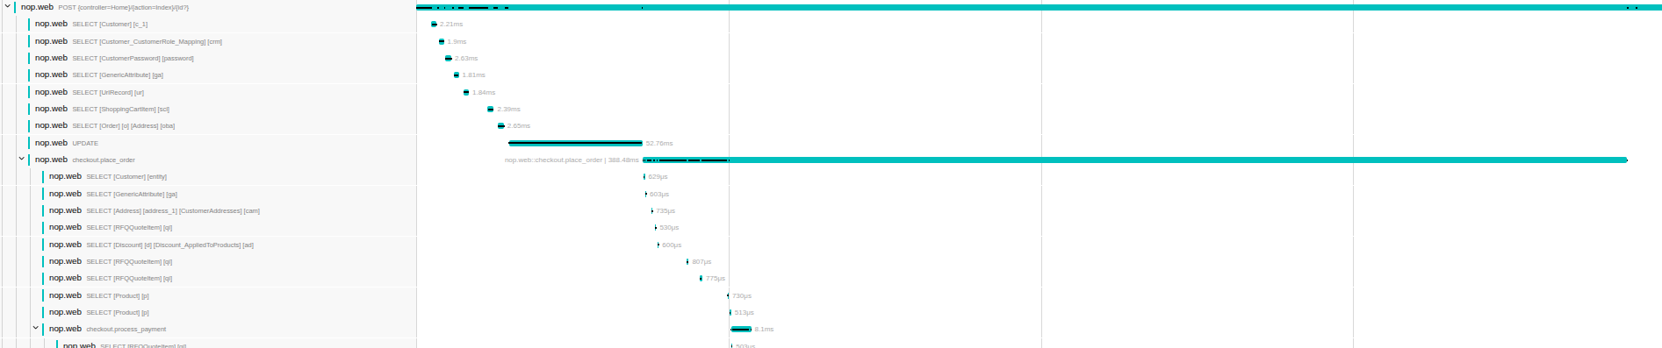
End-to-End Tracing
POST /checkout/OpcConfirmOrder
auto - ASP.NET
checkout.place_order
custom
checkout.process_payment
custom
checkout.save_order
custom
SQL queries
auto - SqlClient
checkout.send_notifications
custom
checkout.publish_event
custom
Included: order.total, payment.method, order.items | Excluded: emails, addresses, names, card numbers (zero PII)
Software Architectures · Assignment 1 · Bruno Tavares

Slide 5
3 Custom Metrics — The 2am Test
Metric
Type
If it fires at 2am, the on-call engineer knows...
nop.checkout.place_order.attempts
Counter
Checkout volume dropped or spiked abnormally — checkout may be unreachable
nop.checkout.place_order.failures
Counter
The checkout pipeline is broken — users cannot complete orders
nop.checkout.place_order.duration
Histogram
DB or payment gateway is degraded — p95 rising before visible errors appear
attempts + failures → error rate in Grafana | duration → detects degradation before failures become visible
Software Architectures · Assignment 1 · Bruno Tavares

Slide 6
Privacy — Defence in Depth
In code
OTel Collector — pii-redact processor
Span attributes are strictly operational: order.total, payment.method, order.items
Deletes before export: authorization headers, cookies, emails, SQL statements, query strings, request bodies
No emails, addresses, names or card numbers are ever recorded
Why here? Auto-instrumentation (ASP.NET, SqlClient) can capture PII without my control — the Collector is the last barrier
Explicit decision for every attribute — full control at the point of instrumentation
Even if something escapes in code, it is filtered here before reaching Jaeger or Prometheus
Rejected alternative: filtering only in code — fragile, auto-instrumentation escapes our control
Software Architectures · Assignment 1 · Bruno Tavares

Slide 7
What I Did NOT Instrument — and Why
Not instrumented
Reasoning
Controllers
ASP.NET auto-instrumentation already covers all HTTP spans
Generic EventPublisher
Would affect the entire system (login, newsletter...) — instrumented only the OrderPlacedEvent
Plugins (Brevo, Avalara)
Independent modules, out of checkout scope
Cache (IStaticCacheManager)
Overhead on thousands of operations per request — noise with no value
Internal checkout methods are protected virtual — subclass override would be possible but fragile and disproportionate. Chose direct surgical change in the service.
Software Architectures · Assignment 1 · Bruno Tavares

Slide 8
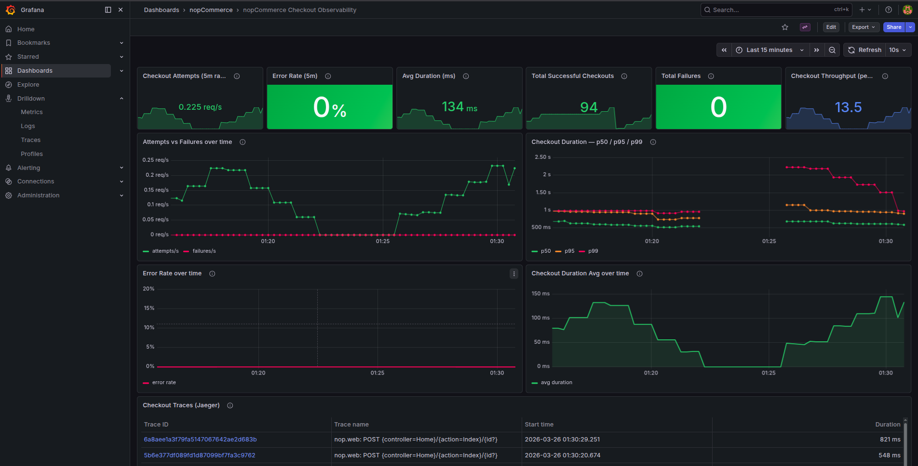
Live Demo
Load Test
Grafana
Jaeger
k6 run loadtest/checkout-flow.js
localhost:3000
localhost:16686
Backup screenshots — real demo runs live with k6 generating traffic
Software Architectures · Assignment 1 · Bruno Tavares

Slide 9
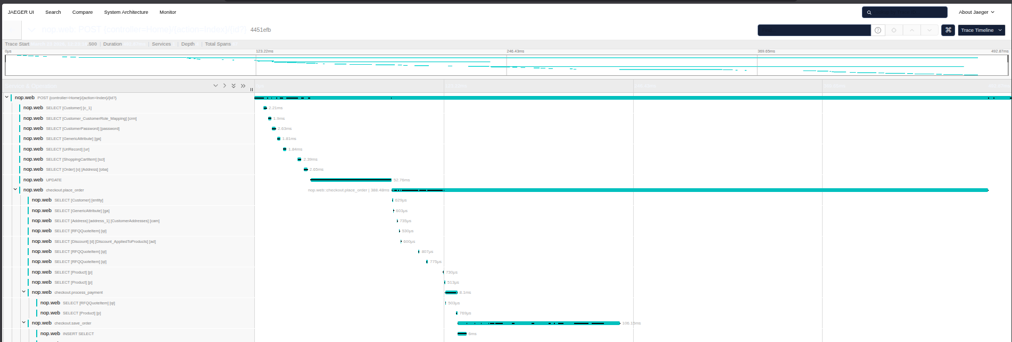
Live Demo
Load Test
Grafana
Jaeger
k6 run loadtest/checkout-flow.js
localhost:3000
localhost:16686
Backup screenshots — real demo runs live with k6 generating traffic
Software Architectures · Assignment 1 · Bruno Tavares

Slide 10
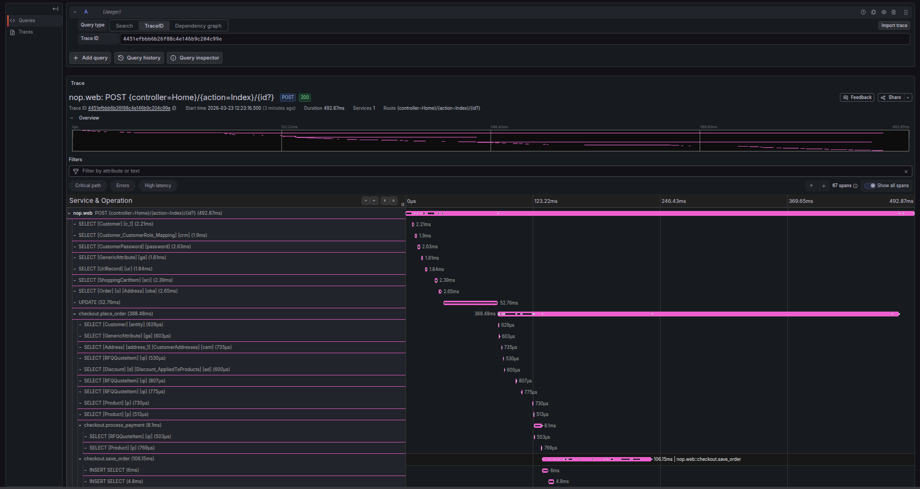
Live Demo
Load Test
Grafana
Jaeger
k6 run loadtest/checkout-flow.js
localhost:3000
localhost:16686
Backup screenshots — real demo runs live with k6 generating traffic
Software Architectures · Assignment 1 · Bruno Tavares

