Slide 1
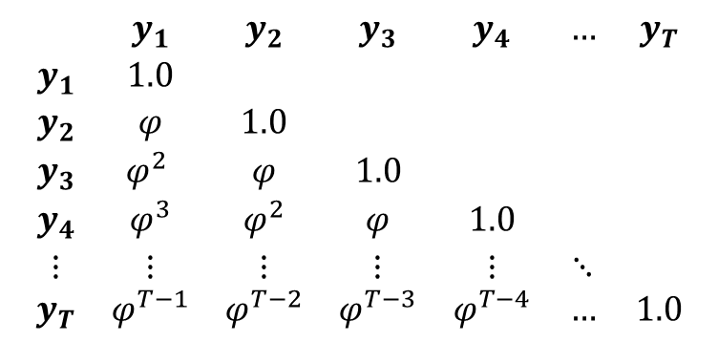
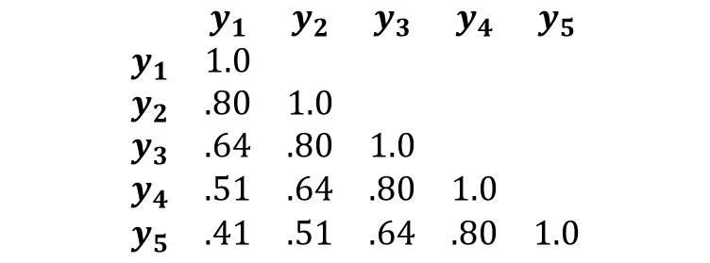
$$\begin{matrix} & y_{1} & y_{2} & y_{3} & y_{4} & y_{5} \\ y_{1} & 1.0 & & & & \\ y_{2} & .80 & 1.0 & & & \\ y_{3} & .64 & .80 & 1.0 & & \\ y_{4} & .51 & .64 & .80 & 1.0 & \\ y_{5} & .41 & .51 & .64 & .80 & 1.0\end{matrix}$$
$$\begin{matrix} & y_{1} & y_{2} & y_{3} & y_{4} & … & y_{T} \\ y_{1} & 1.0 & & & & & \\ y_{2} & φ & 1.0 & & & & \\ y_{3} & φ^{2} & φ & 1.0 & & & \\ y_{4} & φ^{3} & φ^{2} & φ & 1.0 & & \\ ⋮ & ⋮ & ⋮ & ⋮ & ⋮ & ⋱ & \\ y_{T} & φ^{T−1} & φ^{T−2} & φ^{T−3} & φ^{T−4} & … & 1.0\end{matrix}$$

Slide 2
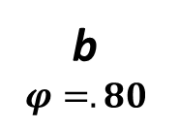

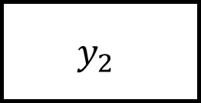
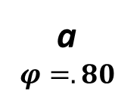

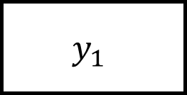

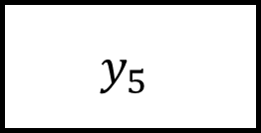

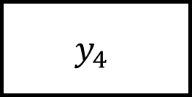
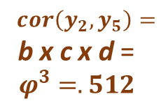
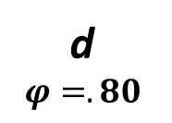
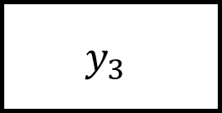
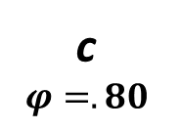
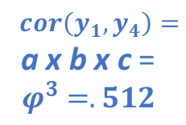
$cor\left(y_{1},y_{4}\right)=$
a x b x c =
$$φ^{3}=.512$$
$cor\left(y_{2},y_{5}\right)=$
b x c x d =
$$φ^{3}=.512$$
a
$$φ=.80$$
b
$$φ=.80$$
c
$$φ=.80$$
d
$$φ=.80$$
$$y_{1}$$
$$y_{2}$$
$$y_{3}$$
$$y_{4}$$
$$y_{5}$$
$$cor\left(y_{1},y_{3}\right)=$$
a x b =
$$φ^{2}=.64$$
$$cor\left(y_{2},y_{4}\right)=$$
b x c =
$$φ^{2}=.64$$
$$cor\left(y_{3},y_{5}\right)=$$
c x d =
$$φ^{2}=.64$$
$$cor\left(y_{1},y_{5}\right)=$$
a x b x c x d =
$$φ^{4}=.41$$

