Slide 1












Azure Kubernetes Service in hybrid scenario
Image building
and hosting
Docker Trusted
Registry
AKV
Application deployment
Express Route
Internal APIs
AKS
Applications running K8s pods
Custom VNet – extending on-prem
Datacenter
On-Prem

Slide 2
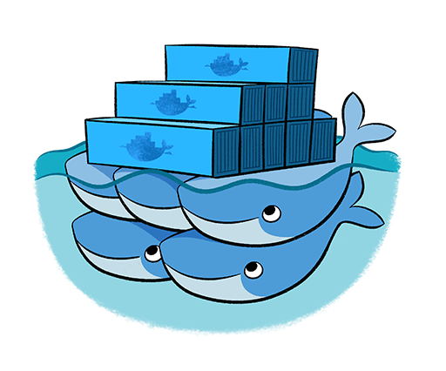
Azure Kubernetes Service in hybrid scenario
Image building
and hosting
Docker Trusted
Registry
AKV
Application deployment
Express Route
Docker EE
Swarm
AKS
Applications running K8s pods
Custom VNet – extending on-prem
Datacenter
On-Prem

