Slide 1
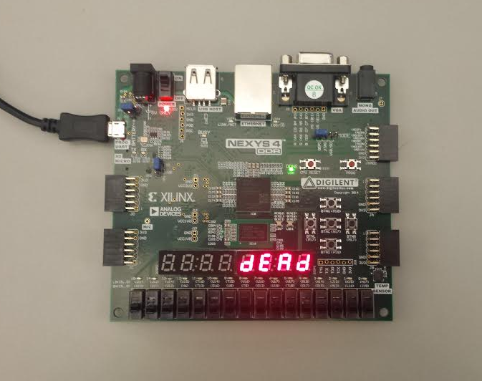
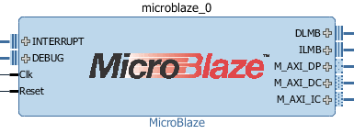
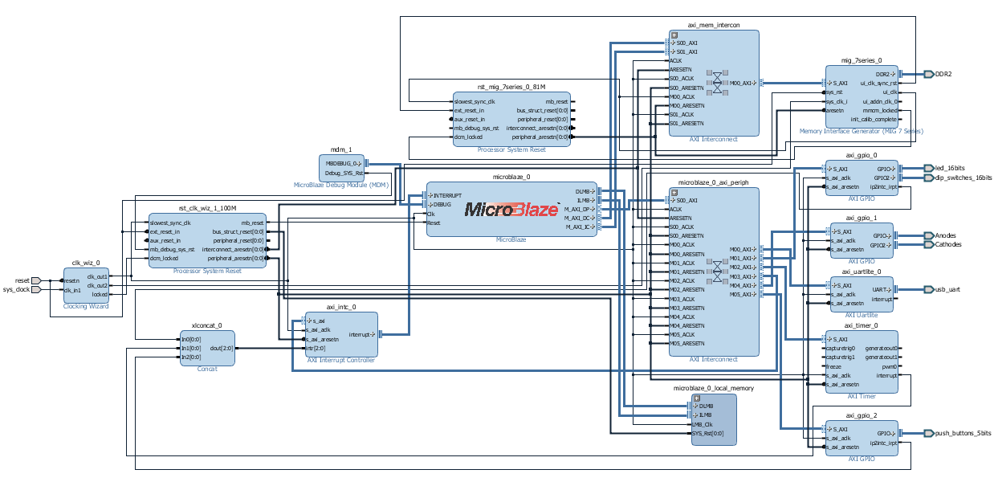
Synchronous Digital System Using Xilinx MicroBlaze Processor
EE316 Computer Engineering Junior Lab
James Bruska, Daniel Heck, and Matthew Michaels
Dr. Abul Khondker
Abstract
This system displays an output sequence using a Xilinx MicroBlaze processor on a Xilinx’s NexysTM 4 board. The system displays a given sequence on four seven-segment displays and changes every second. There are also three buttons: one toggles sequence direction (forward or backward); one pauses the sequence; one resets the system.
Components
Xilinx’s Nexys™
Xilinx MicroBlaze soft-core processor
Xilinx SDK
Four seven-segment displays
Three debounced buttons
One interrupt based timer
MicroBlaze Processor
Design
Project uses modular components
Design focus on composition over hierarchical implementations
System Controller integrates and connects all other major components
Display driver breaks rule to provide hierarchical design for components of similar type
Pinouts occur within a top level above the System Controller
Notes:
<number>

