Slide 1




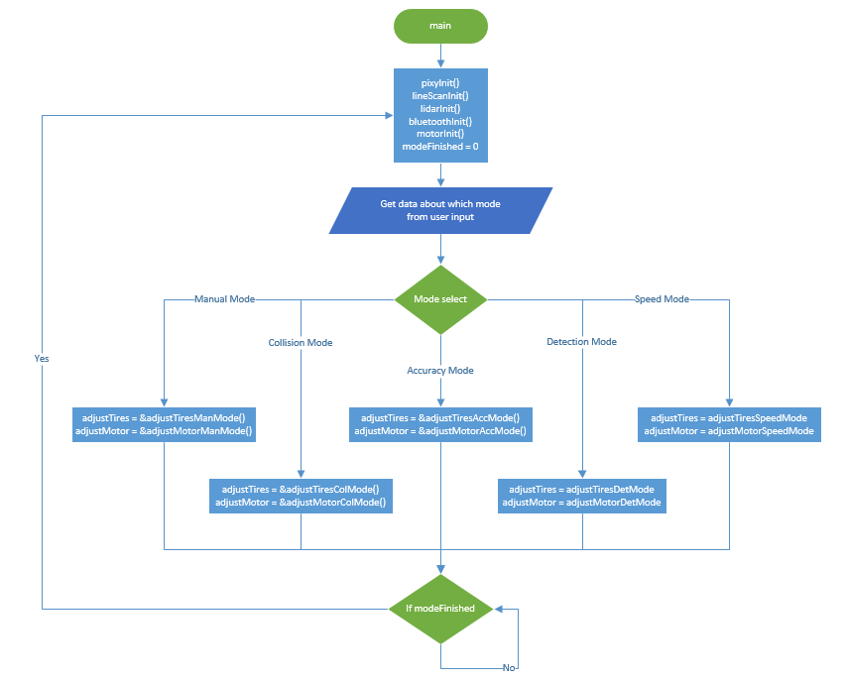
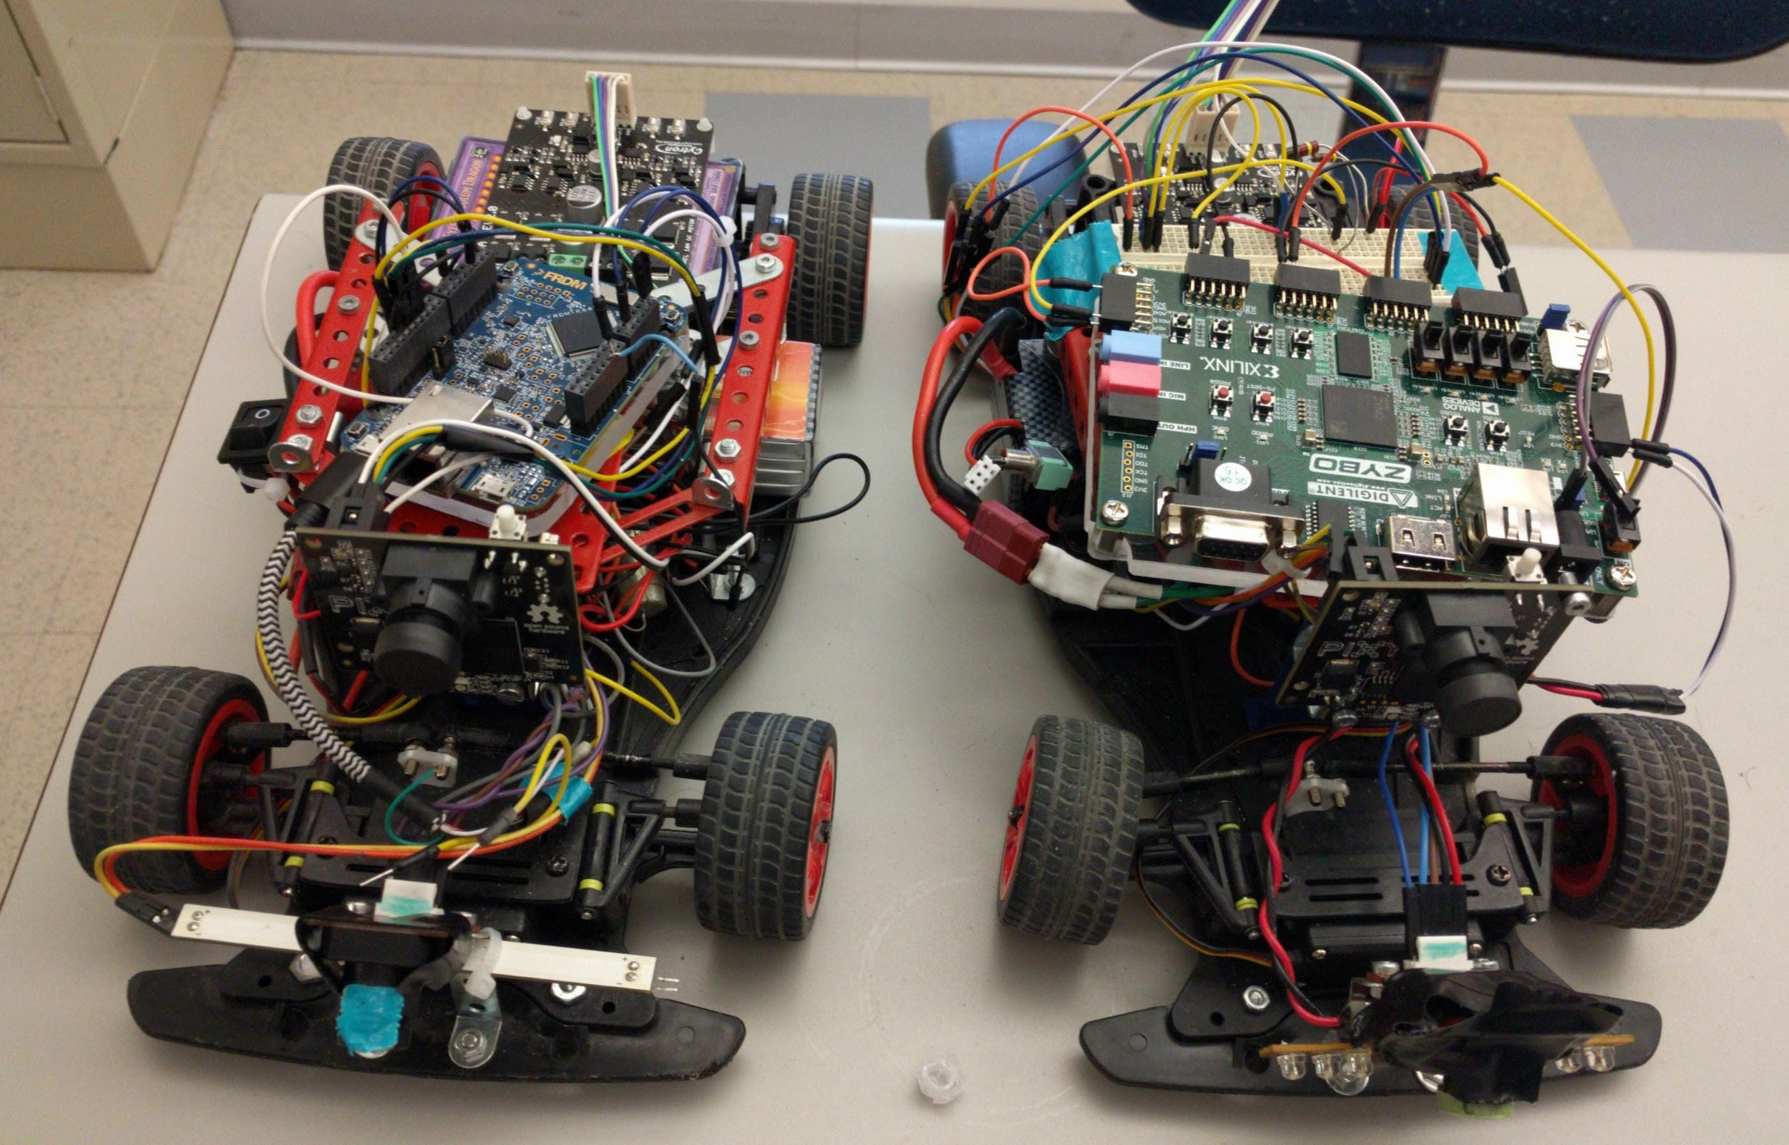
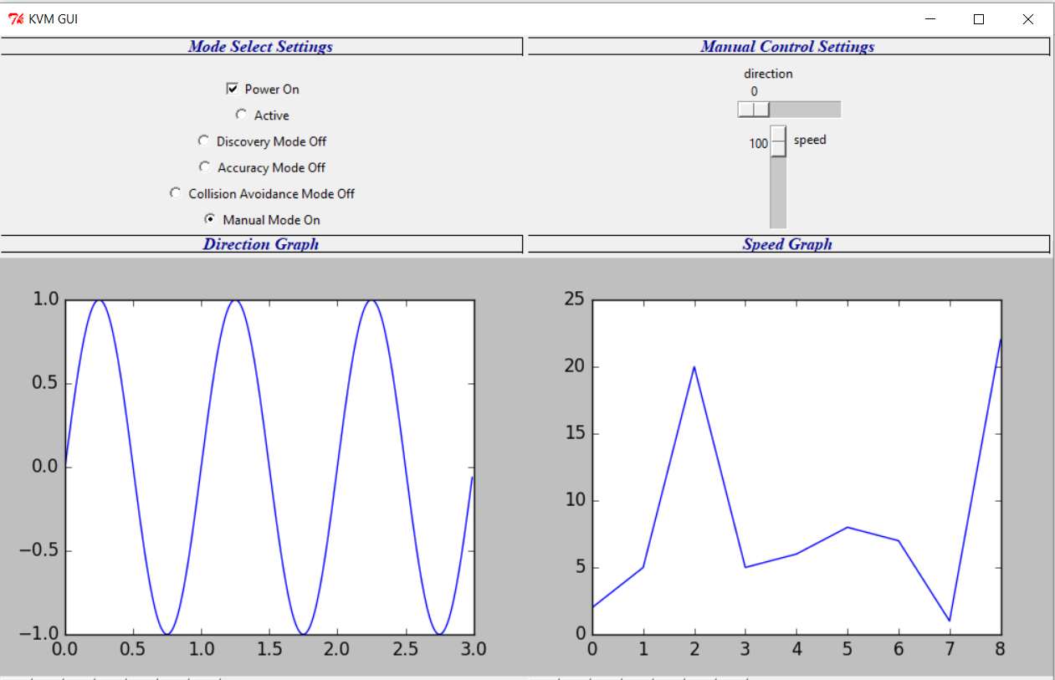
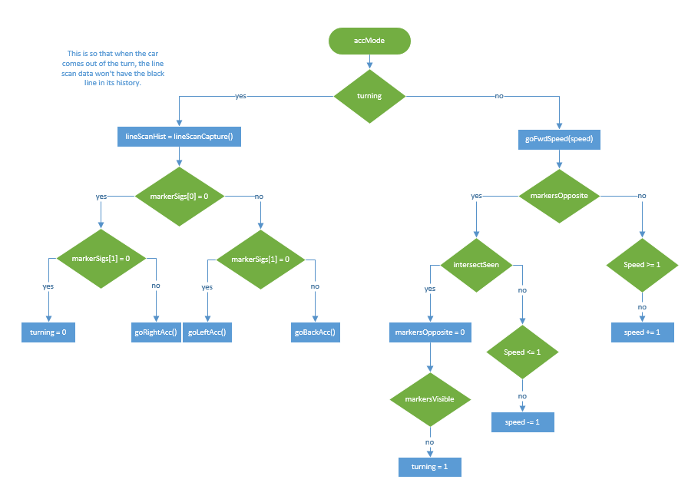
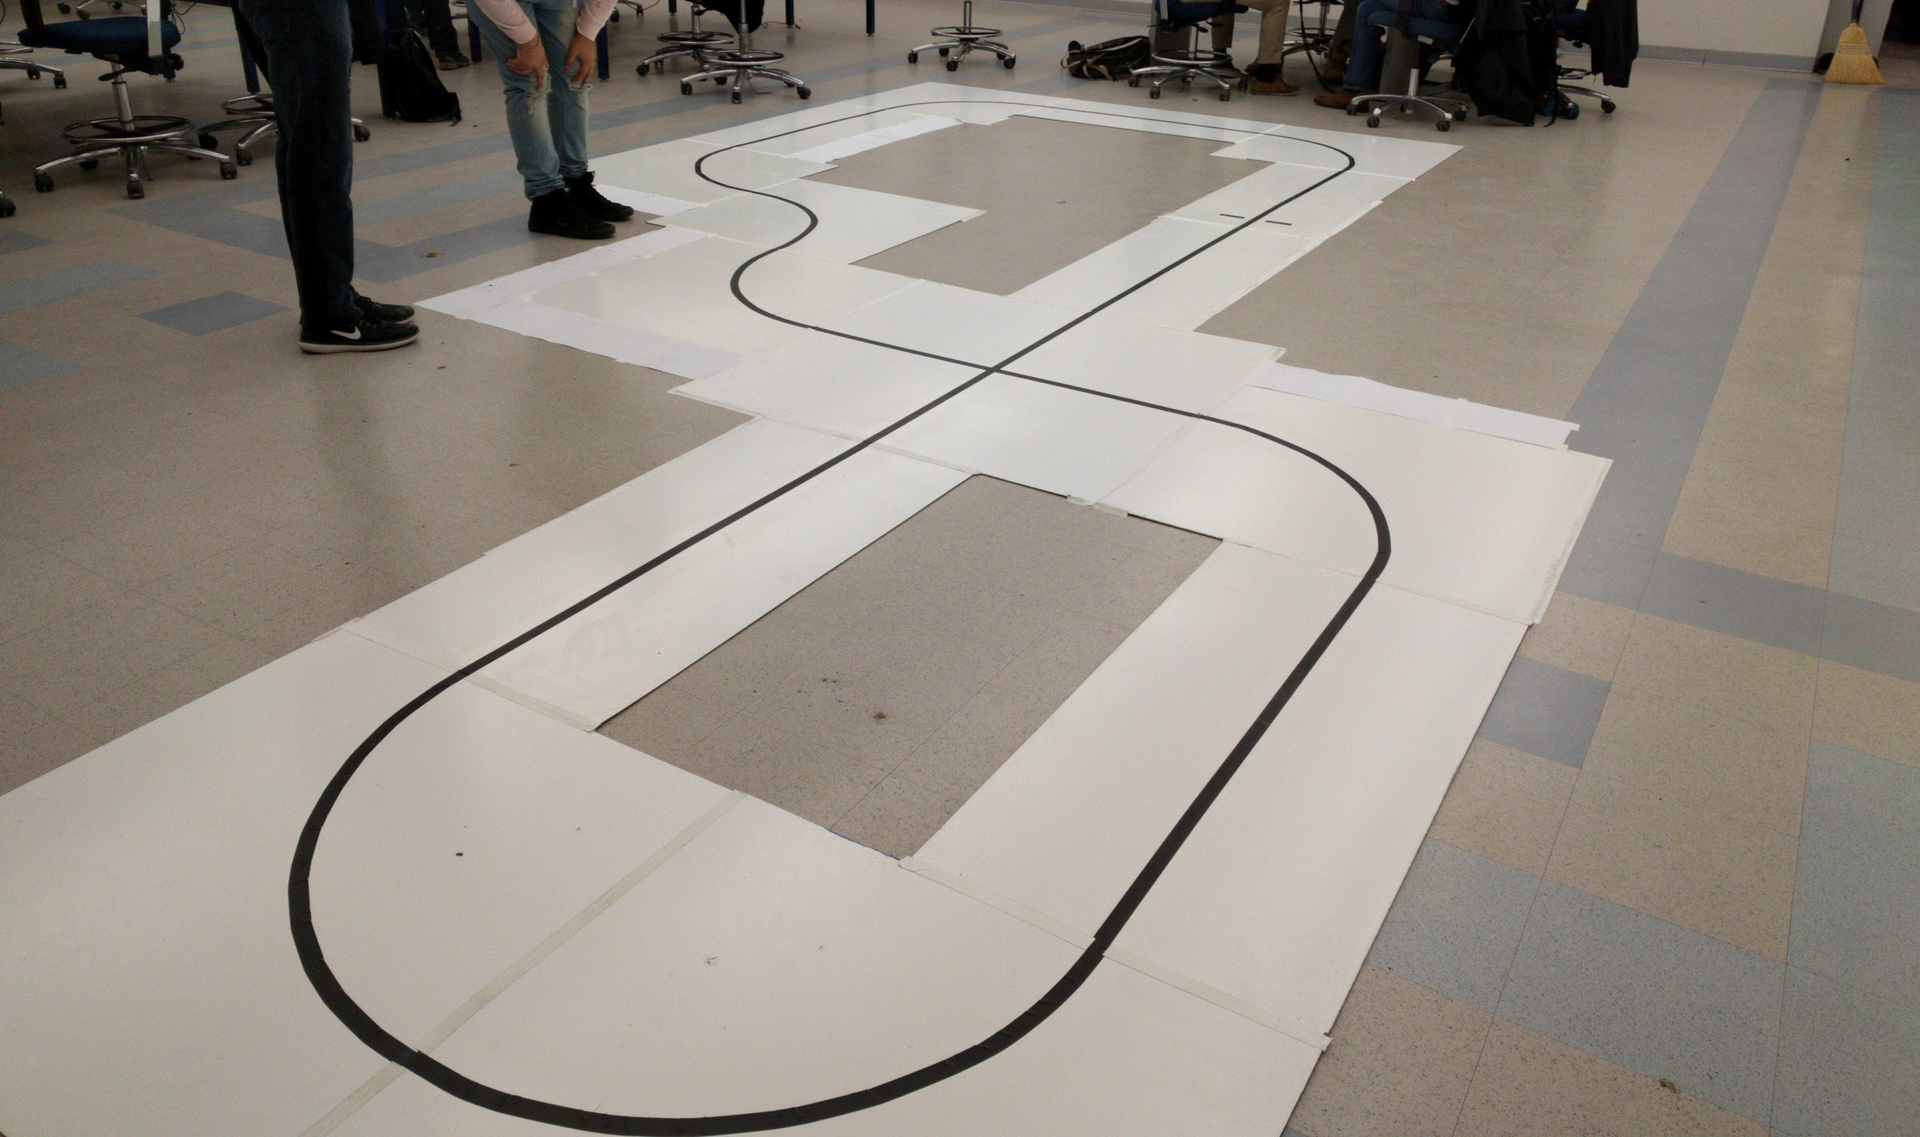
James Bruska, Milton Griffin, Robin Kuhns,
Tim Law, Ryan Shippee, Matt Strenk
PC Manual Controls
Multiple Mode Selection
The project task is to develop, design, build, and test a functional intelligent small-scale vehicle which has the ability to perform several different modes of operation. The underlying basis of each of these modes is a small track which the car must navigate in some fashion depending on the mode.
Hardware:
FRDM K64F or Zybo Zynq-7000
Pixy CMUcam5 Image Sensor
TAOS TSL1401-DB Linescan Camera
Cytron MDD10A Dual Drive Motor Driver
HiTEC HS-422 Deluxe High Speed Servo
AZ1084T 5V Linear Regulator
BA33DD0T 3.3V Linear Regulator
FG24X5R1E226MRT06 22μF Capacitors
Accuracy Mode Autonomous Logic
Clarkson University Computer Engineering Senior Lab Fall 2017

