Slide 1
NetCracker Front-End Academy
Babkin, Ozherelev, Evtushenko, Perepelitsyn, Beda, Dmitrieva

Slide 2
Agenda
Overview and Target
High-level design
Back-end functional details

Slide 3
Overview
01. Prepare students for Front-end development
02. Manage the entire learning process
03. Give students an opportunity to perform various tasks, gain skills
04. Track achievements in personal account

Slide 4


Project target
Make educational online platform for NetCracker front-end developers.
Ability to automatically check and create exercises.
Reduce time costs for retraining developers.
Provide a choice to train from the very beginning.

Slide 5
3
High-level Design

Slide 6
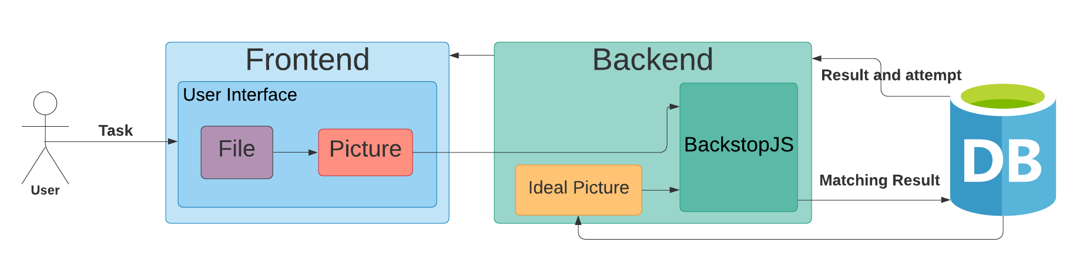
High-level Design

Slide 7
Features
Log-in page
Tasks and conditions page
Task uploading page
User Log-in (username and password fields)
Log-in error – if such user does not exist
Authentication
List with all available tasks (clickable links to Task uploading page)
View full task conditions (“…” button)
Attempts table (with date and match percentage)
Picture swap (button)
Upload done task (Select File button, Upload button, Filename field)
Check of uploaded task
Picture swap (button)
Attempts table

Slide 8
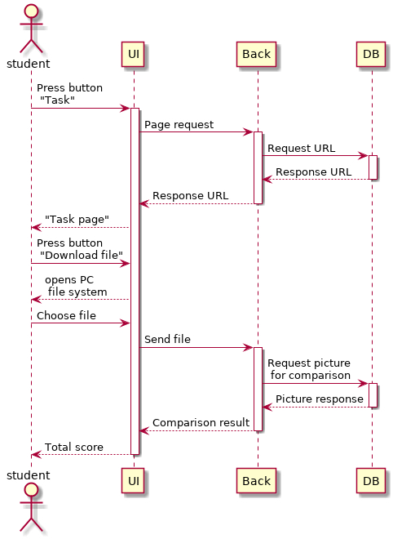
Task
Uploading
After logging in user may solve a task on his own computer via generally usable integrated development environment (IDE).
Solutions may be uploaded up to 10 times.

Slide 9
4
Functional Details Back-end

Slide 10










Back-end Resources
Spring Boot
Swagger
Hibernate
JUnit
JSON Web Token
Maven
PostgreSQL
GitHub
BackstopJS
GSON

Slide 11
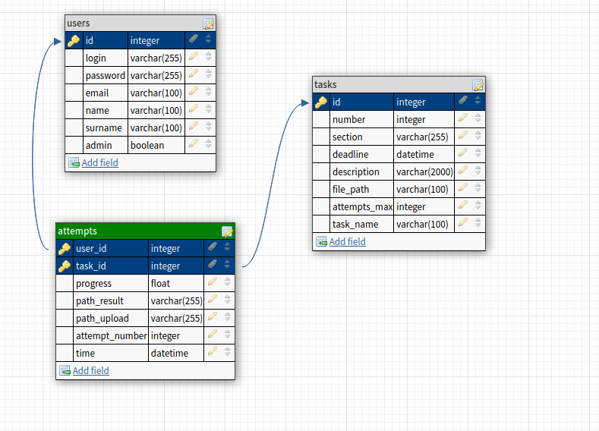
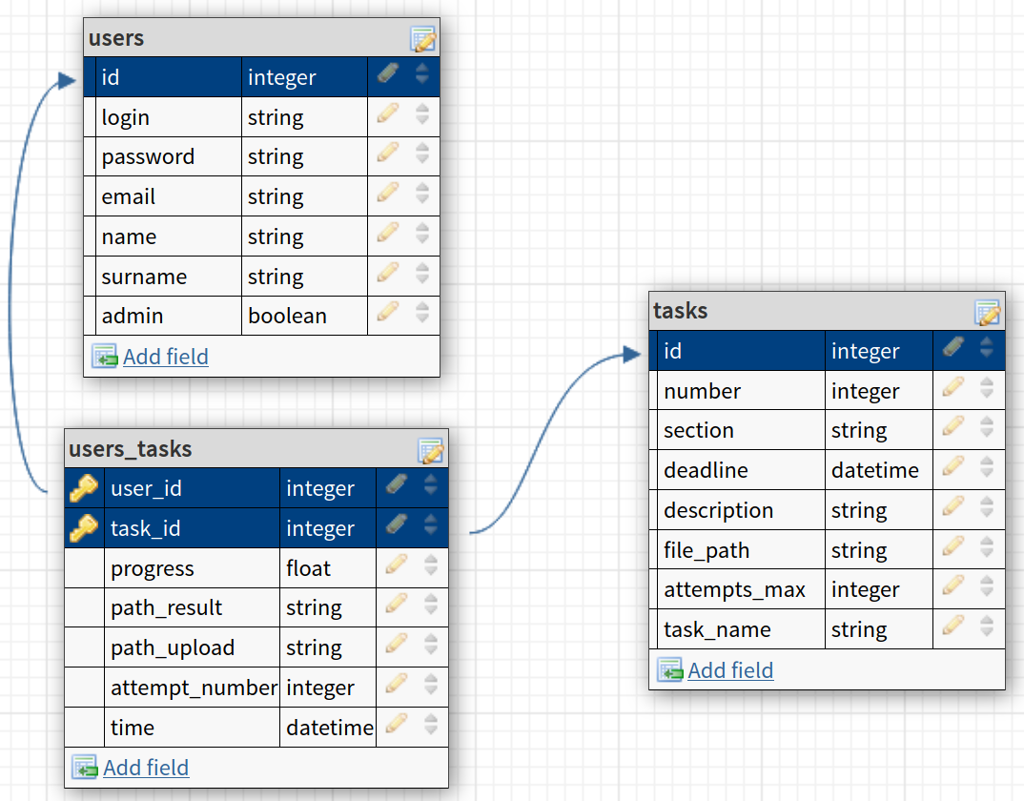
Database

Slide 12
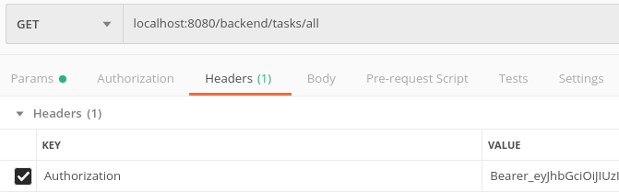

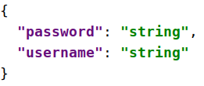
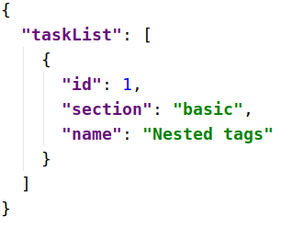
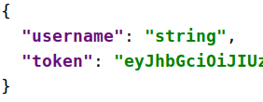
JWT Authorization

Slide 13
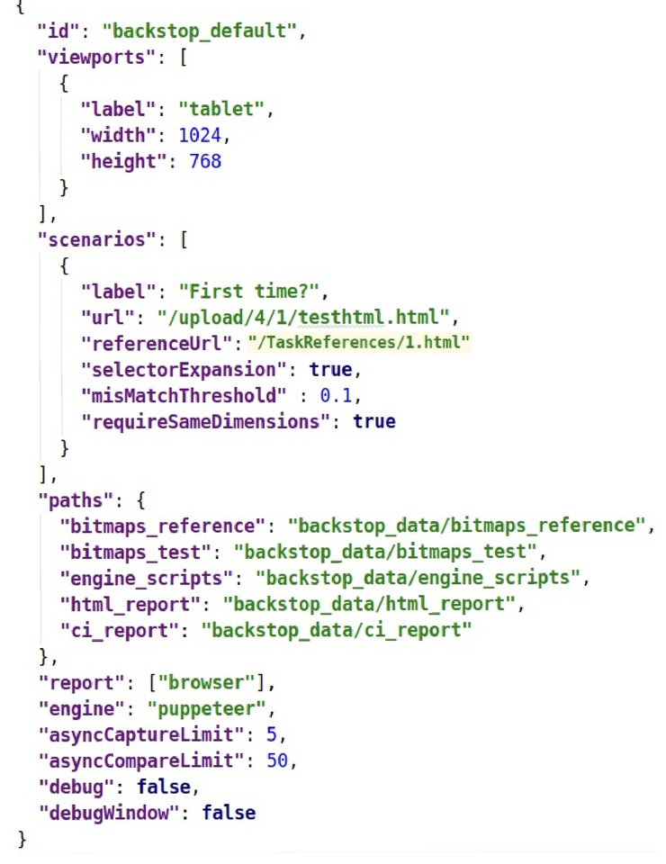
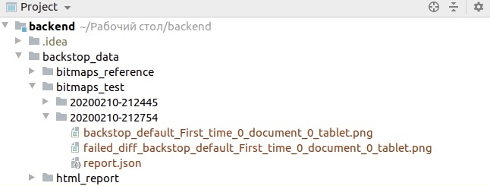
BackstopJS (Backstop.json)

Slide 14
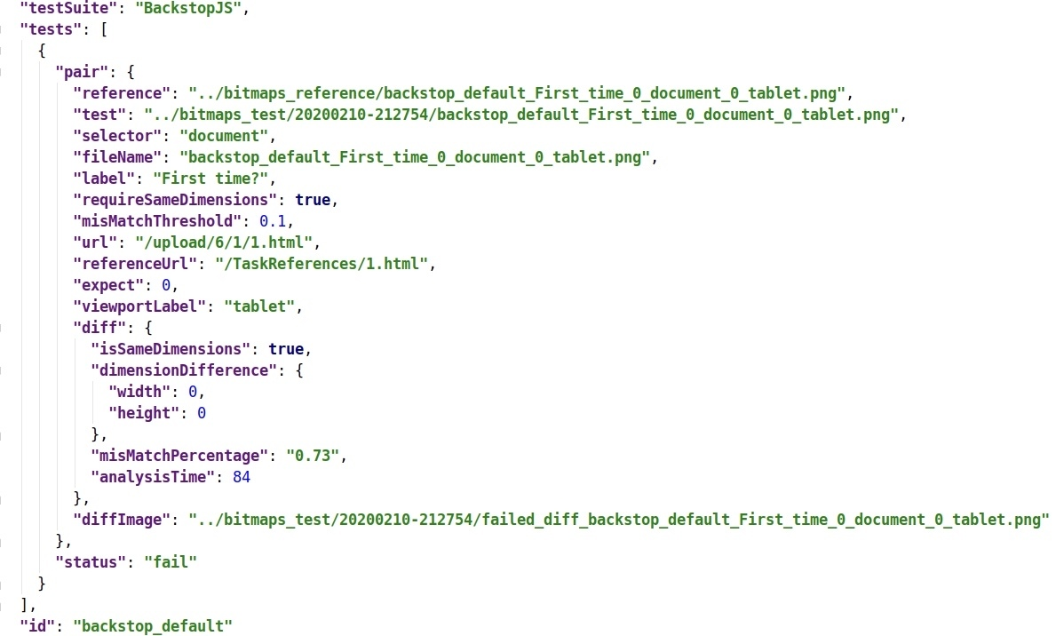
BackstopJS (Report.json)

Slide 15
5
Functional Details Front-End

Slide 16


Front-end Resources
Clarity
Angular 9

Slide 17
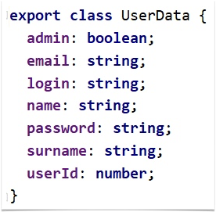
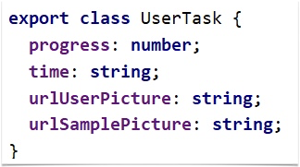
Used
models

Slide 18
Future Plans
Add Admin features
Opportunity to test dynamic elements via BackstopJS scripts
Integrate Karma or Jasmine (end-to-end testing)
Ability to choose Dark mode of web application

