Slide 1
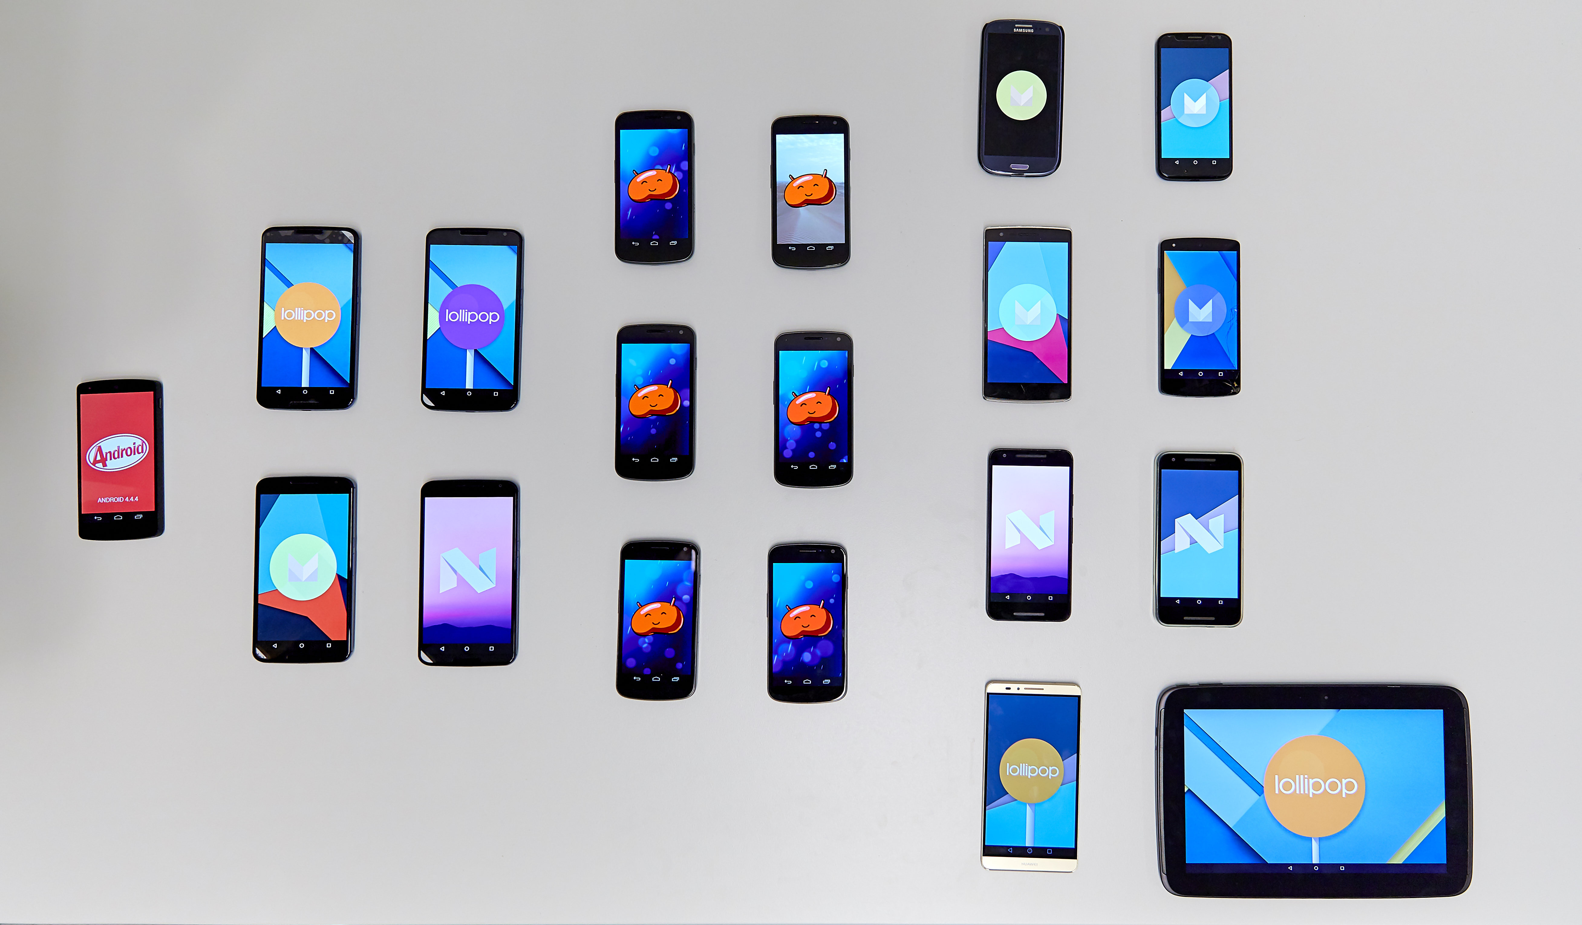
Attack-resilient media using phone-to-phone networking
P.W.G. Brussee

Slide 2
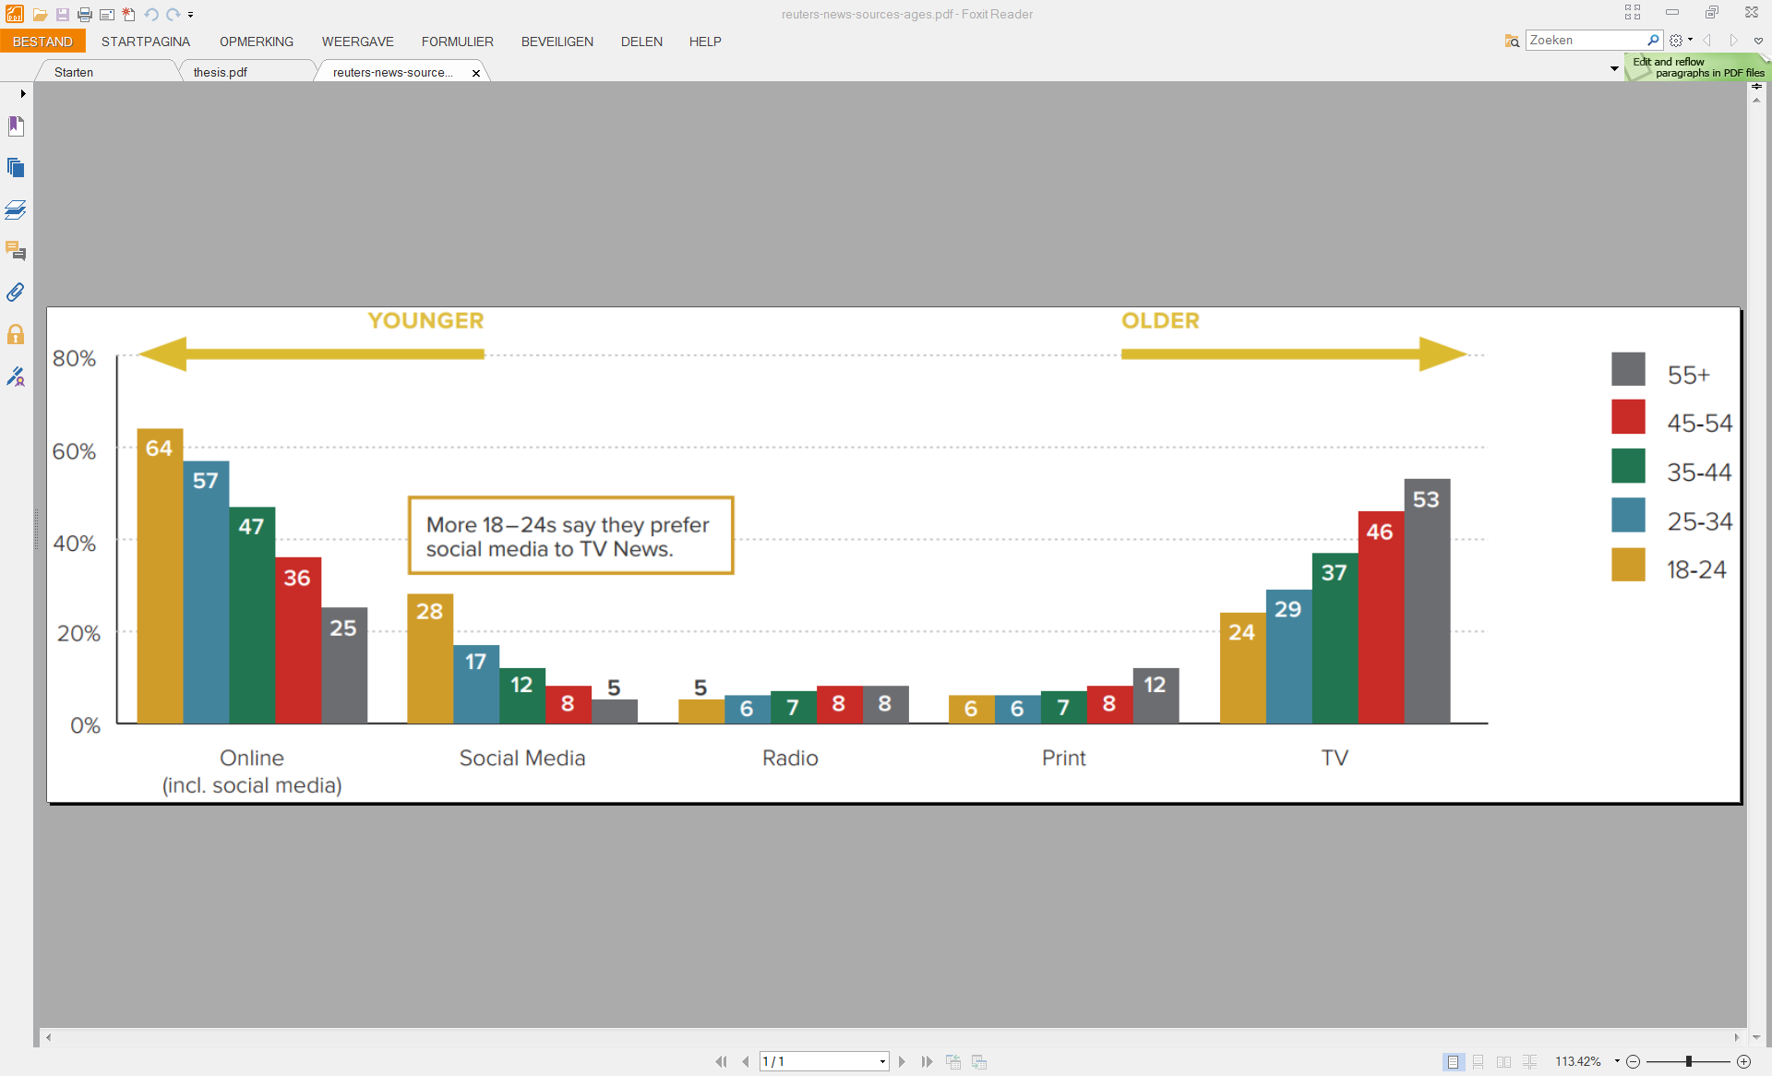
Context
Smartphones are used for calling, mailing, navigating, dating, etc.
Also: news consumption, production and distribution

Slide 3
Adversary model
Internet access is sometimes limited:
Censorship and kill-switches
Egypt, Syria, Turkey
Natural disasters
Katrina, Nepal
Not solved yet

Slide 4
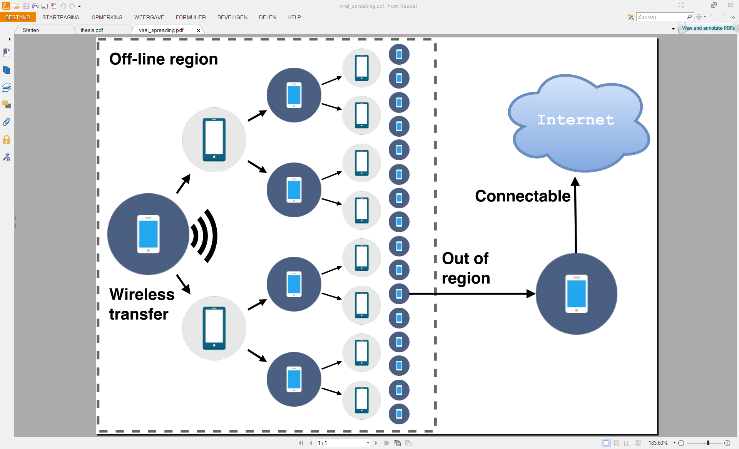
Off-line information spreading
Notes:
Local networking -> very usable in problem situations -> distributed networking solutions

Slide 5

Possible solution: Tribler
TU Delft research project
Distributed information sharing platform
Attack-resilience: hard to take down
Fully decentralized
Route traffic for others
Trust: blockchain
Now: to mobile

Slide 6
Research questions
How feasible is it to run all Tribler functionality on mobile devices?
Given the constraints and unique abilities of mobile devices, what functionality of Tribler can be added or enhanced?

Slide 7
Constraints and unique abilities of mobile devices
Connectable: Wi-Fi, Bluetooth, NFC
Ubiquitous
Resource limited: battery, processing power

Slide 8
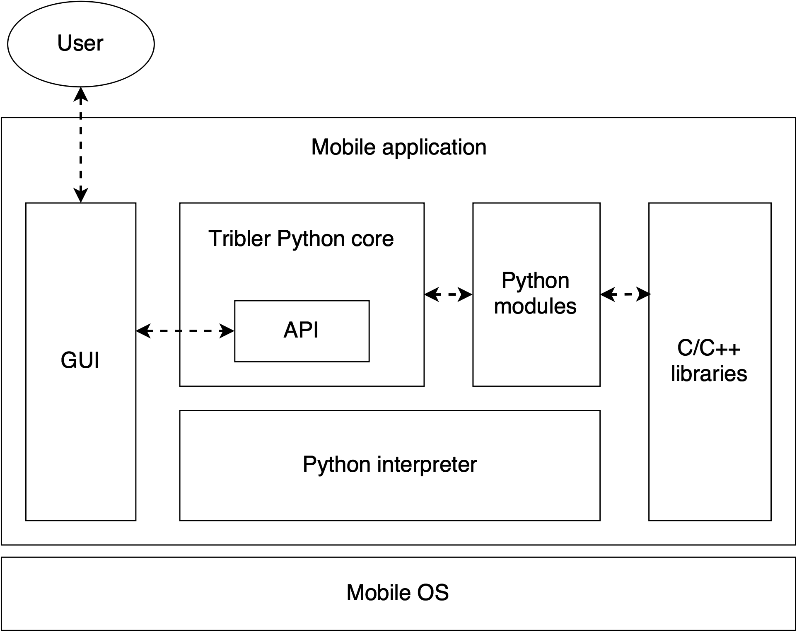
System architecture design
Notes:
Common Python core
API -> modularity & maintain-ability
Android OS -> cross-compile (not exactly linux)

Slide 9
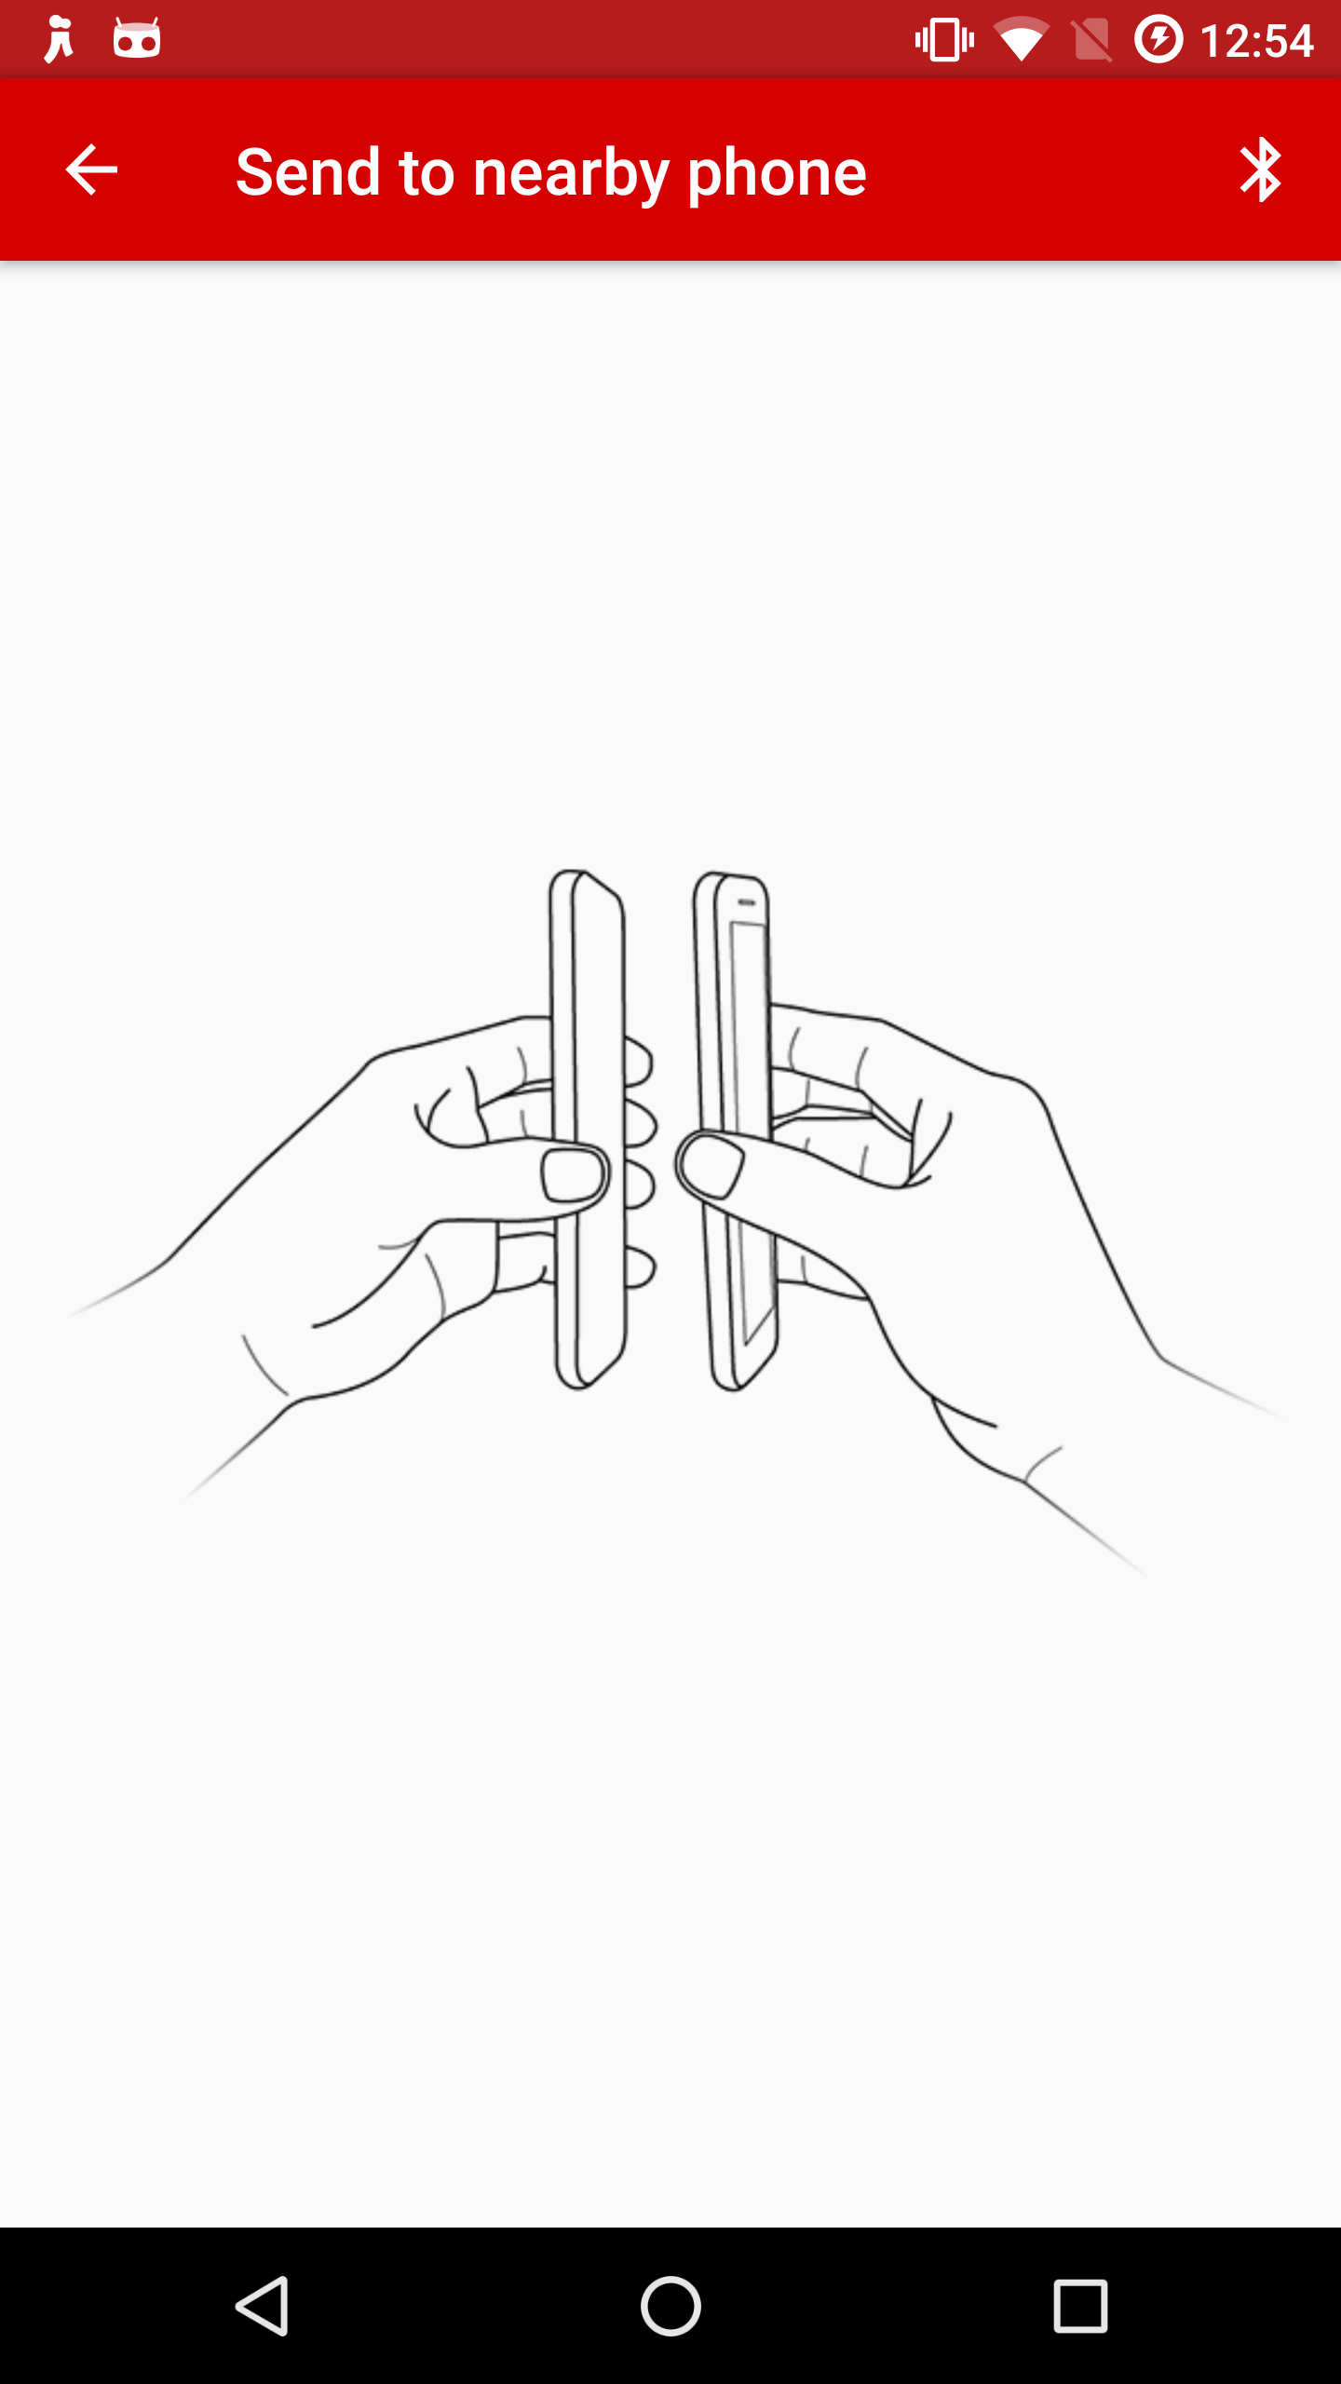
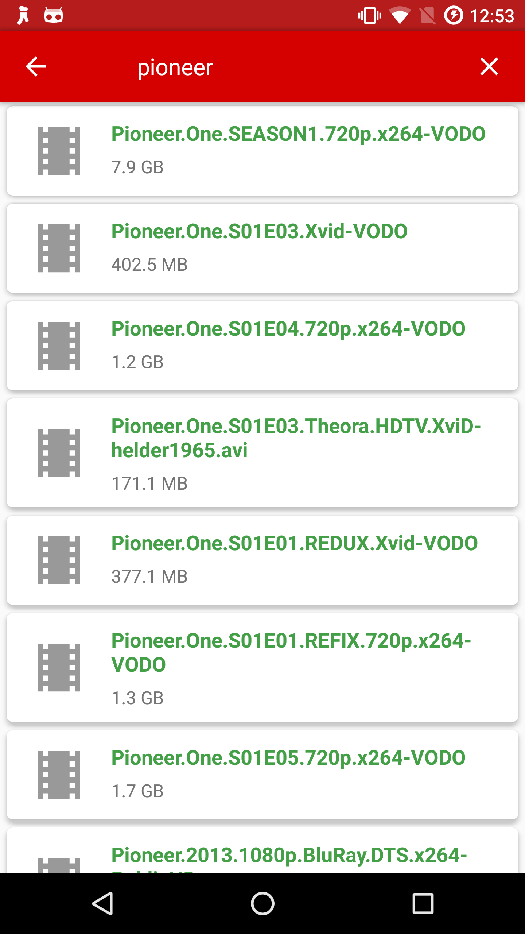
Notes:
Device-2-device enabled

Slide 10
Experiments
Content discovery
Multichain
Startup time
API responsiveness
CPU utilization
And more
Notes:
IT WORKS – NOW TO UNDERSTAND HOW WEL IT WORKS

Slide 11
1. Content discovery – Setup

Slide 12
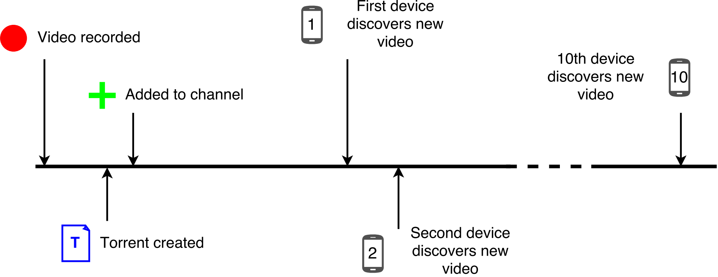
1. Content discovery – Sequence

Slide 13
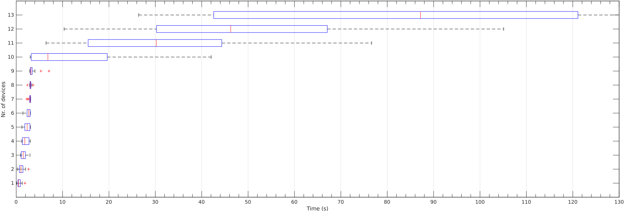
1. Content discovery – Results
Notes:
quick? Scalable?
Clusters of 9?

Slide 14
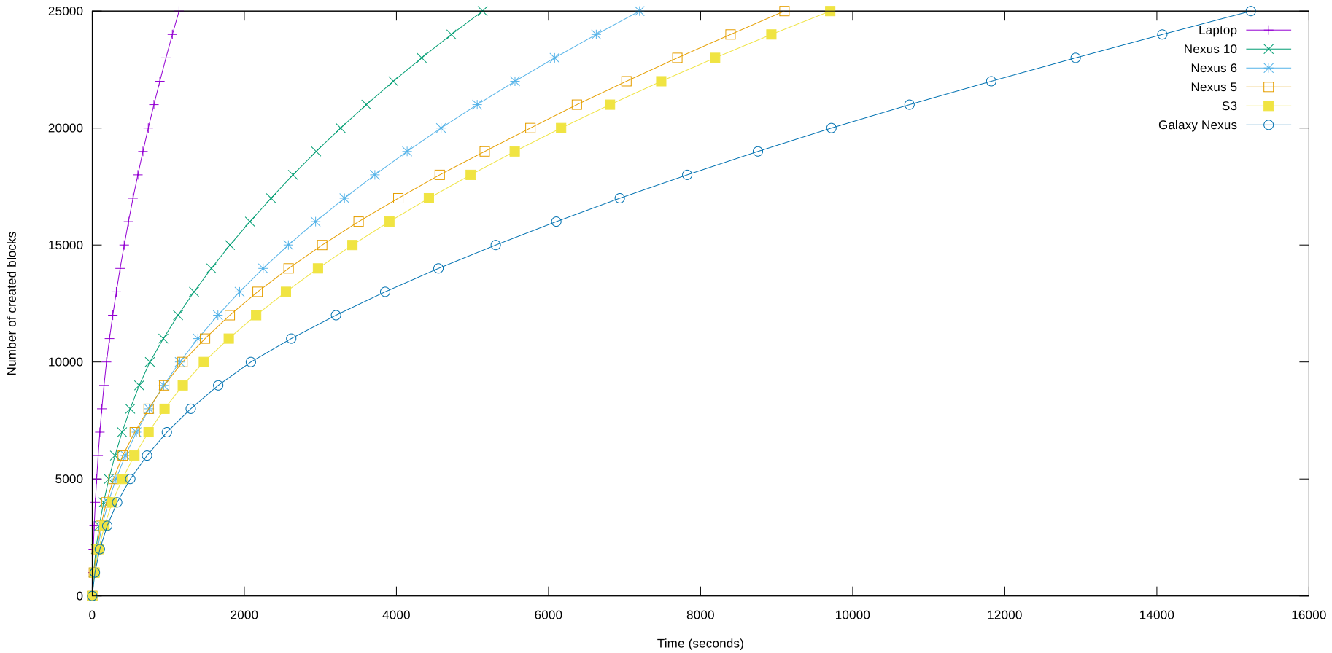
2. Multichain
Notes:
scalable? CPU or IO bound?
The slower the cpu, the less amount of blocks per second
The caracteristics of the graph show IO bound: larger database, slower blocks per second
Bitcoin: 7 transactions per second & 10 + minutes confirmation time global consensus
Nexus 6 starts with 40 transactions per second and ends with 3,5 ; only 1 per 10 minutes needed!

Slide 15
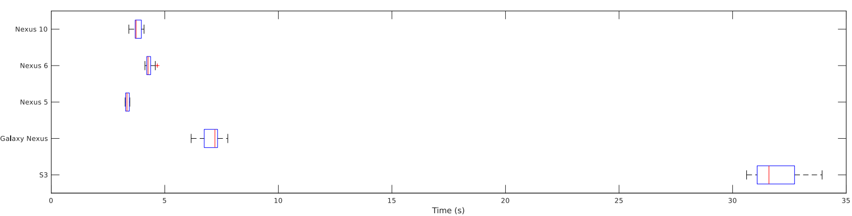
3. Startup time
Notes:
quick? Consistent?
Everyone wants a fast app, we want everyone to use it
Bloated smartphone is significantly slower

Slide 16
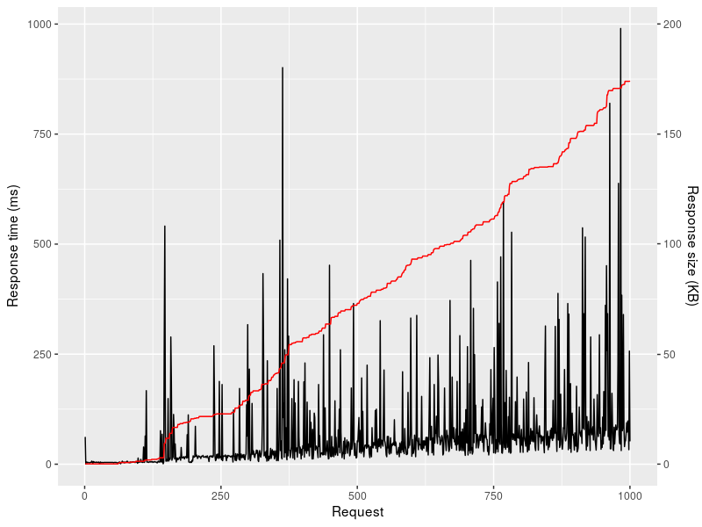
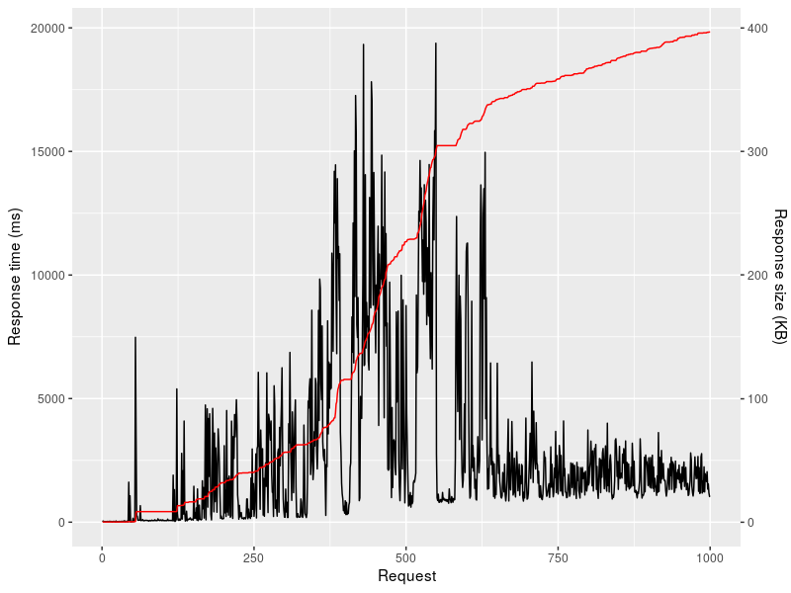
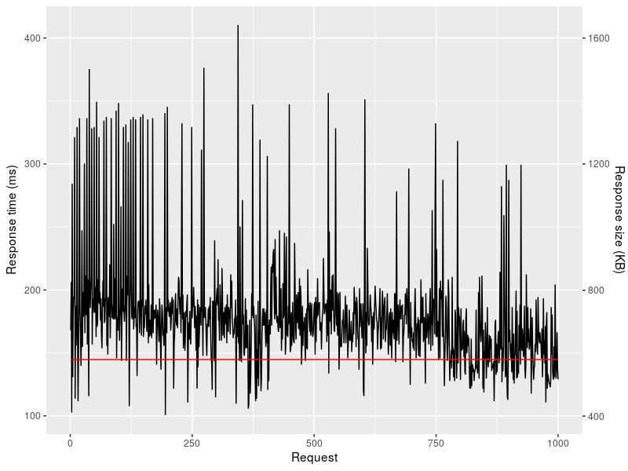
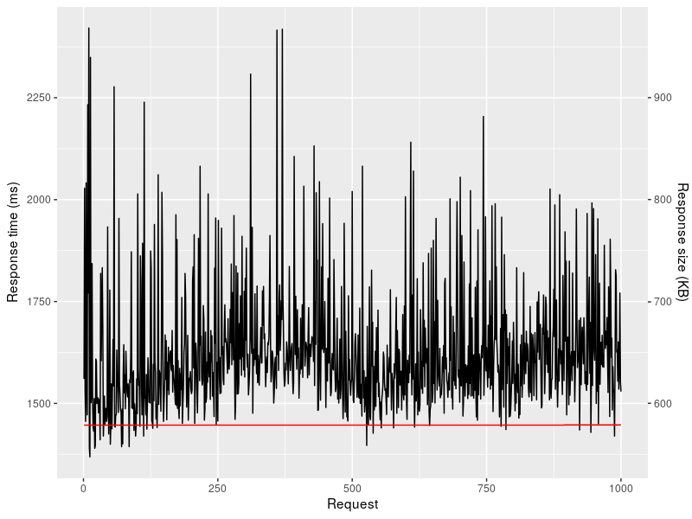
4. API responsiveness
Laptop
Smartphone
Notes:
quick? Consistent?
API is between GUI and back-end
Mind the double vertical-axes!
Consistent, but slower ; 1st order derivative of red line (response size) -> seems to coincide with large amplitude (response time)
Probably because of JSON serialization -> Increase response time, with increase in response size

Slide 17
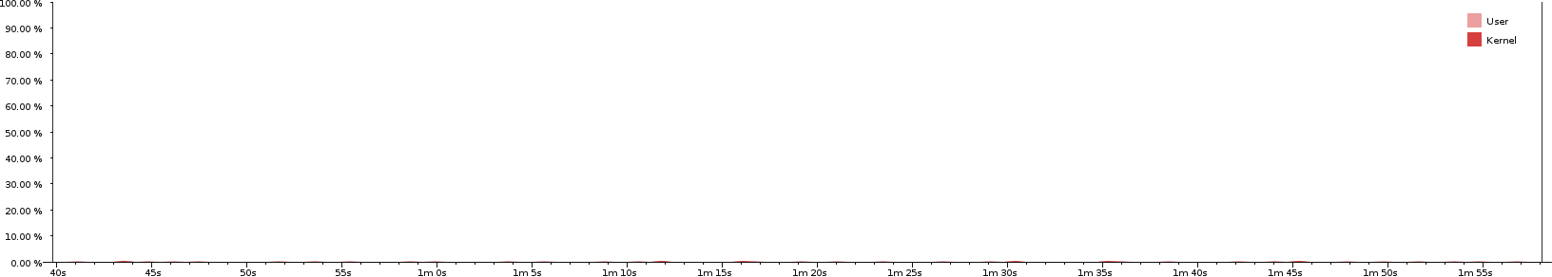
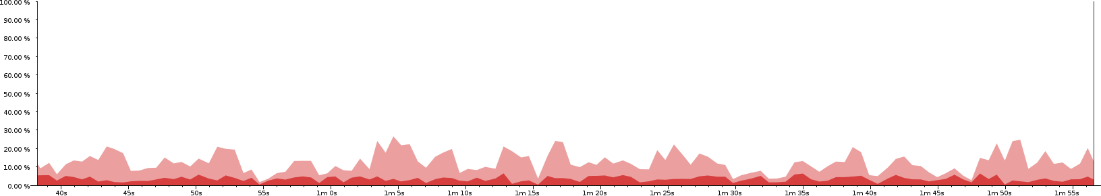
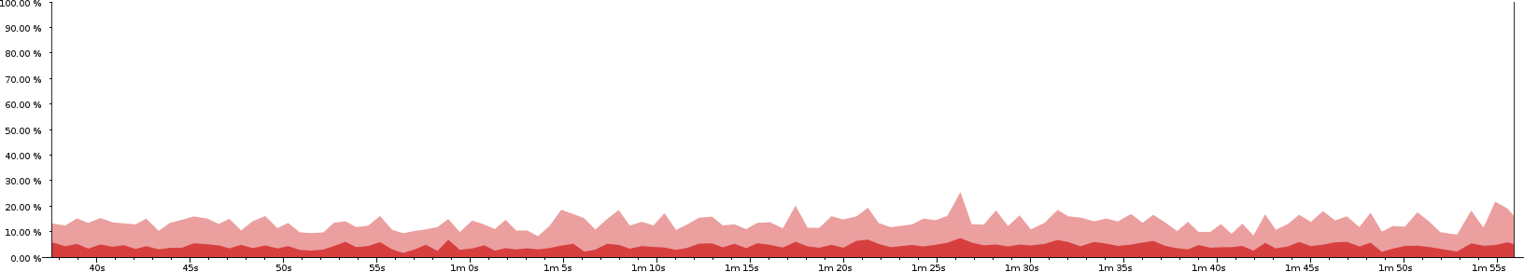
5. CPU utilization – HD video streaming
Tribler GUI
Tribler service: downloading and streaming
VLC video player
Notes:
Max total 40% -> leaves 60% free -> if CPU bound -> room for multi-core processing optimization

Slide 18
Conclusions
We now have a feasible mobile solution with Tribler
First step to overcoming state censorship
Potential user base of millions of people

Slide 19
Future work – Implementation
Multi-core optimization
Streaming API
Towards other platforms
Self-compilation and morphing stealth capabilities

Slide 20
Future work – Research
New directions in Tribler research
How viral spreading of eyewitness content behaves in the real world
Effects of local crowds on anonymity with onion routing
Large-scale experiment with various degrees of powerful censors
Credit mining using shared private keychain

Slide 21
Questions?

