Slide 1
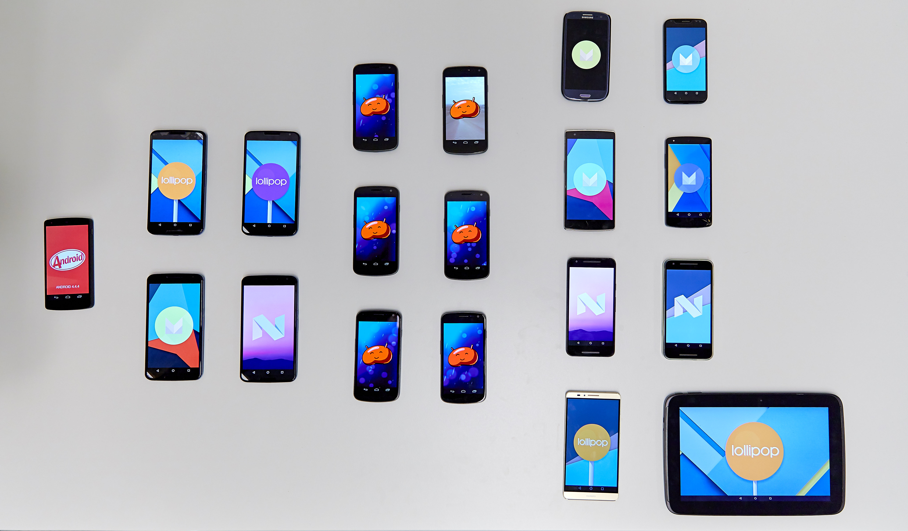
Attack-resilient media using phone-to-phone networking
P.W.G. Brussee

Slide 2
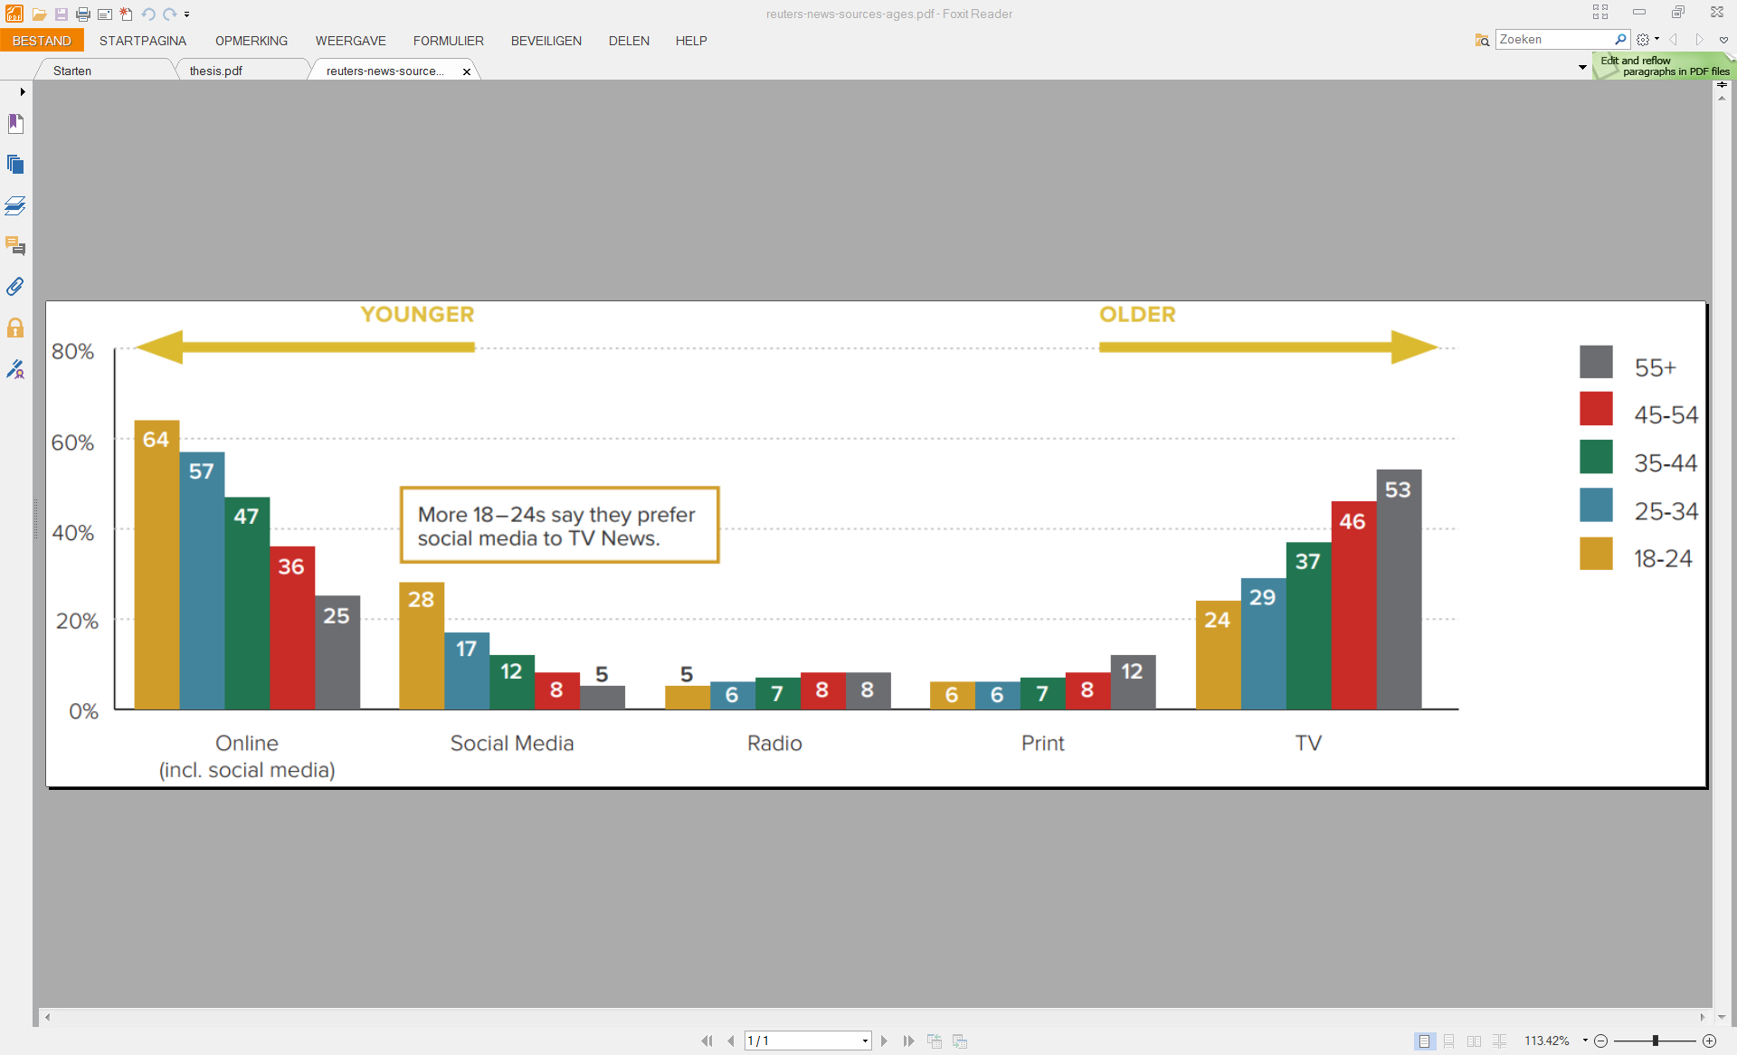
Context
Everyone has a smartphone and uses it for everything

Slide 3
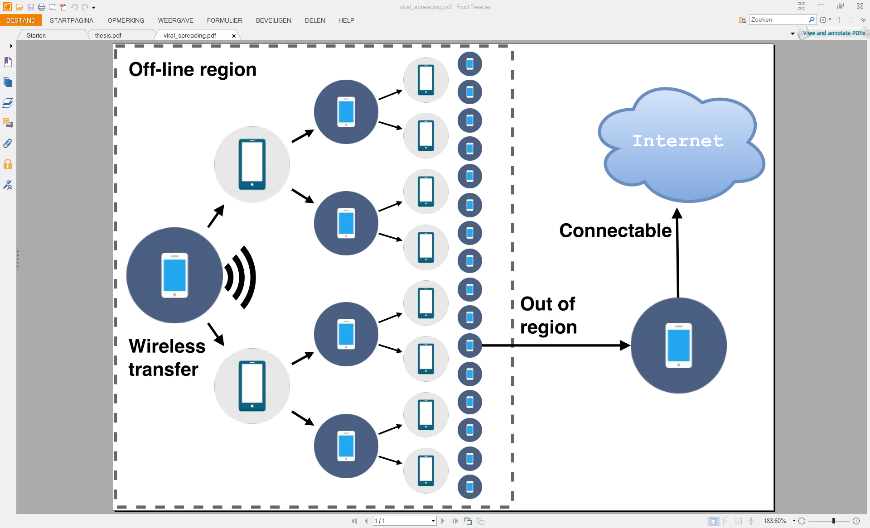
Viral spreading

Slide 4
Adversary model
Kill-switches
Egypt, Syria, Turkey
Natural disasters
Not solved yet

Slide 5

Tribler
Information sharing platform
Attack-resilience
Fully decentralized
Self-organizing
Anonymity: onion routing
Trust: blockchain
TU Delft research project

Slide 6
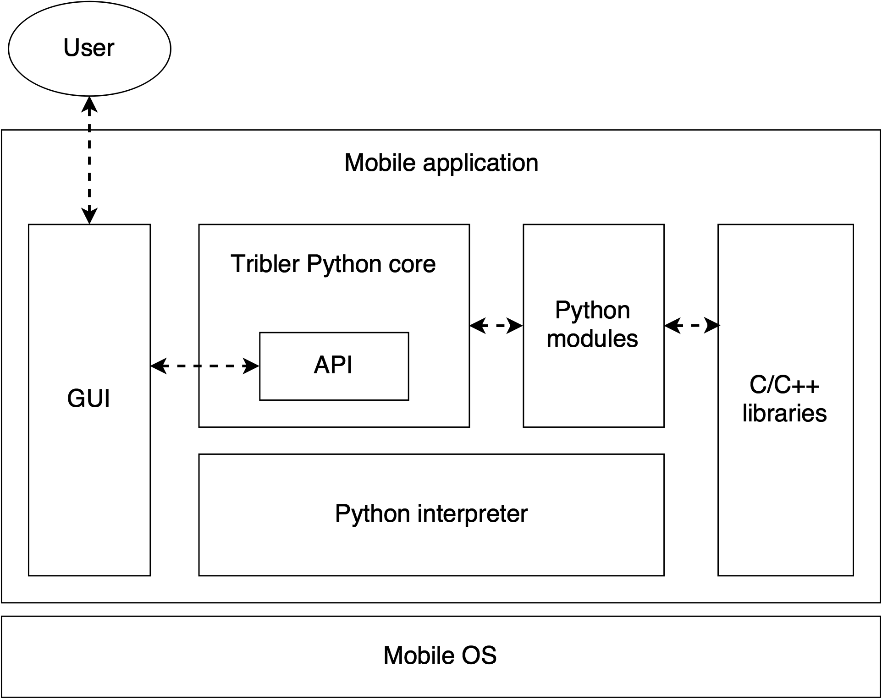
System architecture design

Slide 7
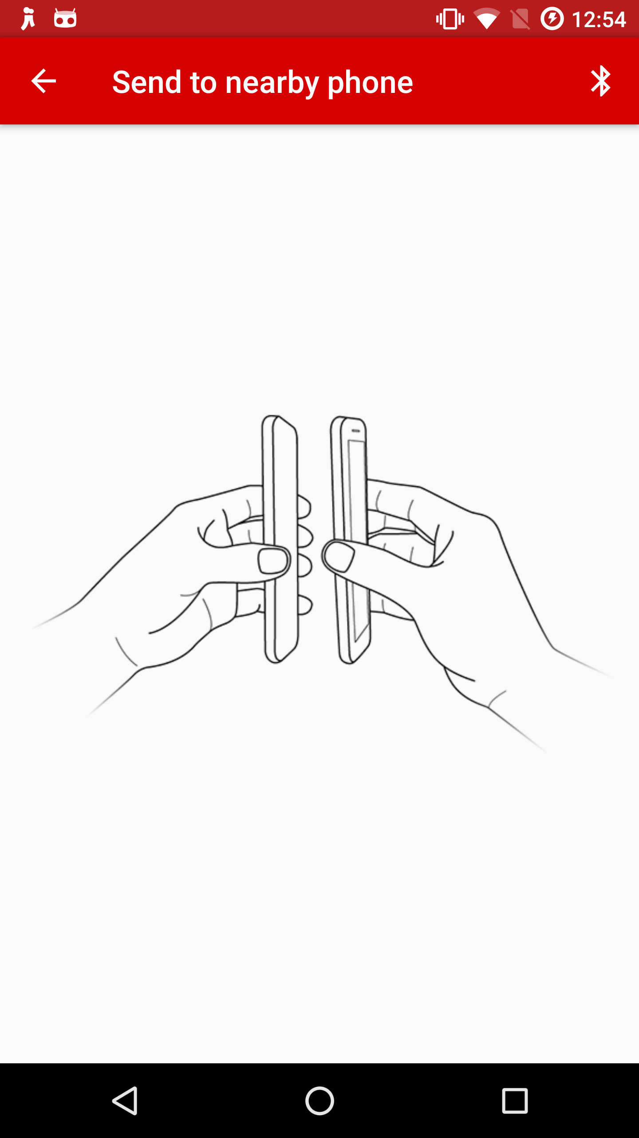
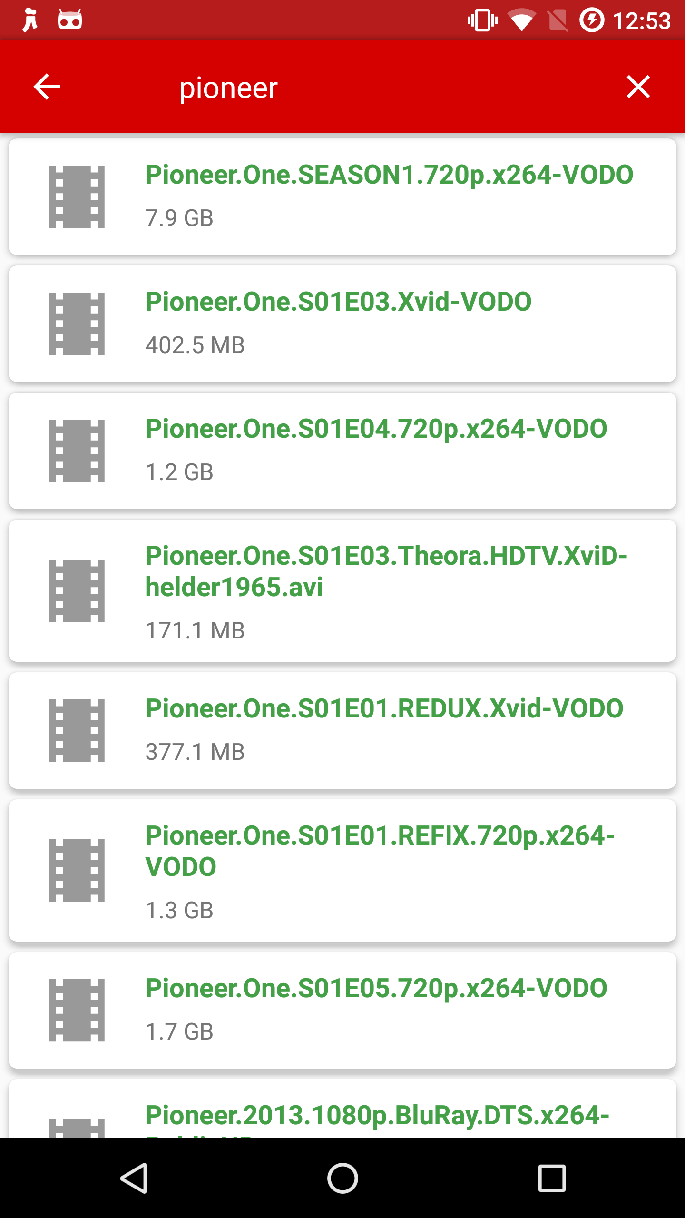
Notes:
IT WORKS – NOW TO UNDERSTAND HOW WEL IT WORKS

Slide 8
Experiments
Content discovery: quick? Scalable?
Multichain: scalable?
Startup time: quick? Consistent?
API responsiveness: quick? Consistent?
CPU utilization: multi-core processing?
And more
Notes:
IT WORKS – NOW TO UNDERSTAND HOW WEL IT WORKS

Slide 9
1. Content discovery – Setup

Slide 10
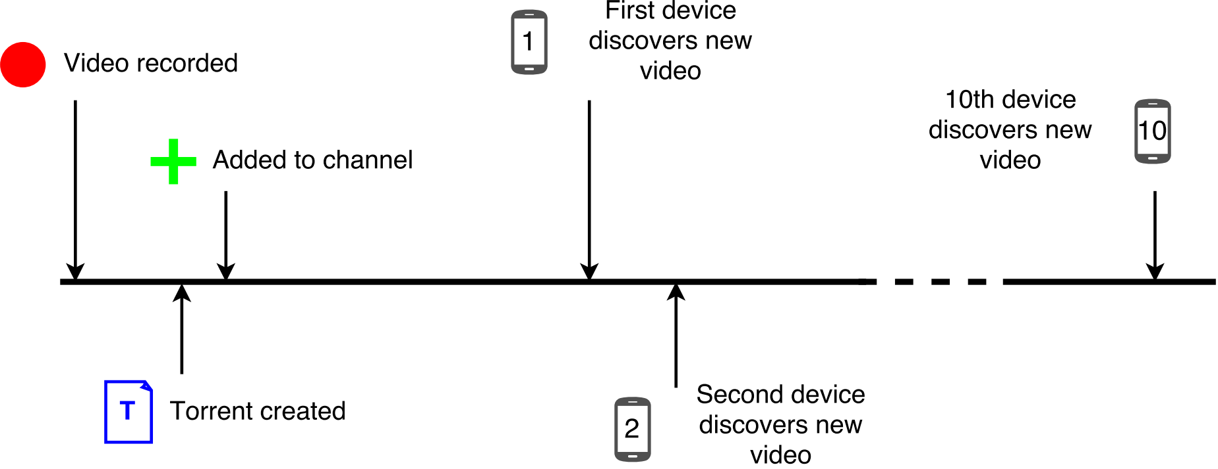
1. Content discovery – Sequence

Slide 11
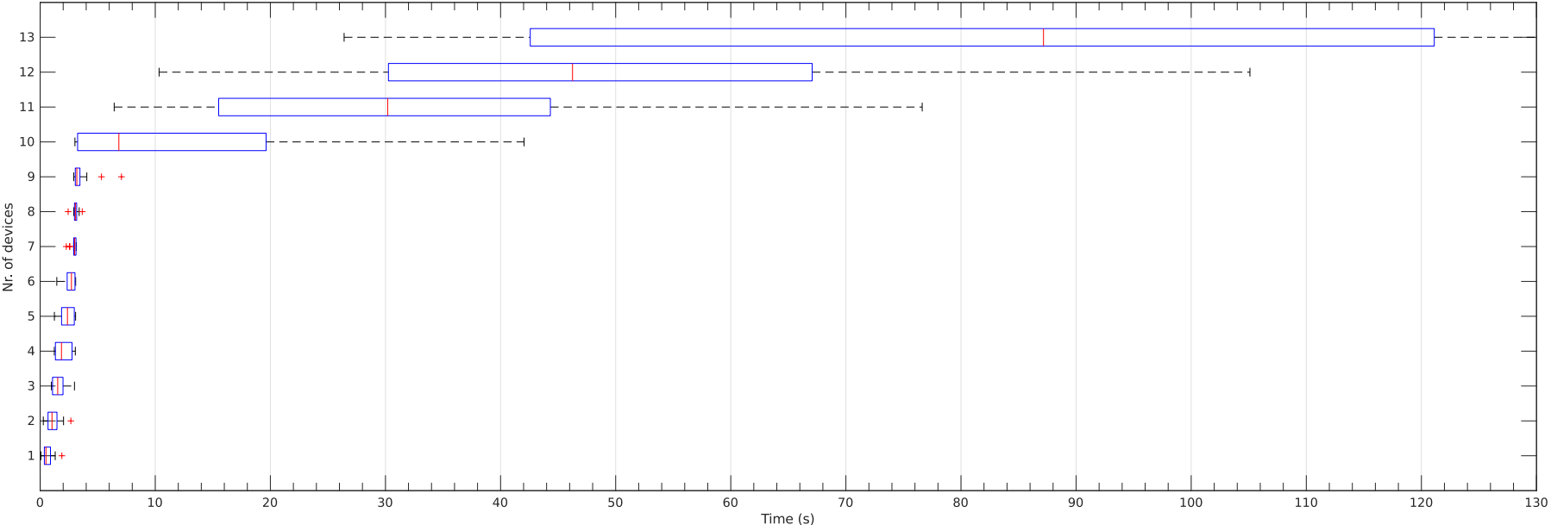
1. Content discovery – Results

Slide 12
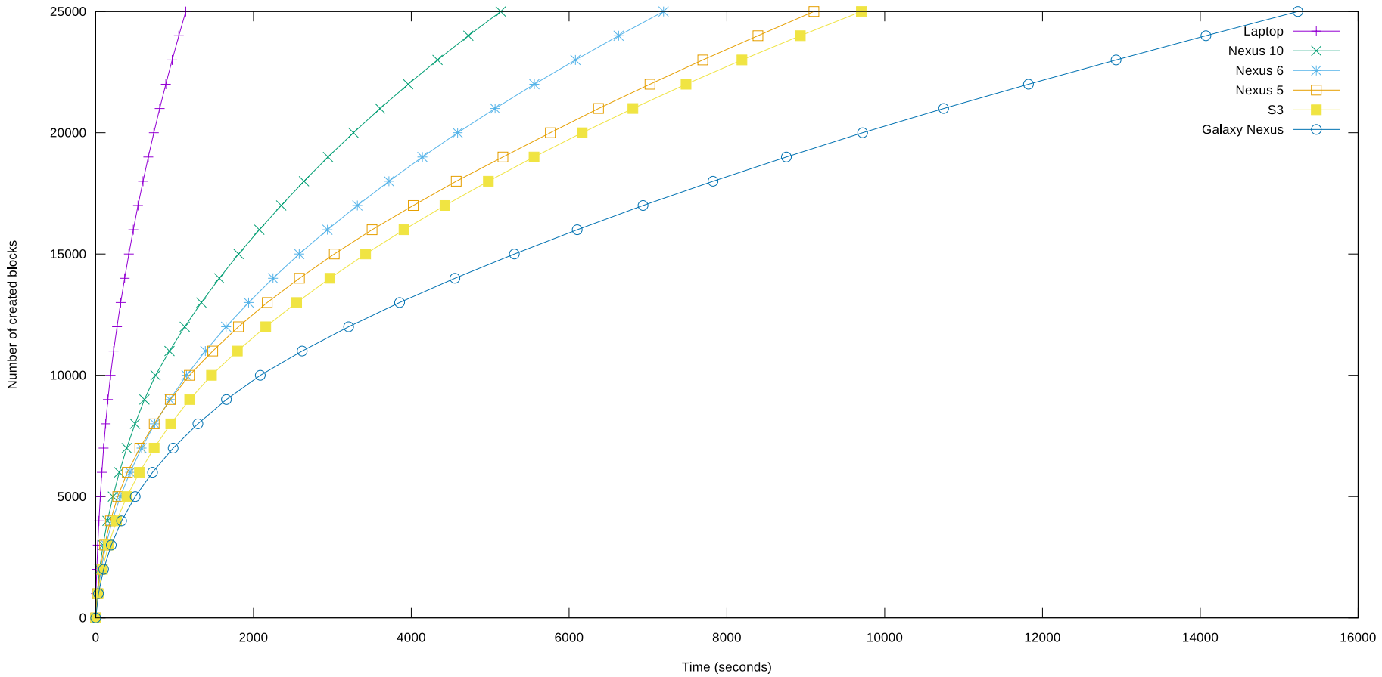
2. Multichain

Slide 13
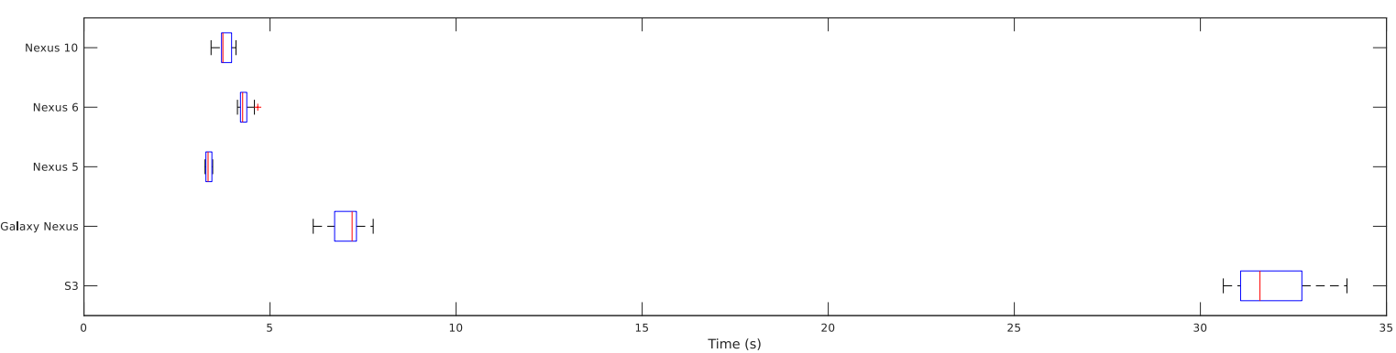
3. Startup time

Slide 14
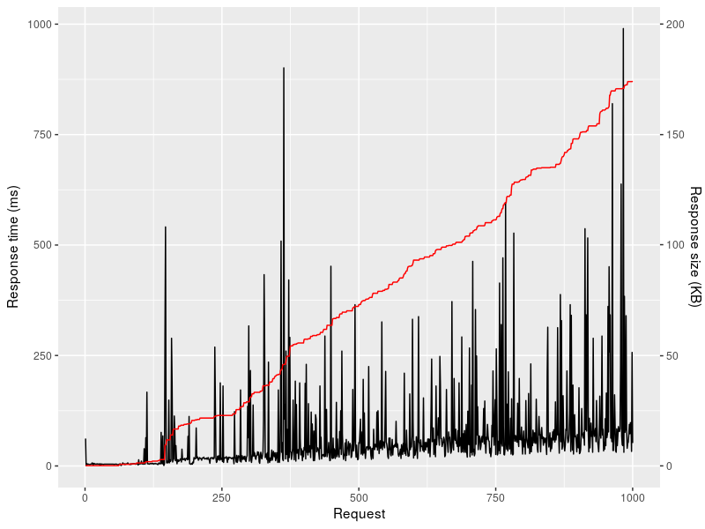
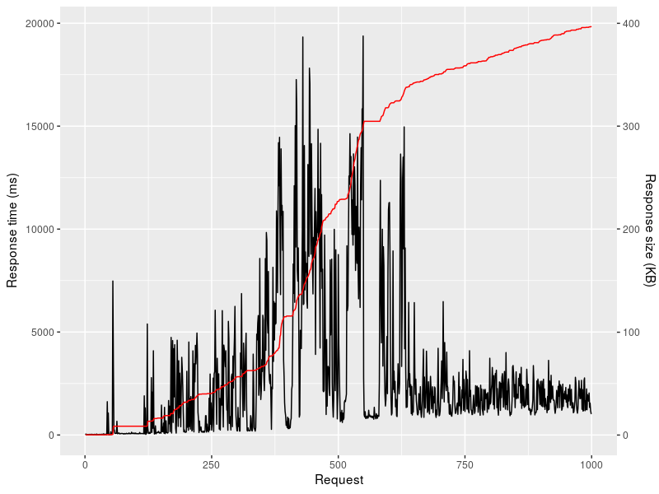
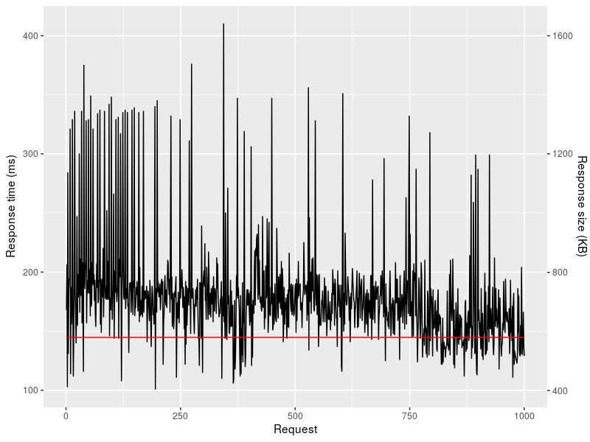
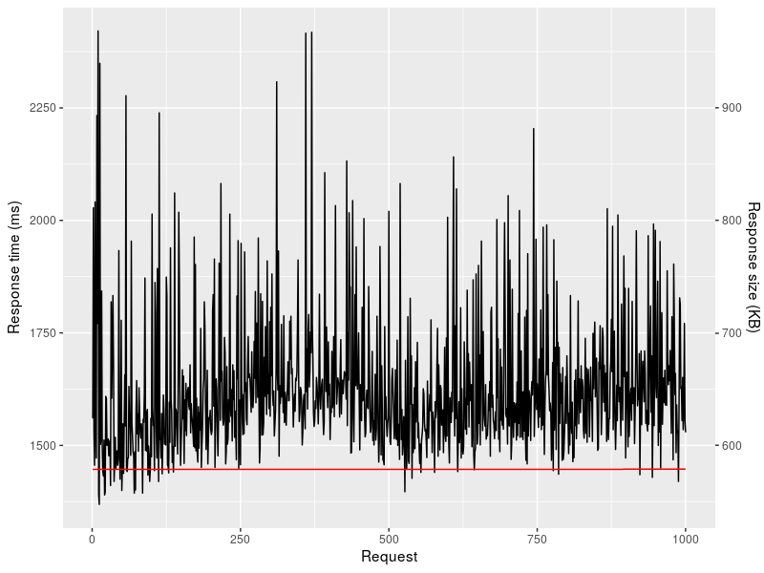
4. API responsiveness

Slide 15
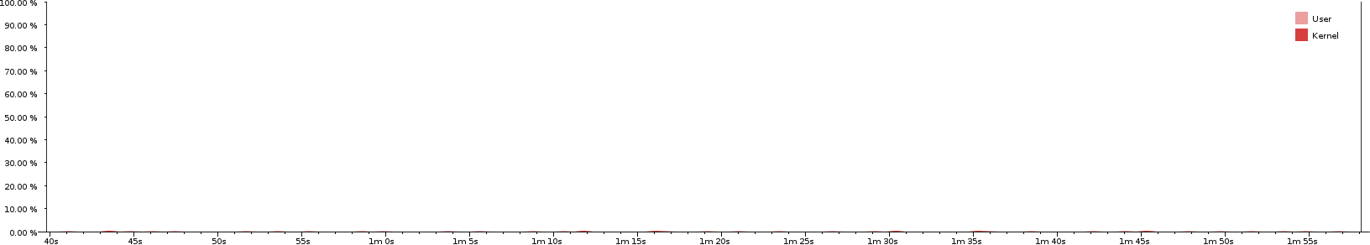
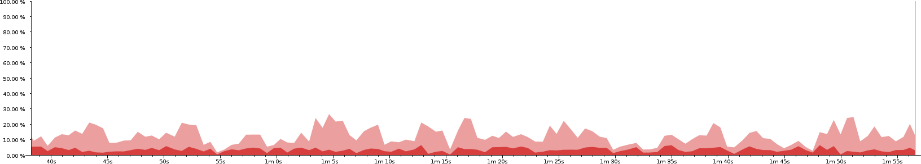
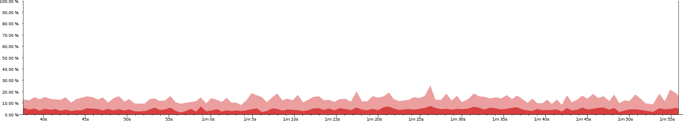
5. CPU utilization
Tribler GUI
Tribler service
VLC video player
Notes:
PROFILING REVEALED…

Slide 16
Conclusions and future work (1)
Implementation
Self-compilation and morphing stealth capabilities
Multi-core optimization
Streaming API
Towards other platforms
Bootstrap peers with NFC + Bluetooth
Automated ad hoc Wi-Fi
Notes:
NEW DIRECTION OF RESEARCH

Slide 17
Conclusions and future work (2)
Tribler research with mobile devices
Large-scale experiment with various degrees of powerful censors
How viral spreading of eyewitness content behaves in the real world
Effects of local crowds on anonymity with onion routing
Credit mining using shared private keychain
Notes:
NEW DIRECTION OF RESEARCH

Slide 18
Questions?

