Slide 1
CIS 430 Final Project Instructions
Fall 2015

Slide 2
Final Project Assumptions
As you read the RFP, you can assume
You are qualified to submit the RFP
You have all the insurance, personnel, skills, legal status, lawyers, certifications, etc. to submit
If you need to make assumptions, write them all down in on an assumptions section and include in an appendix of the written report
Assume Cisco products (if you want) and prices found on the internet. Worst case, use the prices found on page 443-444 of your text. Document where you got your prices.
WAN prices, search the internet – and document

Slide 3
Presentation Instructions
Team to present in front of class on the day of your final exam.
Your team has 10 minutes total
Have 8 minutes of content, leave 2 minutes for Q&A
Every team member speaks.
Introduce everyone at the beginning,
Don’t say, “and now Bill will talk about”, just have Bill start talking
The following slides are “template” – you can modify to your team’s needs
The order can be changed, and modified
Questions are there to guide your solution

Slide 4
Write-up Instructions
There needs to be a “write-up” of your project
Include team names and members names
Write-up your proposal as though it was going to be submitted to your client.
Include all diagrams, costs, and references.
Include a printout of these slides (3-4 per page is fine)
Black and white is ok.
Stapled and handed in on final exam date
The Grading Rubric must be on the title page

Slide 5
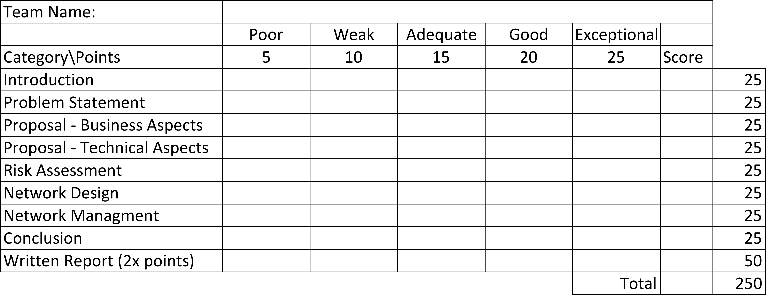
Grading Rubric

Slide 6
Peer Evaluations
There will be a peer evaluation system in place
Peer evaluations will act as damper on your final project grade
For Example, if your team earns 190 out of 200 points, 190 is each team members baseline grade
The Peer evaluation will be used to lower the grade.
If there is significant bias towards a team member, then they will earn less than 190 points by a percentage.

Slide 7
Presentation Template
The following is given as a guide, you are free to change it as your team feels best meets the
RFP guidelines

Slide 8
Team ________
Final Project Template
Fall 2015
MemberA, MemberB, MemberC

Slide 9
Introduction
Introduce the audience to your organization that is responding to the RFP
Introduce the audience to your Roles in the organization

Slide 10
Problem Statement
Summarize the problem being addressed by the RFP
Tell the story - “The Acme School District is building a new high school and they asked us to design a network infrastructure, plan, design, management and risk assessment to meet business and technical needs”)
Have pictures and charts as appropriate

Slide 11
Business Solution
Present your solution that addresses the business requirements
Include financial information
Justify the value, return on investment, expected life of the solution

Slide 12
Proposed Solution – Technical Aspects
Describe how your solution addresses the technical aspects of the requirements
What technologies did you choose
Why did you choose them
What best practices did you consult
Why should they trust your solution

Slide 13
Risk Assessment
Use the tools and techniques from research, lecture and text to assess risk
What controls will your solution propose to manage the risk
What is the cost of not having controls, what is the cost of implementing them

Slide 14
Network Design
What is the network design
Include WAN/MAN/LAN as appropriate
Include Core, Distribution, access as appropriate
Subnets, VLANs as appropriate
Routers, switches, access points, gateways, firewall, network services as appropriate
Diagrams are key

Slide 15
Network Management
How are you going to manage the solution?
How are you going to implement the solution?
Timelines, costs, reduction of risk
What is the cost of ongoing management?

Slide 16
Conclusion
Summarize your solution
Summarize the price
Summarize the value proposition
Why they should choose your solution

