Slide 1
Vcounselling (Career Counselling APP.) {ID:IT-C11}
Guide: Prof. Debarati Ghosal
Farooque Vadraiwala
Jeet Upadhyaya
Ganesh Dongre

Slide 2
Project Need & Scope
It is often seen that the students have to face difficulties in choosing their appropriate career While selecting courses , colleges and universities. This is where Career Counselling plays a crucial role and also boost students morale . Career counselling has come as a true gift of modern technology to the new generation .
The task of Proposed System includes the evaluation of students abilities and personalities to help them develop realistic academic and career goals they will be facilitated with many features such as QnA, Aptitude test, college compare and prediction, Exams, Chatbot and formulate potential paths to success.

Slide 3
Literature Survey
[1] Abisoye Opeyemi, Alabi I., Ganiyu Shefiu, Abisoye Blessing, Omokore Josiah "A Web Based Career Guidance Information System for Pre-Tertiary” Proceedings of the 2015 IJSRSET | Volume 1 | Issue 3 | Print ISSN : 2395-1990 Online ISSN : 2394-4099 Themed Section: Engineering and Technology..
[2] Methodology for the Implementation of Virtual Assistants for Education Using Google Dialogflow Roberto Reyes1, David Garza1, Leonardo Garrido1, V´ıctor De la Cueva1, and Jorge Ramirez1 Tecnol´ogico de Monterrey, Wrinting Lab, TecLabs, Vicerrector´ıa de Investigaci´onyTransferenciadeTecnolog´ıa,Monterrey64849,NL,M´exico{a00344331,a00820764}@itesm.mx,leonardo.garrido,vcueva,juresti}@tec.mxConversational.

Slide 4
Literature Survey
[3] Ajit Thorat, Tanvi Pugaonkar, Viraj Kamble, Jyoti Mobarkar, Prof. SachinBarahate, “An Android Application for Course Guidance and College Finder,”International Journal of Scientific Research in Computer Science, Engineering and Information Technology, vol. 2, no. 2, pp. 1029-1037, 2017
[4]Google Cloud Dialogflow Documentation: https://cloud.google.com/dialogflow/docs
[5] An Analysis of Artificial Intelligence and Implementing Chatbot based on Multilingual Language 1C. Hari Gowtham, 2B. Suchitra 1Student, 2Assistant Professor Department of information Technology, Sri Krishna Arts and Science College, Tamil Nadu, India

Slide 5
Future Scope
-Further, the application can be extended to include Online Courses Section which will be helpful for student to understand and develop the skills that are required to be successful in their future pathway or in the stream that they have chosen and also it can be extended further by including an news feed section where a student can discover new related to numerous streams.
-Further challenges include making the design more secure. The greater security can be provided to individuals accessing the application using cryptographic functions.
-Hence, future scope of VCounselling Application is unpredictable as it can be further extended with many tools as technology grows.

Slide 6
Modules In Proposed System
Student
-Sign-in/Sign-up
-Ask Questions/Answer
-College List
-Exams
-College Prediction & Compare
-ChatBot(careers,Study Abroad)
Admin
-Sign-in
-Add college/Exam
-Adding/Updating Aptitiude Test questions

Slide 7
Hardware & Software Requirements
Hardware
-Minimum 8GB RAM
-Minimum 15GB Hard Disk Space
-Processor- Minimum i5
Software
-Operating System- Linux or Windows 10
-Visual Studio
-Microsoft SQL Server

Slide 8
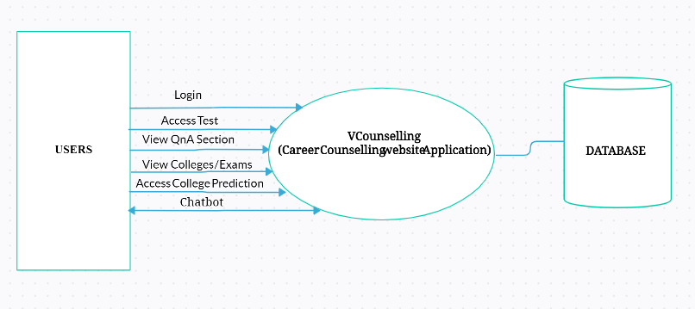
Data Flow Diagram

Slide 9
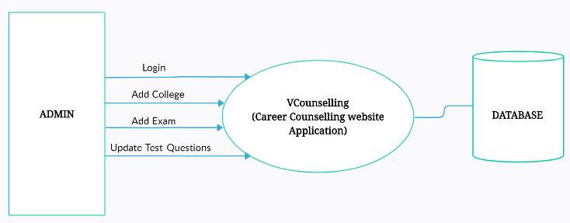
Data Flow Diagram

Slide 10
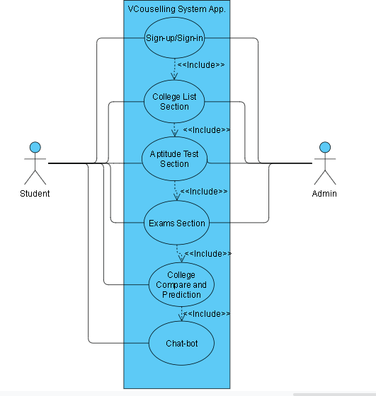
Use Case Diagram

Slide 11
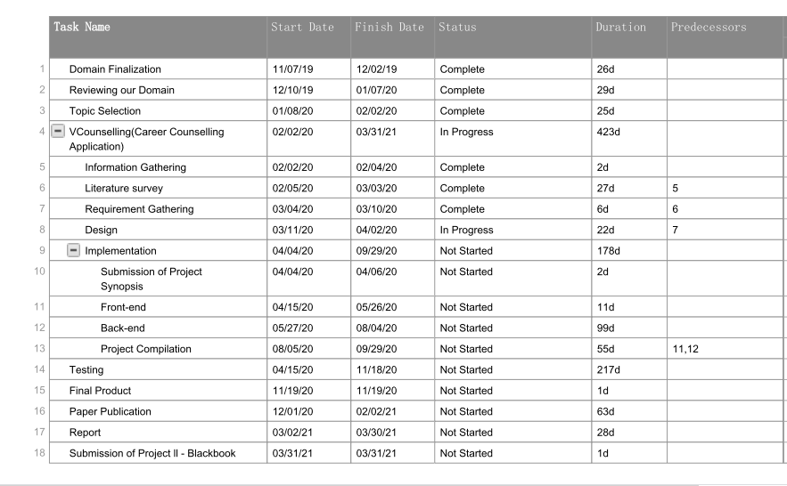
Timeline Chart

Slide 12
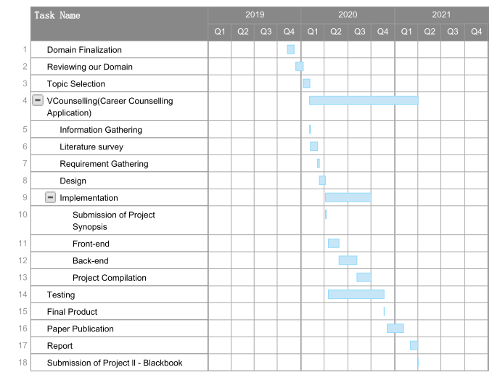
Gantt Chart

Slide 13
Conclusion
The purpose of this project is to develop an advanced web Application to Guide young people to adopt fair and realistic decisions about the opportunities they have in terms of educational and vocational route on which to build a successful career with the use of web technology.
This application provides an interface where the students can interact with chatbot for guidance on their career path.

Slide 14
THANKS!
Any questions?
You can find us at infant.c11@gmail.com

