Slide 1




Slide 2
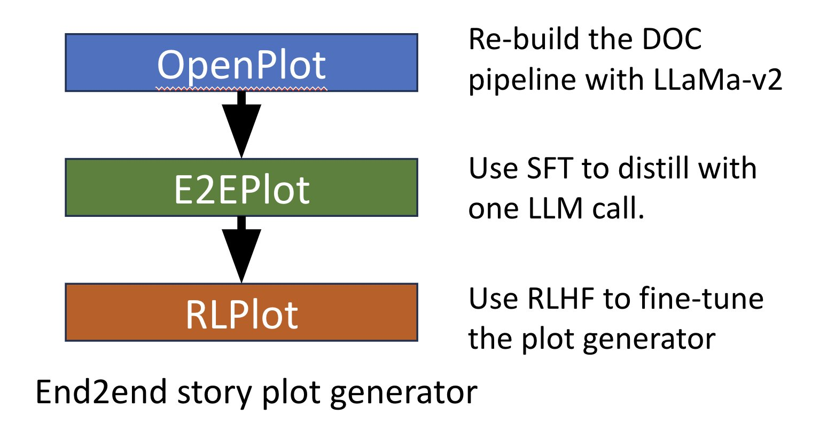

Slide 3
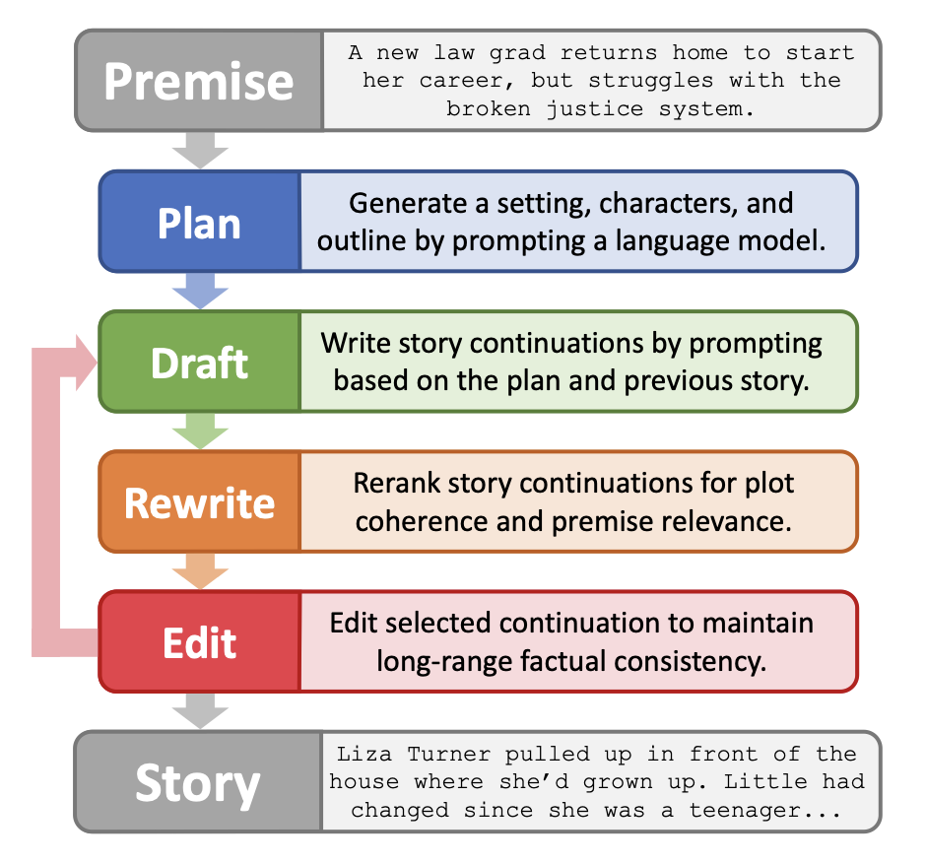
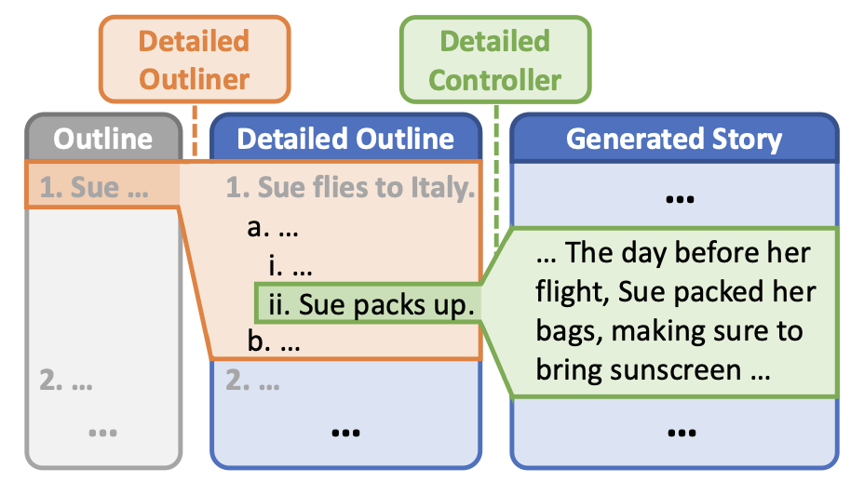
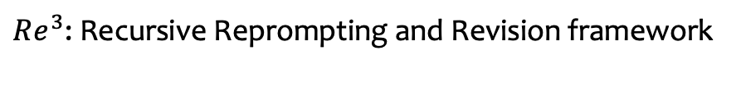
$Re^{3}$: Recursive Reprompting and Revision framework
DOC: Detailed Outline Control framework

Slide 4
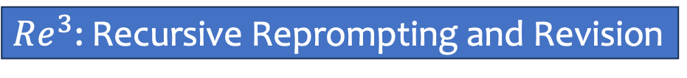
$Re^{3}$: Recursive Reprompting and Revision
Long-form Story
Generate
DOC: Detailed Outline Control
E2E Plot: Plot Generator with Human Feedback
Evaluate
Reinforcement Learning
PerSE: Personalized Story Evaluator
Human Feedback

Slide 5
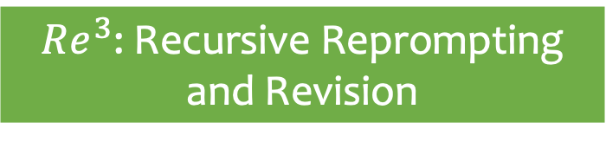
Story Generation
$Re^{3}$: Recursive Reprompting and Revision
E2E Plot: Plot Generator with Human Feedback
DOC: Detailed Outline Control
Generate
Long-form Story
Reinforcement Learning
Evaluate
PerSE: Personalized Story Evaluator
General Human Feedback
Story Evaluation

Slide 6
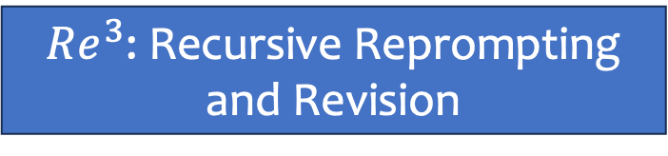
Author
$Re^{3}$: Recursive Reprompting and Revision
PerSE: Personalized Story Evaluator
Human Feedback
DOC: Detailed Outline Control
Reader

