Slide 1



Accelerating Antimicrobial Peptide Discovery with Latent Sequence-Structure Model
Danqing Wang, Zeyu Wen, Fei Ye, Hao Zhou, Lei Li

Slide 2
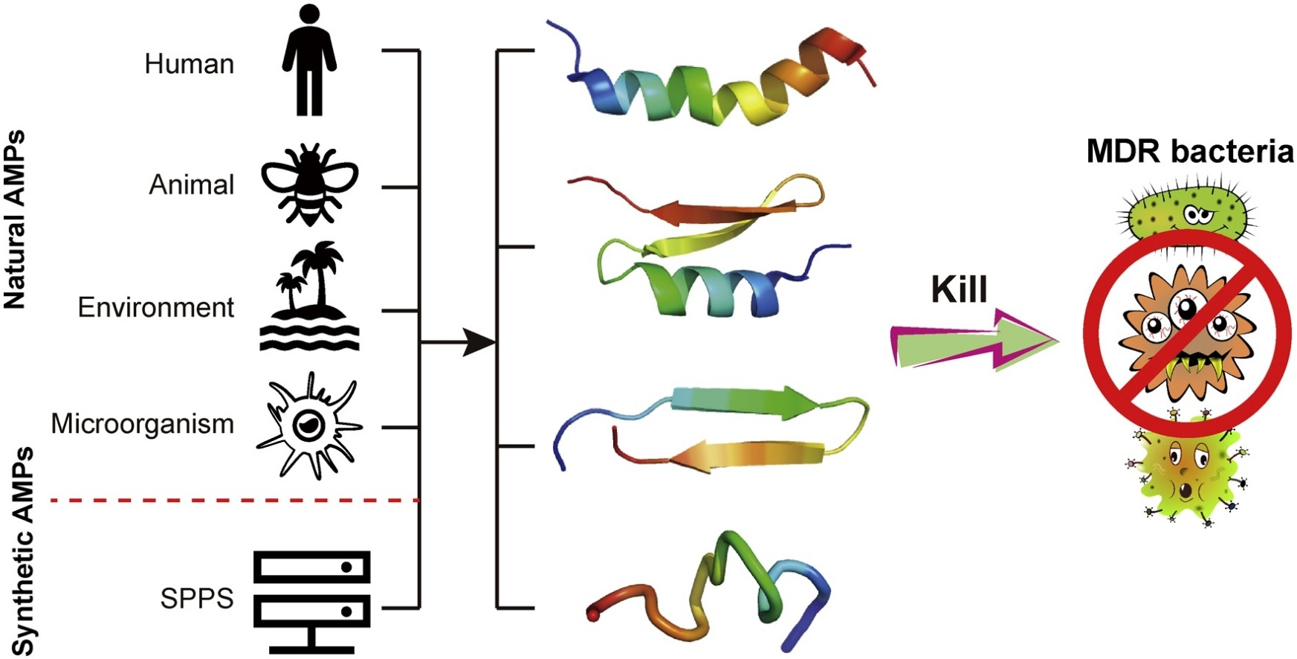
What is Antimicrobial Peptide ?
Peptide: short protein

Slide 3
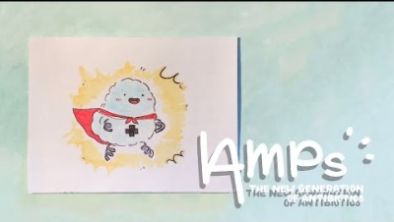
How can AMP kill bacteria?
Notes:
https://www.youtube.com/watch?v=zr7rEFKmmmo&t=34s

Slide 4
So, we now know that
Peptide is short protein ( < 50 amino acid)
Antimicrobial Peptide: kill bacteria
for example, insert into the bacteria membrane and destroy it
The main challenge:
The unknow mechanism
The cost to discover new AMP

Slide 5
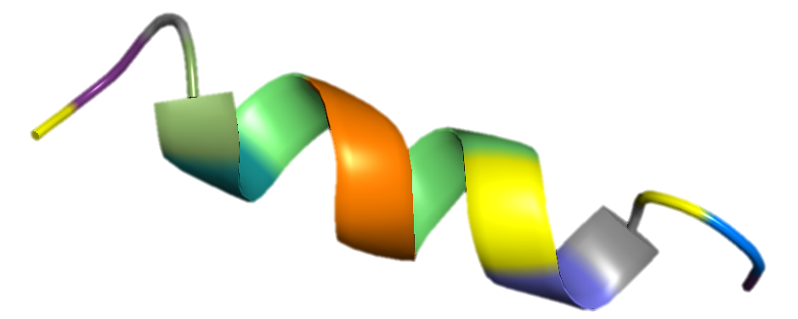
Currently, the AMP discovery is usually
Attribute Filter
Candidate Library
Structural Modeling
Wet Laboratory
Activity Predictor
Sequence-level
Structure-level
Synthesize
G
L
F
V
D
K
V
G
S
I
V
K
G
A
F
L
Existing Generative Models
bacteria

Slide 6
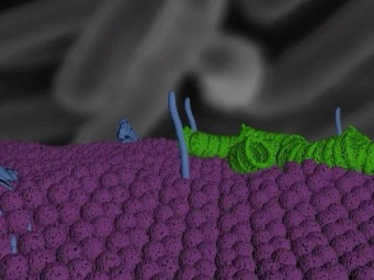
Can we ignore the structure ?

Slide 7
Structure plays an important role in biological functionality

Slide 8
From Sequence-then-Structure to Sequence-Structure
Latent Sequence-Structure Model for AMP
(LSSAMP)
Attribute Filter
Candidate Library
Structural Modeling
Wet Laboratory
Activity Predictor
Sequence-level
Structure-level
Synthesize
G
L
F
V
D
K
V
G
S
I
V
K
G
A
F
L
Existing Generative Models
bacteria

Slide 9
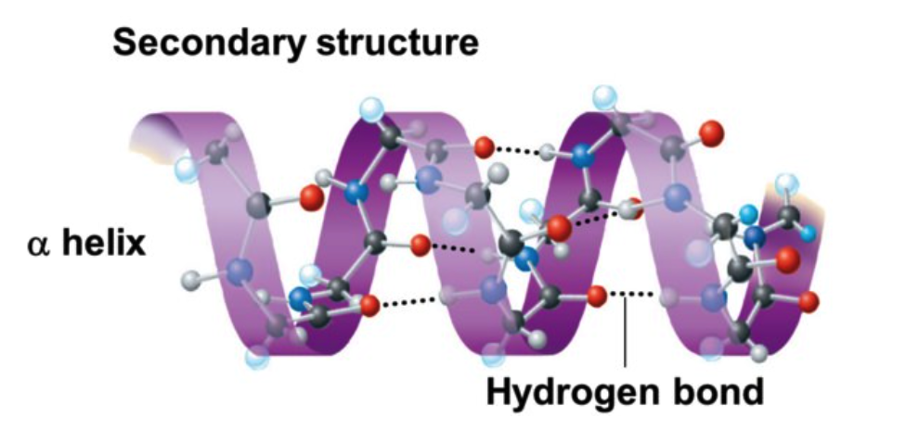
Secondary Structure
3D structure is complex: relationship between residue
relative distance, direction, dihedral angle, ...
Divide into local segments
annotate each residue with a label
indicate the structural element it locates
G
L
F
V
D
K
V
G
S
I
V
K
G
A
F
L
---HHHHHHHHHH---
Notes:
/daɪˈhidrəl/

Slide 10
The problem is ...
How to generate ideal peptide sequences with ideal secondary structures simultaneously
sequence: amino acid / residue, 20 vocabulary size
secondary structure: labels, 8 category
A distribution for sequence
A distribution for secondary structure

Slide 11
LSSAMP: overview

Slide 12
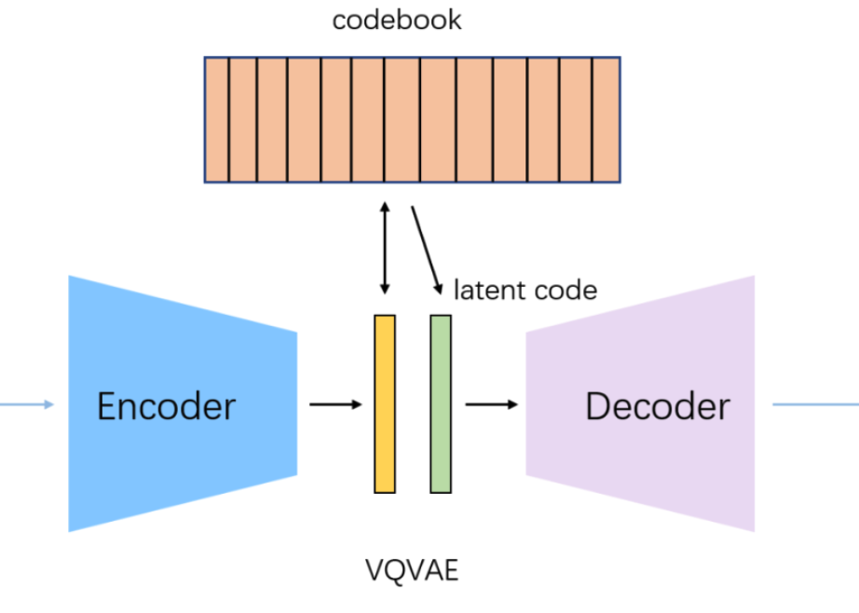
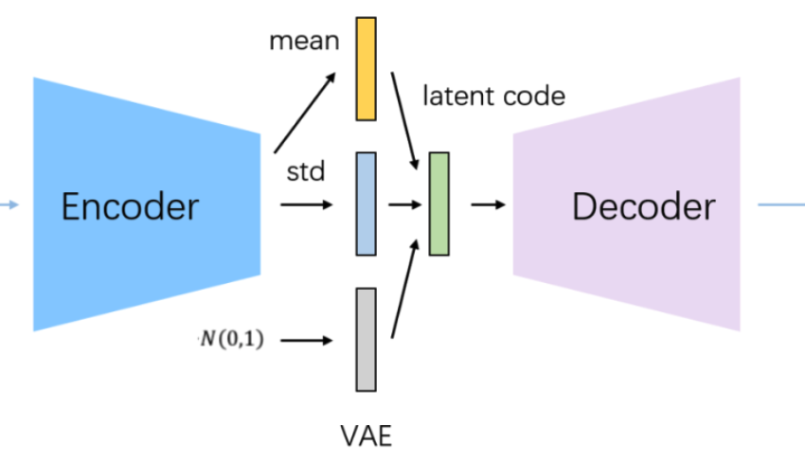
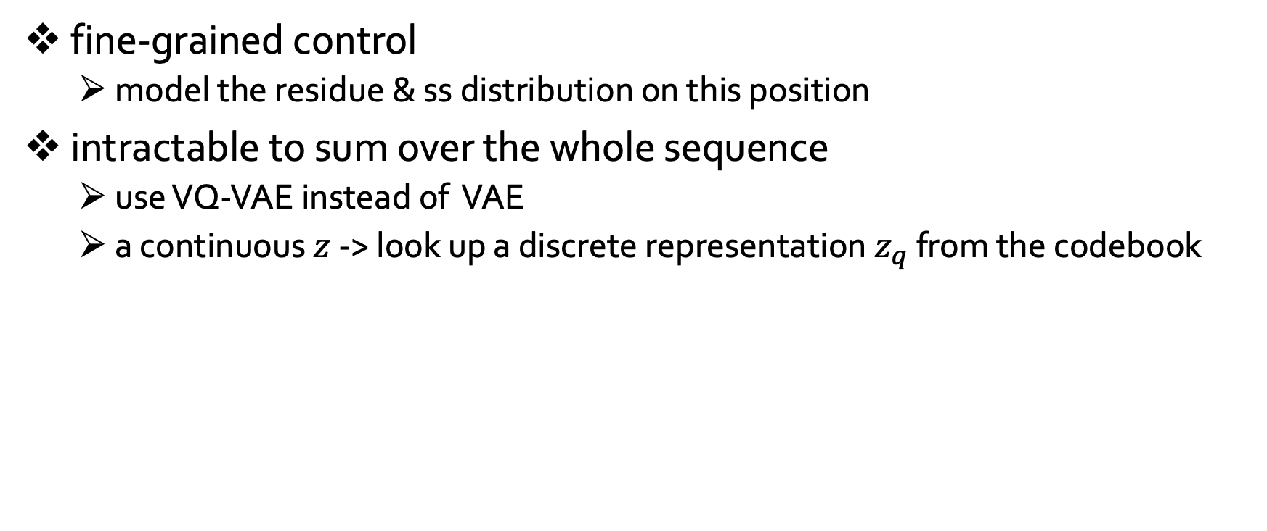
LSSAMP: latent variable per position
fine-grained control
model the residue & ss distribution on this position
intractable to sum over the whole sequence
use VQ-VAE instead of VAE
a continuous $z$ -> look up a discrete representation $z_{q}$ from the codebook
Notes:
figure from https://zhuanlan.zhihu.com/p/388299884

Slide 13
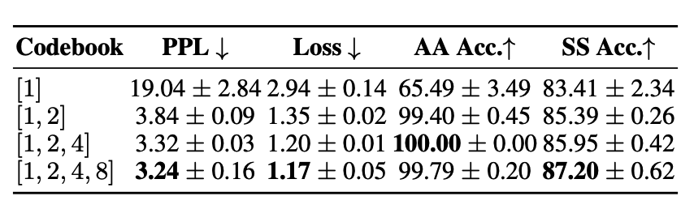
LSSAMP: multi-scale features
Sequence and structure have various feature scale
sequence pattern: relative short, e.g. 1~4
structure motif: much longer, e.g. at least 4 for alpha-helix
Different feature selectors
with different codebooks

Slide 14
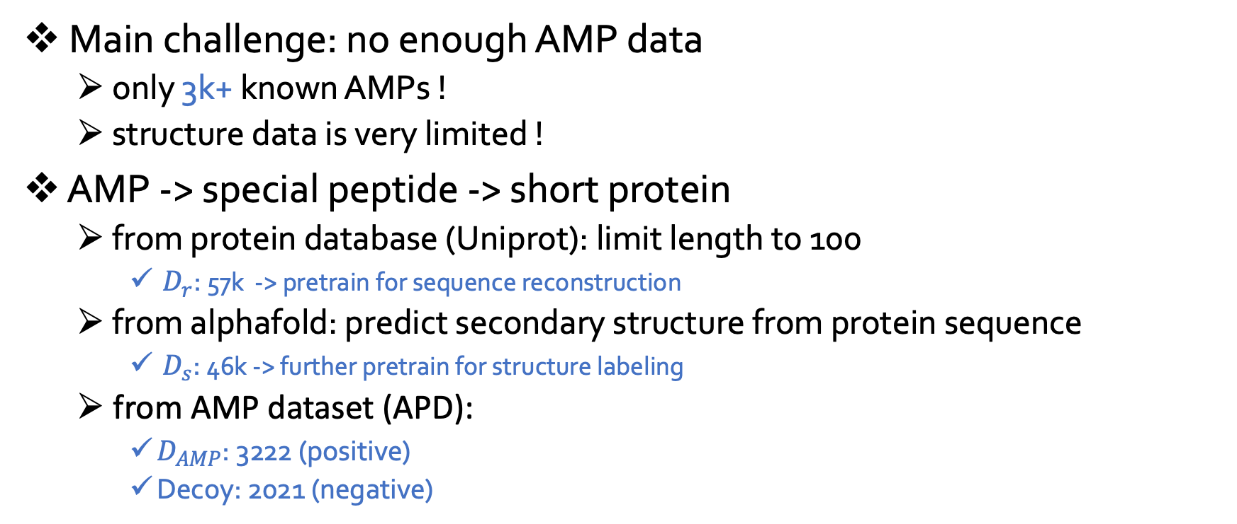
LSSAMP: training phase
Main challenge: no enough AMP data
only 3k+ known AMPs !
structure data is very limited !
AMP -> special peptide -> short protein
from protein database (Uniprot): limit length to 100
$D_{r}$: 57k -> pretrain for sequence reconstruction
from alphafold: predict secondary structure from protein sequence
$D_{s}$: 46k -> further pretrain for structure labeling
from AMP dataset (APD):
$D_{AMP}$: 3222 (positive)
Decoy: 2021 (negative)

Slide 15
How to evaluate the generated peptide?
Computational metric
charge, hydrophobicity, hydrophobic moment (amphipath)
Public classifiers
score the probability of AMP
Wet laboratory experiment
minimal inhibitory concentration (MIC)
Notes:
ˌæmfɪˈpæθ

Slide 16
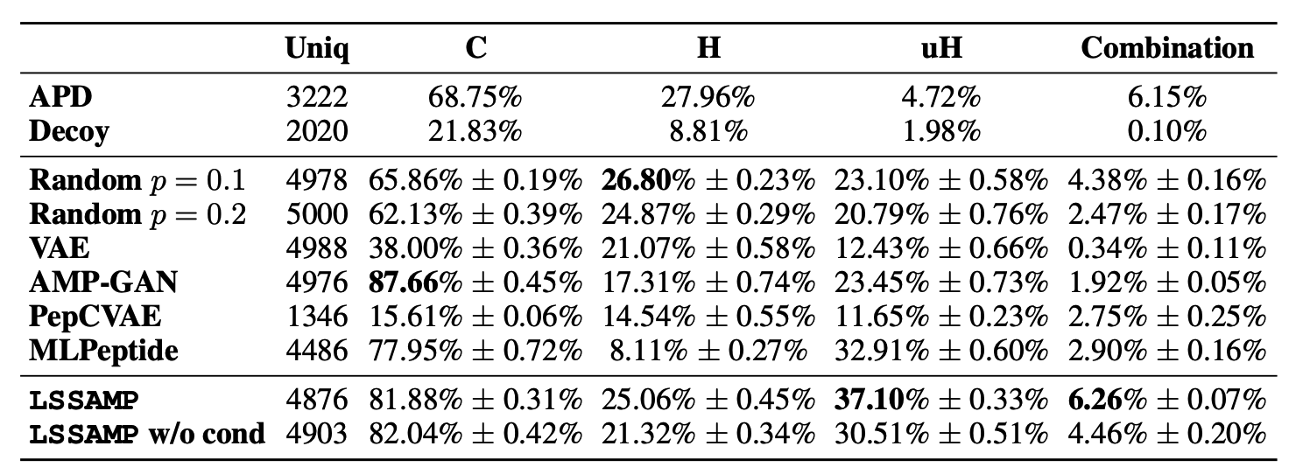
Performance: outperform on combination of three attributes

Slide 17
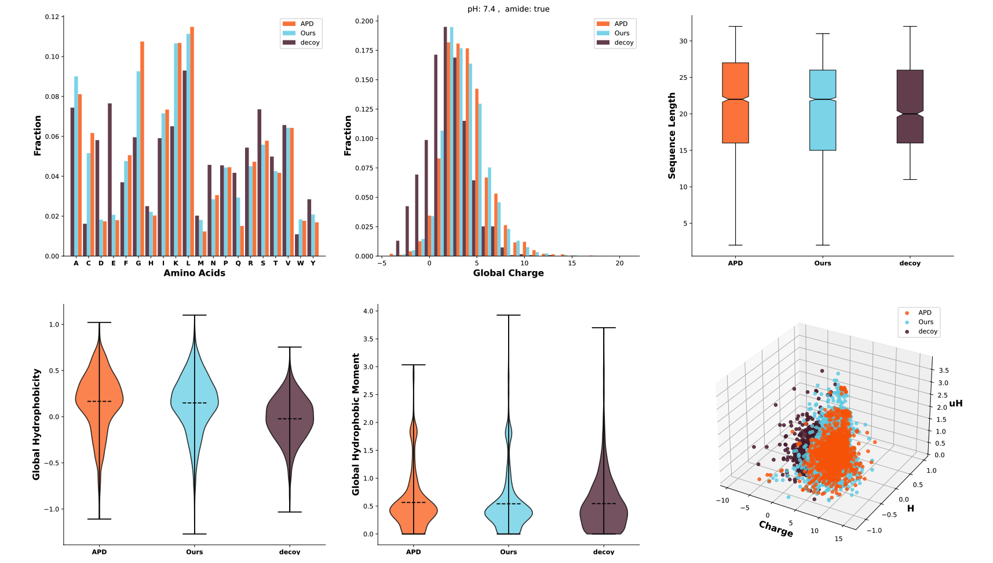
Performance: generation has the similar distribution of existing AMP

Slide 18
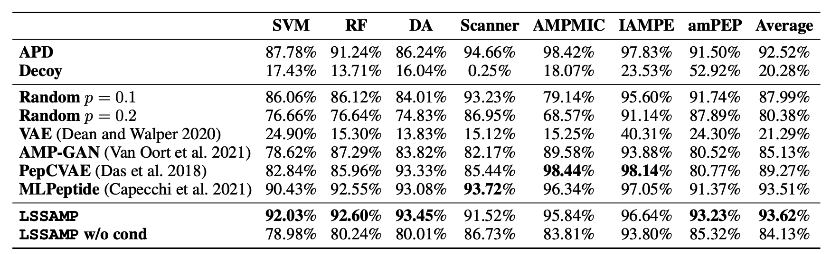
Performance: outperform on the average score of 7 classifiers

Slide 19
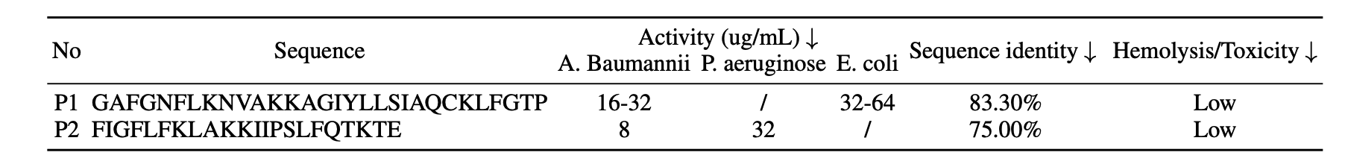
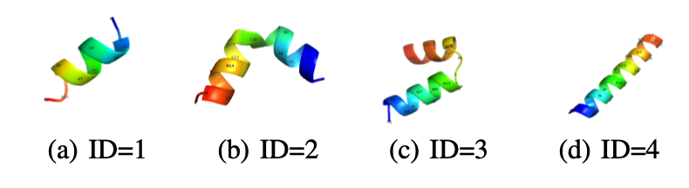
Performance: real AMPs found!
2/21 have been verified with high antimicrobic activity (<128)
Our generated peptides have ideal alpha-helix structures

Slide 20
Sum up
AMP is promising treatment to replace antibiotic
challenge: unknown mechanism & costly discovery process
Accelerate the discovery by creating more effective candidates
current generative works only focus on sequence-level
still need to check the structure
Model the sequence-structure distribution
fine-grained control on position
multi-scale features
Evaluate from different aspects to verify effectiveness
Notes:
/ˌæntibaɪˈɒtɪk/

